Slide 1
Microbial Taxonomy
Dr. Surojit Das, PhD
Assistant Professor
Vidyasagar University

Slide 2
What’s the name? that which we call a rose
By any other name would smell as sweet....
W. Shakespeare

Slide 3
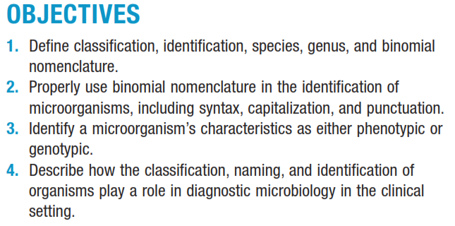
Taxonomy is the area of biologic science comprising three distinct but highly interrelated disciplines: classification, nomenclature (naming), and identification of organisms.

Slide 4
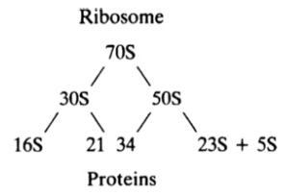
Taxonomy [Greek taxis, arrangement or order, and nomos, law, or nemein, to distribute or govern]
The science of biological classification
Consists of three separate but interrelated parts: classification, nomenclature, & identification
Rapidly changing due to acquisition of new data, particularly the use of molecular techniques such as the comparison of ribosomal RNA structure & chromosome sequences
Classification: Arrangement of organisms into groups or taxa (s., taxon) based on mutual similarity or evolutionary relatedness.
Nomenclature: Assignment of names to taxonomic groups in agreement with published rules.
Identification: Process of determining that a particular isolate belongs to a recognized taxon.

Slide 5
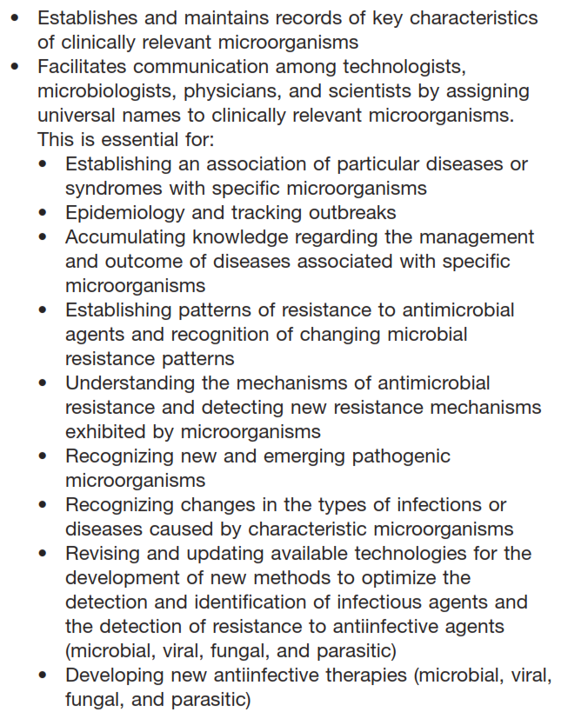
Role of Taxonomy in Diagnostic Microbiology & Infectious Diseases

Slide 6
Systematics often is used for taxonomy
The scientific study of organisms with the ultimate object of characterizing & arranging them in an orderly manner.
Deals disciplines including morphology, ecology, epidemiology, biochemistry, molecular biology, & physiology.

Slide 7
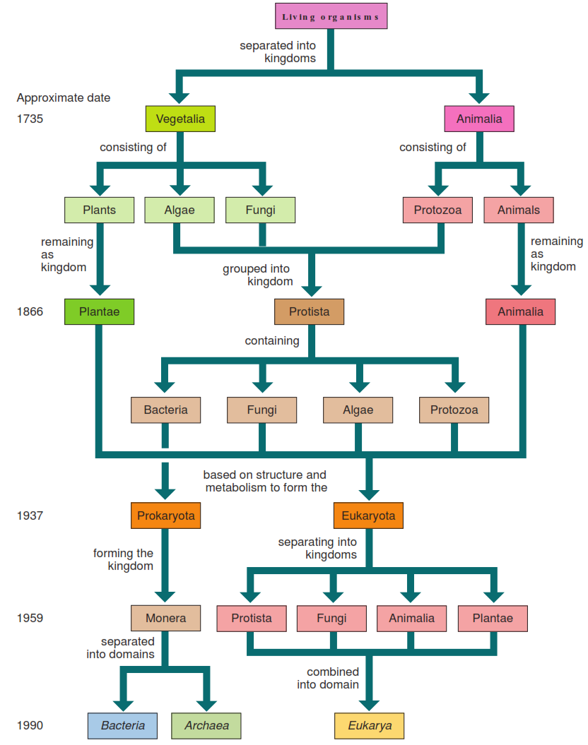
The Development of Classification for Living Organisms: A Concept Map

Slide 8
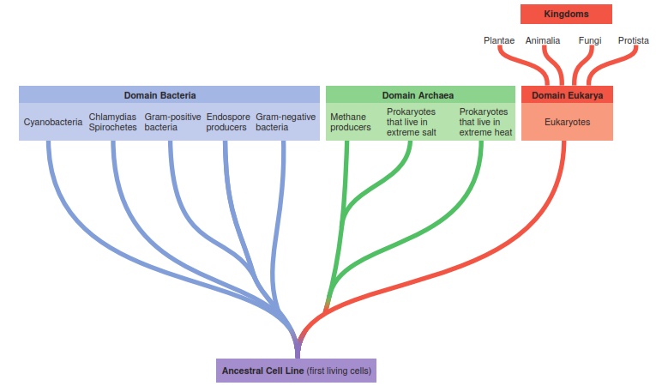
Woese-Fox 3 Domain System
A system for representing the origins of cell lines and major taxonomic groups as proposed by Carl
Woese and colleagues. They propose three distinct cell lines placed in superkingdoms called domains. The ﬁrst primitive cells, called progenotes,
were ancestors of both lines of prokaryotes (Domains Bacteria and Archaea), and the Archaea emerged from the same cell line as eukaryotes
(Domain Eukarya). Selected representatives are included. Some of the traditional kingdoms are still present with this system

Slide 9
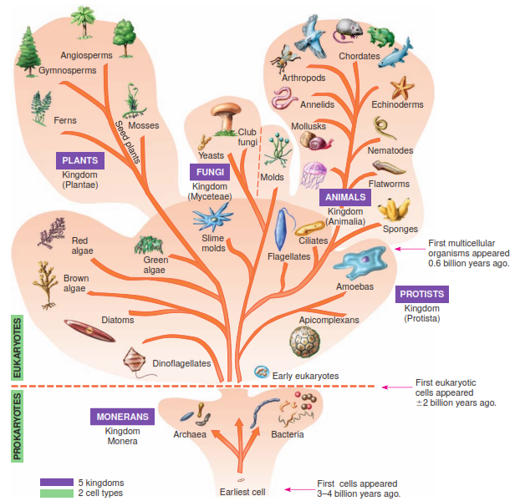
Traditional Whittaker 5 Kingdom System
In this system, kingdoms are based on cell structure and type, the nature
of body organization, and nutritional type. Bacteria and Archaea (monerans) have prokaryotic cells and are unicellular. Protists have eukaryotic
cells and are mostly unicellular. They can be photosynthetic (algae), or they can feed on other organisms (protozoa). Fungi are eukaryotic cells
and are unicellular or multicellular; they have cell walls and are not photosynthetic. Plants have eukaryotic cells, are multicellular, have cell walls,
and are photosynthetic. Animals have eukaryotic cells, are multicellular, do not have cell walls, and derive nutrients from other organisms.

Slide 10
Taxonomic Classification of Humans, Brewer’s Yeast, and a Common Bacterium

Slide 11
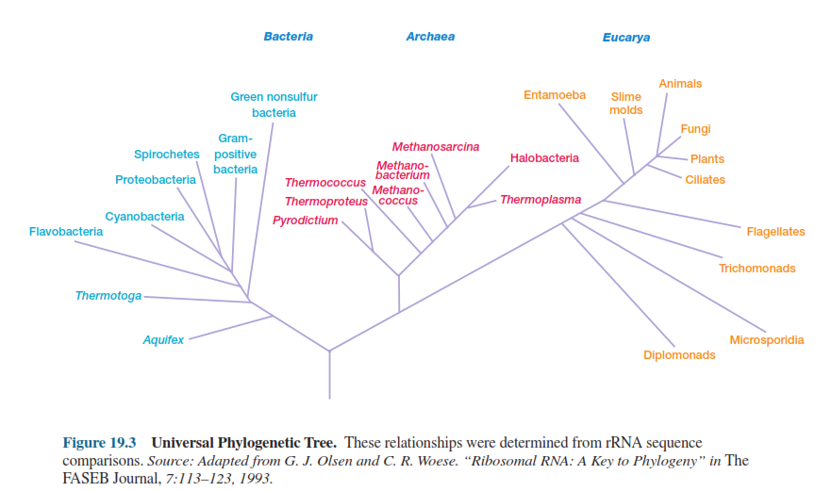
Phylogenetic Tree
It appears that the procaryotic groups (Archaea & Bacteria) 1st developed, then the eucaryotes.
This resulted in three domains: Bacteria, Archaea, and Eucarya.
These domains differ from one another in rRNA sequences & many other ways.

Slide 13
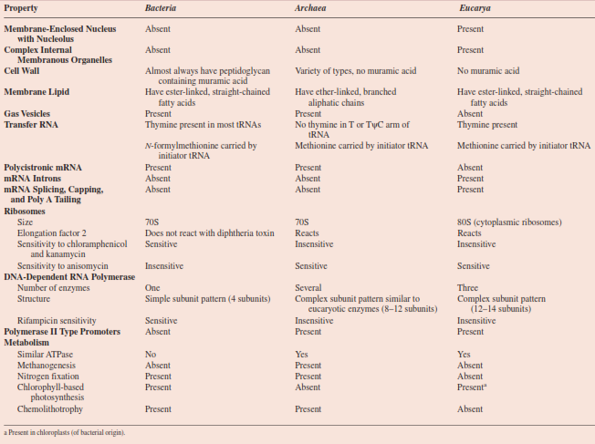
Comparison of Bacteria, Archaea, and Eucarya

Slide 14
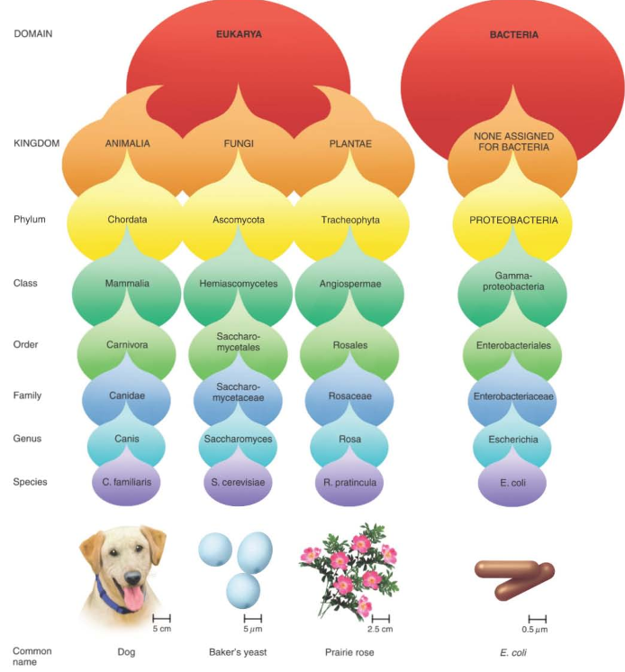
The Taxonomic Hierarchy

Slide 15
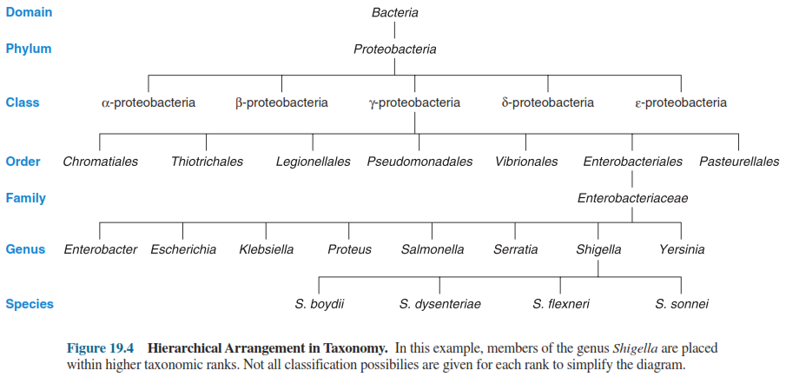
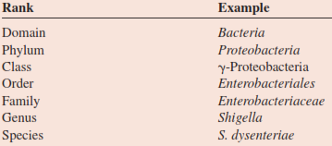
Classification
Organization of m.orgs that share similar morphologic, physiologic, & genetic traits into specific groups, or taxa.
Species >>> subspecies
Subspecies >>> biotype, serotype, or genotype

Slide 16
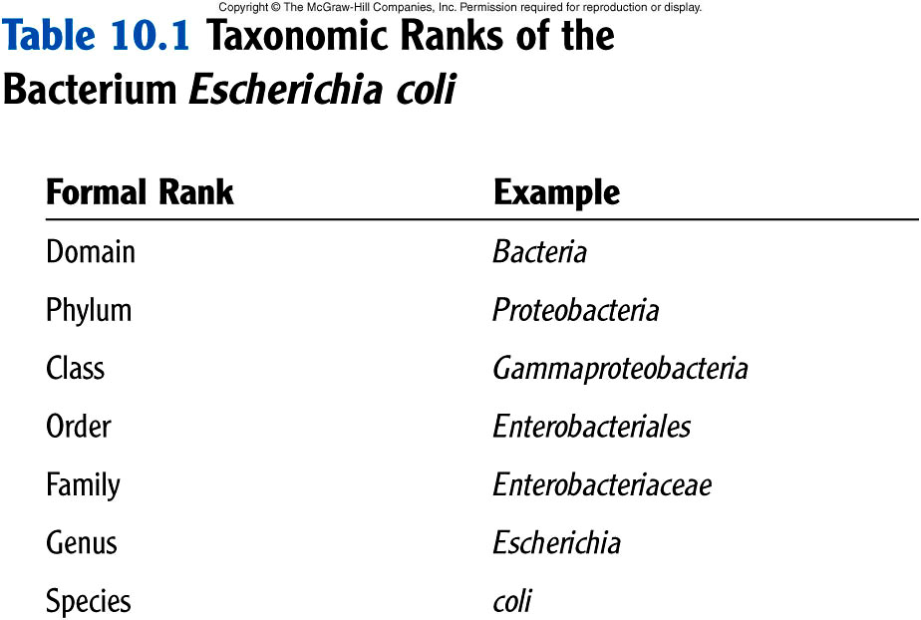
Var/types O157:H7
Strain XYZ

Slide 17
Salmonella enterica subsp. enterica serovar Typhi (S. Typhi) & Typhoid fever
Disease
Typhoid
Paratyphoid
Gastroenteritis & Septicemia
Coburn et al., 2007

Slide 18
Nomenclature
Nomenclature is the naming of microorganisms according to established rules and guidelines set forth in the International Code of Nomenclature of Bacteria (ICNB) or the Bacteriological Code (BC).
Linnaeus introduced the binomial system of scientific nomenclature
Each organism has two names: the genus and species epithet
Italicized or underline
Genus name is capitalized and species in lower case.

Slide 19
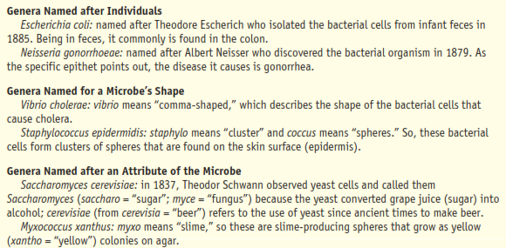
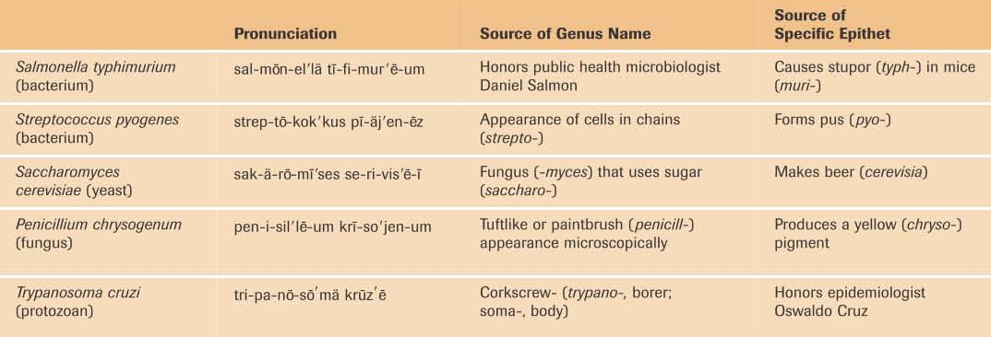
Scientific Names

Slide 20
Nomenclature
Naming of m.orgs (binomial, two name, Latin or Greek derivation) according to established rules & guidelines, provides the accepted labels by which orgs. are universally recognized.
Bergey’s Manual of Systematic Bacteriology
1st Ed.: Largely phenotypic & divided procaryotes into groups based on easily determined characteristics such as shape, Gram-staining properties, oxygen relationship, & motility.
2nd Ed. (five vol.): Phylogenetically organized & distributes procaryotes among two domains & 25 phyla.
Streptococcus pneumoniae
Staphylococcus aureus
Klebsiella pneumoniae
Salmonella enterica subsp. enterica serovar Typhi
Stenotrophomonas (Xanthomonas) maltophila
Burkholderia (Pseudomonas) cepacia
Cutibacterium (Propionibacterium) acnes
Clostridioides (Clostridium) difficile
Klebsiella (Enterobacter) aerogenes

Slide 21
Identification
Microbial identification is the process by which a m.org’s key features are delineated.
Genotypic characteristics: Relate to an org’s genetic makeup, including the nature of the org’s genes & constituent nucleic acids.
Phenotypic characteristics: Based on features beyond the genetic level & include readily observable characteristics & those characteristics that may require extensive analytic procedures to be detected.

Slide 22
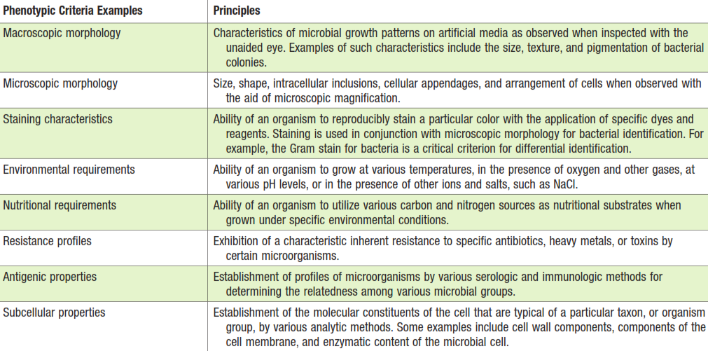
Identification Criteria & Characteristics of Microbial Classification

Slide 23
Identification criteria & characteristics of microbial classification

