Slide 1
Topic 1: Basic Concepts & Different Types of SocietIES

Slide 2
Paper-203 M.A. 2nd sem in Sociology Vidyasagar University

Slide 3
Course-CoOrdinator: Dr. Asmita Bhattacharyya ASSIGNMENT DONE BY: Sanjukta Rauth(Roll No.:17)(Team Leader) Susmita Kar (Roll No.:83) Sharmistha Sarkar (Roll No.:06) Shila Barman (Roll No.:05) Bilkisa Khatun (Roll No.:46) Paramita Mondal(Roll No.:84)

Slide 4
Contents
Defining Society
Types of Societies (By Gerhard Lenski)
Traditional & Industrial Societies (Emile Durkheim)
Pre-capitalist vs Capitalist Societies (Karl Marx)
Traditional vs Rational Societies (Max Weber)
Rural vs Urban Societies ( A.R. Desai)
References

Slide 5
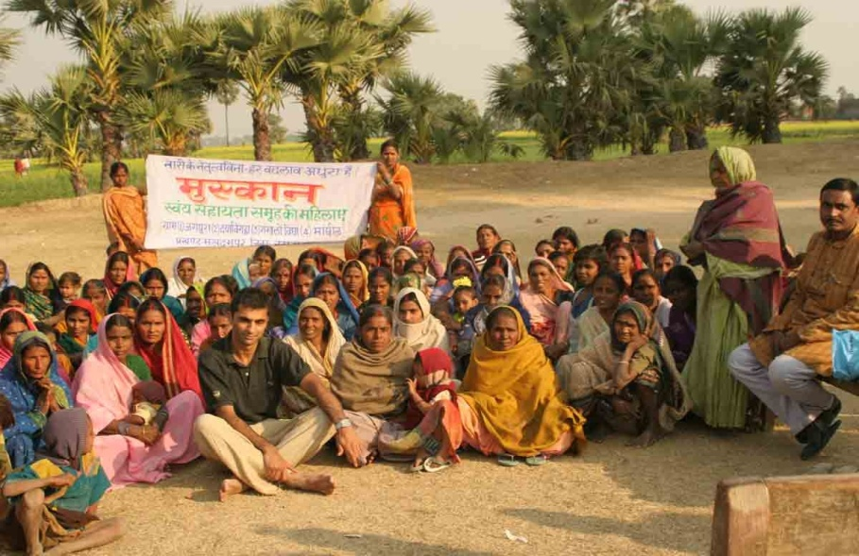
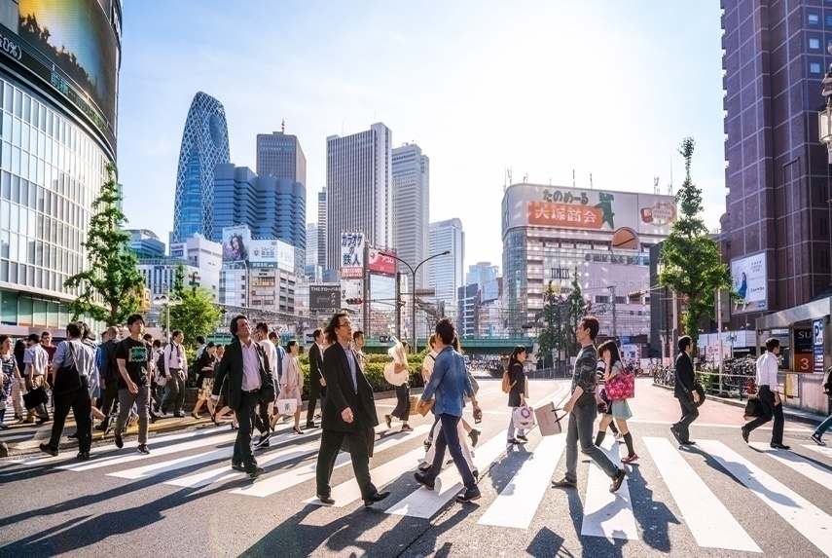
Definition of Society
A Society, according to sociologists, is a group of people with common territory, interaction and culture.
Social groups consist of two or more people who interact and identify themselves with one another.
... Geographic distance and language barriers can separate societies within a country.

Slide 6
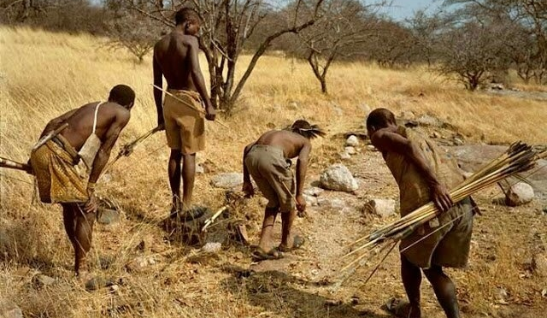
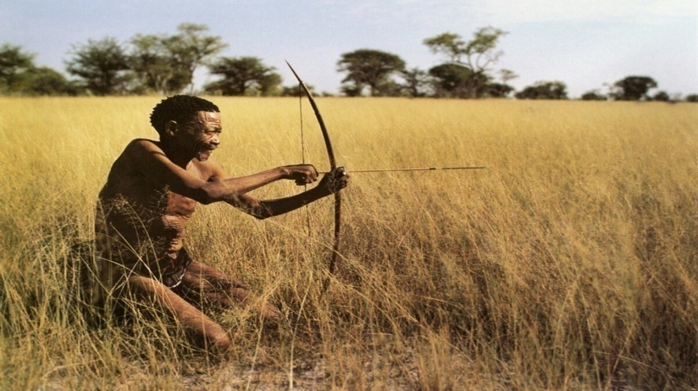
TYPES OF SOCIETIES (Classified BY GERHARD LENSKI)
Hunting and gathering societies (12000yrs ago):
Used simple tools to hunt animals and gather vegetables.
Socio-cultural evolution, food production & specialisation were minimal.
Nomadic groups are small & scattered.
Society was kinship-based.

Slide 7
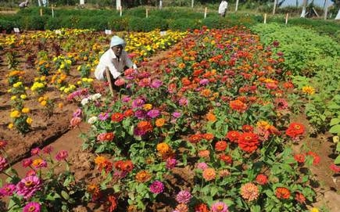
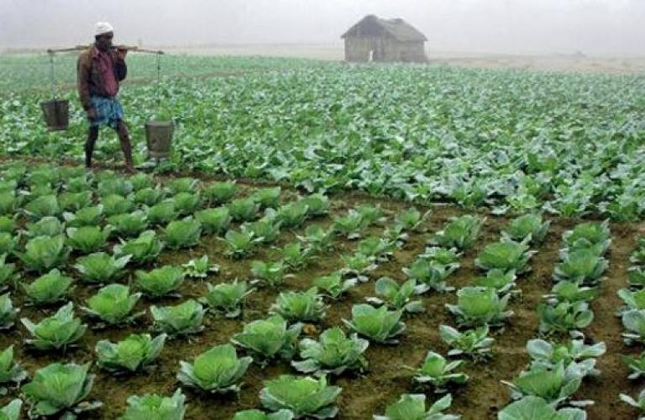
Horticulture and Pastoral Societies
Employed technology based on using hand tools to raise crops.
Technology supported the domestication of animals

Slide 8
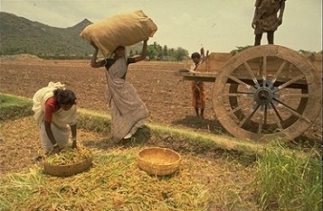
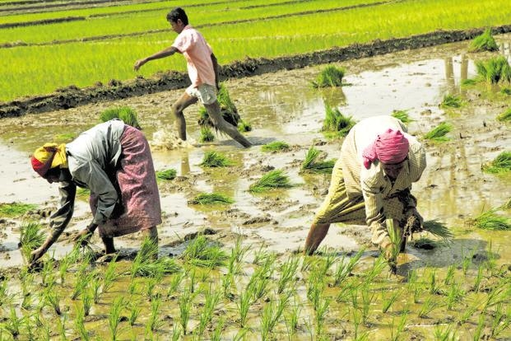
Agrarian societies
Agro-based societies
Technologies developed for large scale cultivation using ploughs harnessed by animals.
Used powerful sources of energy.
Agrarian societies produced food surpluses
Societies inequities increased.

Slide 9
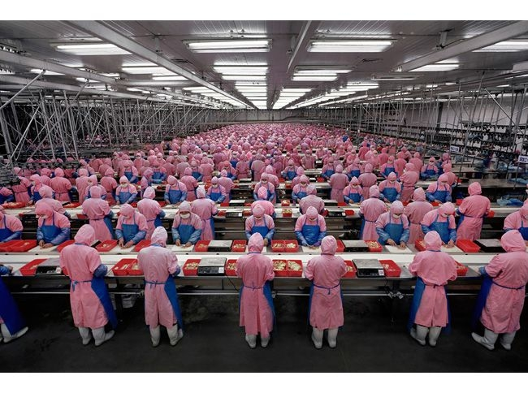
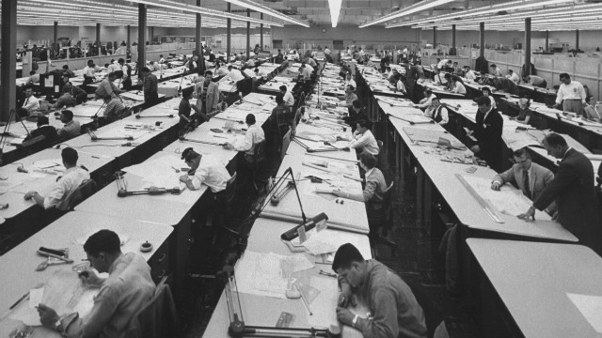
Industrial societies
Societies based on industrialism
Used advanced sources of energy
Used large machineries
Exploitation in this society increased

Slide 10
Post Industrial societies
Information technologies is information based economy.
At this stage, societies begin to change very fast

Slide 11
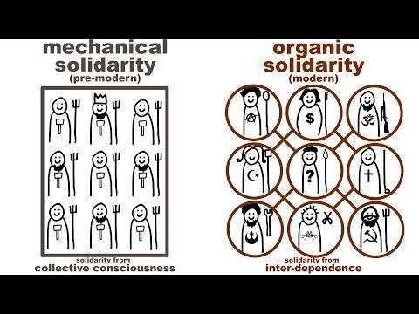
Traditional Vs Industries societies (Emile Durkheim)
Traditional Societies are characterised by a strong collective conscience or, mechanical solidarity,
Industrial Societies where Organic Solidarity through division of Labour dominates.

Slide 12
Capitalism , Alienation & Class Conflict (Karl Marx):
Industrial capitalism showed predominance of two major social classes- Capitalist vs Proletariat had class conflict .
Capitalism & Alienation: 4 ways by which industrial capitalism alienated workers in four ways.
(i)Alienation from act of working,
(ii) Alienation from product of work,
(iii) Alienation from other workers,
(iv) Alienation from one’s own human potential.

Slide 13
Tradition and Rational Societies (Max Weber):
Historical change in dominant mode of human thought between traditional to rational societies.
Pre-industrial societies embrace tradition, sentiments and beliefs passed from generation to generation.
Industrial societies are rational societies.

Slide 14
Rural & URBAN Societies
Generally, a rural area or, country-side is a geographic area that is located outside towns or cities.
Typical rural areas have a low population density and small settlements.
A urban city is typical modern industrial civilization and having heterogeneous in cultural tradition.

Slide 15
DIFFERENCES BETWEEN THE RURAL WORLD-URBAN WORLD(BY A.R.DESAI)
 | Rural World | Urban World
Occupation | Totality of cultivators and their families. In the community are usually a few representatives of several non-agricultural pursuits. | Totality of people engaged principally in manufacturing, mechanical pursuits, trade commerce, professions, governing and other non-agricultural occupations.

Slide 16
 | Rural World | Urban World
Environment | Predominance of nature over anthropo-social environment. Direct relationship to nature. | Greater isolation from nature. Predominance of man-made environment over natural.
Size of community | Open farms or small communities, agriculturalism and size of community are negatively correlated. | As a rule in the same country and at the same period, the size of urban community is much larger than the rural community. In other words, urbanity and size of community are positively correlated.
Density of population | In the same country and at the same period the density is lower than in urban community. Generally | Greater than rural communities. Urbanity and density are positively correlated.

Slide 17
 | Rural World | Urban World
 | density and rurality are negatively correlated.
Heterogeneity and homogeneity of the population | Compared with urban populations, rural communities are more homogenous in racial and psychological traits. (Negative correlation with heterogeneity). | More heterogeneous than rural communities (in the same country and at the same time.) Urbanity and heterogeneity are positively correlated.
Social differentiation and stratification | Rural differentiation and stratification less than urban. | Urban differentiation and stratification show positive correlation with urbanity.

Slide 18
 | Rural World | Urban World
Mobility | Territorial, occupational and other forms of social mobility of the population area comparatively less intensive. Normally the migration current carries more individuals from the country to the city. | More intensive. Urbanity and mobility are positively correlated. Only in the periods of social catastrophic is the migration from the city to the country greater than from the country to the city.
System of interaction | Less numerous contacts per man. Narrower area of the interaction system of its members and the whole aggregate. More prominent part is occupied by primary contacts. | More numerous contacts. Wider area of interaction system per man and per aggregate. Predominance of secondary contacts. Predominance of impersonal casual

Slide 19
 | Rural World | Urban World
 | Predominance of personal and relatively durable relations. Comparative simplicity and sincerity of relations. Man is interacted as a human person. | And short-lived relations. Greater complexity, manifoldedness, superficiality and standardized formality of relations. Man is interacted as a number and address.

Slide 20
ReferenceS
Wirth, Louis, (1938) Urbanism as a way of life. American journal of sociology. 44(2).
Desai A.R. (ed.) (1969), Rural Sociology in India, Popular Prakashan, Bombay.

Slide 21
Thank You

