Slide 1
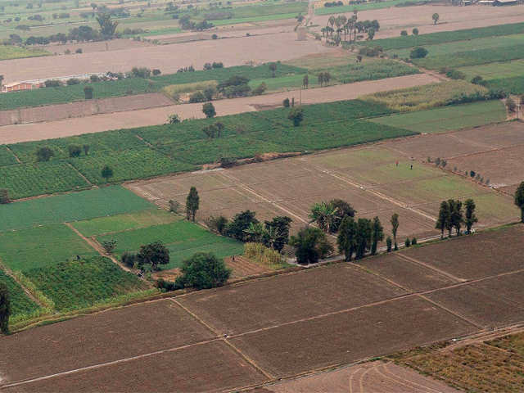
LAND REFORM SYSTEM
-Project work is done under the overall supervision of Dr. Asmita Bhattacharyya.
Assignment done by:-
Shiuli Dalapati, (Roll 32).
Susmita Das, (Roll 31).
Saswati Parihari, (Roll 30).
Debosmita Ghosh, (Roll 29).
Chandana Pal , (Roll 42).
Chandni Khatun, (Roll 38).
Course - M.A
Sociology Department,
Vidyasagar University
Second Sem.
2019-2021

Slide 2
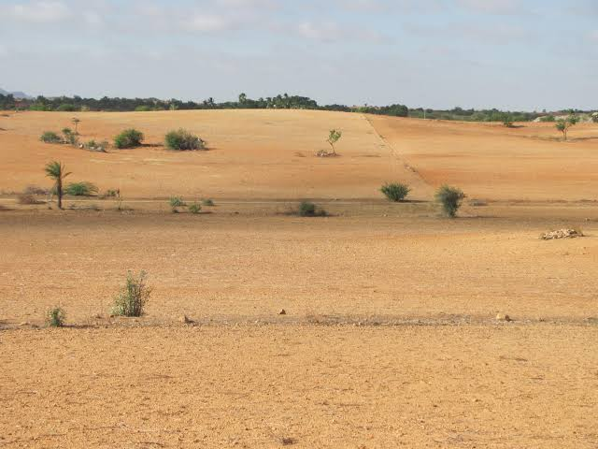
LAND
Land is considered as an important element of life and is highly valued in most of the world.
Land is useful to man in many ways as a source of food, for place to live, for wood, for place to work etc.,
In India , before colonial rule, the land was used to be in the hands of the community as a whole .
However during the British Raj this has changed.

Slide 3
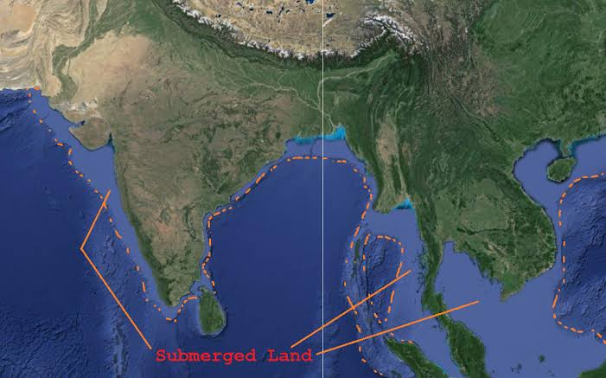
Lord Carnwallies has introduced Permanent Land Settlement for Bengal, Bihar and Orissa in 1793. According to this the tax farmers appointed by the british rulers will be coverted as various Land Lords. Under this rule they have to pay fixed commission to East India Company. Thus these intermediary are formed, called as Jagirdar / Jamindar.

Slide 4
Emergence of Tenants
Following the Land Settlement Act, 1793, The farmers purchase lands from the Land Lords and hire it for their agricultural use. These people who hired the land are called Tenants.
Variations in Tenency
Cash Tenents : They pay a fixed tax for the use and occupy of the land.
Share - Cash Tenants: They pay part of their rent in cash and other part as share of the crop.
Crop - share Tenants : They pay a share of crops only.
Croppers : They pay crop of the share. But they are not independent. They work under the landlord.
Other unspecified tenants.

Slide 5
LandLord - Tenant Relationships
Land lord -Tenant
Landlord - Agricultural labour
Tenancy Systems :
Ryotwari: This existed in Madras since 1772. And extended to Bombay Presidency.
Under this system, every registered holder of the land is considered as proprietor
He paid revenue directly to the government and is having liberty to sell these.
Mahalwari: The land ownership is held asjoint ownership with the village body. The land can be cultivated by tenants who can pay cash I kind I share.
Jamindari: Under this system the whole village was under one landlord .The persons interested can work in thejamindarsland as tenant Ilabourer based on the agreement with the jamindar. The jamindari system was known to be more exploitive,as the jaminder used to fix higher prices of land when ever he wished to do so.
Jagirdari: Almost as similar as Jamindari system. The jagirdar is powered to control the unproductive masses of village by engaging them in agrarian activities

Slide 6
Land Reforms
After India Independence, the government has decided to abolish the systems of Jamindaris and Jagirdari, in order to remove intermediaries between state and peasant. This was the first legislation taken by almost all the states called as Abolition of Jamindari/Jagirdari systems Act in 1950s.
The main objectives of the Land Reforms are
To make redistribution of land to make a socialistic pattern of society. Such an effort will reduce the inequalities in ownership of land.
To ensure land ceiling and take away the surplus land to be distributed among the small and marginal farmers.
To legitimize tenancy with the ceiling limit.
To register all the tenancy with the village panchayats.
To establish relation between tenancy and ceiling.

Slide 7
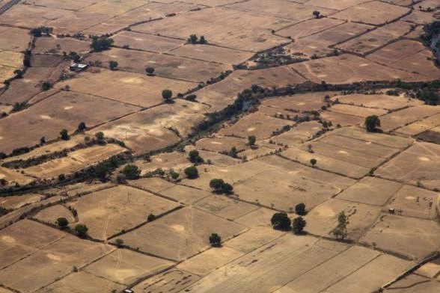
Access to Land Reforms
Gandhidian Approach: The Sarvodaya movement of Mahatma Gandhi talks more about the universal upliftment. Inspired by Gandhism, Vinoba Bhave has started the Gramdam movement. This movement approached the landlords to donate to surplus to the landless / marginalised farmers.
The radical nationalist approach: Has been formally adopted by most of the state governments, however this approach couldn't contribute much.
The Marxist approach has been taken into account and is supported in the wake of peasant movements

Slide 8
Outcomes of Land Reforms
1. Abolition of Jamindars and Jagirdars.
• The powerful Jamindars and Jagirdars have become extinct.
The abolition of intermediaries have ceased exploitation
Transfer of land to peasants from intermediaries has reduced inequalities
The new proprietorship has given scope for innovation in Land Reforms
The ex-jagirdars and ex-Jamindars have engaged themselves actively in other work thus contributing for National Growth
The abolishment of these systems have multiplied to the new land owners thus adding revenue to the state governments.

Slide 9
2. Land Ceiling
Land is a source of Income: In rural India land provides employment opportunities.
Therefore it's important for the marginal farmers, agricultural laborers, and small farmers.
Land Ceiling should be imposed on all kinds of lands: The land of different types : 1.Fallow 2.Uncultivable 3. irrigated and 4. Cultivable land. All the mentioned are inclusive of ceiling Act.
Ceiling on irrigated and two crops a year: The ceiling act varies from state to state on ceiling on two crops a year land. However in most of the places the ceiling is 18 Acres. Anything above has to be taken by the respective state government.
Ceiling on irrigated and one crop a year: A peasant is eligible to have 27 acres of one crop a year land. Any land above the mentioned is declared surplus and taken over by the state government.
Ceiling upto 54 acres: Peasants can have other different kinds of land which are of best used for cultivation until 54 acres.

Slide 10
3. Land Possession and Social power: It has been increasingly realised that the land is not only the source of production but also for generating power in the community. More capable more land.

Slide 11
Legitimisation of tenancy
In the Indian system the land is often transferred from one generation to another generation. However all this lack in the documentation of possession of land. In this given context, the government had made it mandatory to register all tenancy arrangements .

Slide 12
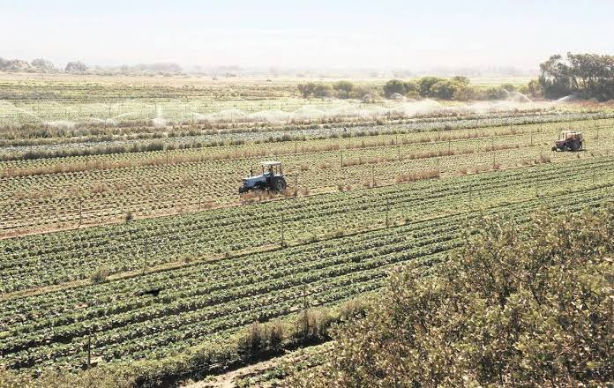
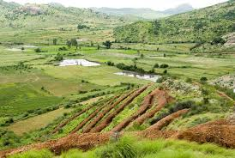
Land as a private property
Lands are now owned as a private property

Slide 13
Failures of Land Reforms
State side with big farmers
2. Big Farmers corner the land of marginalised farmers
3. Surplus Land is always fallow and uncultivable Benami Transactions
4.Lack of Political Will.

Slide 14
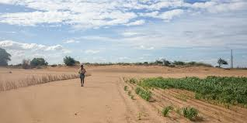
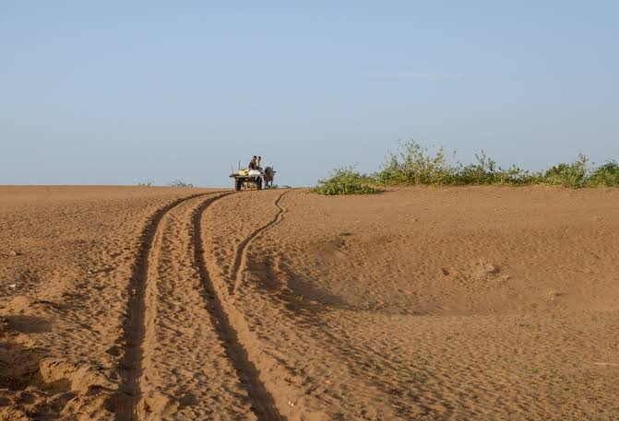
References
1. Joshi, P. C. (1974). Land reform and Agrarian change in India and Pakistan since 1947: 1. The Journal of Peasant Studies, 1(2), 164-185.
2. Dai, H., & Tai, H. C. (1974). Land reform and politics: a comparative analysis. Univ of California Press.
3. Ghatak, M., & Roy, S. (2007). Land reform and agricultural productivity in India: a review of the evidence. Oxford Review of Economic Policy, 23(2), 251-269.
4. Raychaudhuri, A. (2004). Lessons from the land reform movement in West Bengal, India.
5. Joshi, P. C. (1970). Land reform in India and Pakistan. Economic and Political Weekly, A145-A152.

