Slide 1
Land Tenure System
Paper-203, Topic 6: Land Tenure System
Department- Sociology,
Vidyasagar University
Course Coordinator:- Dr. Asmita Bhattacharyya
Group Members’ Names :-
Rabia Parvin
Priya Rana
Subhajit Jali
Moupriya Dolai
Sayan Patra
Sonali Kapri

Slide 2
INTRODUCTION
Land tenure refers to the bundle of rights and responsibilities under which land is held, used, transferred, and succeeded. The meaning of the term varies with context.
It is used to refer to land tenure prescribed by statutory or common law; to customary land tenure; and to observed land tenure practices in a particular historical context.
Land tenure arrangements vary enormously across urban and rural areas primarily because of the use of land for agriculture in rural areas and for residential and business use in urban areas.
Economic historians have focused on analyzing tenure systems on agricultural lands, as until the twentieth century the majority of people in most societies earned their livelihood by cultivating the land; accumulated wealth by improving the land; and transferred wealth to the next generation by bequeathing thing the land.

Slide 3
LAND TENURE:MEANING
Land tenure refers to the way in which land is held by an individual from the Government. It shows the relationship between the land holder and the state. The absolute ownership of land rests with the Government.
Government gives proprietary rights to individuals or communities.
Thus, whom we call a land owner, is in that sense is the proprietor of that land and he has to pay for renewing land rights.

Slide 4
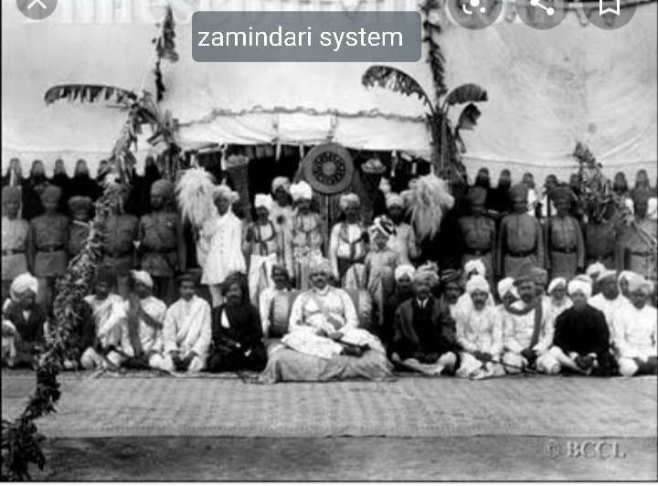
HISTORY OF LAND TENURE
Land Tenure system under British Rule:- Under British Rule there ware three main types of land tenure systems in India. They were Zamindars, Mahalwari and Roytwari.
1. Permanent Settlement /Zamindari System: -
Roughly 19 percent of total area were under this system in British- Bengal, Orissa, Bihar, Banaras.

Slide 5
2. Ryotwari System:- Covered about 51% of the area under British rule – Assam, Bombay and Madras Presidencies.

Slide 6
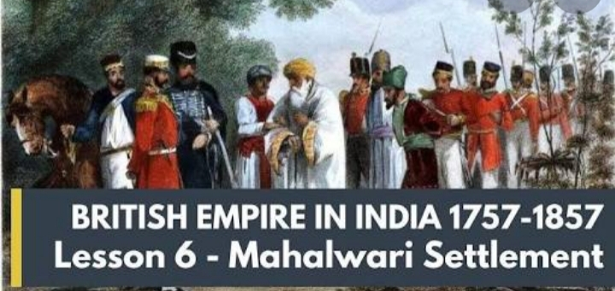
3. Mahalwari System :- Covered 30% of area under British Rule – major parts of NWFP, central provinces and Punjab.

Slide 7
Importance of land tenure system
Locating Actual Owner
Development of Agriculture
Importance of Society

Slide 8
Features of an Ideal Land Tenure System
The tiller or cultivator of the Land should possess a definite and permanent right over his land.
2. Rent should be collected from the cultivators at reasonable rate.
3. The limits of cultivation process must be specified clearly.

Slide 9
REFERENCES
S.L. Doshi and P.C. Jain, (2009) Rural Sociology. Rawat Publications.
AGRICULTURE INFORMATION LAND TENURE:http//
www.indiaagronet.com/indiaagronet/agri-economics/CONTENTS/Land%20Tenure.htm.
LAND TENURE SYSTEM:IMPORTANCE AND FETUSES :
http://www.economicsdiscussion.net/India/land-tenure-system inportance-and-fetures/1907

Slide 10
THANK YOU

