Slide 1
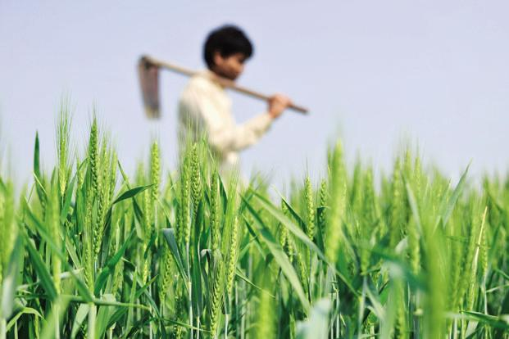
Course coordinator- Dr. Asmita Bhattacharyya Team Members- Eshita Maity( Roll 49) (group leader) Silpa Bhanja( Roll 04) Rupali Senapati(Roll 43) Sonali Senapati(Roll 44) Babita Mishra (Roll 48) Puspita Poyra( Roll 86)
Topic -5:
AGRARIAN SOCIAL STRUCTURE

Slide 2
CONTENTS
Introduction
Issues for Land Problems
Aspects of Rural Stratification
History of the Study of Agrarian Structure
References

Slide 3
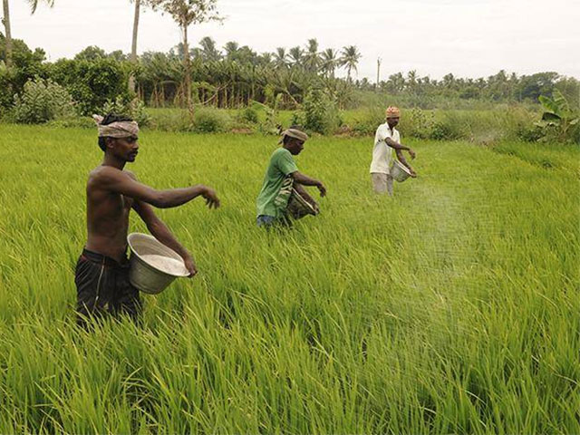
Introduction
‘Agrarian’ means anything related to land, its management or distribution i.e., ‘equitable division of land’.
According to Beteille- ‘the meaning of the phrase (agrarian
system) may not be immediately clear but what I implied is something more specific than the study of peasant societies and cultures, as this is generally understood by anthropologists…. The term ‘peasantry’ has variety of referents. But it is more meaningfully used to describe a more or less homogenous and undifferentiated community of families characterized by small holdings operated mainly by family labor.

Slide 4
Issues For Land Problems
Beteille, said that the land problem in India and for that matter the study of agrarian social structure revolves round two major issues –
Technological arrangements
Social arrangements

Slide 5
Technological Arrangements
Technological arrangement means the management of land, landownership, control and use of land. It is discussed in relation to variations in ecological conditions.
Technological arrangements include ecological conditions along with the new agriculture technology, such as water pumps, thresher, chemical manure, improved seeds, etc.

Slide 6
Social Arrangements
It includes land control and landownership. The Indian agricultural communities have recently been highly stratified having a close relationship between the system of stratification and the division of work.
According to K.L. Sharma agrarian structures in India have always been uneven. He observes that despite the abolition of intermediaries not much substantive change in agrarian relations has come. The uneven structures of landholdings have also resulted in ‘diverse land tenure systems’ which has greatly affected the social structure.

Slide 7
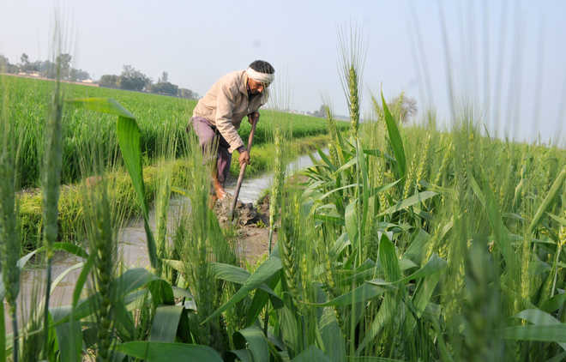
ASPECTS OF RURAL STRATIFICATION
Control over land
Pattern of cultivation

Slide 8
Control over Land
Sociologists and anthropologists strongly argued that changes in land relations have affected the stratification pattern of villages. The crucial aspect of agrarian structure is the control over land.
It is the basis of agrarian stratification.
Oliver Mendelsohn and Marika Vicziany have discussed the rural land reform with reference to untouchables, argue that the subordinated people have gained nothing out of land reforms. The present social stratification of the village is due to the failure to settle land reforms.

Slide 9
Pattern of Cultivation
Another aspect of rural stratification is the pattern of cultivation adopted by the peasantry. If the cultivators take to crops which require hard labour, naturally it would require larger number of agriculture labourers.
In the states of Punjab and Bihar where paddy is grown, larger number of labourers is hired. Even landless labourers migrate from Bihar to Punjab for transplanting paddy. The agrarian hierarchy, therefore, is the resultant of the crops grown by the peasantry.

Slide 10
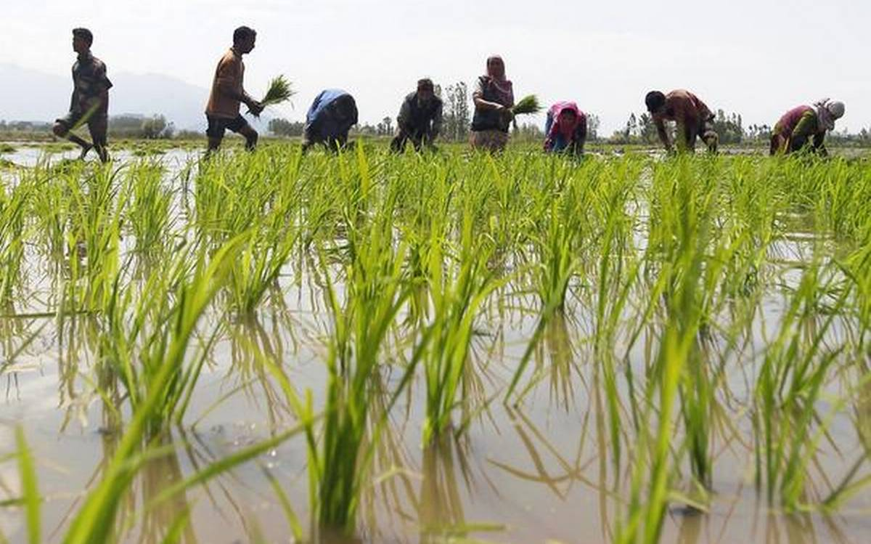
HISTORY OF THE STUDY OF AGRARIAN STRUCTURE
Colonial land policy
Nationalist policy

Slide 11
Colonial Land Policy
It is argued by economists and sociologists that the present agrarian problem of rural India is the outcome of the colonial policy adopted by British in pre-independent India.
P.C. Joshi traces the history of land policy from pre-mutiny period of British rule in India in which the agrarian policy which India had in pre-mutiny period was not the gift of social science but was the result of the interplay of political factors.
The most significant example was the report of the Royal Commission on Agriculture appointed in 1928 to make recommendations for the improvement of agriculture and to promote the welfare and prosperity of the rural people.
After the post-mutiny period, emergence of colonial problem was due largely to the nationalist approach to this problem. British constituted their own land policy which Gunnar Myrdal called “the colonial theory of poverty and economic backwardness”.

Slide 12
Nationalist Policy
The colonial theory of land control, including revenue system, was contested by Indian nationalists. This approach is labeled as institutional approach. The nationalists’ point of view was strongly put forward by Ranade.
He argued that the Indian political economy would only be ex­plained by adopting an institutional approach.
Ranade’s observations assume importance because he contested the very methodology on which the colonial theory was based. He was himself in search of a new methodology, a new premise so as to contribute an alternative land policy.
R.C. Dutta also provided a critique to colonial theory. He contributed insights into the inter-connections and interactions between different elements of the institutional framework.

Slide 13
Gandhi’s Approach towards Land Problems
Gandhiji was concerned with the agrarian relations, he did not make any full- fledged agenda for land reform. However, whatever he thought about the land system on different occasions has a great bearing in the formulation of any land policy.
P.C. Joshi, in his discourse on political genesis of agrarian studies, has made a precise note which indicates the importance of Gandhian ideology relating to land tenure, land ceiling and land relations.
1. Village is the backbone of Indian society
2. Rural-urban nexus
3. New type of approach to town-village relationship
4. Multi-pronged approach to rural uplift
5. Emphasis on the human relations and human resource development

Slide 14
Reference
S.L. Doshi and P.C. Jain, (2009) Rural Sociology. Rawat Publications.
Relevance of Gandhian principles in Agriculture | Articles - On and By Gandhihttps://www.mkgandhi.org › articles › relevance-of-Gandhian-principles-in...
Publicly Funded Agricultural Research and the Changing Structure. https://www.nap.edu › catalog › publicly-funded-agricultural-research-and...

