Slide 1
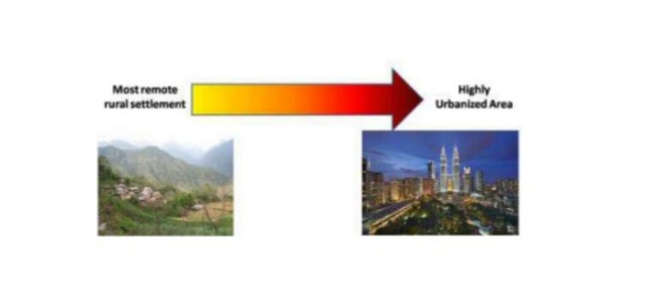
TOPIC:- RURAL-URBAN CONTINUUM SUBJECT:- SOCIOLOGY(PAPER-203) COURSE CO-ORDINATOR – DR. ASMITA BHATTACHARYYA
Assignment Done by:-
SOURAV GHOSH (Roll No.- 08)
BISAKHA GHOSH (Roll No.- 35)
DEBJANI GHORAI (Roll No.- 14)
SUCHARITA PAL (Roll No.- 37)
SANCHITA JALI (Roll No.- 34)
SHILPA HAIT (Roll No.-07)
RAJESH ROY (Roll No.- 81)

Slide 2
Meaning & Concept of Rural – Urban Continuum
Meaning:- By Rural – Urban Continuum is meant by “continuity from village to the city.”
Robert Redfield(1930) has given the concept of rural – urban continuum on the basis of his study of Mexican peasants of Tepoztlain.
Therefore, rural – urban continuum is a process of socio- economic interaction between the villages and the towns or cities.
Rural – urban continuum proposes a linear depiction of the contrasting natures of social relationships characteristic of rural & urban settlements, and there is no such breaking points in the degree of quantity of rural – urban differences.

Slide 3
DEFINITIONS ON RURAL – URBAN CONTINUUM
According to P.A. Sorokin and Zimmerman, in ‘Principles of Rural – Urban Sociology’ have stated that the factors distinguishing rural from urban communities include occupation, size and density of population as well as mobility , differentiation and stratification.
According to R.K. Mukherjee prefers the continuum model by talking of the degree of urbanization as a useful conceptual tool for understanding rural – urban relations.

Slide 4
CHARACTERISTICS OF RURAL – URBAN CONTINUUM
RURAL CHARACTERISTICS | URBAN CHARACTERISTICS
i) Rural area is sparsely populated . | i) Urban area is thickly populated .
ii) Rural area is homogenous in nature. (dress, language and customs etc.) | ii) Urban area is heterogeneous in nature. (castes, classes, ethnic groups , religions etc.)
iii) Rural areas have very slow rate of change. | iii) Urban areas have got fast rate of change.
iv) Rural communities have got strong relationships and interactions of the people. | iv) Urban areas have got weak interactions and ties on the basis of their complex .
v) Rural areas have got informal social life. | v) Urban areas have got formal social life .
vi) In Rural areas there is less rate of pollution. | vi) In Urban areas there is high rate of pollution.

Slide 5
IMPORTANCE OF RURAL – URBAN CONTINUUM
Overhelming of population.
Both cities and villages create jobs and offer better livelihoods.
Rural –Urban continuum has enhanced rural production and productivity.
70% of rural- urban areas of population , are provided with medical care, recreational facility, education, transport and communication.
Protecting local and regional ecosystems .

Slide 6
RURAL – URBAN LINKAGES
RURAL SYSTEMS
URBAN SYSTEMS
SOCIO- ECONOMIC STRUCTURE AND RELATIONS
RURAL ECONOMY
(SECTORS)
RURAL PRODUCTION
REGIMES
RURAL –URBAN FLOWS
NON – AGRICULTURAL
EMPLOYMENT
URBAN SERVICES
PRODUCTION SUPPLIES
NON – DURABLE AND DURABLE FOODS
MARKETS FOR SELLING RURAL PRODUCTS
PROCESSING / MANUFACTURING
INFORMATION ON EMPLOYMENT , PRODUCTION, PRICES, WELFARE SERVICES
PEOPLE
PRODUCTION
COMMODITIES
CAPITAL/INCOME
INFORMATION
NATURAL RESOURCES
WASTE AND POLLUTION

Slide 7
CAUSES OF RURAL- URBAN CONTINUUM
Migration
Diminishing of politics
Increasing number of people in employment
Development of extensive road networks
Demarcation process erases and clearing both the rural – urban areas.

Slide 8
STAGES OF RURAL – URBAN CONTINUUM
As The Law Of Three Stages is an idea developed by Auguste Comte in society –
Theological stage
Metaphysical stage
Positive stage
From rural to urban communities, the urbanization process started in 1940(Approximately) .
Likewise ,on the basis of Population & Economic the Rural –Urban continuum is classified into 4 stages by Gibbs & Hautamaki .
The Pre- Industrial (Agricultural ) society .
The concentration of the economy .
Economic growth spreads across the country
The spatial integration .

Slide 10
SUSTAINABLE URBAN/RURAL
LIVING CONDITIONS
URBAN
RURAL
RURAL/URBAN
INTER
RELATIONSHIP
Good Governance
Good Land Policy
INSTITUTIONS &
GOVERNANCE
LAND & NATURAL
RESOURCE INFRASTRUCTURES
CAPACITY BUILDING & DEVELOPMENT

Slide 11
Transport
Water
Building Materials, Resources
URBAN
Lifestyles/Consumption Patterns
Tourism , Recreation,
Cultural Activities
Knowledge Transfer
Work/ Education
RURAL
Food
Waste/Pollution
Trade
Migration/ Habitation
Energy

Slide 12
SIGNIFICANCE OF RURAL- URBAN CONTINUUM
Majority of the population in Rural –Urban communities.
The rural – urban development is to organize , develop and utilize the resources of land , water and human resources.
The rural- urban communities lead a simple lifestyle, large amount of effects and resources which accommodates the people enhancing the livelihoods .
The rural –urban areas are based on sustainability aspects to include environmental, social and economic dimensions.

Slide 13
RURAL – URBAN CONTINUUM DEBATE
It is noticed that both the concepts rural and urban communities are not adequately defined in a proper way.
In western ideas and thoughts fail to fit the rural – urban continuum into Indian reality .
In rural –urban communities, the people are in a difficulty of mode of life on the basis of no living amenities.
There is a debate issue that there is no demarcation between the rural –urban continuum and it is difficult to know where the urban area begin and the rural ends.

Slide 14
CONCLUSION
In our opinion, the rural –urban continuum , it is seen that the transformation of people from rural to urban areas are noteworthy.
In rural areas and the allied issue of the urban bias is in a collective sense and therefore the rural –urban continuum depends upon the specific zone in which the community falls .
One thing is clear from the above all of the discussion is that the rural and urban life in complex relationship is not the opposite of one another.
Spatial and geographical factors also influence and contribute towards the rural – urban continuum .
As it is a continue process , the socio- economic interaction between the village and towns are always liable to one another.

Slide 15
REFERENCES
Bertrand A. (ed.),(1958) Rural Sociology, McGraw Hill Book Co., New York.
Sharma, K.L. (1997) ,Rural Society in India, Rawat Publications, Jaipur.
Desai A.R. (ed.) (1969), Rural Sociology in India, Popular Prakashan, Bombay.
Anderson &Elijah (ed.), (1990) Race, Class & Change in an rural- urban community, Chicago Press.

Slide 16
THANK YOU

