Slide 1
Topic- 3 Whither the Indian Village Culture and Agriculture in ‘Rural’ India (based on Dipankar Gupta’s writings)
Course coordinator- Dr. Asmita Bhattacharyya
Team members –
Shrotriya dash (roll- 02) (team leader)
Debarashi Kundu (roll- 01)
Utpal Patra (roll- 27)
Moupiya Ghosh (roll- 28)
Sk Rohan Afsar (roll-47)
Prasenjit Rana (roll- 82)
Shilpi Roy (roll-85)

Slide 2
Introduction
The so called unchanging and idyllic Indian village life has undergone a sea change in recent decades.
The typical features like caste and agriculture do not work as vigorously as they use to do.
The agricultural stagnation and job facilities in urban areas have created migration of village people into urban areas.
The culture based on agriculture in village life has undergone changes due to the change in agrarian texture of Indian villages.

Slide 3
Country- town Nexus
Indian villages are changing economically and culturally.
The contemporary rural dynamics is that urbanization is not always a critical factor that has a lasting impact on village life.
The inertia of the agrarian economy forcing people to look somewhere else for their survival. ‘If 80% of landholdings are below five acres, where is the scope to hire workers on the farm? In fact, there is an excess of family labour in most agrarian households’.
The country-town nexus has achieved a new dimension as villagers are leaving their agrarian pasts for a non-agrarian present.

Slide 4
The uprooting of village life from within and linking it with towns and cities marks a new beginning of village town nexus which grows over the years.
According to Gupta, ‘Migrating out of the village has always been a major attraction in rural India, but of late it has become a compelling factor. The drive to leave agriculture is so pronounced that it can no longer be viewed as a phenomenon that peripherally relates to rural life. It is a significant aspect of village life itself ’.
In the works of T. Scarlett Epstein, it is the city that is influencing the village, but nary a word of the movement the other way. There are detailed descriptions in accounts of this sort that document how many motorcycles, TV sets, and coffee shops are in the village. But what they fail to point out is that villagers are not sleeping at the switch. They too are active agents who are keen to exchange their mud huts for urban shanties.

Slide 5
Village under Duress
The Indian agriculture depends on climate. Due to the increase of mechanization and chemical inputs (during the green revolution), agriculture no longer depends fully on climate.
The sociological reality of the village are shrinking even it exists in space. Due to migration, slums are increasing in the urban areas and the crime rates are also increasing. But according to Ambedhkar, “village was a cesspool of degradation, corruption and worse”.
The emergence of non-farm employment leads to the decrease of “rural ethos” among the farmers who proclaim farming as the noblest of all occupation.
Urban world has opened up their horizons and while village economy has lost it sustaining power.

Slide 6
According to Gupta, ‘If approximately 85% of landholdings are below five acres, then land reforms obviously have no scope. It is population increase, more than anything else, which has seen to the demise of the category once called ‘landlords’. Till very recently these landlords stalked the village, killing, raping and looting at will. Their descendants have no such luck’.
While the rigidity of the caste system no longer operates, caste prejudices and identities are still prominent.

Slide 7
Pre-conceptions & conceptions of Village India
Early studies (Village India, 1955 by Mckim Marriot), the local culture of villages was mixed up with a pan Indian Hinduism with a metamorphosis for both of them.
The village communities bind the population together in a native authentically lives making a ‘village republic’.
According the Ronald Inden- “village are atom of Indian civilization”, due to its obdurate and independent nature.

Slide 8
Caste identity and caste system
Rise of backward & scheduled caste- The reason for the rise of scheduled caste political assertion in recent times is primarily because the propertied classes in rural India can no longer exercise economic domination over the landless peasants.
Self declared castes- In Punjab, once low caste chamars now identify themselves as adi-dharmis. Without formally rejecting Sikhism they established their own gurdwaras and do not go to those that are controlled by Jat Sikhs.
Defiance of the lower caste people to work under the upper-caste landlords as there is uncertainty with amount and time of payment.

Slide 9
Economically secure - In several instances, both adi-dharmis and mazhabis would not work in a landowner’s field if they were able to get a job elsewhere even if the wages are slightly lower. They would rather work as a coolies and rickshaw-pullers for, as a mazhabi Sikh said: "At the end of the day I knew how much I am talking home as a mazdoor.
Caste equality- Caste identity has resurfaced at every level now. Caste as a system is dying in rural India while caste identities are coming up.
Freedom for ex-untouchable caste - Now that the pressure of the upper class, landed castes has been lifted in the economic domain, the ex-untouchable castes have the space and the opportunity extravert their origin myths and their sense of identity without fearing reprisals

Slide 10
Farmers’ movement
The concept of rural agitation changed from problems between agricultural laborers to other organizations with political allegiance.
The migrant labor increased and became season centric.
Different state level farmer’s movements were caused for different reasons. The Maoist movement of Bihar and Andhra Pradesh are no longer, for the benefit of the agricultural workers. In UP and Punjab, the people who worked earlier as agrestic labor are no longer willing to work in the same capacity.
The whole philosophy of farmer’s movement changed its orientation from agriculture → business → salaried jobs → beggary to politicians who beg for vote → salaried job → agriculturist.

Slide 11
Marginalized world of the owner-cultivators
The growth rates between industry and agriculture.
A remarkable shift is taking place in the number of agriculture workers.
It is getting rather hasty to conclude the Indians national culture is determined by the village.
The usual concessions are made in terms of subsidies or minimum price for agriculture produce but the kernel of political ideologies do not reflect any major pre - occupation with the village.
Present activists like JOSHI of Shetkari Sangathan who welcomes an open market for he believes that the present in Maharasthra would do very well if they could take their products abroad.

Slide 12
Horticulture, floriculture- the cultivation of aromatic and medicinal plants over and above animal husbandry and fisheries are some of the alternatives presented to improve agriculture.
While the Owner-Cultivators are protected politically, their features are left unplanned.
The majority of Indians live in villages, the village leaves little impress upon the National Culture today.

Slide 13
Rural non-farm employment
Rural non-farm employment is on the rise.
Scope for agricultural employment has fallen rapidly.
Growth in post harvesting activities particularly food processing has generated large number of non-farm employment scopes.
RNFE is no longer a distress employment as it has continuously increased in spite of stagnant rates of agricultural growth.
Availability of off-farm employment drives the local villagers to seek jobs outside the villages.

Slide 14
The Vanishing Indian Village?
Old taboos against holding certain kinds of jobs are disappearing.
Caste system does not operate as strongly as it used to.
Untouchability is not practiced widely.
Even land owners also seek a future outside the villages.
The culture against this background, we have to understand the culture surrounding this new agricultural phenomenon.

Slide 15
Conclusion
It can be concluded from the length about the declining significance of the village as a social entity, posing the question, at one point, as to whether there is not a sense in which it is “vanishing”.
Gupta draws attention to the implications of economic changes, including the decline of agriculture, that have seen more and more people trying to leave villages in search of employment, and relatively the decline of caste hierarchies in villages.

Slide 16
References
Gupta, Dipankar. (2005). Whither the Indian Village Culture and Agriculture in ‘Rural’ India. Economic and Political Weekly. 40(8): 751-758. Retrieved on: 23.03.2020
Gupta, Dipankar. (2008), ‘The Changing Villagers’. Retrieved from: https://www.india-seminar.com. Retrieved on: 24.03.2020
Gupta, Dipankar. (2013), “Eminent Sociologist Dipankar Gupta Speaks on “Town and Country: the Changing Face of India” Jamia Journal. Retrieved from: https://www.jamiajournal.com. Retrieved on: 24.03.2020

Slide 17
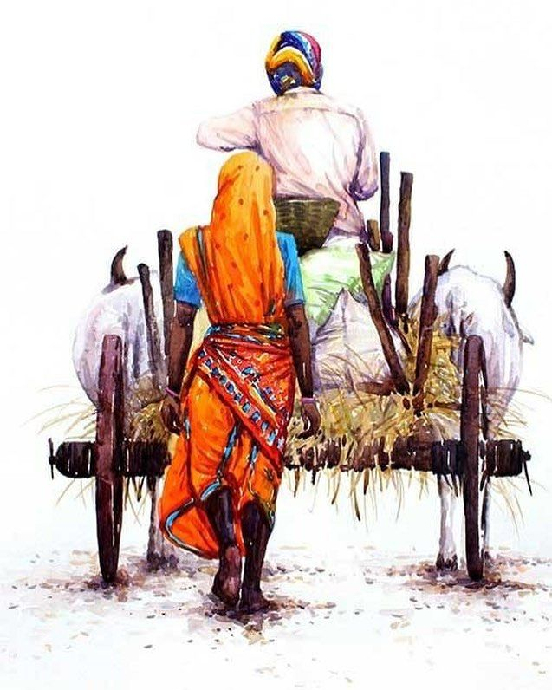
THANK YOU

