Slide 1
Distributed Database System
By
Mr. Prabhash Kumar Singh
Assistant Professor,
Dept. of Computer Science, Vidyasagar University.

Slide 2
Distributed System
The database is stored on several computers
Communication through different media such as high speed networks, telephone lines
Do not share main memory or disks
Computer vary in size and functions
Computers are called such as sites or nodes

Slide 3
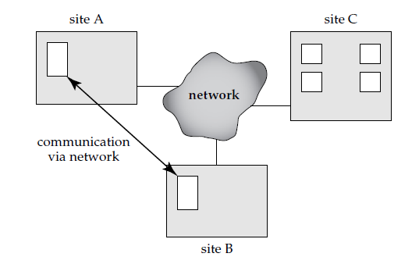

Slide 4
Why Distributed Database Systems?
Sharing Data
Autonomy
Availability

Slide 5
Local vs Global Transaction

Slide 6
Complexity
Software-development Cost
Greater potential for bugs
Increased processing for Bugs

Slide 7
Types of DDS
Homogeneous
Heterogeneous

Slide 8
Distributed Data Storage
Consider a relation r that is to be stored in the database. There are two approaches:
Replication
Fragmentation

Slide 9
Data Replication
Advantages
Availability
Increased Parallelism
Disadvantages
Increased Overhead on Update

Slide 10
Data Fragmentation
If relation r is fragmented, r is divided into a number of fragments r₁, r₂, . . . , r_{n}.
It contain sufficient information to allow reconstruction of the original relation r.
Two different schemas for fragmenting
Horizontal Fragmentation
Vertical Fragmentation

Slide 11
Horizontal Fragmentation
Account-schema = (account-number, branch-name, balance)
A relation r is partitioned into a number of subsets, r₁, r₂, . . . , r_{n}.
Each tuple of relation r must belong to at least one of the fragments, so that the original relation can be reconstructed, if needed.
r= r₁U r₂U . . . U r_{n}

Slide 12
Vertical Fragmentation
Fragmentation of r(R) involves the definition of several subsets of attributes R₁, R₂, . . .,R_{n} of the schema R so that R = R₁ ∪ R₂ ∪ · · · ∪ R_{n}
It should be done in such a way that we can reconstruct relation r from the fragments by taking the natural join

Slide 13
employee-info(employee-id, name, designation, salary)
employee-privateinfo(employee-id, salary)
employee-public-info(employee-id, name, designation)

Slide 14
Transparency
The user of a distributed database system should not be required to know either
where the data are physically located or
how the data can be accessed at the specific local site called data transparency
It can take several forms
Fragmentation Transparency
Replication Transparency
Location Tranparency
how the data can be accessed at the specific local site

Slide 15
Data items—such as relations, fragments, and replicas—must have unique names.
In a distributed database, however, we must take care to ensure that two sites do not use the same name for distinct data items.
One solution to this problem is to require all names to be registered in a central name server.
We can also use the name server to locate a data item, given the name of the item. This approach, however, suffers from two major disadvantages.
First, the name server may become a performance bottleneck when data items are located by their names, resulting in poor performance.
Second, if the name server crashes, it may not be possible for any site in the distributed system to continue to run.

Slide 16
A more widely used alternative approach requires that each site prefix its own site identifier to any name that it generates.
This approach ensures that no two sites
generate the same name (since each site has a unique identifier).
No central control is required. This solution, however, fails to achieve location transparency, since site identifiers are attached to names. Thus, the account relation might be referred to as site17.account, or account@site17, rather than as simply account.
To overcome this problem, the database system can create a set of alternative names or aliases for data items.
The mapping of aliases to the real names can be stored at each site. With aliases, the user can be unaware of the physical location of a data item.
Furthermore, the user will be unaffected if the database administrator decides to move a data item from one site to another.

Slide 17
Distributed Transactions
Each site has its own local transaction manager, whose function is to ensure the ACID properties of those transactions that execute at that site. The various transaction managers cooperate to execute global transactions.
To understand how such a manager can be implemented, consider an abstract model of a transaction system, in which each site contains two subsystems:

Slide 18
The transaction manager manages the execution of those transactions (or sub transactions) that access data stored in a local site.
Note that each such transaction may be either a local transaction (that is, a transaction that executes at only that site) or part of a global transaction (that is, a transaction that execute at several sites).
The transaction coordinator coordinates the execution of the various transactions (both local and global) initiated at that site.

Slide 19
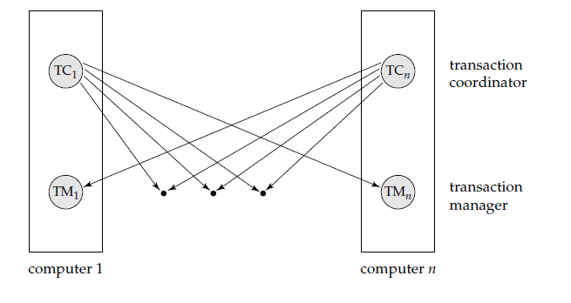
System Architecture

Slide 20
Each transaction manager is responsible for
Maintaining a log for recovery purposes
Participating in an appropriate concurrency-control scheme to coordinate the concurrent execution of the transactions executing at that site

Slide 21
Each transaction, the coordinator is responsible for
Starting the execution of the transaction
Breaking the transaction into a number of sub transactions and distributing these sub transactions to the appropriate sites for execution
Coordinating the termination of the transaction, which may result in the transaction being committed at all sites or aborted at all sites

Slide 22
System Failure Modes
A distributed system may suffer from the same types of failure that a centralized system does (for example, software errors, hardware errors, or disk crashes). There are, however, additional types of failure with which we need to deal in a distributed environment. The basic failure types are
Failure of a site
Loss of messages
Failure of a communication link
Network partition

Slide 23
Commit Protocols
To ensure atomicity all sites in which a transaction T executed must agree on the final outcome of the execution
To ensure this property, the transaction coordinator of T must execute a commit protocol
Among the simplest and most widely used commit protocols is the two-phase commit protocol (2PC)

Slide 24
The Commit Protocol
Consider a transaction T initiated at site S_{i}, where the transaction coordinator is C_{i}
Phase – I
C_{i} adds the record <prepare T> to the log, and forces the log onto stable storage.
It then sends a prepare T message to all sites at which T executed.
On receiving such a message, the transaction manager at that site determines whether it is willing to commit its portion of T.
If the answer is no, it adds a record <no T> to the log, and then responds by sending an abort T message to C_{i}
If the answer is yes, it adds a record <ready T> to the log, and forces the log (with all the log records corresponding to T) onto stable storage.
The transaction manager then replies with a ready T message to C_{i}

Slide 25
Phase-2
When C_{i} receives responses to the prepare T message from all the sites, or when a pre specified interval of time has elapsed since the prepare T message was sent out, C_{i} can determine whether the transaction T can be committed or aborted.
Transaction T can be committed if C_{i} received a ready T message from all the participating sites.
Otherwise, transaction T must be aborted.
Depending on the verdict, either a record <commit T> or a record <abort T> is added to the log and the log is forced onto stable storage.
At this point, the fate of the transaction has been sealed.
Following this point, the coordinator sends either a commit T or an abort T message to all participating sites.
When a site receives that message, it records the message in the log.

Slide 26
Handling of Failures
Failure of a participating site - If the coordinator C_{i} detects that a site has failed, it takes these actions:
If the site fails before responding with a ready T message to C_{i}, the coordinator assumes that it responded with an abort T message.
If the site fails after the coordinator has received the ready T message from the site, the coordinator executes the rest of the commit protocol in the normal fashion, ignoring the failure of the site.
When a participating site S_{k} recovers from a failure, it must examine its log to determine the fate of those transactions that were in the midst of execution when the failure occurred.

Slide 27
Let T be one such transaction. We consider each of the possible cases:
The log contains a <commit T> record. In this case, the site executes redo(T).
The log contains an <abort T> record. In this case, the site executes undo(T).
The log contains a <ready T> record. In this case, the site must consult C_{i} to determine the fate of T. If C_{i} is up, it notifies S_{k} regarding whether T committed or aborted.
In the former case, it executes redo(T); in the latter case, it executes undo(T).
If C_{i} is down, S_{k} must try to find the fate of T from other sites. It does so by sending a querystatus T message to all the sites in the system. On receiving such a message, a site must consult its log to determine whether T has executed there, and if T has, whether T committed or aborted. It then notifies S_{k} about this outcome. If no site has the appropriate information (that is, whether T committed or aborted), then S_{k} can neither abort nor commit T. The decision concerning T is postponed until S_{k} can obtain the needed information. Thus, S_{k} must periodically resend the querystatus message to the other sites. It continues to do so until a site that contains the needed information recovers. Note that the site at which C_{i} resides always has the needed information.
The log contains no control records (abort, commit, ready) concerning T.
Thus, we know that S_{k} failed before responding to the prepare T message from C_{i}. Since the failure of S_{k} precludes the sending of such a response, by our algorithm C_{i} must abort T. Hence, S_{k} must execute undo(T).

Slide 28
Failure of the coordinator
If the coordinator fails in the midst of the execution of the commit protocol for transaction T, then the participating sites must decide the fate of T.
We shall see that, in certain cases, the participating sites cannot decide whether to commit or abort T, and therefore these sites must wait for the recovery of the failed coordinator

Slide 29
If an active site contains a <commit T> record in its log, then T must be committed.
If an active site contains an <abort T> record in its log, then T must be aborted.
If some active site does not contain a <ready T> record in its log, then the failed coordinator C_{i} cannot have decided to commit T, because a site that does not have a <ready T> record in its log cannot have sent a ready T message to C_{i}.
However, the coordinator may have decided to abort T, but not to commit T. Rather than wait for C_{i} to recover, it is preferable to abort T.
If none of the preceding cases holds, then all active sites must have a <ready T> record in their logs, but no additional control records (such as <abort T> or <commit T>).

Slide 30
Since the coordinator has failed, it is impossible to determine whether a decision has been made, and if one has, what that decision is, until the coordinator recovers.
Thus, the active sites must wait for C_{i} to recover.
Since the fate of T remains in doubt, T may continue to hold system resources.
For example, if locking is used, T may hold locks on data at active sites. Such a situation is undesirable, because it may be hours or days before C_{i} is again active. During this time, other transactions may be forced to wait for T. As a result, data items may be unavailable not only on the failed site (C_{i}), but on active sites as well. This situation is called the blocking problem, because T is blocked pending the recovery of site C_{i}.

Slide 31
Network partition
When a network partitions, two possibilities exist:
The coordinator and all its participants remain in one partition.
In this case, the failure has no effect on the commit protocol.
The coordinator and its participants belong to several partitions.
From the viewpoint of the sites in one of the partitions, it appears that the sites in other partitions have failed.
Sites that are not in the partition containing the coordinator simply execute the protocol to deal with failure of the coordinator.
The coordinator and the sites that are in the same partition as the coordinator follow the usual commit protocol, assuming that the sites in the other partitions have failed.

Slide 32
Alternative Models of Transaction Processing

Slide 33
Protocols

Slide 34
Replication with weak degress of Consistency
Replication with different forms may exist
Master Slave Replication
Multimaster Replication (Update anywhere)
Types of Updates
Immediate Update
Biased Protocol
Lazy Propagation

Slide 35
Deadlock Handling
The deadlock-prevention and deadlock-detection algorithms can be used in a distributed system, provided that modifications are made
Tree Protocol by defining global trees
Deadlock prevention may result in unnecessary waiting and rollback
If we allow deadlocks to occur and rely on deadlock detection, the main problem in a distributed system is deciding how to maintain the wait-for graph

Slide 36
Common techniques for dealing with this issue require that each site keep a local wait-for graph
When a transaction Ti on site S1 needs a resource in site S2, it sends a request message to site S2.
If the resource is held by transaction Tj , the system inserts an edge Ti → Tj in the local wait-for graph of site S2
If any local wait-for graph has a cycle, deadlock has occurred.
Also, the fact that there are no cycles in any of the local wait-for graphs does not mean that there are no deadlocks

Slide 37
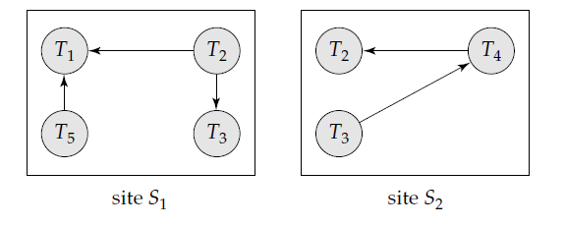
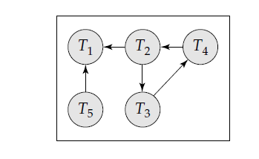
Example

Slide 38
When the coordinator invokes the deadlock-detection algorithm, it searches its global graph.
If it finds a cycle, it selects a victim to be rolled back
The coordinator must notify all the sites that a particular transaction has been selected as victim
The sites, in turn, roll back the victim transaction

Slide 39
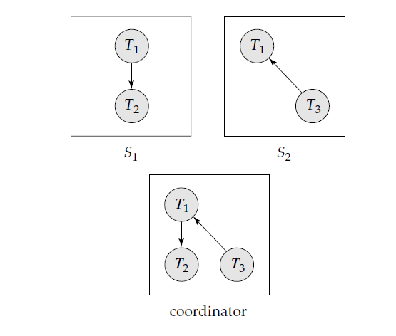
This scheme may produce unnecessary rollbacks if:
False Cycles

Slide 40
A deadlock has indeed occurred and a victim has been picked, while one of the transactions was aborted for reasons unrelated to the deadlock.
For example, suppose that site S1 decides to abort T2. At the same time, the coordinator has discovered a cycle, and has picked T3 as a victim. Both T2 and T3 are now rolled back, although only T2 needed to be rolled back.

Slide 41
Availability
One of the goals in using distributed databases is high availability;
i.e the database must function almost all the time.
Since failures are more likely in large distributed systems, a distributed database must continue functioning even when there are various types of failures.
The ability to continue functioning even during failures is referred to as robustness.

Slide 42
Majority-Based Approach
Each data object stores with it a version number to detect when it was last written to
Whenever a transaction writes an object it also updates the version number in this way:
If data object a is replicated in n different sites, then a lock-request message must be sent to more than one-half of the n sites in which a is stored. The transaction does not operate on a until it has successfully obtained a lock on a majority of the replicas of a.
Read operations look at all replicas on which a lock has been obtained, and read the value from the replica that has the highest version number. Writes read all the replicas just like reads to find the highest version number. The new version number is one more than the highest version number. The write operation writes all the replicas on which it has obtained locks, and sets the version number at all the replicas to the new version number.

Slide 43
Read One,Write All Available Approach
Special case of quorum consensus,
we can employ the biased protocol by giving unit weights to all sites, setting the read quorum to 1, and setting the write quorum to n (all sites).
In this special case, there is no need to use version numbers;
even a single site containing a data item fails, no write to the item can proceed, since the write quorum will not be available.
This protocol is called the read one, write all protocol since all replicas must be written.

Slide 44
Site Reintegration
An easy solution is to halt the entire system temporarily while the failed site rejoins it.

Slide 45
Coordinator Selection
Backup coordinator
New Coordination choosen may be chosen dynamically by sites that are live
Election algorithms enable the sites to choose the site for the new coordinator in a decentralized manner
Example: Bully Algorithm

Slide 46
Bully Algorithm
To keep the notation and thediscussion simple, assume that the identification number of site Si is i and that the chosen coordinator will always be the active site with the largest identification number.
Hence, when a coordinator fails, the algorithm must elect the active site that has the largest identification number.
The algorithm must send this number to each active site in the system.
In addition, the algorithm must provide a mechanism by which a site recovering from a crash can identify the current coordinator.
Suppose that site Si sends a request that is not answered by the coordinator within a prespecified time interval T.
In this situation, it is assumed that the coordinator has failed, and Si tries to elect itself as the site for the new coordinator.

Slide 47
contd…
Site Si sends an electionmessage to every site that has a higher identification number.
Site Si then waits, for a time interval T, for an answer from any one of these sites.
If it receives no response within time T, it assumes that all sites with numbers greater than i have failed, and it elects itself as the site for the new coordinator and sends a message to inform all active sites with identification numbers lower than i that it is the site at which the new coordinator resides.

Slide 48
contd…
If Si does receive an answer, it begins a time interval T, to receive a message informing it that a site with a higher identification number has been elected. (Some other site is electing itself coordinator, and should report the results within time T.)
If Si receives no message within T, then it assumes the site with a higher number has failed, and site Si restarts the algorithm
After a failed site recovers, it immediately begins execution of the same algorithm.
If there are no active sites with higher numbers, the recovered site forces all sites with lower numbers to let it become the coordinator site, even if there is a currently active coordinator with a lower number.
It is for this reason that the algorithm is termed the bully algorithm.

