Slide 1
Vidyasagar University
M.Phil
2nd Semester
Paper: SOC 211
Department of Sociology
‘Women’s Oppression’
Course C0ordinator Name: Dr. Asmita Bhattacharyya
Group Members’ Names:-
Ranajit Nayak (Roll 12) and Sourav Das (Roll 01)

Slide 2
Welcome

Slide 3
OPPRESSION
The term “feminism”, which highlights their oppression specifically in relation to men, however, has been in use in English only since the campaigns for women’s suffrage during the last decade of the nineteenth century. More recently, it has been the resurgence of women’s movements in the late 1960s- the so-called “second wave”- that is usually associated with feminist strivings for women’s equal rights, and freedom from oppressive constraints of sex, self-expression and autonomy.

Slide 4
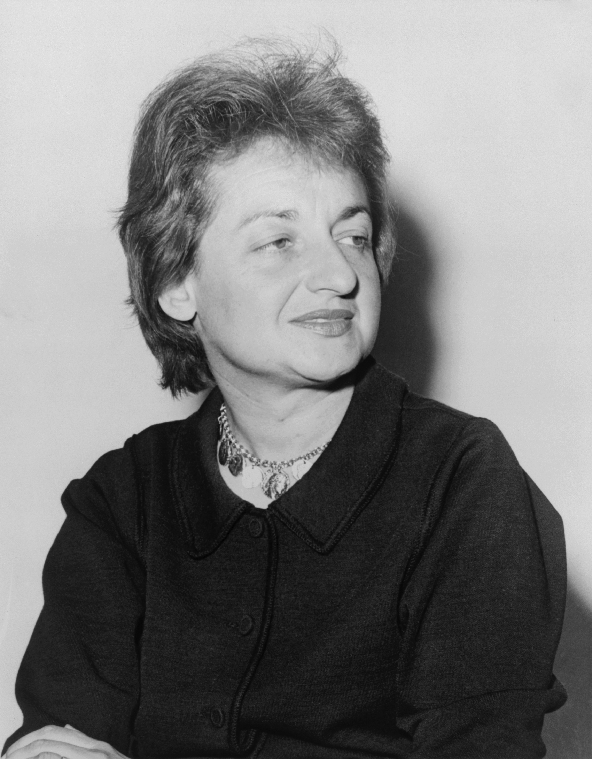
Betty Friedan
American Writer: ‘The Feminine Mystique’(1963)
Highlight termed – “the problem that has no name”
Women’s own sense of their needs
Subsequent thinkers-
These problems are at the heart of feminism
Different ways : oppression, subordination, discrimination, inequality, etc.

Slide 5
Public and Private Spheres
Friedan twentieth century articulation “Problem with no name”
Greater Educational opportunities than women of earlier times
White middle-class (limitation of Friendan)
“Equality feminist” – first choice Public, second class choice is house keeping etc.
Juggling paid employment
East and West

Slide 6
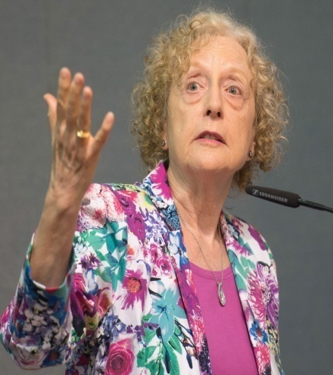
Carole Pateman
British Political theorist
“Feminist Critiques of the Public/Private Dichotomy”(1989)
Challenging the structure of Society
Hierarchical Division
Women’s work and Men’s work

Slide 7
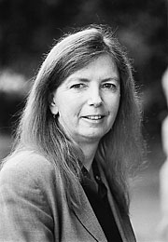
Susan Moller Okin
American feminist
“Humanist liberalism”(1989)/ equal public sphere participation and equal sharing
Interrelationship (Domestic and Public sphere)

Slide 8
Friedan vs Later Feminists
Friedan suggested-
Opportunity, respect and freedom of choice
Later feminists have argued-
Public-Private dichotomy, Division of labour etc.

Slide 9
Different potentials and values
Values of attachment
Support family and community life
Male-identified public sphere activities

Slide 10
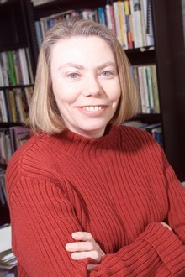
Iris Marion Young
American political philosopher
Instrumentalized and Authoritarian masculinist culture
Devaluation

Slide 11
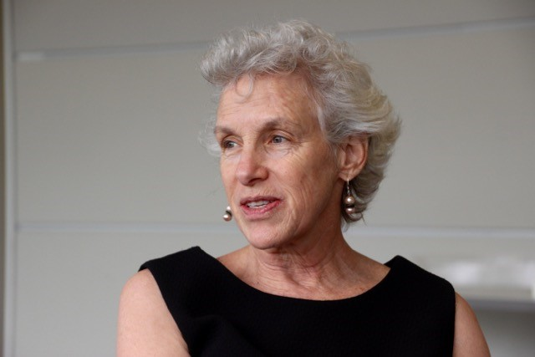
Joan William
Feminist legal theorist
Unbending Gender(2000)
Equality- Difference

Slide 12
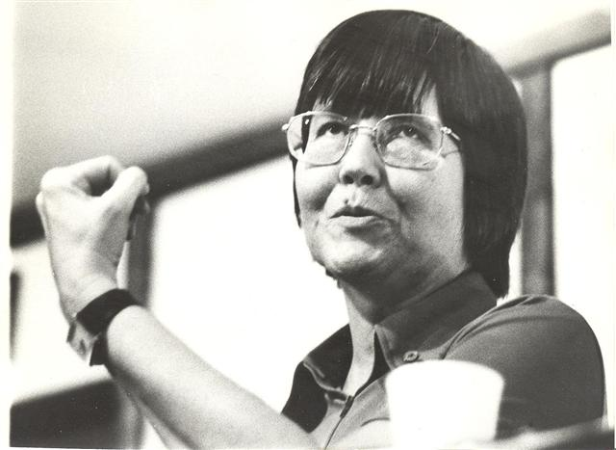
Mary Daly
Radical Feminist
Gyn/Ecology(1978)
“re-claiming of life-loving female energy”
Critiques all moves for equal rights
Some thinkers-
Understand the “problem that has no name” as a cluster of problems with many names.

Slide 13
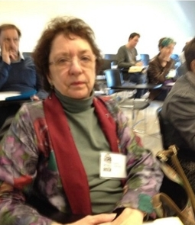
Nancy Hartsock
American Marxist feminist
“Feminist standpoint”
Redefining and Restructuring society
Women to be able to achieve their potential

Slide 14
The equality-difference debate
Mainstream feminism
Two Unsatisfactory alternatives equality – difference
Several thinkers- Relationships Public-Private sphere
Women’s activism

Slide 15
References
Bowden, P., & Mummery, J. (2009). Understanding Feminism. Acumen Publishing.
Harrison, Kevin & Boyd, Tony. (2018). Feminism. 10.7765/9781526137951.00019.
Tong, R., & Botts, T. F. (2014). Feminist thought: a more comprehensive introduction (4th ed.). Boulder: Westview Press.
Lionel, 1882-192, G. W. (1913). Woman and to-morrow. Retrieved from http://nlist.inflibnet.ac.in:2269/

Slide 16
Thank You

