Slide 1
Virology
Dr. Surojit Das
Ph.D
Assistant Professor
Vidyasagar University

Slide 2
It’s just a piece of bad news wrapped up in protein.
Nobel laureate Peter Medawar (1915-1987) describing a virus

Slide 3
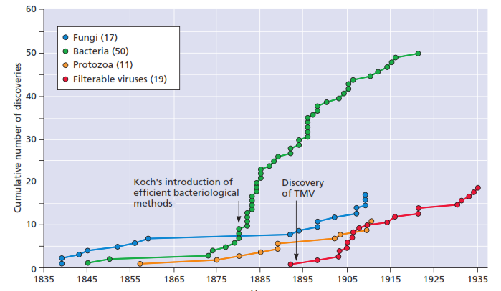

Slide 4
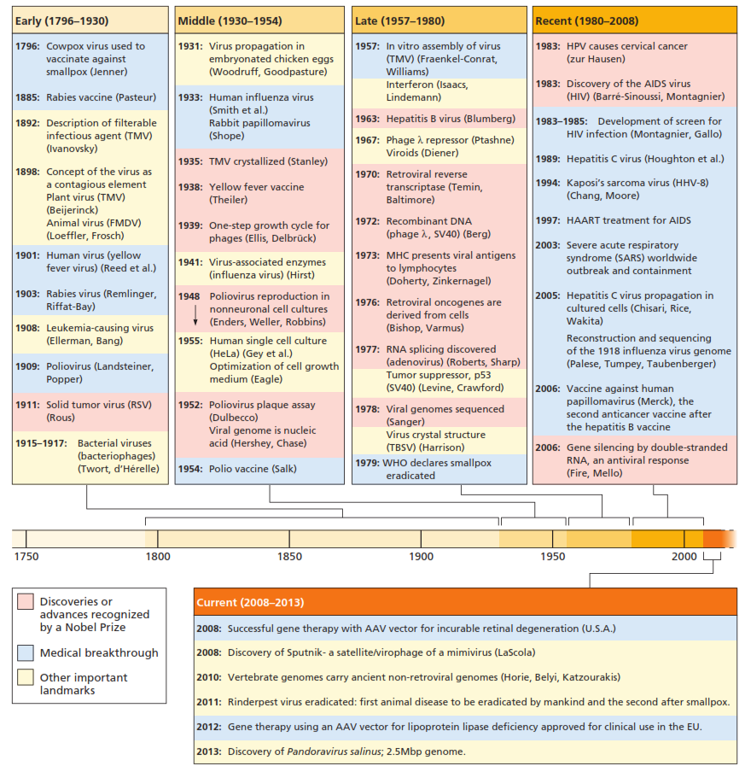

Slide 5
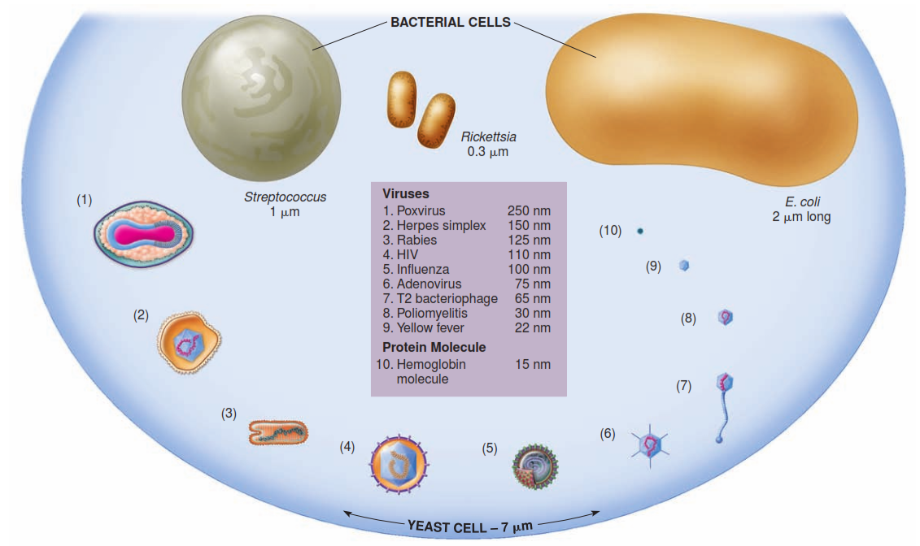

Slide 6
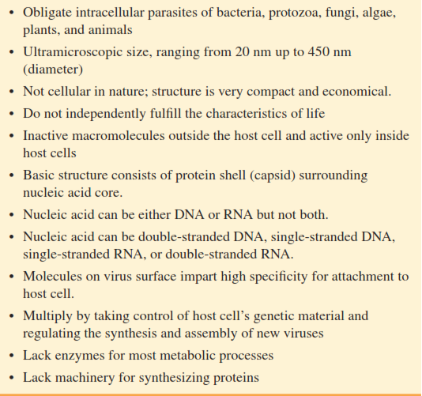

Slide 7
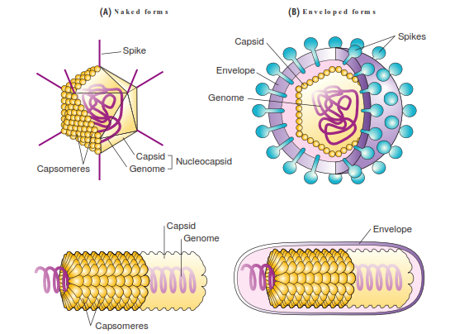
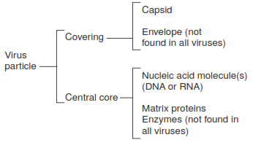
Ether sensitivity: The envelope is disrupted by solvents like ether to such an extent that lipid-mediated activities are blocked or envelope proteins are denatured and rendered inactive

Slide 8
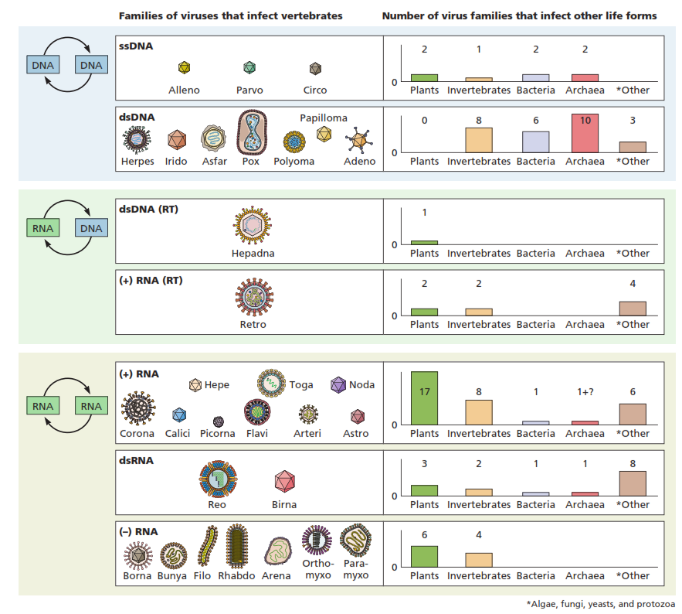

Slide 9
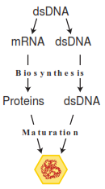
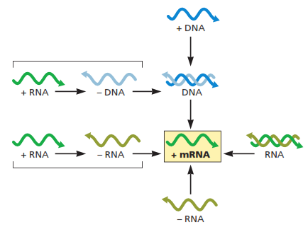
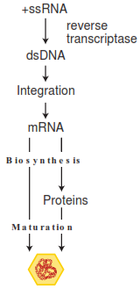
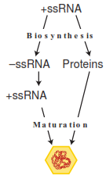
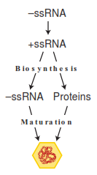
The Baltimore Classification
All viruses must produce mRNA that can be translated by the cellular ribosomes

Slide 10
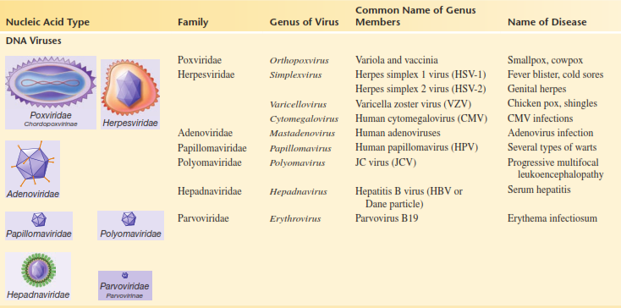
The International Committee on the Taxonomy of Viruses (ICTV) lists 3 orders, 63 families, & 263 genera of viruses

Slide 11
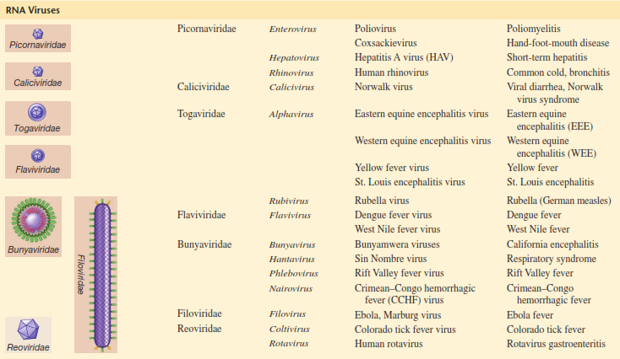

Slide 12
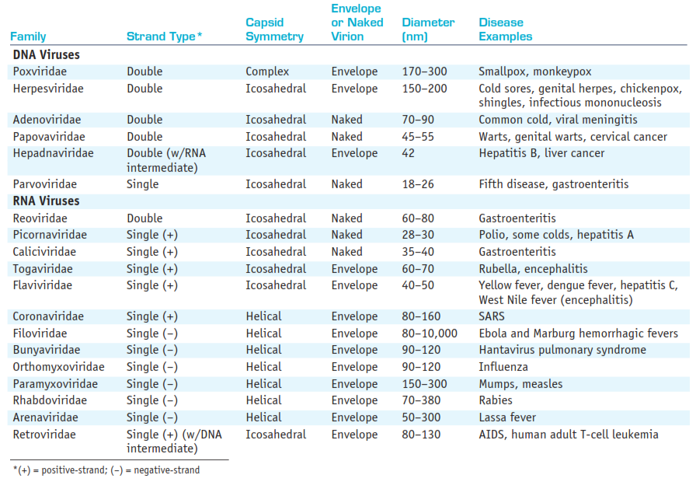

Slide 13
Helical virus
Icosahedral virus
Complex virus

Slide 14
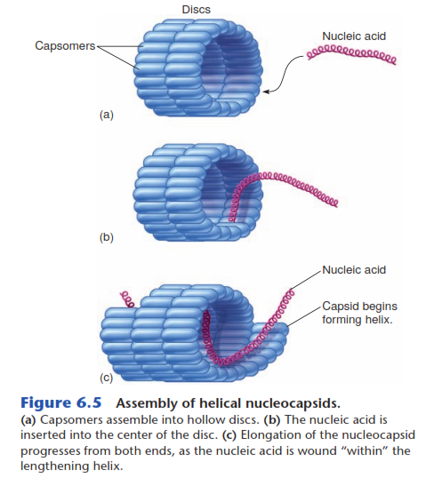
Helical virus
The simpler helical capsids have rod-shaped capsomers (capsa, box; mer, part; identical protein subunits) that bind together to form a series of hollow discs resembling a bracelet

Slide 15
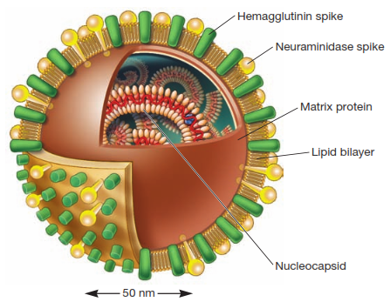
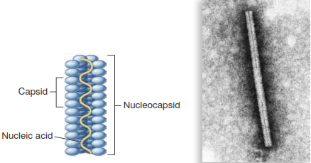
Helical Nucleocapsids
Naked helical virus (TMV)
Enveloped helical virus (influenza virus)

Slide 16
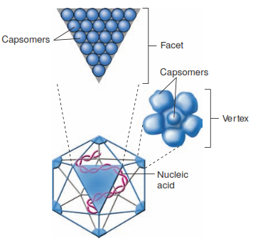
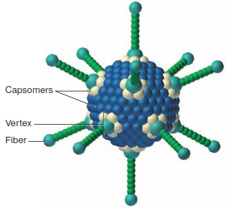
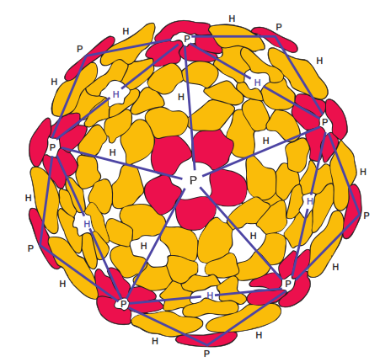
Icosahedral Virus
The icosahedron (icos, twenty; edros, side) is one of nature’s favourite shapes because it is the most efficient way to enclose a space (the helix is probably most popular).
They have regular polyhedron with 20 equilateral triangular faces and 12 vertices.
The capsids are constructed from ring- or knob-shaped units called capsomers, each usually made of five (pentamers/pentons/P) or six (hexamers/hexons/H) protomers.
Pentons are at the vertices of the icosahedron, whereas hexamers form its edges & triangular faces.

Slide 17
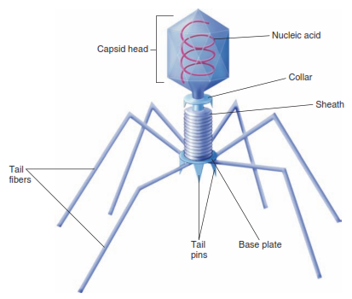
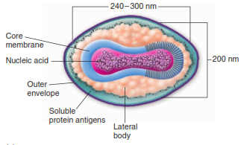
Complex Viruses
Few atypical viruses neither purely icosahedral nor helical belongs to complex symmetry.
Vaccinia virus (pox)
Bacteriophage T4

Slide 18
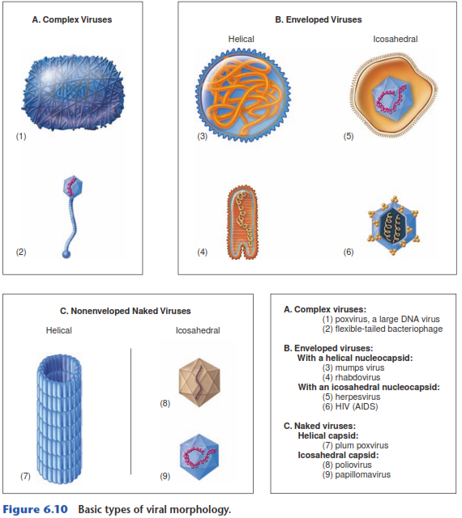
Basic Types of Viral Morphology

Slide 19
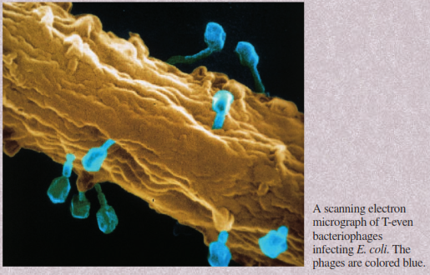
Bacteriophage

Slide 20
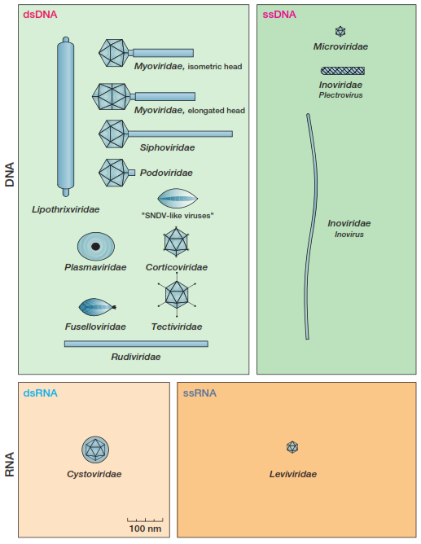
Major Bacteriophage Families & Genera

Slide 21
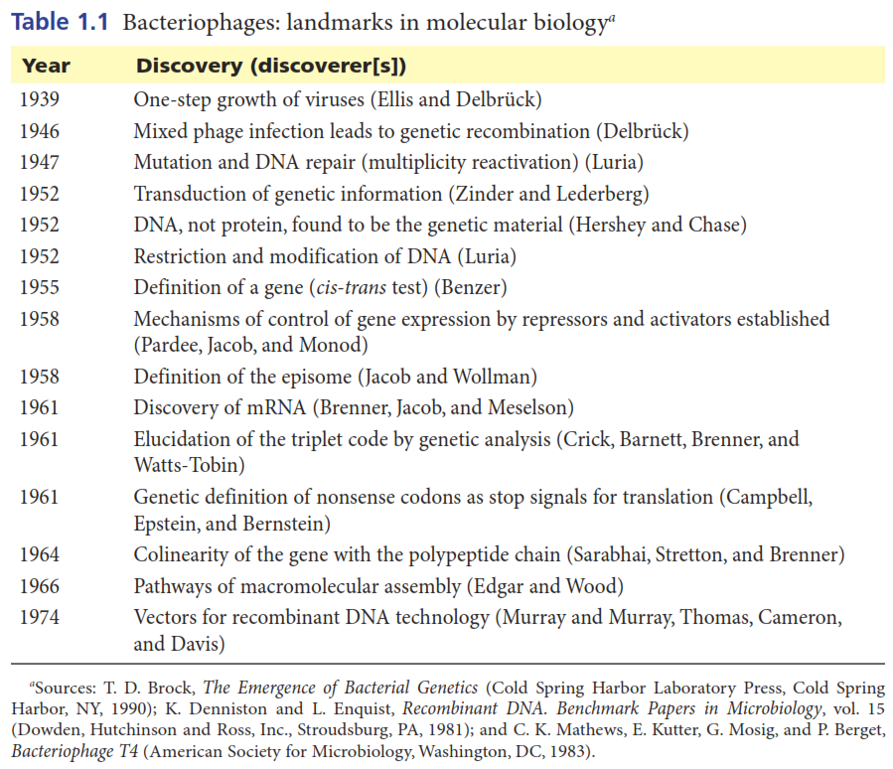

Slide 22
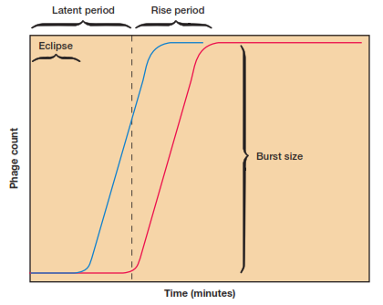
The One-Step Growth Curve
Latent period: The initial phase in the one-step growth expt., i.e., after the phage addition in which no virions are released.
Rise period/burst: Host cells rapidly lyse & release infective phages.
Burst size: The no. of phages produced per infected cell during the lytic life cycle.
Eclipse (conceal) period: The initial part of the latent period in which infected host bacteria do not contain any complete virions.
Free viruses (unadsorbed virions + released from host cells)
Complete virion

Slide 23
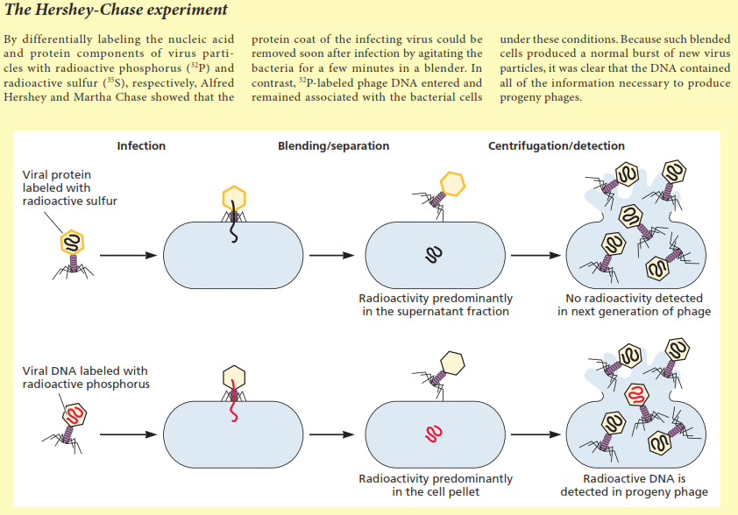

Slide 24
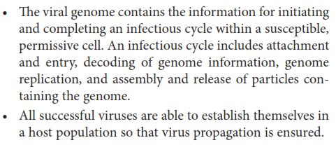
A Common Strategy for Viral Propagation

Slide 25
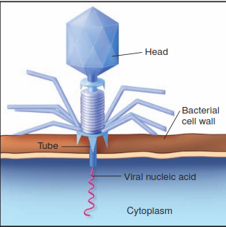
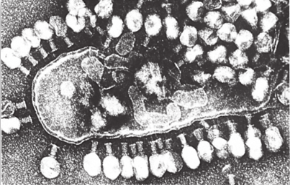
T-even Phage Adsorption & DNA Injection

Slide 26
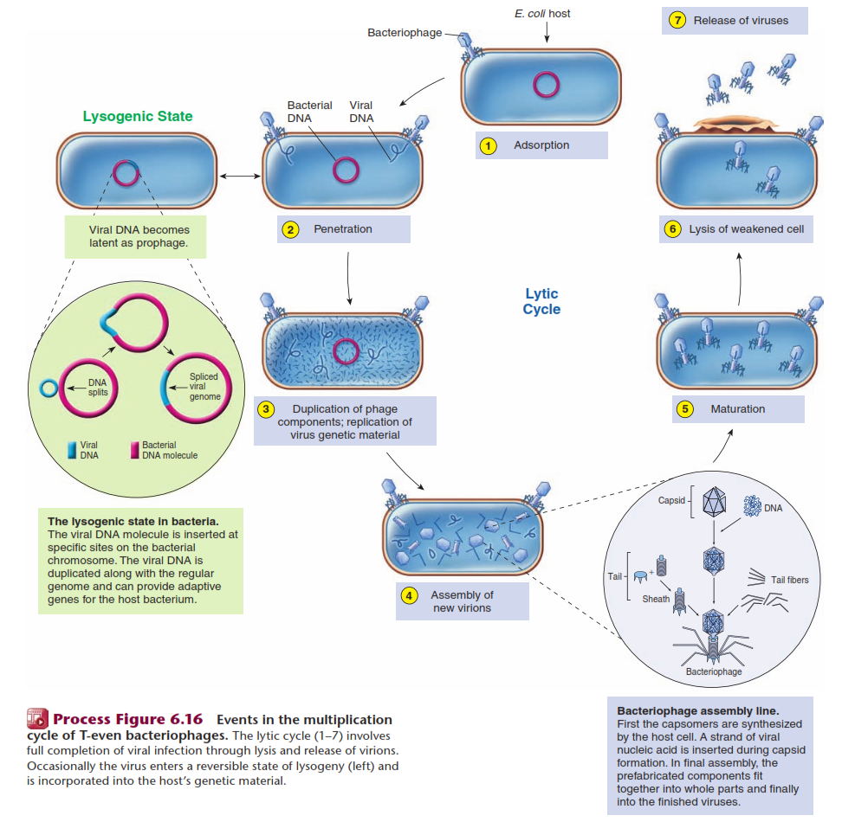
Life Cycle of T-even Bacteriophage: Takes ~30 mins
(temperate phage)
(virulent phage)

Slide 27
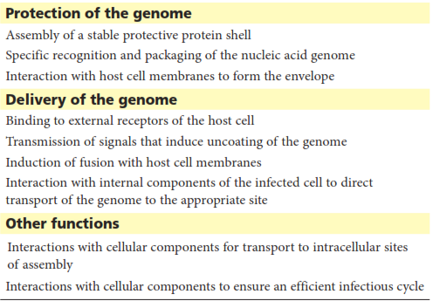
Functions of Virion Proteins

Slide 28
Animal Viruses

Slide 29
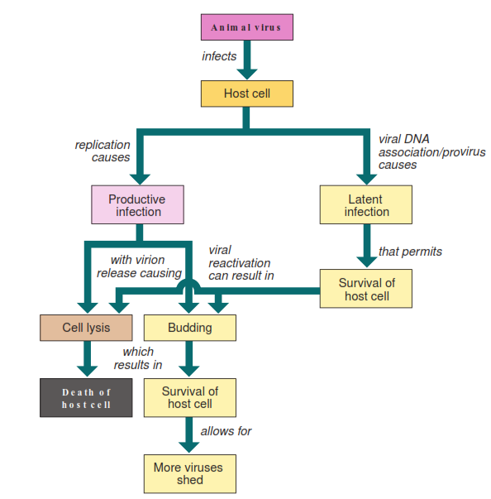
Potential Outcomes for Animal Virus Infection of a Host Cell

Slide 30
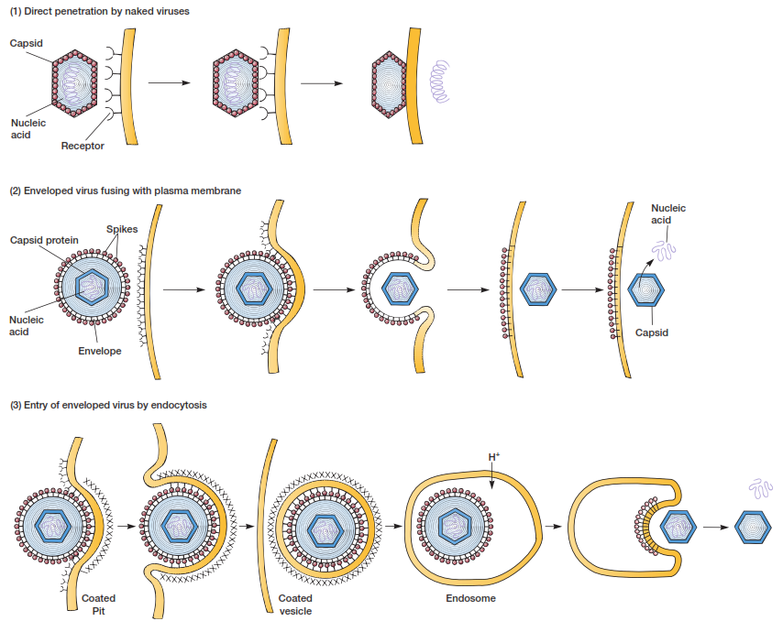
Modes of Virus Entry

Slide 31
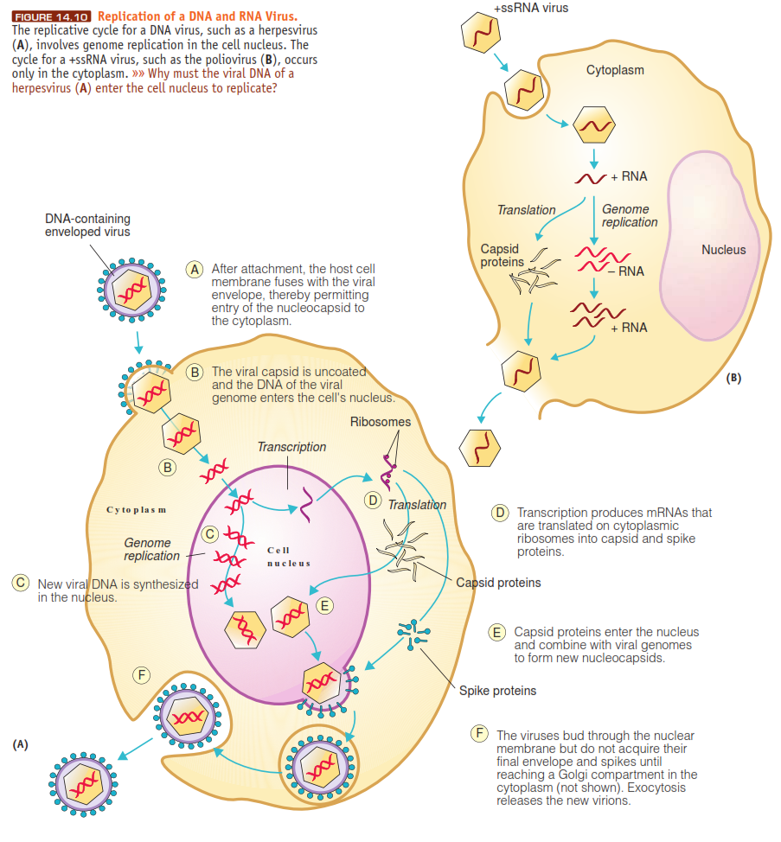
Productive Infection

Slide 32
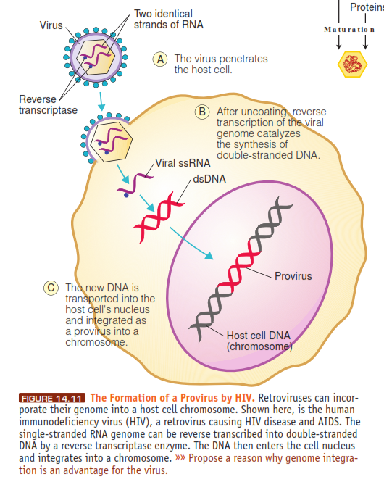
Latent Infection

Slide 33
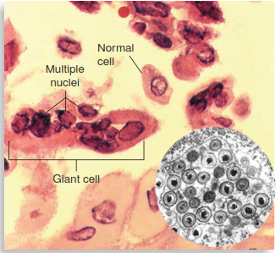
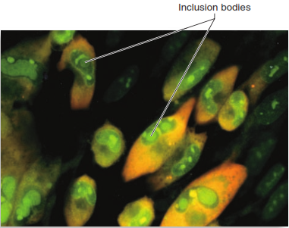
Damage to the Host cells
Cytopathic effect (CPE): Defined as virus-induced damage to the cell that alters its microscopic appearance.
Syncytia: One very common CPE is the fusion of multiple host cells into single large cells containing multiple nuclei. (RSV, respiratory syncytial virus)

Slide 34
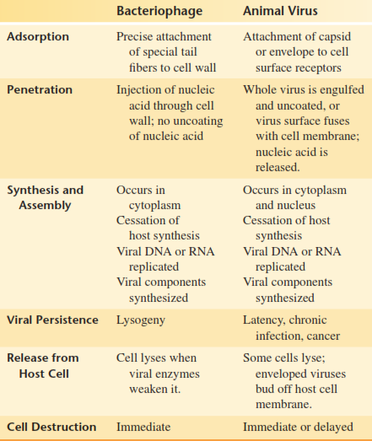
Comparison of Bacteriophage & Animal Virus Multiplication

Slide 35
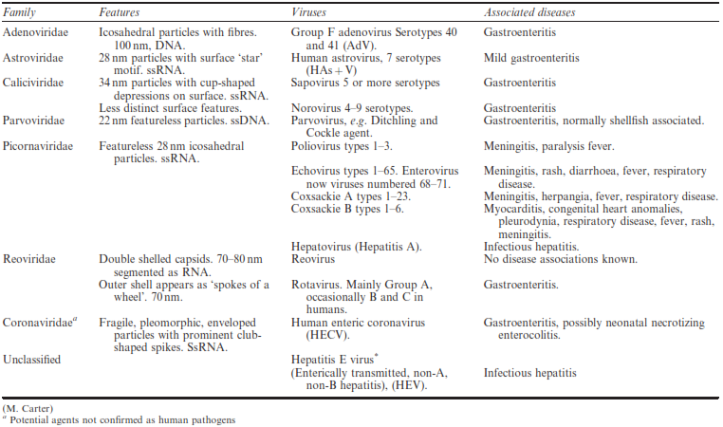
Human Enteric Viruses

