Slide 1
8085 Microprocessor Architecture & Pin configuration
MCA 1ST YEAR 2ND SEMESTER
Paper No. MCA-203
Paper name: Microprocessor
Dr. Utpal Nandi
Dept. of Computer Science
VIDYASAGAR UNIVERSITY

Slide 2
8085 Microprocessor Architecture & Pin configuration
Pin configuration of 8085
Limitations of 8085
MPU Communication
Internal Architecture of 8085
8085Single board Microcomputer System

Slide 3
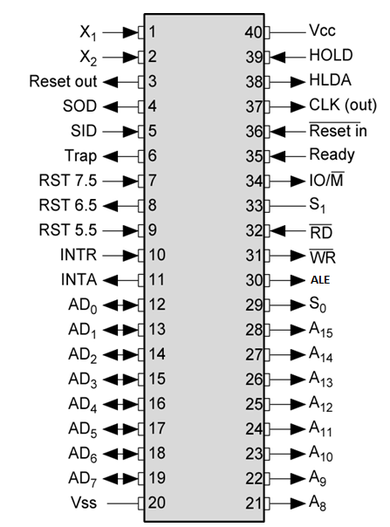
Pin configuration of 8085
8-bit general purpose μp
Capable of addressing 64 k of memory
Has 40 pins
Requires +5 v power supply
Can operate with 3 MHz clock

Slide 4
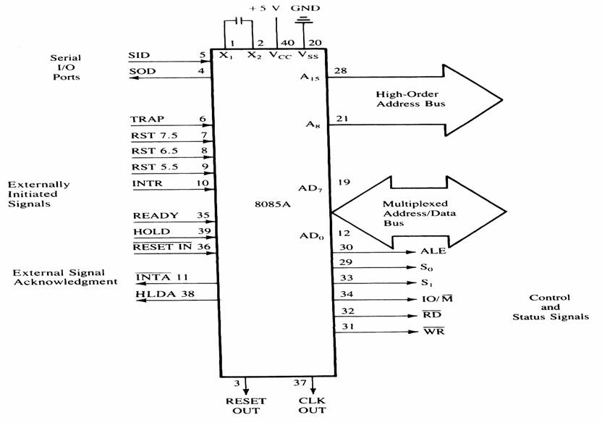
Pin configuration of 8085
All the signals can be classified into
Six groups –
Address Bus
Data Bus
Control & Status signals
Power signal & frequency signals
Externally initiated signals
Serial I/O ports

Slide 5
Address & data bus
8085 μp consists of 16 signal pins use as address bus.
Divide into 2 part: A15 – A8 (upper)
AD7 – AD0 (lower).
A15 – A8 : Unidirectional, known as ‘high order address’.
AD7 – AD0 : bidirectional and dual purpose (address and data placed
once at a time).
AD7 – AD0 also known as ‘low order address’.
To execute an instruction, at early stage AD7 – AD0 uses as address bus and alternately as data bus for the next cycle.
The method to change from address bus to data bus known as ‘bus multiplexing’.

Slide 6
Control & Status signals
This group of signal includes-
Two control signals (RD’ & WR’)
Three status signals (IO/M’ , S1 & S0)
One special signal (ALE)
RD’ – Read (active low). To indicate that the I/O or memory selected is to be read and data are available on the bus.
WR’ – Write (Active low). This is to indicate that the data available on the bus are to be written to memory or I/O ports.
IO/M’ – To differentiate I/O operation or memory operations.
‘0’ - indicates a memory operation.
‘1’-indicates an I/O operation.
IO/M’ combined with RD and WR to generate I/O and memory control signals.

Slide 7
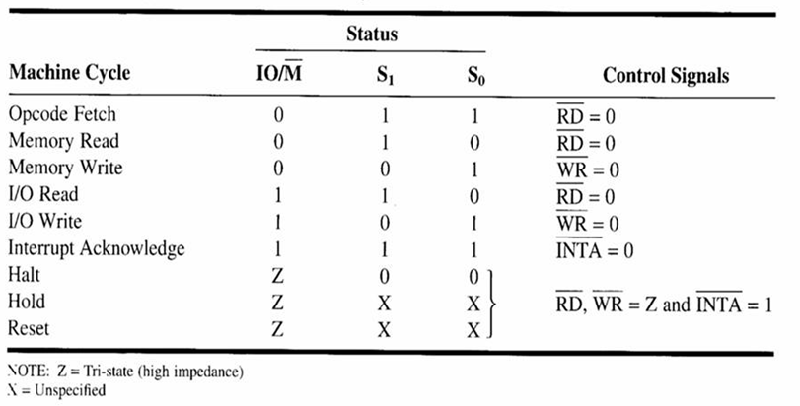
Control and Status Signals.
S1 and S0: Status signals, similar to IO/M, can identify various
operations as shown on the following table :

Slide 8
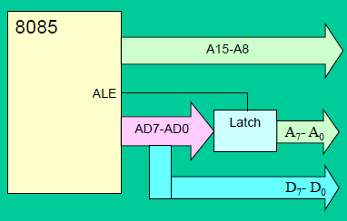
Control & Status signals
ALE (Address Latch Enable) signal :
ALE used to de-multiplex address/data bus
Active high signal - generated to show the start of 8085 operation.
When transition 1-to-0: indicate that lines AD7-AD0
(AD7-AD0 = A7-A0) act as address lines.

Slide 9
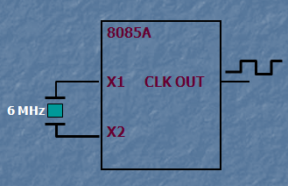
Power signal & frequency signals
Vcc : +5 V power supply
Vss : Ground reference
X1 & X2 : A crystal is connected at these two pins. The frequency is divided by two.
Therefore, to operate a system at 3 MHz, the crystal should have a frequency of 6 MHz.
CLK OUT : This signal is used as the system clock for other devices.

Slide 10
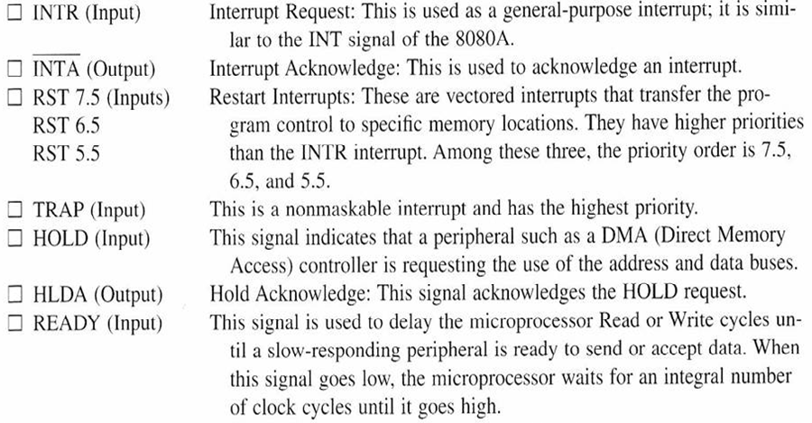
Externally initiated Signals including Interrupt

Slide 11
Externally initiated Signals including Interrupt
An interrupt is a hardware-initiated subroutine CALL.
When interrupt pin is activated, an ISR will be called, interrupting the program that is currently executing.
Pin | Subroutine Location
TRAP | 0024
RST 5.5 | 002C
RST 6.5 | 0034
RST 7.5 | 003C
INTR | *
Note: * the address of the ISR is determined by the external hardware.

Slide 12
Externally initiated Signals including Interrupt
INTR input is enabled when EI instruction is executed.
The status of the RST 7.5, RST 6.5 and RST 5.5 pins are determined by both EI instruction and the condition of the mask bits in the interrupt mask register.

Slide 13
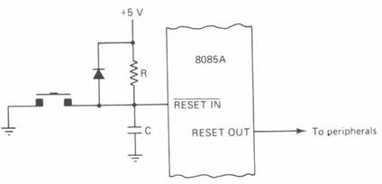
Externally initiated Signals including Interrupt
RESET IN’ : When the signal on this pin goes low,
the program counter is set to zero.
the buses are tri-sated.
MPU is reset.
RESET OUT : This signal is used to reset other
devices.

Slide 14
Serial I/O ports
The 8085 has two signals to implement the
serial transmission:
SID: Serial Input Data
SOD: Serial Output Data

Slide 15
Limitations of 8085
The low order address bus is multiplexed with the data bus. The buses need to be de-multiplexed.
Appropriate control signals need to be generated to interface memory and I/O with the 8085.

Slide 16
Generating Control Signals

Slide 17
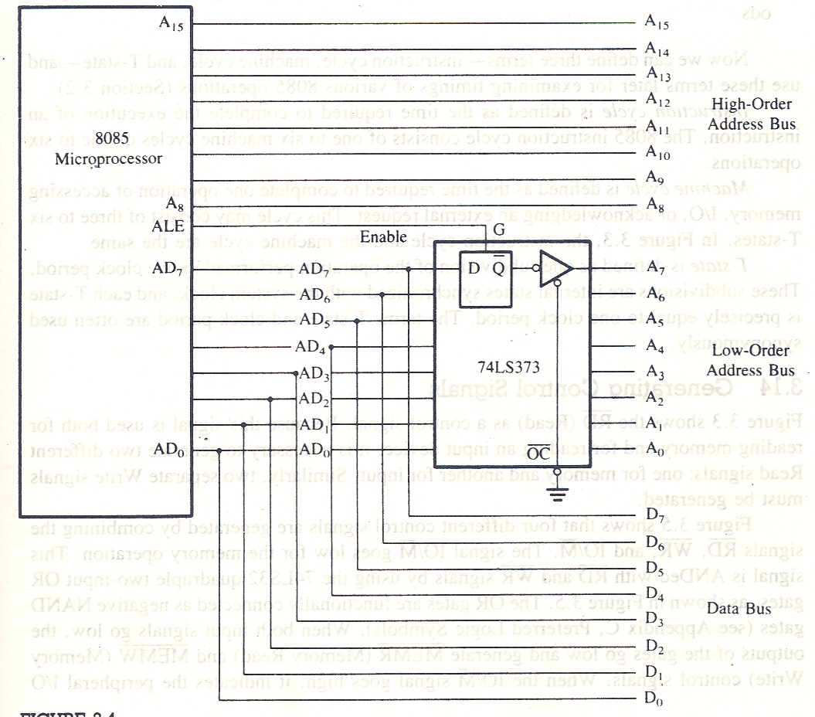
De-multiplexing Address/Data Lines
Mr. Utpal Nandi, Dept. of Computer Science, Vidyasagar University

Slide 18
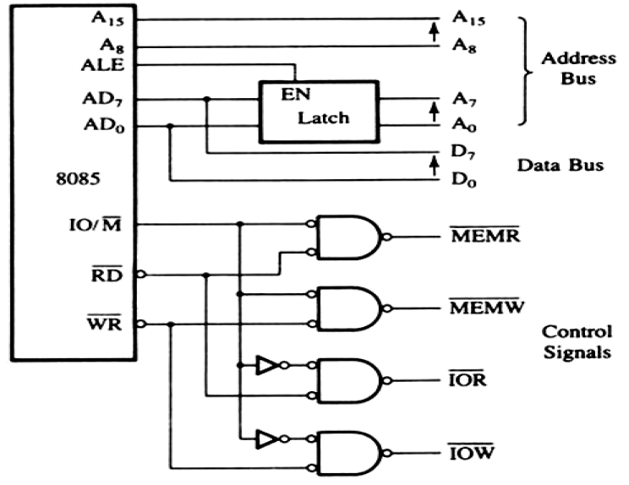
De-multiplexed Address & Data bus with Control Signals

Slide 19
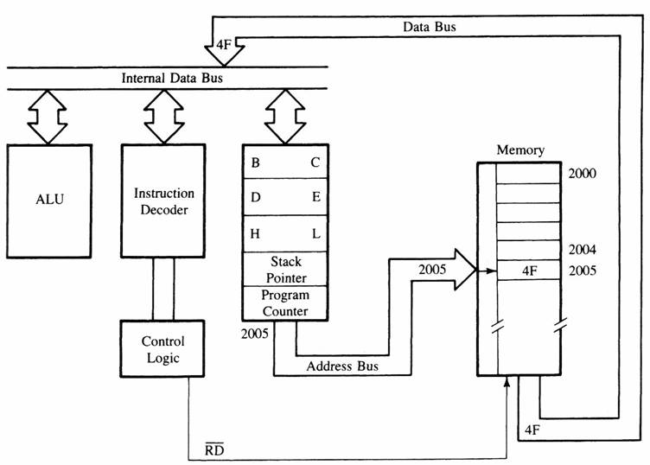
MPU Communication
Figure : Moving data form memory to MPU using instruction MOV C, A (code machine 4FH = 0100 1111)

Slide 20
MPU Communication
The μp placed a 16 bit memory address from PC (program counter) to address bus.
The high order address, 20H, is placed at A15 – A8.
the low order address, 05H, is placed at AD7 - AD0 and ALE is active high.
Synchronously the IO/M is in active low condition to show it is a memory operation.
Then, active low control signal, RD, is activated so as to activate read operation; it is to indicate that the MPU is in fetch mode operation.

Slide 21
MPU Communication
The active low RD signal enabled the byte instruction, 4FH, to be placed on AD7 – AD0 and transferred to the MPU. While RD high, the data bus will be in high impedance mode.
The machine code, 4FH, will then be decoded in instruction decoder. The content of accumulator (A) will then copied into C register.

Slide 22
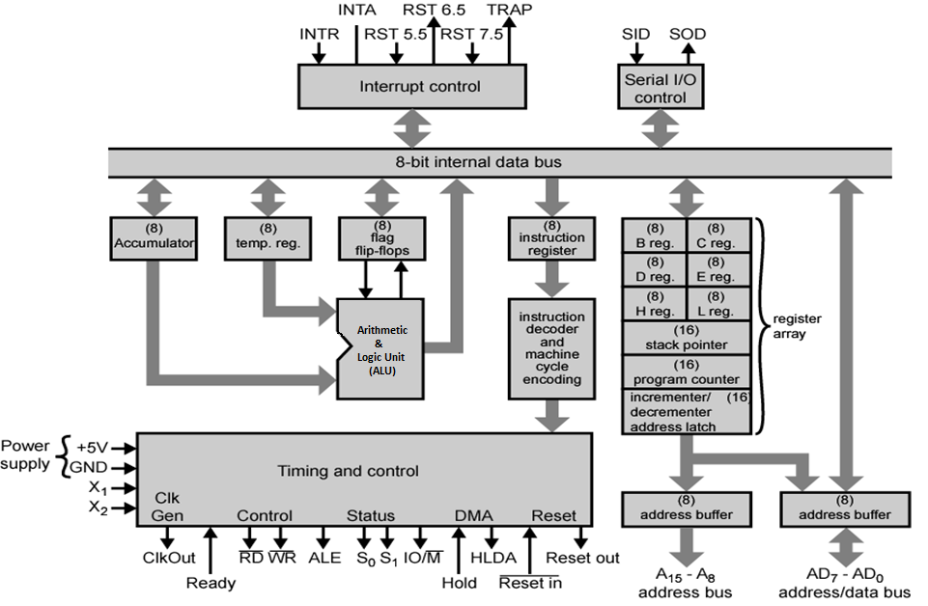
Internal Architecture of 8085

Slide 23
Internal Architecture of 8085
It includes-
ALU
Timing & Control Unit
Instruction Register and Decoder
Register Array
Interrupt Control
Serial I/O Control

Slide 24
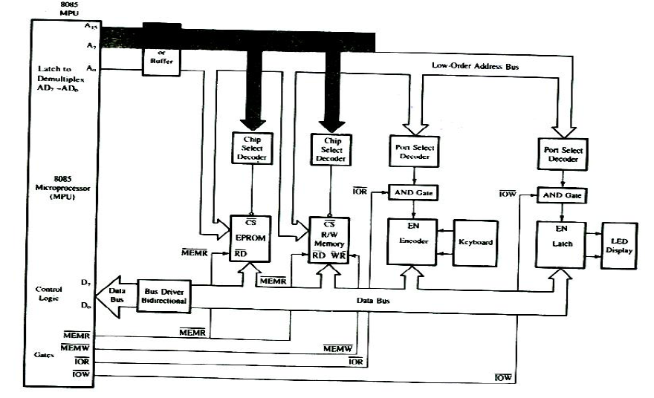
8085Single board Microcomputer System

Slide 25
END

