Slide 1
Microbiology 2nd Sem MCB 203B
2. Basic Local Alignment Sequence Tool (BLAST)
Dr. Nandini Ghosh

Slide 2
BLAST
BLAST (Basic Local Alignment Search Tool) allows rapid sequence comparison of a query sequence against a database.
The BLAST algorithm is fast, accurate, and accessible both via the web and the command line.

Slide 3
Why use BLAST?
BLAST searching is fundamental to understanding
the relatedness of any favorite query sequence
to other known proteins or DNA sequences.
Applications include
identifying orthologs and paralogs
discovering new genes or proteins
discovering variants of genes or proteins
investigating expressed sequence tags (ESTs)
exploring protein structure and function

Slide 4
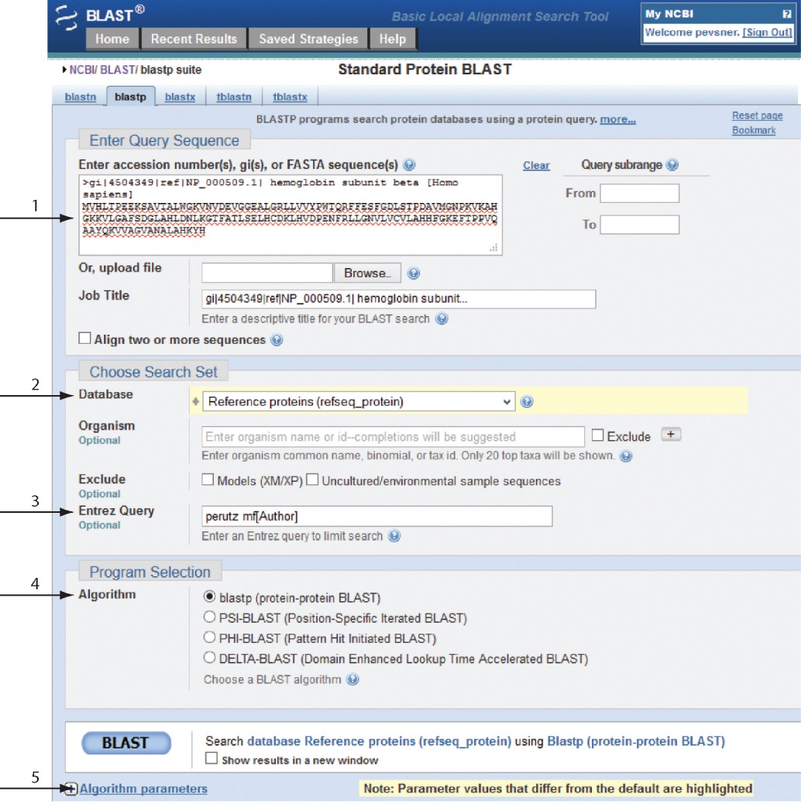
BLASTP search at NCBI: overview of web-based search
query: FASTA format or accession
database
Entrez query
algorithm
parameters

Slide 5
Entrez Query

Slide 7
BLAST Searching steps
Step 1: Choose your sequence
Sequence can be input in FASTA format or as accession number

Slide 8
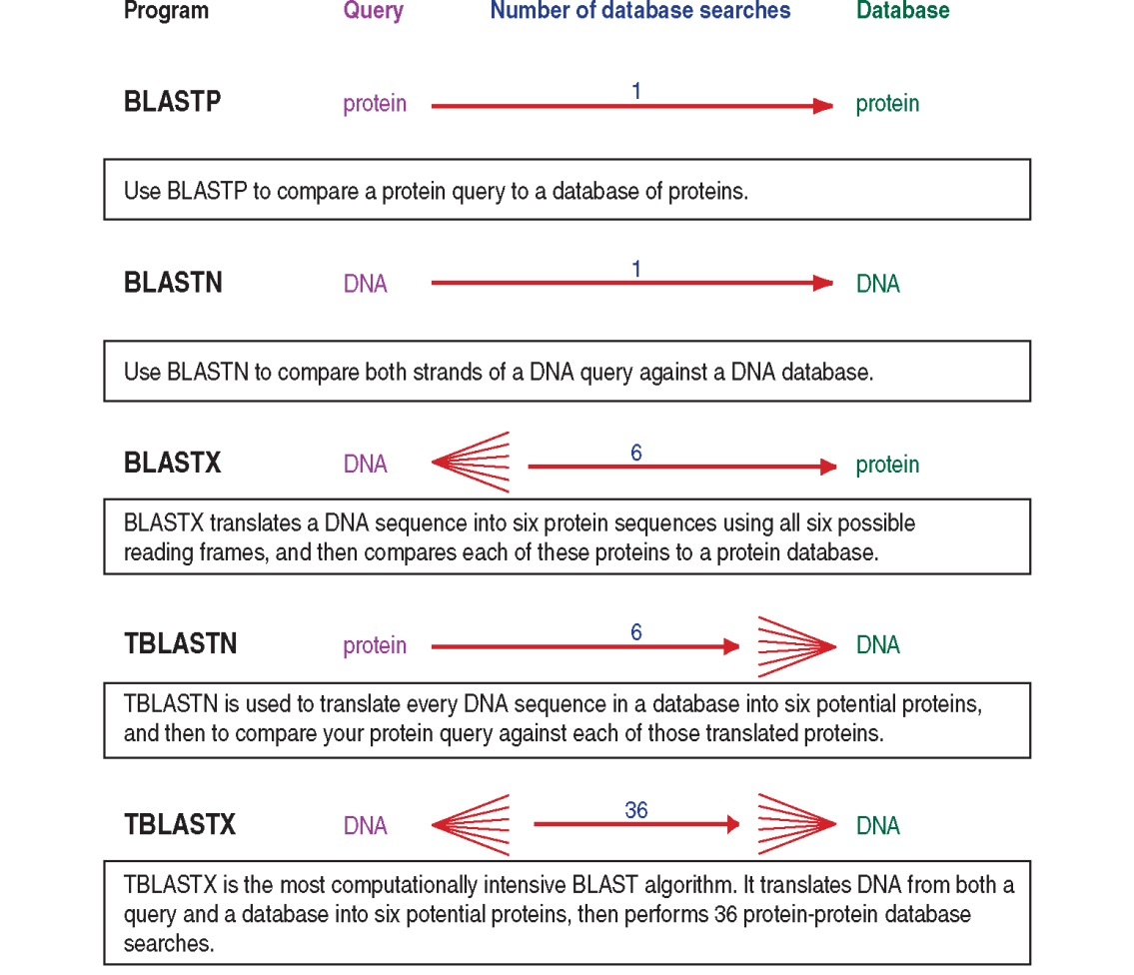
BLAST step 2: choose program

Slide 9
Step 2. Choose the BLAST program
Program Input Database
1
blastn DNA DNA
1
blastp protein protein
6
blastx DNA protein
6
tblastn protein DNA
36
tblastx DNA DNA

Slide 10
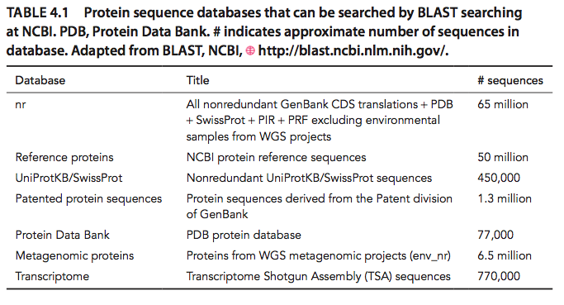
Step 3: choose a database to search (protein databases)

Slide 11
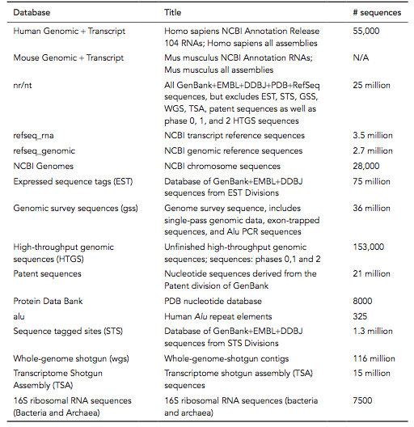
Step 3: choose a database to search (nucleotide)

Slide 12
Step 4: optional parameters
You can...
• choose the organism to search
• turn filtering on/off
• change the substitution matrix
• change the expect (e) value
• change the word size
• change the output format
Example: BLASTP human insulin (NP_000198) against a C. elegans RefSeq database. Varying some parameters (filtering, compositional adjustments) can greatly affect the alignment itself.

Slide 13
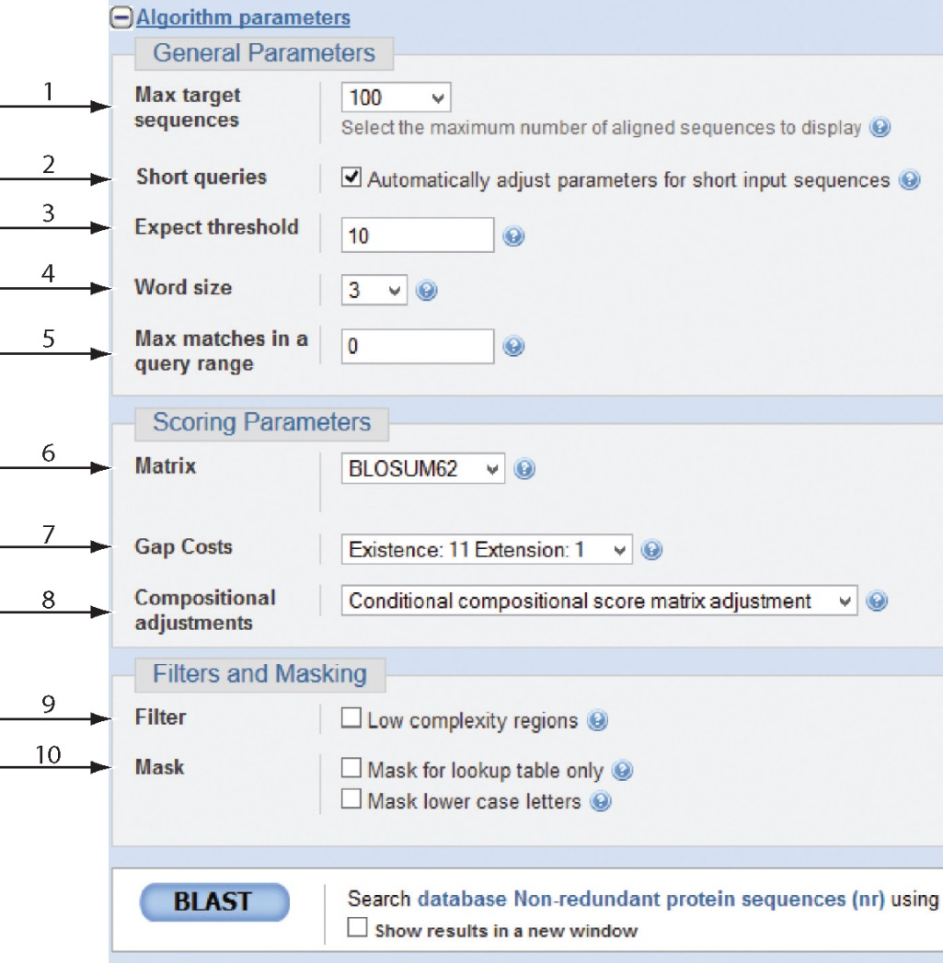
Step 4a: choose optional BLASTP search parameters
max sequences
short queries
expect threshold
word size
max matches
scoring matrix
gap costs
compositional adjustment
filter
mask
B&FG 3e
Fig. 4-4
Page 128

Slide 14
Expect value (E)
The Expect value (E) is a parameter that describes the number of hits one can "expect" to see by chance when searching a database of a particular size. It decreases exponentially as the Score (S) of the match increases.
Essentially, the E value describes the random background noise.
For example, an E value of 1 assigned to a hit can be interpreted as meaning that in a database of the current size one might expect to see 1 match with a similar score simply by chance.
The lower the E-value, or the closer it is to zero, the more "significant" the match is.

Slide 15
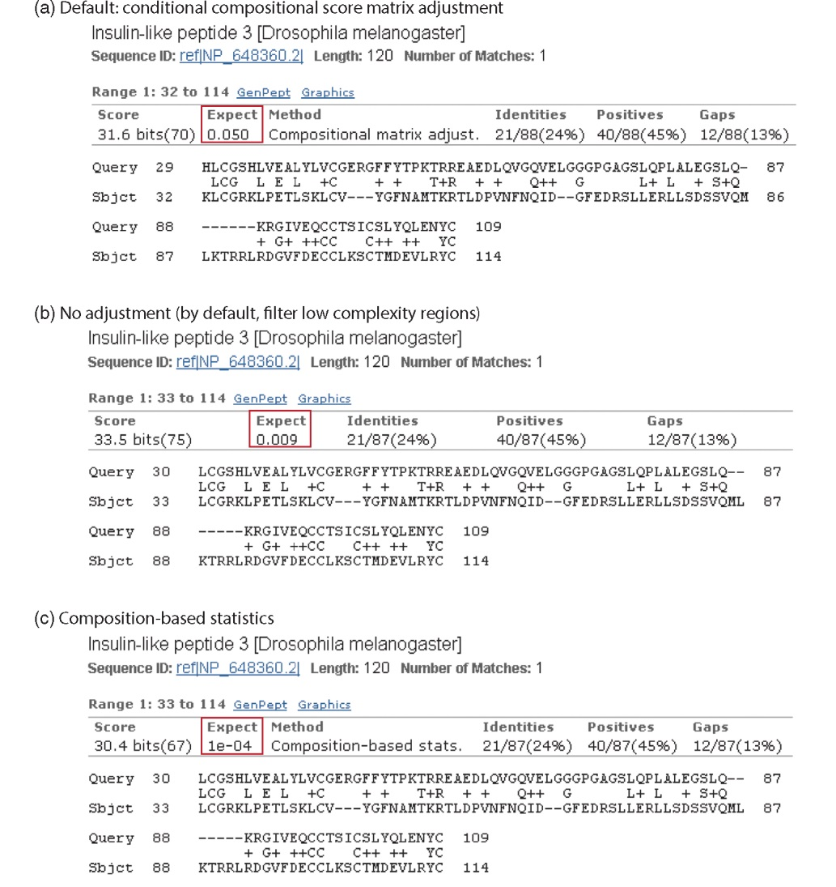
Step 4a: compositional adjustment influences score, expect value search results
expect = 0.05
Default: conditional compositional score matrix adjustment
expect = 0.09
no adjustment
expect = 1e-04
B&FG 3e
Fig. 4-5
Page 129
composition-based statistics

Slide 16
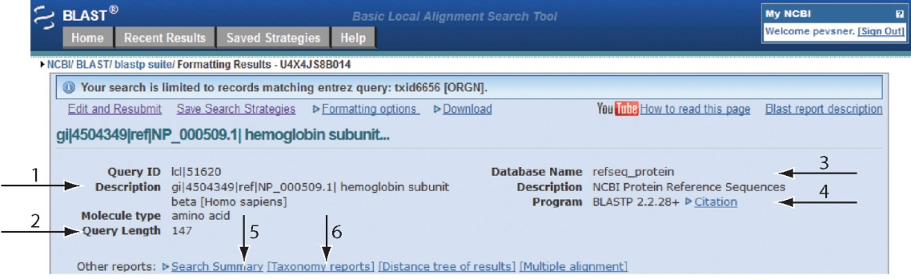
Step 4b: formatting options
The top of the BLAST output summarizes the query, database, and BLAST algorithm.
Click to access a summary of the search parameters or a taxonomic report.
B&FG 3e
Fig. 4-6
Page 132

Slide 17
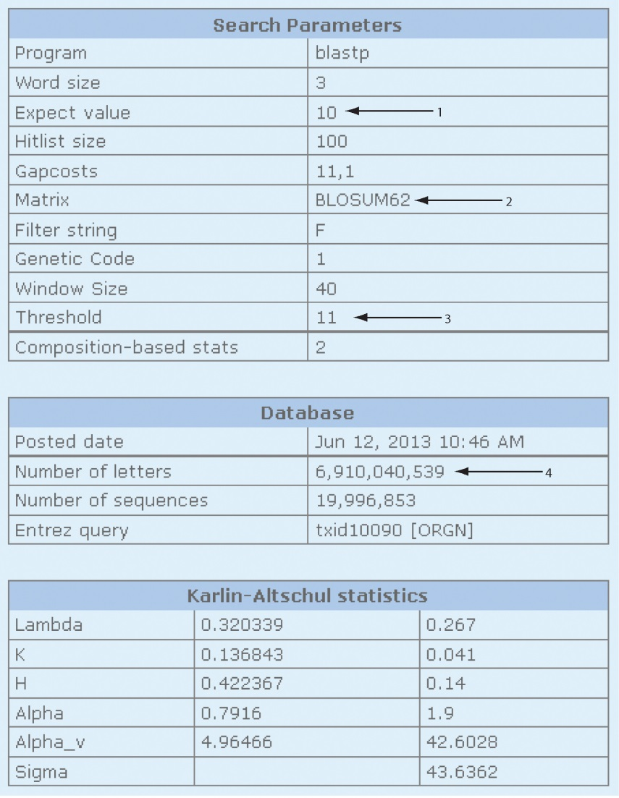
Step 4b: formatting options (you can view search parameters)
Expect value
BLOSUM62 matrix
Threshold value T
Size of database
B&FG 3e
Fig. 4-7
Page 133

Slide 18
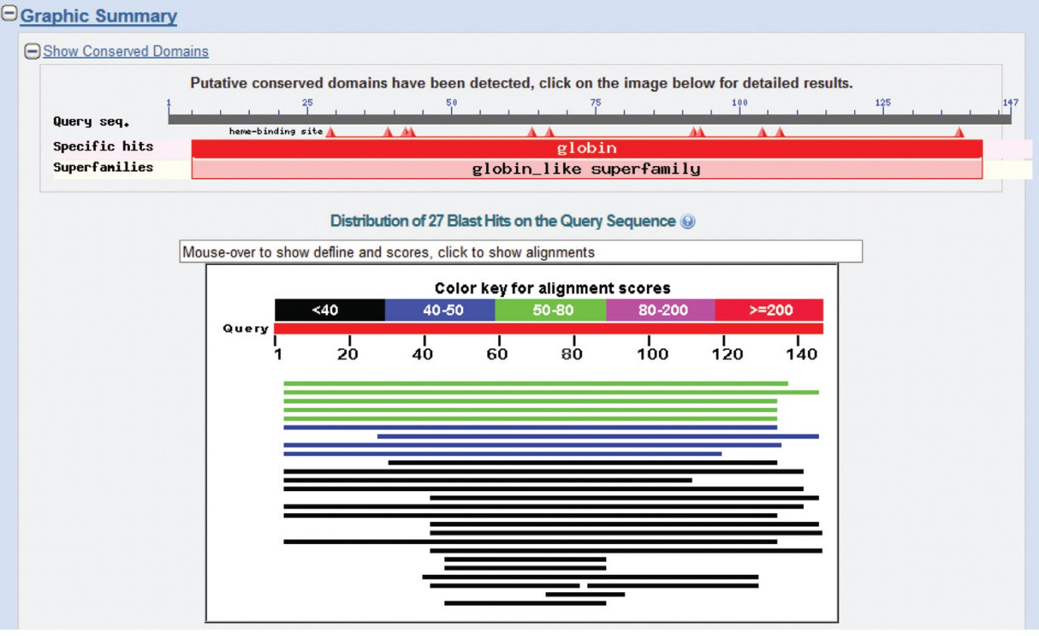
Step 4b: formatting options
Graphic summary of the results shows the alignment scores (coded by color) and the length of the alignment (given by the length of the horizontal bars)
B&FG 3e
Fig. 4-8
Page 134

Slide 19
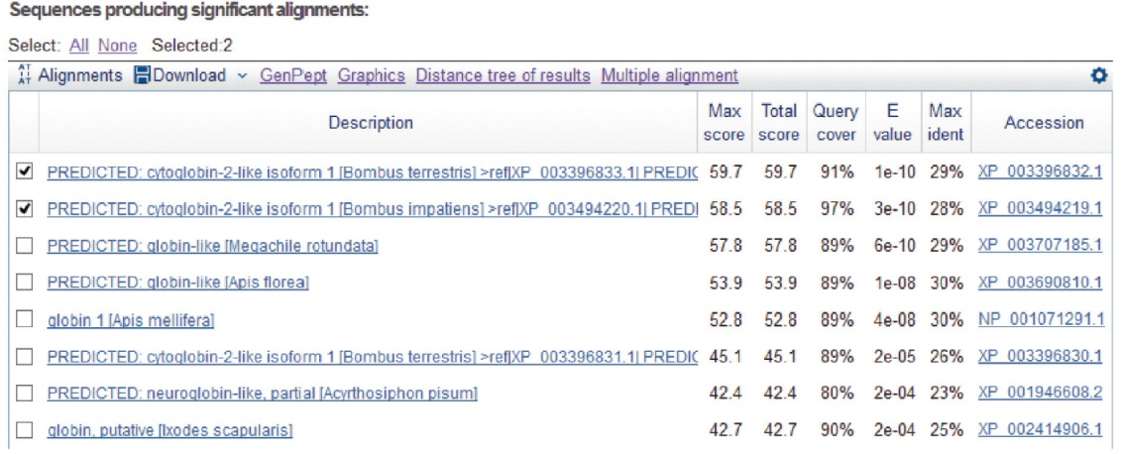
BLASTP output includes list of matches; links to the NCBI protein entry; bit score and E value; and download options
B&FG 3e
Fig. 4-9
Page 134

Slide 20
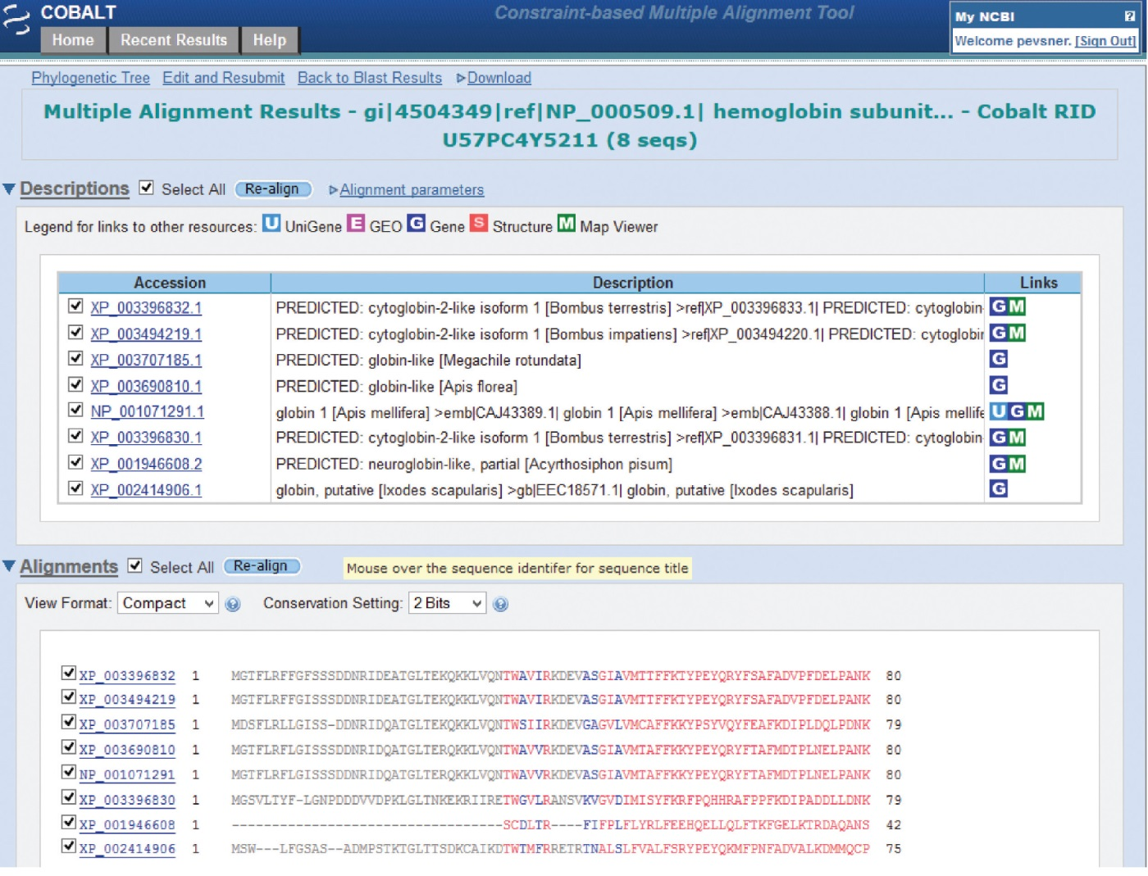
BLAST output can be formatted to display multiple alignment
B&FG 3e
Fig. 4-10
Page 135

Slide 21
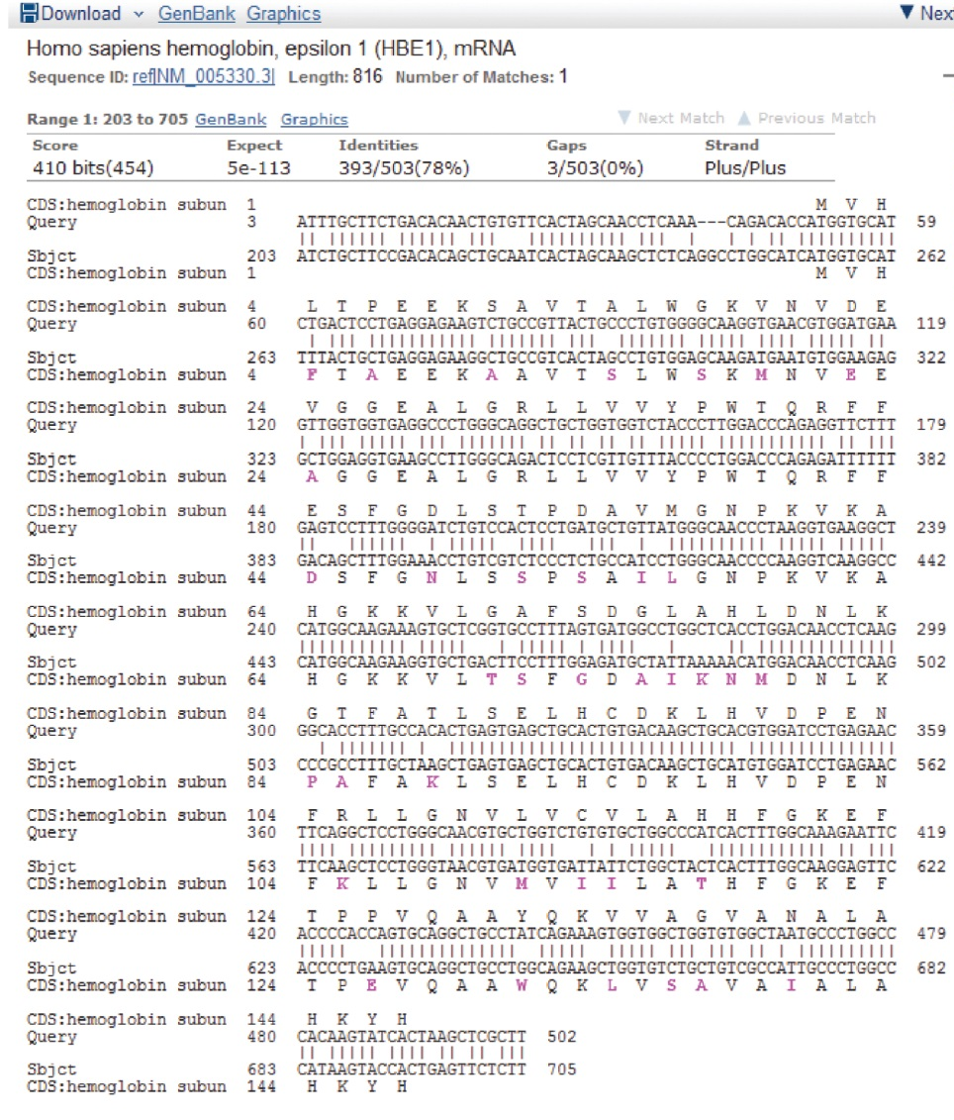
For BLASTN, CDS output displays amino acids above DNA sequence of query and subject
B&FG 3e
Fig. 4-11
Page 136

Slide 22
Command-line BLAST+
Visit the BLAST site at NCBI (“help” tab) to find the URL for the BLAST+ download.
Three steps:
Obtain a protein database (we’ll use a perl script included in the BLAST+ installation);
Obtain a query protein (we’ll use EDirect);
Perform the search
B&FG 3e
Page 137

Slide 23
Command-line BLAST+ (Step 1: obtain a database)
Visit the BLAST site at NCBI (“help” tab) to find the URL for the BLAST+ download.
B&FG 3e
Page 137

Slide 24
Command-line BLAST+ (Step 2: obtain a query protein)
Use EDirect to obtain a globin protein.
B&FG 3e
Page 137

Slide 25
Command-line BLAST+ (Step 3: perform a search!)
Do the search:
View the results:
Try repeating the search, e.g. changing the database size:
B&FG 3e
Page 137

Slide 26
How a BLAST search works
“The central idea of the BLAST
algorithm is to confine attention
to segment pairs that contain a
word pair of length w with a score
of at least T.”
Altschul et al. (1990)

Slide 27
How the original BLAST algorithm works:
three phases
Phase 1: compile a list of word pairs (w=3)
above threshold T
Example: for a human RBP query
…FSGTWYA… (query word is in green)
A list of words (w=3) is:
FSG SGT GTW TWY WYA
YSG TGT ATW SWY WFA
FTG SVT GSW TWF WYS
...

Slide 28
Phase 1: compile a list of words (w=3)
GTW 6,5,11 22
neighborhood GSW 6,1,11 18
word hits ATW 0,5,11 16
> threshold NTW 0,5,11 16
GTY 6,5,2 13
GNW 10
neighborhood GAW 9
word hits
< below threshold
(T=11)
Fig. 4.11
page 116

Slide 29
B&FG 3e
Fig. 4-12
Page 139

Slide 30
Phase 2: scan the database for matches and extend
B&FG 3e
Fig. 4-12
Page 139

Slide 31
Phase 3: Traceback to generate gapped alignment
B&FG 3e
Fig. 4-12
Page 139

Slide 32
How a BLAST search works: threshold
You can locally install BLAST and modify the threshold parameter.
The default value for BLASTP is 11.
To change it, enter “-f 16” or “-f 5” in the
advanced options of BLAST+.

Slide 33
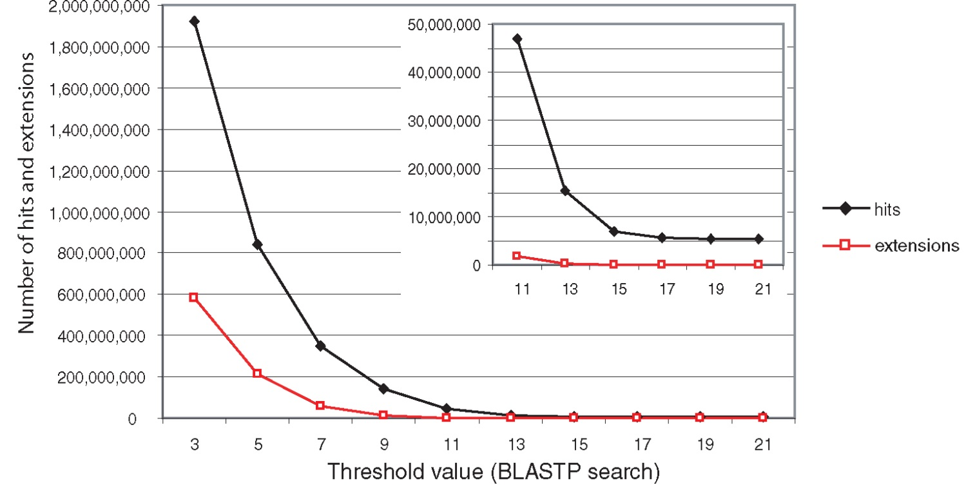
Effect of changing the threshold T: Lower T yields more database hits (black line) and extensions (red)

Slide 34
For BLASTN, the word size is typically 7, 11, or 15 (EXACT match). Changing word size is like changing threshold of proteins. w=15 gives fewer matches and is faster than w=11 or w=7.

Slide 35
How to interpret a BLAST search: expect value
It is important to assess the statistical significance
of search results.
For global alignments, the statistics are poorly understood.
For local alignments (including BLAST search results),
the statistics are well understood. The scores follow
an extreme value distribution (EVD) rather than a
normal distribution.

Slide 36
Normal distribution
0.40
0.35
0.30
0.25
normal
distribution
probability
0.20
0.15
0.10
0.05
0
-5
-4
-3
-2
-1
0
1
2
3
4
x

Slide 37
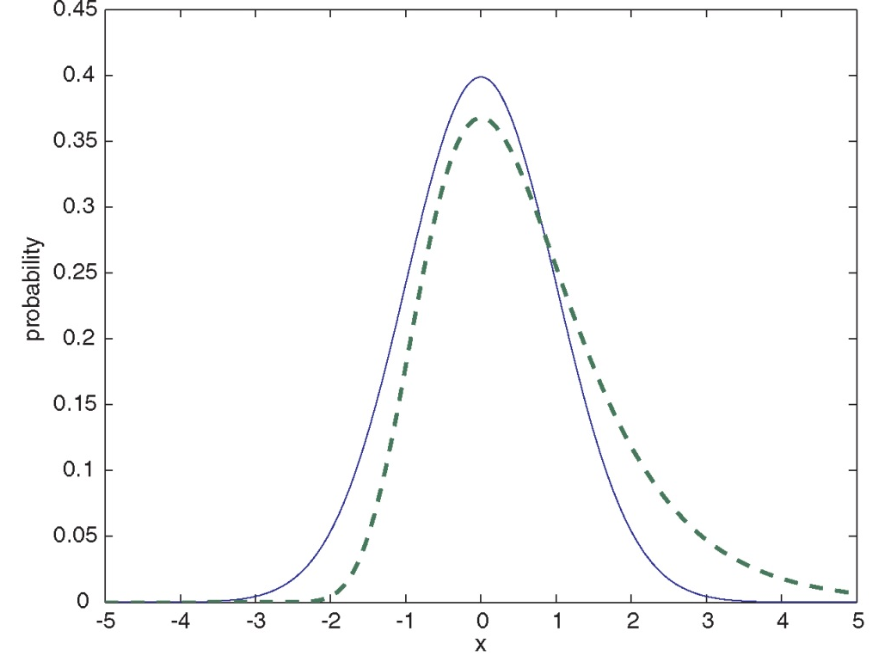
Normal distribution (solid line) compared to extreme value distribution (dashed line): note EVD skewing to the right

Slide 38
How to interpret a BLAST search: expect value
The expect value E is the number of alignments
with scores greater than or equal to score S
that are expected to occur by chance in a
database search.
An E value is related to a probability value p.
The key equation describing an E value is:
E = Kmn e^{-λS}

Slide 39
E = Kmn e^{-λS}
This equation is derived from a description
of the extreme value distribution
S = the score
E = the expect value = the number of high-
scoring segment pairs (HSPs) expected
to occur with a score of at least S
m, n = the length of two sequences
λ, K = Karlin Altschul statistics

Slide 40
“Find-a-gene project” to practice BLAST
Start with the sequence of a known protein
TBLASTN
Inspect the output
BLASTX nr
or
BLASTP nr

Slide 41
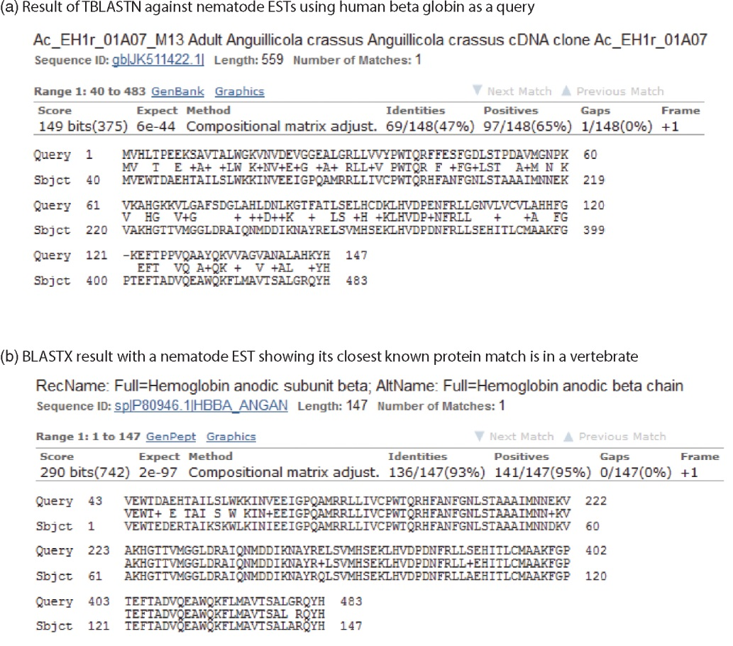
“Find-a-gene project” example: novel globin
Query: NP_000509 Program: TBLASTN
Database: EST (nematodes) Match: novel globin
Confirmation
Query: nematode EST Program: BLASTX Best match: a globin, but not a previously annotated globin
B&FG 3e
Fig. 4-24
Page 158

Slide 42
“Find-a-gene project”
The find-a-gene project is meant to be a very focused, specific project to help you understand how to use various BLAST tools (e.g. TBLASTN, BLASTX, BLASTP) and various databases.
You can start with (almost) any protein, from the organism of your choice, and discover a “novel” gene in another organism that is homologous but has never been annotated before as related to your query. Therefore you are discovering a new gene.
You can take your new gene/protein, name it, then search it against databases to confirm it has not been described before.
You can further perform multiple sequence alignment and predict its protein structure and its function

