Slide 1
Urbanisation
India is witnessing an increased pace of urbanization. Despite its population being predominantly rural, it is emerging as one of the fastest urbanizing countries. It is the second largest urban system in the world with an urban population of about 340 million and 35 metros. Cities are emerging as the engines of national economy and generators of wealth. Cities are the centers of technology, innovation, creativity and economic growth and employment, reservoirs of skills, knowledge and hope for migrants from rural areas.

Slide 2
Census broadly defines urban areas as follows:
All statutory places with a municipality, corporation, cantonment board, or notified area committee,
A place satisfying the following three criteria simultaneously:
1) a minimum population of 5,000;
2) at least 75 per cent male working population engaged in non-agricultural pursuits; and
3) a density of population of at least 400 persons per sq. km.
Others which do not satisfy the above criterion are also classified as urban, if they have distinct urban characteristics such as major project colonies, areas of intensive industrial development, railway colonies, university campus, important tourist centers,
etc.

Slide 3
The urban population increased from 26 million in 1901 to 285 million in 2001
10 per cent to 28 per cent during the same period India’s urbanization presents a contrasting picture – a large urban population with low urbanization. The annual exponential growth rate of urban population and rate of urbanization shows that urban population of India grew by less than 1 per cent per annum up to 1921, 3.5 per cent per annum during 1941- 51, peaked up at 3.8 per cent per annum during 1971-81 and decelerated during 1981-2001. The trend in the rate of urbanization also remained fluctuating. The number of urban centers increased from 3,126 in 1971 to 5,161 by 2001.

Slide 4
Components of Urban Growth
There are four components of urban population growth - natural increase or organic growth, rural to urban migration, reclassification, and boundary changes of the existing urban centers.

Slide 5
Indian census classifies urban centers into six categories based on population ranges as given below:
Class I cities : 100,000 or more
Class II towns : 50,000-99,999
Class III towns : 20,000-49,999
Class IV towns : 10,000-19,999
Class V towns : 5,000-9,999
Class VI towns : population < 5,000
There has been a steady increase in the population of Class I cities and a steady decline in the population of Class, IV, V and VI towns over the decades. The population of Class I cities, which constituted 26.28% in 1901 increased to 68.62% by 2001 and the population of Class VI towns declined from 6.07% to 0.23% during the same period.

Slide 7
Projections indicate that by 2030 that India’s urban population will be 575 million
constituting over 40% of total population

Slide 8
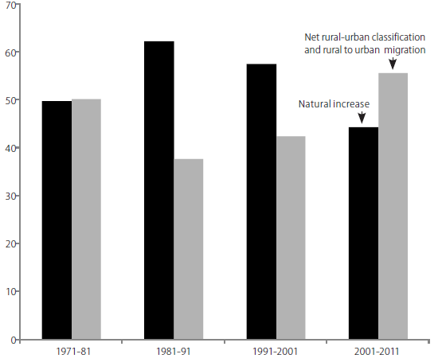
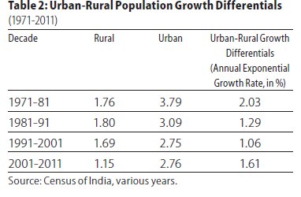

Slide 9
Awakening (2010) a McKinsey report projected that by 2030 five states viz., Gujarat, Karnataka, Maharashtra, Punjab and Tamil Nadu will have more than 50% urban
population and 13 cities will have more than 4 million population each. Six cities viz., Delhi, Mumbai, Bangalore, Chennai, Kolkata and Pune will have more than ten million population each

Slide 10
Rapid economic activity - urban growth running faster than solutions can catch up and there is very little reliable data being generated to track this
Multiplicity of agencies with multiple institutional jurisdictions like basic services with ULB and PDS /housing with other state departments
Weak administrative systems and human resources with minimal training, poorly designed cadre and recruitment rules
Inadequate or dysfunctional internal systems – finance, land records, etc.

Slide 11
Mismatch between emerging problems and the available new skills; PPPs, outsourcing, use complex contracts, etc.,
Urbanisation of poverty, land rights, permanent and seasonal migration, problems in beneficiary identification under different schemes;
Increased financial requirements for provision of basic minimum urban infrastructure – for 63cities,
Rural-urban issues, peri-urban growth, extension of services to these areas, etc

Slide 12
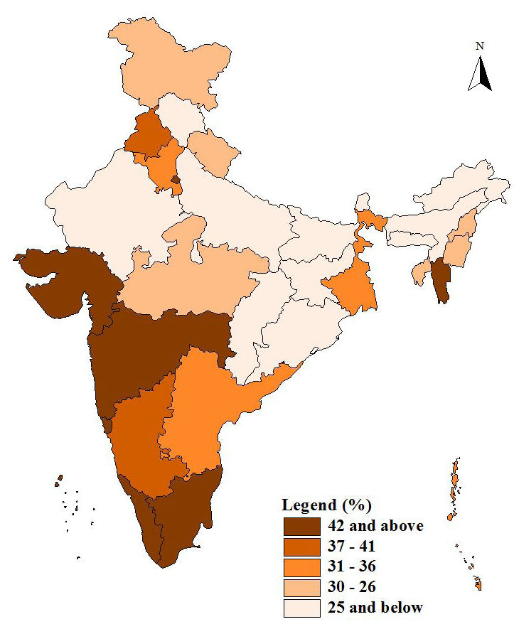
Levels of Urbanisation, India (2011)

Slide 13
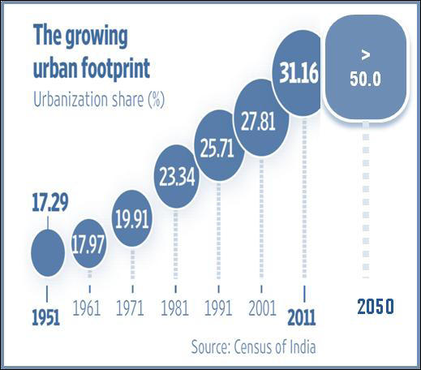
Urban Growth
Urban population likely to increase from present 377 million to 600 million by 2030 & 900 million by 2050 53 Million Plus cities
Urban cities and towns have increased from 5,161 in 2001 to 7,935 in 2011

Slide 14
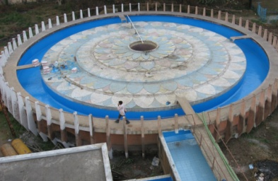
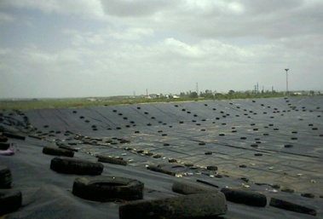
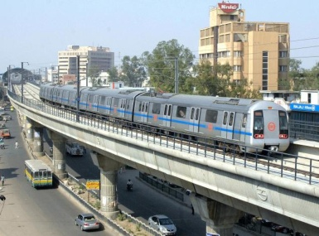
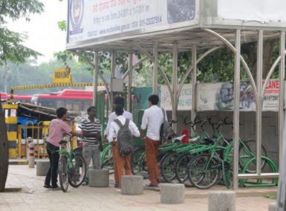
Status of Urban Services in India
Drinking Water availability within the premises is 71.2%;
Only 32.7% of the urban population has access to piped sewer system; and
Waste collection efficiency ranges between 70% and 90% in major Metro cities.
Public Transport | City (Operational/under Implementation)
Organized City Bus | More than 65 cities , >15000buses sanctioned in 2009.
BRTS | Ahmedabad, Delhi, Indore, Bhopal, Jaipur, Vijayawada, Visakhapatnam, Rajkot, Surat, Hubli Dharwad, Naya Raipur
MRTS | Delhi, Kolkata, Bangalore*, Chennai*, Hyderabad*, Jaipur*, Mumbai*
Source: Census 2011,India

Slide 15
JnNURM at a Glance
Duration
From 2005-06 to 2011-12, extended up to March 2014 for completion of ongoing projects and achievement of reforms
Central Allocation
INR 42,900 crore (USD 7.15 Billion)*
Projects
1564 Sanctioned
634 Completed
78% achievement of 23 reforms implemented
Reforms
Around 765 Cities/Towns
Coverage
INR 80,725 crore (USD 13.4 Billion)*
Infra. Investment
*$=60 INR

Slide 16
Sector wise JnNURM Projects at a Glance
Sectors | UIG |  | UIDSSMT
 | Number of Projects | Approved Cost (Amount Rs. In Crore) | Number of Projects | Approved Cost (Amount Rs. In Crore)
Water Supply | 182 | 22,330 | 526 | 11,110
Sewerage | 116 | 15,269 | 109 | 3,960
Drainage | 76 | 8,601 | 72 | 985
Solid Waste Management | 44 | 1,923 | 63 | 413
Roads & Flyovers | 100 | 8,082 | 184 | 1,717
MRTS | 23 | 5,408 | - | -
Buses & Ancillary Infrastructure | 65 Mission Cities (18323 Buses) | 7,585 | 70 Cities (4038 Buses) | 1742
Others | 43 | 2,458 | 26 | 118
Total | 584 | 71,656 | 980 | 20,045

Slide 17
Sector wise % of funds sanctioned under UIG

Slide 18
Sector wise % of funds sanctioned under UIDSSMT

Slide 19
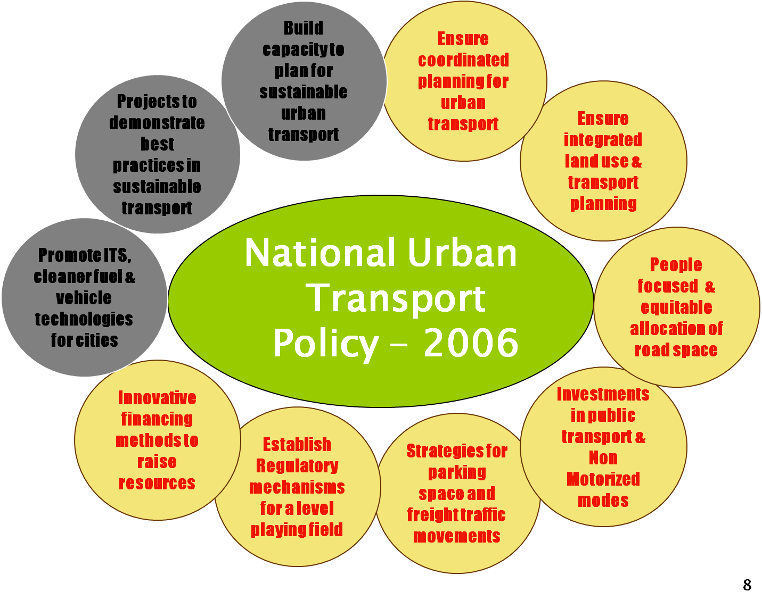
National Urban Transport Policy-2006

Slide 20
India - Urban Transportation Scene
Trip Rates are high (1.2/ person) and increasing (2/per capita)
Motorization rates are high and rapid
High number of two wheelers and bicycle fleet
In 2006 organised city bus service existed in only 20 cities
Poor Air Quality- GHG Emissions
Road fatalities are very high
Pedestrians and cyclists not included in planning and implementation
Basic facilities are missing (No paved roads/no drainage)
In smaller cities, 3-Wheelers, Bicycles and walking are major modes

Slide 21
BUS funding Scheme – overview
Launched in 2009 for 65 cities
Number of cities benefited: 63
15260 buses sanctioned, around 14400 purchased
Total project sanctioned :Rs. 4724 cr.
Number of city specific SPVs formed: 28
Dedicated Urban Transport Funds created: 17
Unified Metropolitan Transport Authority (UMTA) formed: 16

Slide 22
Metro Rail Projects in India
Total about Rs.135000 cr. worth Projects under implementation in 8 cities - Delhi, Mumbai, Jaipur, Kolkata, Bengaluru, Chennai, Hyderabad, Kochi.
Policy to provide Metro in all 2 million plus cities (Total 21 cities).
Metro Rail Projects in pipe line are: Ludhiana, Lucknow, Pune, Nagpur, Chandigarh etc.
DPR under preparation: Bhubaneswar, Guwahati, Bhopal, Nagpur etc.

Slide 23
BRTS Projects
BRTS Projects (10 no.) : Ahmedabad, Bhopal, Indore, Jaipur, Pune-Pimpri-Chinchwad, Rajkot, Surat, Vijaywada, Vishakhapatnam, and Kolkata under the JnNURM
covering a total length of 487.82 km (approx.) at a total estimated cost of Rs. 5211.06 crore.
Ahmedabad phase I & Indore completed
Under SUTP at Hubli Dharwad and Naya Raipur is in progress
Under consideration are Amritsar and Bhubaneswar

