Slide 1
Integrity Constraints

Slide 2
Integrity Constraints
Some rules those govern the databases to be stayed accurate and it can be easily all-time accessible are called integrity constraints.

Slide 3
Example
Two rows of a table are exactly same and while someone tries to access all values of one of rows, a problem will be raised for selecting the particular row of records.
Therefore, a rule should be enforced here that two rows of a table will not be same of a table.

Slide 4
Types of integrity constraints
Key constraint
Attribute constraint
Referential integrity constraint

Slide 5
Key Constraint
Key constraint guarantees the uniqueness of a column or set of columns of a table. It has a unique value for each row of a table and it never holds a null value.
Examples:
Primary key, candidate key, unique key, etc.

Slide 6
Primary Key

Slide 7
Unique Key

Slide 8
Candidate Key
Candidate Key is a column, or set of columns, of a table that uniquely identify a record. A database table may have more than one candidate keys.
Example : Primary key
CREATE TABLE customer (
ssn CHAR(9) PRIMARY KEY,
cname CHAR(15),
address CHAR(30),
city CHAR(10),
UNIQUE (cname, address, city);

Slide 9
Primary vs Unique (candidate)
A table has only one primary key but it may be several unique keys.
Primary key can only be referenced by foreign key.
Primary key never be NULL but UNIQUE key may be NULL.

Slide 10
Attribute Constraint
It applied on the values of column. Enforce constraints to values of a column.
Example,
>= 0 rather than integer. In SQL, attribute constraints are NOT NULL, CHECK, etc.

Slide 11
NOT NULL Constraint
NOT NULL constraint applied on a column to make assure that it will never be NULL.
e.g.: CREATE TABLE branch(
bname CHAR(15) NOT NULL,
....
)

Slide 12
CHECK Constraint
CHECK constraint is acted on insertions, update in applied column.
e.g.: CREATE TABLE depositor(
....
balanceint NOT NULL,
CHECK( balance >= 0),
....
)

Slide 13
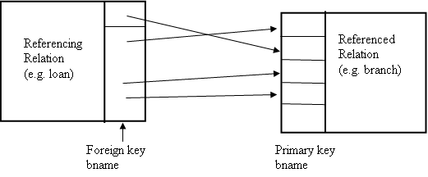
Referential Integrity Constraint
CREATE TABLE branch(
bname CHAR(15) PRIMARY KEY
....);
CREATE TABLE loan (
.........
FOREIGN KEY bname REFERENCES branch);

Slide 14
References
1. C.J. Date, A. Kannan and S. Swamynathan, An Introduction to Database Systems, Pearson Education, 8th Edition, 2009.
2. Patrick O’Neil, Database Principles,Programming, and Performance, Morgan Kaufmann, 2nd Edition, 2000.
3. Abraham Silberschatz, Henry F. Korth and S. Sudarshan, Database System Concepts, McGraw-Hill Eucation (Asia), 5th Edition, 2006.
4. Atul Kahate, Introduction to Database Management System, 1st Edition, Pearson, 2004.
5. Peter Rob and Carlos Coronel, Database Systems Design, Implementation and Management, Thomson Learning –Course Technology, 7th Edition, 2007.

