Slide 1
Nanotechnology Based Drug Delivery

Slide 2
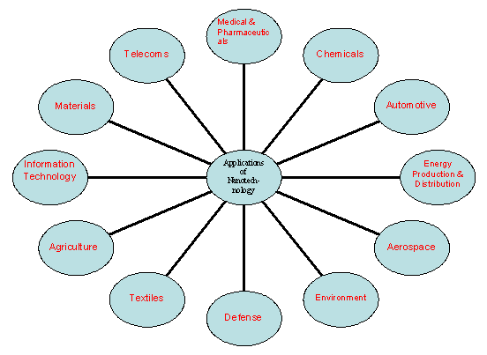
Applications of Nanotechnology

Slide 3
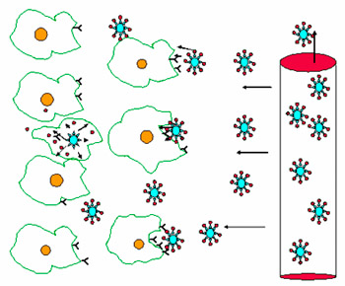
Targeted Drug Delivery

Slide 4
Nanoparticles for Drug Delivery
Metal-based nanoparticles
Lipid-based nanoparticles
Polymer-based nanoparticles
Biological nanoparticles

Slide 5
Nanobiopharmaceuticals
In biopharmaceuticals, in addition to the main technologies covered-liposomal, monoclonal antibody-based, and polymer-based technologies host of newer technologies such as nanoparticles including various nanodimensional entities such as molecular imprinted polymers, metallofullerenes, prodrug delivery, oral, injectable and implantable, pulmonary, and transdermal and transmucosal delivery have come up.

Slide 6
Drug Delivery Technology Important to Pharma Industry
Drug delivery formulations involve low cost research compared that for discovery of new molecule.
Minimizing the drug use would significantly reduce the effective cost of drug which would give financial relief to the patients,

Slide 7
Drug Delivery Technology Important to Pharma Industry
Delivery systems increase commercial opportunity by distinguishing a drug from competitive threats posed by “me too” drugs.
Novel means of delivery particularly using nano-carriers, can allow branded drugs to be rescued from abyss of generic competition (may be called “resurrection of drug”).

Slide 8
SOME SIGNIFICANT ACHIEVEMENTS OF NANODEVICES
Development of one dose a day ciprofloxacin using nanotechnology
Tumor targeted taxol delivery using nanoparticles in Phase 2 clinical trial stage
Improved ophthalmic delivery formulation using smart hydrogel nanoparticles
Oral insulin formulation using nanoparticles carriers.
Liposomal based Amphotericin B formulation

Slide 9
CHALLENGES
Prevention of drug from biological degradation
Effective Targeting
Patient Compliance
Cost effectiveness
Product life extension

Slide 10
PRIORITY AREAS
Cancer Nanotechnology
(i) Diagnosis using Quantum Dots
(ii) Tumor Targeted Delivery
(iii) Imaging
(iv) Cancer Gene Therapy

Slide 11
PRIORITY AREAS
DNA Vaccines for parasitic, bacterial and viral diseases
Oral and pulmonary routes for systemic delivery of proteins and peptides.
Nanotechnology in Tissue Engineering

Slide 12
Drug Delivery Carriers

Slide 13
Targeting Ligands

Slide 14
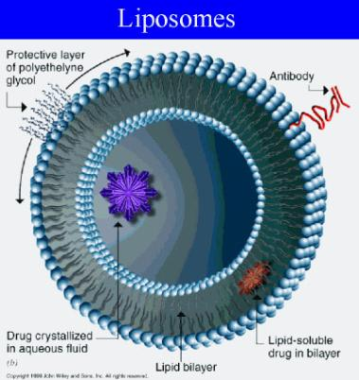
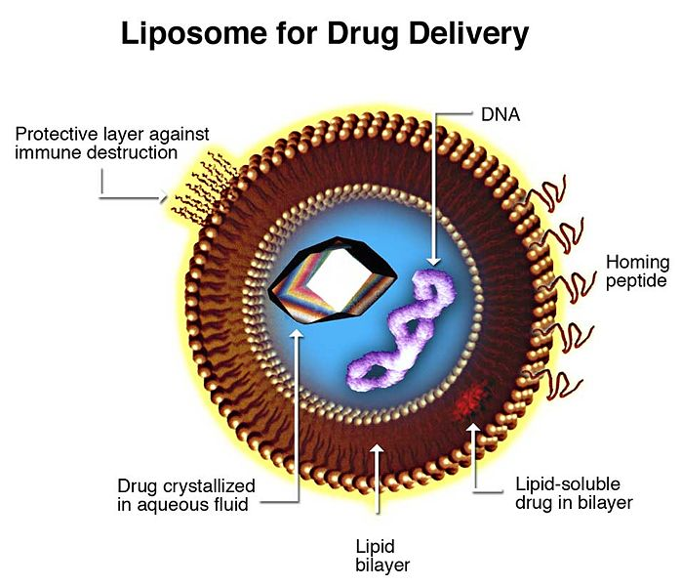
Liposome's

Slide 15
Liposome's
Their exterior lipid bilayer is very chemically reactive, thereby providing a means to conveniently couple “tags” on a covalent basis.
Such “tags” can be antibodies, antigens, cell receptors, nucleic acid probes, etc.
This provides significant versatility in assay formats (i.e., immunoassay, receptor-based, nucleic acid probe, etc.) possible.
With diameters ranging in size from approximately 50 nm to 800 nm, their aqueous core encapsulates up to millions of molecules of signal generating “markers” that can be detected in a variety of different way.
A variety of different encapsulants are possible including visually detectable dyes (since the lipid bilayer is transparent), optically and fluorometrically detectable dyes, enzymes, and electroactive compounds.
This provides significant versatility in the detection schemes possible.

Slide 16
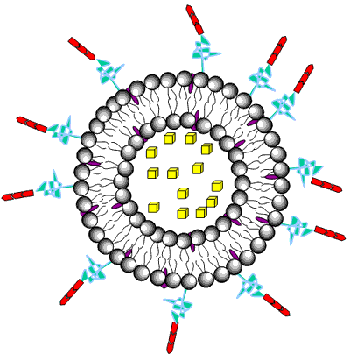
Niosomes

Slide 17
Niosomes
Niosomes, non-ionic surfactant vesicles, are widely studied as an alternative to liposomes
These vesicles appear to be similar to liposomes in terms of their physical properties
They are also prepared in the same way and under a variety of conditions, from unilamellar or multilamellar structures.
Niosomes alleviate the disadvantages associated with liposomes, such as chemical instability, variable purity of phospholipids and high cost.
They have the potential for controlled and targated drug delivery
Niosomes enhanced the penetration of drugs

Slide 18
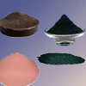
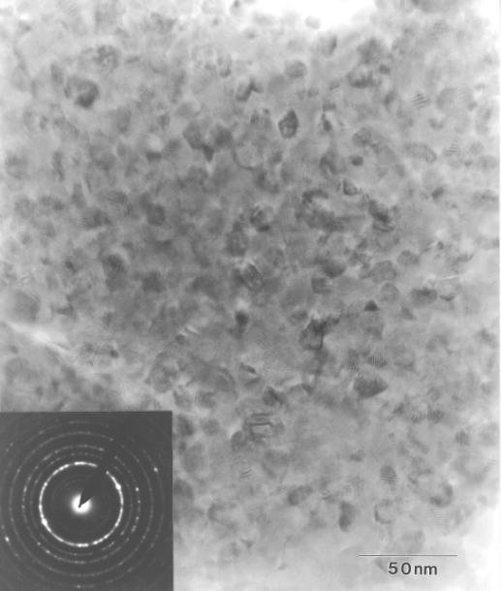
Nanopowder

Slide 19
Nanopowder
Nanopowders are powders composed of nanoparticles, that is particles having an average diameter below 50 nanometers (nm).
A jar of a true nanopowder when emptied from chest height to toward the floor will disperse into the air before reaching the floor.
Most manufacturers of “nanopowders” produce micropowder assemblies of nanoparticles but the powder itself is rarely a nanopowder.
Such compounds have two or more different cations (positively charged elements) in their chemical formula. An example of a complex compound is calcium titanate (CaTiO3).

Slide 20
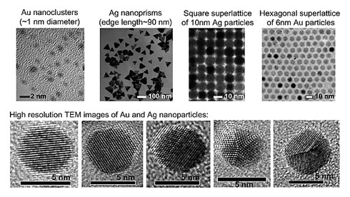
Nanocluster

Slide 21
Nanocluster
One of the central themes in nanoscience research is to synthesize high quality nanoparticles with precise control over particle size, shape, structure, and composition.
For inorganic nanoparticles (e.g. metal and semiconductor), two regimes are of particular interest, that is, nanoclusters in a size range from subnanometer to ~2 nm and nanocrystals (typically 2-100 nm).

Slide 22
Nanocrystals

Slide 23
Nanocrystals
When the size of the material is reduced to less than 100 nanometers, the realm of quantum physics takes over and materials begin to demonstrate entirely new properties.
Nano-design of drugs by various techniques like milling, high pressure homogenization, controlled precipitation etc., are explored to produce, drug nanocrystals, nanoparticles, nanoprecipitates, nanosuspensions (which for ease of understanding commonly mentioned as nanocrystals).
As decreased size will increase the solubility of drugs hence, this technology is explored to increase oral bioavailability of sparingly water soluble drugs.

Slide 24
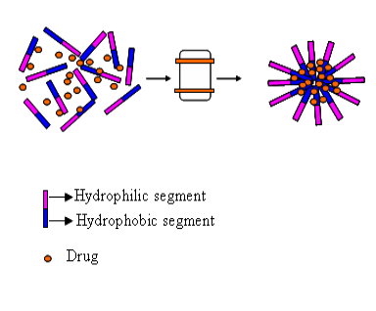
Micelle

Slide 25
Micelle
Micelle is an aggregate of amphipathic molecules in water, with the nonpolar portions in the interior and the polar portions at the exterior surface, exposed to water.
Amphiphilic molecules form micelle above a particular concentration which is called as critical micellar concentration (CMC).
Micelles are known to have an anisotropic water distribution within their structure, means water concentration decreases from the surface towards the core of the micelle, with a completely hydrophobic (water-excluded) core.
Hydrophobic drugs can be encapsulated/solubalized, into inner core.
The spatial position of a solubilized drug in a micelle will depend on its polarity, nonpolar molecules will be solubilized in the micellar core, and substances with intermediate polarity will be distributed along the surfactant molecules in certain intermediate positions.

Slide 26
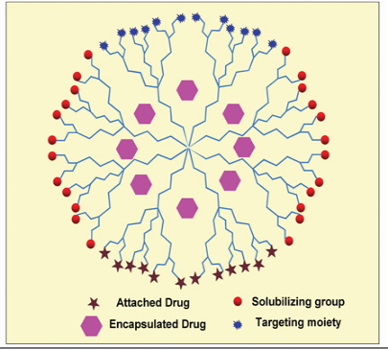
Dendrimers

Slide 27
Dendrimers
These branched macromolecules are constructed around a simple core unit.
Dendrimers have a high degree of molecular uniformity, narrow molecular weight distribution, specific size and shape characteristics, and a highly- functionalized terminal surface.
The manufacturing process is a series of repetitive steps starting with a central initiator core. Each subsequent growth step represents a new "generation" of polymer with a larger molecular diameter, twice the number of reactive surface sites, and approximately double the molecular weight of the preceding generation.

Slide 28
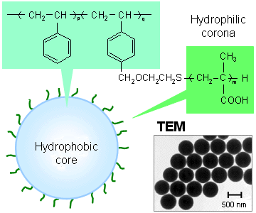
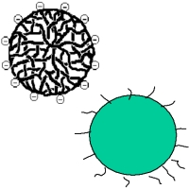
Polymeric Nanoparticles

Slide 29
Polymeric Nanoparticles
In recent years, biodegradable polymeric nanoparticles have attracted considerable attention as potential drug delivery devices in view of their applications in drug targeting to particular organs/tissues, as carriers of DNA in gene therapy, and in their ability to deliver proteins, peptides and genes through a per oral route of administration.

Slide 30
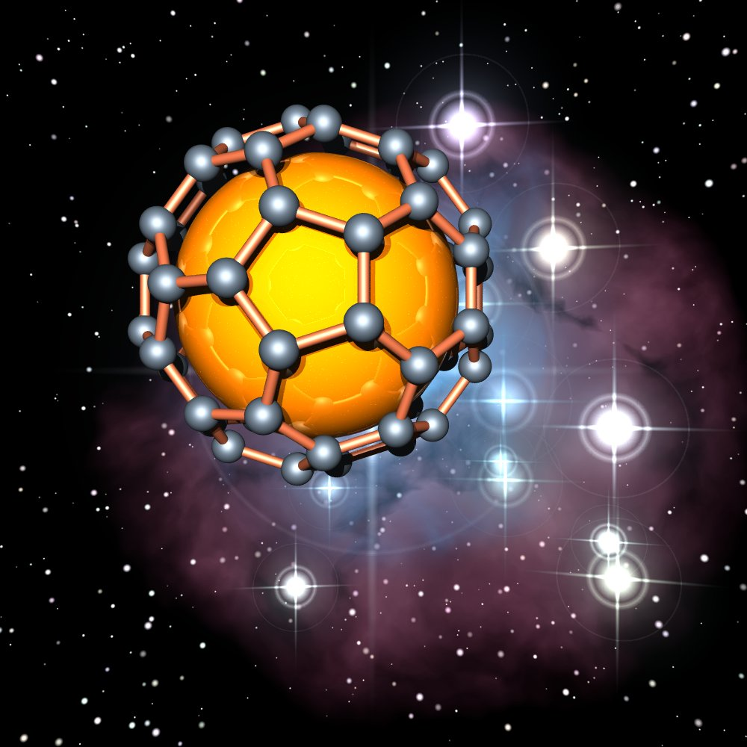
Carbon 60

Slide 31
Carbon 60
C60 are spherical molecules about 1nm in diameter, comprising 60 carbon atoms arranged as 20 hexagons and 12 pentagons: the configuration of a football.
Hence they find application as NanoPharmaceuticals with large drug payload in their cage like structure.
On the other hand with development of various chemical substitutes for C60, it is possible to develop functionalized C60 with better drug targeting properties

Slide 32
Carbon Nanotube

Slide 33
Carbon Nanotube
Carbon nanotubes are adept at entering the nuclei of cells and may one day be used to deliver drugs and vaccines.
The modified nanotubes have so far only been used to ferry a small peptide into the nuclei of fibroblast cells.
But the researchers are hopeful that the technique may one day form the basis for new anti-cancer treatments, gene therapies and vaccines.

Slide 34
Equipments for Nanoparticles
Ultra Sonicator
MillsHomogenizer
Spray Milling
Supercritical Fluid Technology
Electrospray
Ultracentrifugation
Nanofiltration

Slide 35
Methods of Drug Delivery

