Slide 1
Timing Diagram
MCA 1ST YEAR 2ND SEMESTER
Paper No. MCA-203
Paper name: Microprocessor
Dr. Utpal Nandi
Dept. of Computer Science
VIDYASAGAR UNIVERSITY

Slide 2
Timing Diagram is a graphical representation. It represents the execution time taken by each instruction in a graphical format. The execution time is represented in T-states.
Instruction Cycle:
The time required to execute an instruction .
Machine Cycle:
The time required to access the memory or input/output devices .
T-State:
The machine cycle and instruction cycle takes multiple clock periods.
A portion of an operation carried out in one system clock period is called as T-state.

Slide 4
Timing diagrams
The 8085 microprocessor has 7 basic machine cycle. They are
1. Op-code Fetch cycle(4T or 6T).
2. Memory read cycle (3T)
3. Memory write cycle(3T)
4. I/O read cycle(3T)
5. I/O write cycle(3T)
6. Interrupt Acknowledge cycle(6T or 12T)
7. Bus idle cycle

Slide 5
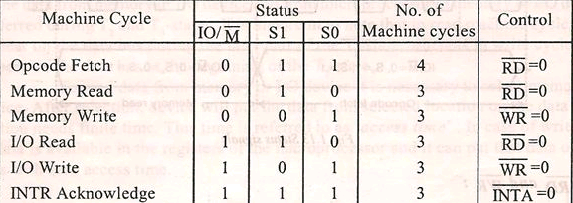

Slide 6
Following Buses and Control Signals must be shown in a Timing Diagram:
Higher Order Address Bus.
Lower Address/Data bus
ALE
RD
WR
IO/M

Slide 7
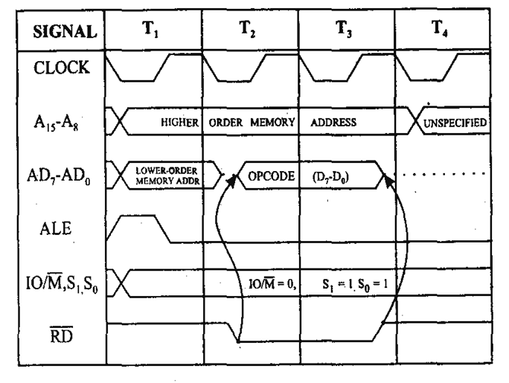
Opcode fetch cycle(4T or 6T)

Slide 8
Opcode Fetch
The Opcode fetch cycle, fetches the instructions from memory and delivers it to the instruction register of the microprocessor
Opcode fetch machine cycle consists of 4 T-states.
T1 State:
During the T1 state, the contents of the program counter are placed on the 16 bit address bus. The higher order 8 bits are transferred to address bus (A8-A15) and lower order 8 bits are transferred to multiplexed A/D (AD0-AD7) bus.
ALE (address latch enable) signal goes high. As soon as ALE goes high, the memory latches the AD0-AD7 bus. At the middle of the T state the ALE goes low

Slide 9
T2 State:
During the beginning of this state, the RD’ signal goes low to enable memory. It is during this state, the selected memory location is placed on D0-D7 of the Address/Data multiplexed bus.
T3 State:
In the previous state the Opcode is placed in D0-D7 of the A/D bus. In this state of the cycle, the Opcode of the A/D bus is transferred to the instruction register of the microprocessor. Now the RD’ goes high after this action and thus disables the memory from A/D bus.
T4 State:
In this state the Opcode which was fetched from the memory is decoded.

Slide 10
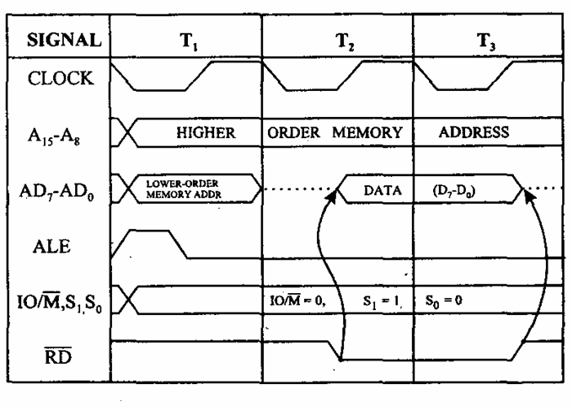
Memory read cycle (3T)

Slide 11
These machine cycles have 3 T-states.
T1 state:
The higher order address bus (A8-A15) and lower order address and data multiplexed (AD0-AD7) bus. ALE goes high so that the memory latches the (AD0-AD7) so that complete 16-bit address are available.
The mp identifies the memory read machine cycle from the status signals IO/M’=0, S1=1, S0=0. This condition indicates the memory read cycle.
T2 state:
Selected memory location is placed on the (D0-D7) of the A/D multiplexed bus. RD’ goes LOW
T3 State:
The data which was loaded on the previous state is transferred to the microprocessor. In the middle of the T3 state RD’ goes high and disables the memory read operation. The data which was obtained from the memory is then decoded.

Slide 12
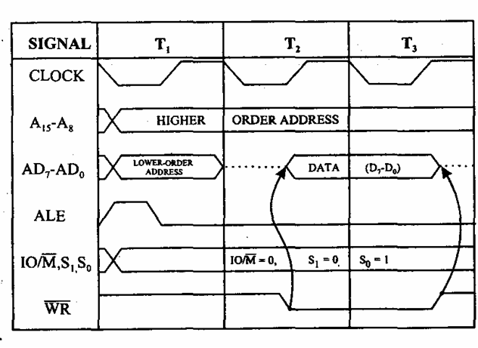
Memory write cycle (3T)

Slide 13
These machine cycles have 3 T-states.
T1 state:
The higher order address bus (A8-A15) and lower order address and data multiplexed (AD0-AD7) bus. ALE goes high so that the memory latches the (AD0-AD7) so that complete 16-bit address are available.
The mp identifies the memory read machine cycle from the status signals IO/M’=0, S1=0, S0=1. This condition indicates the memory read cycle.
T2 state:
Selected memory location is placed on the (D0-D7) of the A/D multiplexed bus. WR’ goes LOW
T3 State:
In the middle of the T3 state WR’ goes high and disables the memory write operation. The data which was obtained from the memory is then decoded.

Slide 14
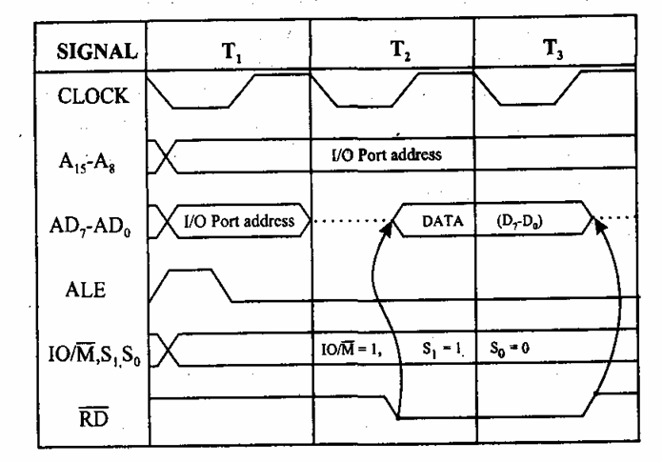
I/O read cycle(3T)
Mr. Utpal Nandi, Dept. of Computer Science, Vidyasagar University

Slide 15
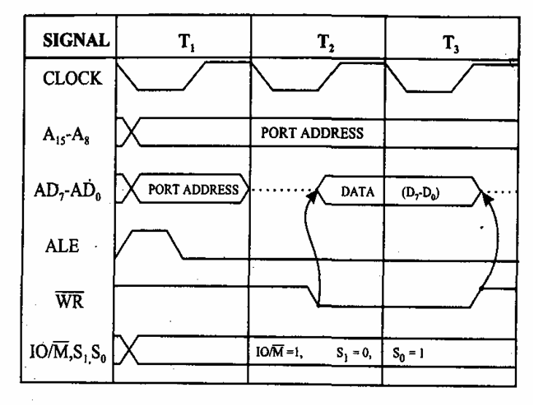
I/O write cycle(3T)

Slide 16
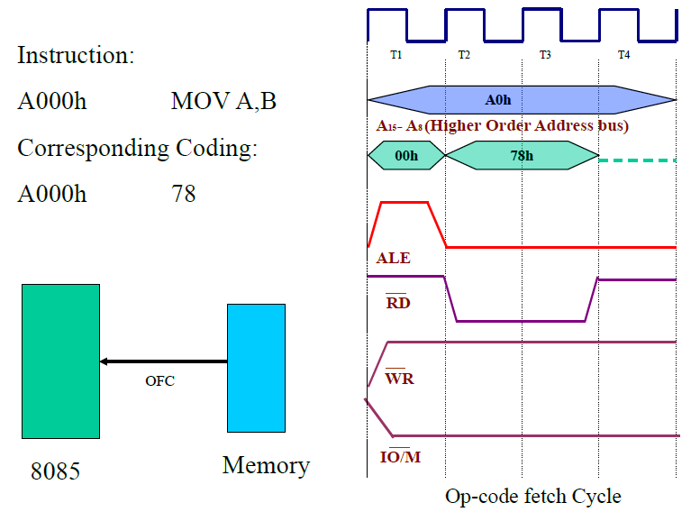

Slide 17
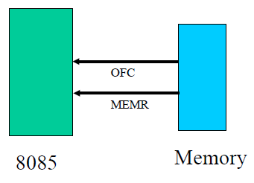
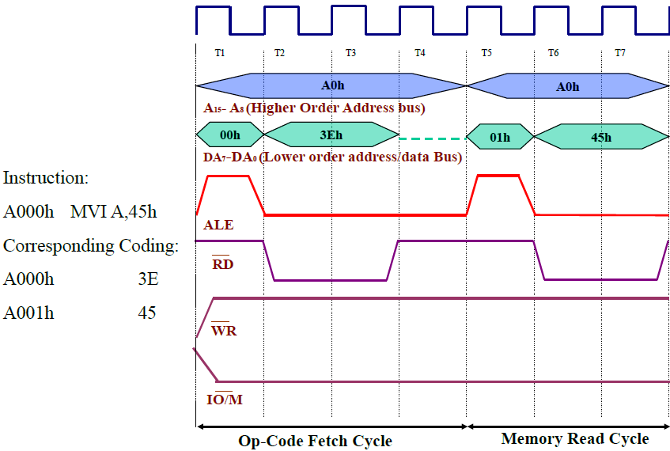

Slide 18
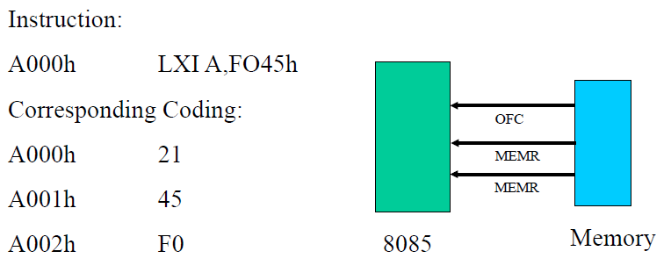

Slide 19
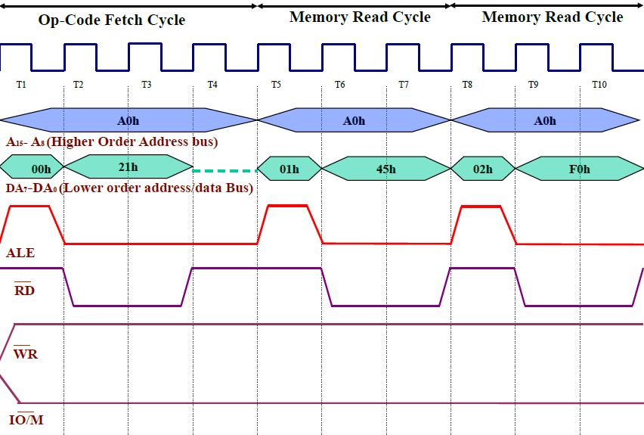

Slide 20
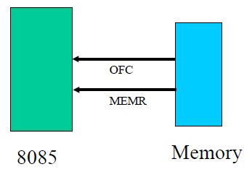
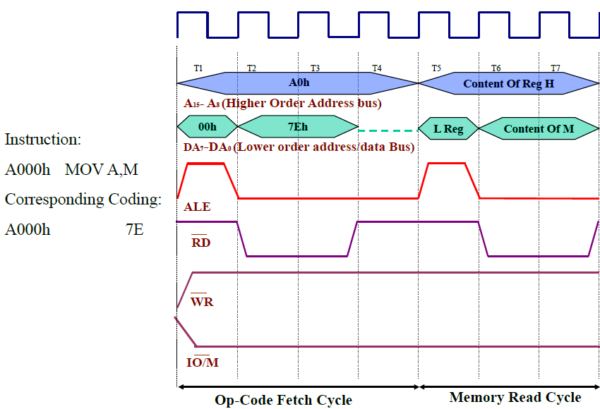

Slide 21
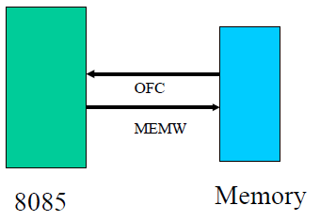
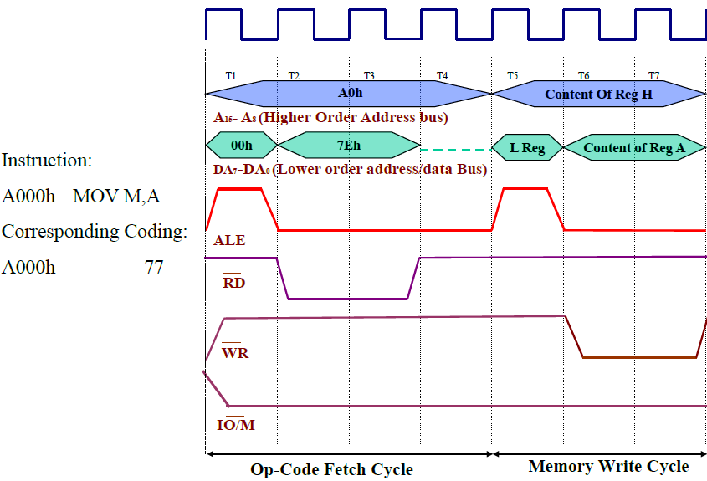

Slide 22
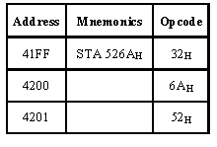
STA instruction ex: STA 526A

Slide 23
It require 4 m/c cycles 13 T states 1.opcode fetch(4T) 2.memory read(3T) 3.memory read(3T) 4.Memory write(3T)

Slide 24
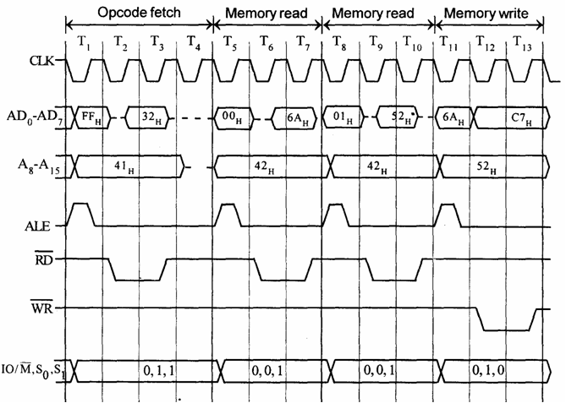

Slide 25
Timing diagram for IN C0H
Fetching the Opcode DBH from the memory 4125H.
Read the port address C0H from 4126H.
Read the content of port C0H and send it to the accumulator.
Let the content of port is 5EH.

Slide 26
It require 3 m/c cycles ,10 T states opcode fetch(4T) memory read(3T) I/O read(3T)

Slide 27
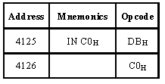

Slide 29
OUT instruction Machines Cycles(10T): 1.instruction fetch(4T) 2.memory read (3T) 3.IO write (3T)

Slide 30
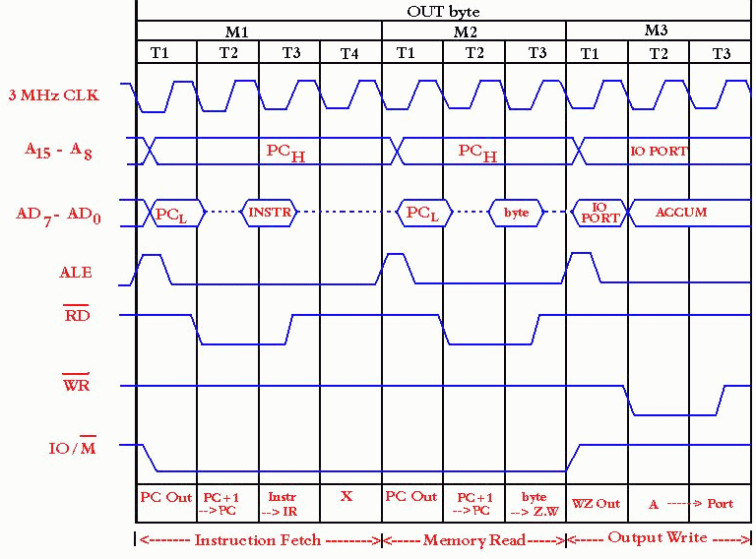

Slide 31
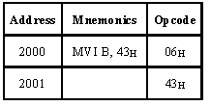
Timing diagram for MVI B, 43h
Fetching the Opcode 06H from the memory 2000H. (OF machine cycle)
Read (move) the data 43H from memory 2001H. (memory read)

Slide 32
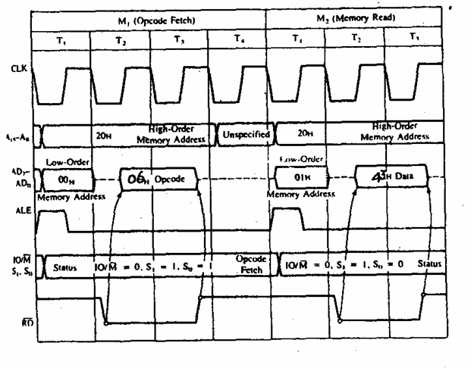

Slide 33
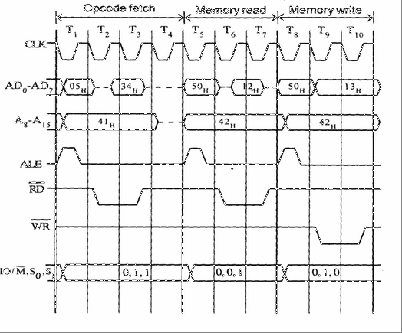
INR M

Slide 34
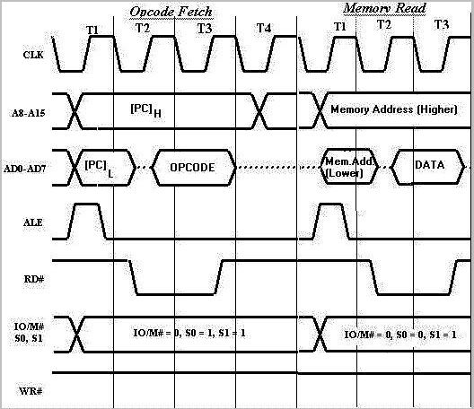
ADD M

Slide 35
End

