Slide 1
Human Semen Analysis
Dr Surojit Das, PhD
Assistant Professor
Vidyasagar University

Slide 2
Introduction
A semen analysis measures the amount of semen a man produces and determines the number and quality of sperm in the semen sample.
A semen analysis is usually one of the first tests done to help determine whether a man has a problem fathering a child (infertility).
A problem with the semen or sperm affects more than one-third of the couples who are unable to have children (infertile).

Slide 3
Purpose of seminal fluid analysis
There are basically four indications for the examination of seminal fluid:
The investigation of fertility: male infertility is primarily responsible in 30-50% of infertile marriages.
To determine the effectiveness of vasectomy (a surgical intervention for male sterilization or permanent contraception).
To determine the suitability of semen for artificial insemination (the medical procedure of injecting semen into vagina or uterus).
Medico-legal testes to detect semen are frequently requested in alleged rape or in association with other sexual crimes of violence.

Slide 4
Fluid Fractions
Bulbourethral & Urethral glands (2-5%) are very small mucus secreting glands, add alkaline mucus to neutralize prostatic acid and vaginal acidity.
Prostate: (produce about 13-33% of the fluid volume of semen) Prostate glands secretion is a milky, alkaline fluid that plays a role in activating sperm, the secretion contains acid phosphatase and proteolytic enzymes that act on the fluid from the seminal vesicles, resulting in the coagulation and liquefaction of the semen.
Seminal vesicles (produce about 46-80% of the fluid volume of semen) Viscous, yellowish secretion is rich in fructose, vitamin C, prostaglandin, and other substances, which nourish and activate the sperm passing through the tract. This component has high flavin content, which is largely responsible for the fluorescence of semen.
Testis & Epididymis: (5%) Spermatozoa are produced in the testis under the influence of testosterone, and then the epididymis (is the first part of the duct system) provides a temporary storage site for the immature sperm that enter it from testis. This fraction still in the inactive form until ejaculation due to the high content of carnitine, glyceryle-phosphorylcholine and diminished oxygen supply.
Notes:
The sperm within the semen are the cells that actually fertilize the egg and are therefore the most important to assess. However, the sperm account for only 1-2 % of the seminal fluid volume. Problems with the surrounding fluid may also interfere with the movement and function of the sperm. Therefore, both the sperm and the fluid must be tested

Slide 5
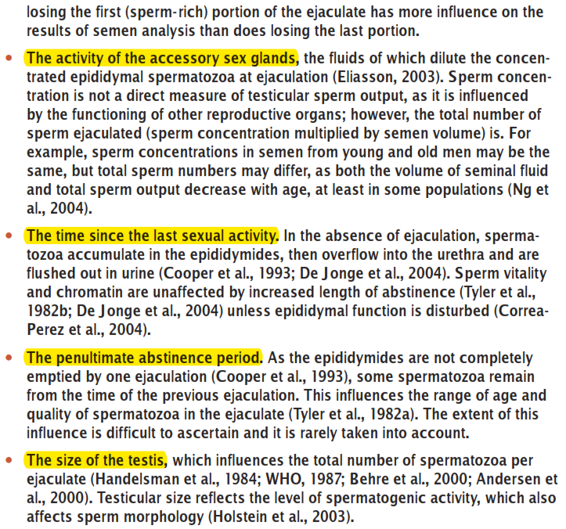
Factors Effecting the Semen Analysis Results

Slide 6
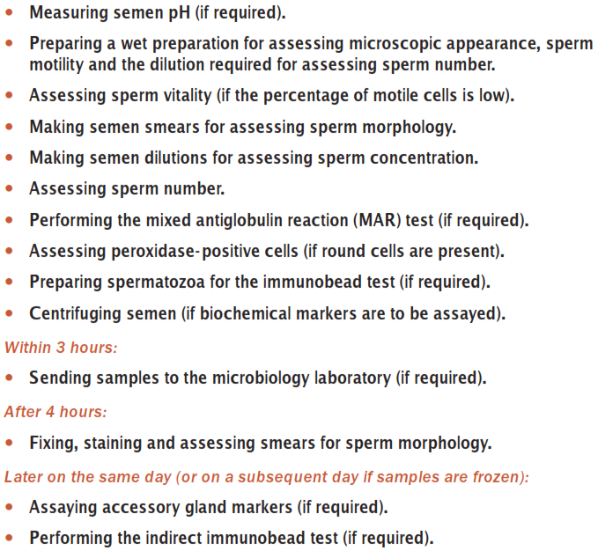
Time-line of Semen Analysis

Slide 7
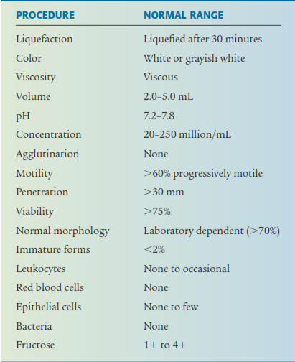

Slide 8
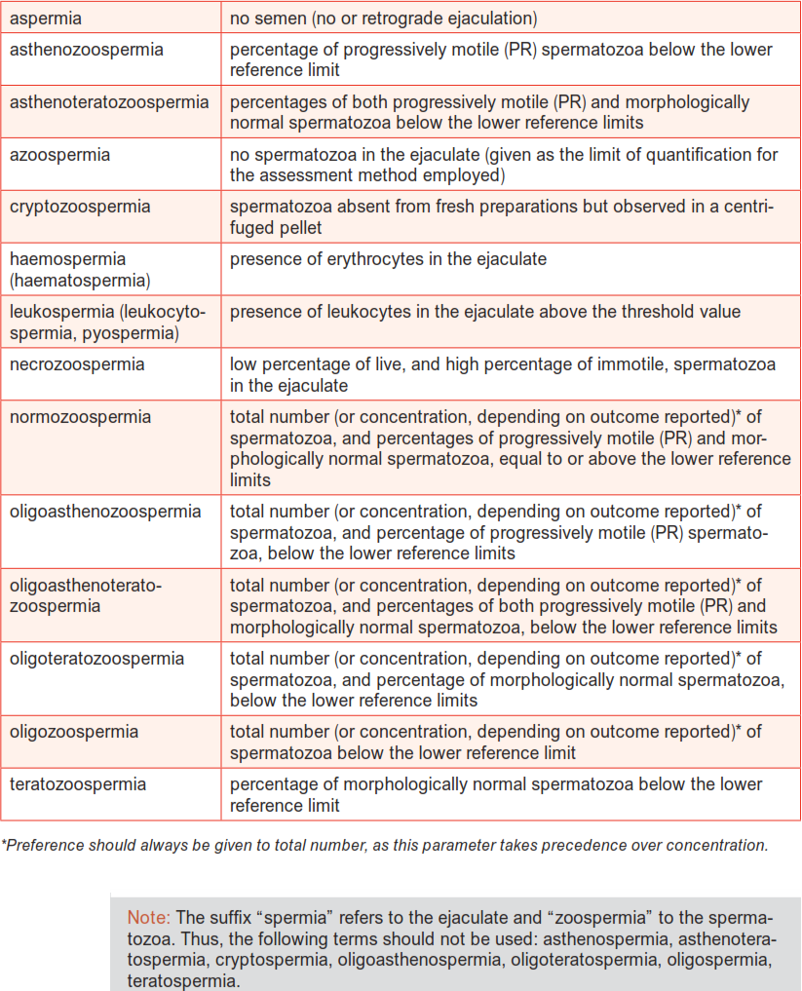
Nomenclature Related to Semen Quality

Slide 9
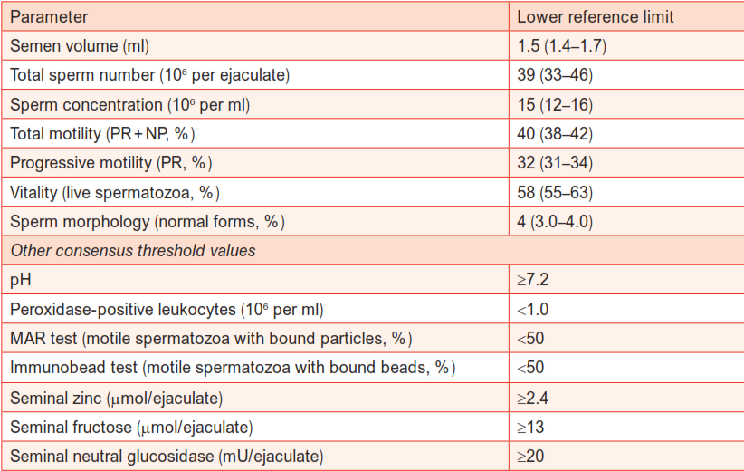
Lower Reference Limits (5th percentiles & 95% confidence intervals) for Semen Characterestics
Notes:
Centiles: A measure used in statics indicating the value below which a given % of observations in a group of observations falls. E.g., the 20th of the centile is the value below which 20% of the observations may be found.

Slide 10
Sample Collection

Slide 11
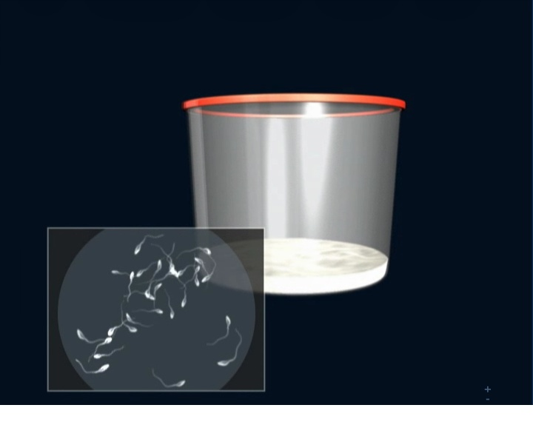
Semen Collection
Good and reliable SA results starts from semen collection, preferably by masturbation
Abstinence days 2-6
Pass urine
Wash hands with soap, dry
Collect the entire sample into the wide mouth sterile container, 70% of sperms is in the first part of the ejaculate
Keep the sample at body temperature, no sunlight
Deliver the sample within one hour of ejaculation

Slide 12
Ways to Collect Semen
Masturbation - directing the semen into a clean sample cup. Do not use a lubricant which can kill sperms.
Coitus interruptus - withdrawing the penis from the partner just before ejaculating follow by ejaculating into a clean sample cup.
Coitus - by using a condom. A special (silicon) condom that does not contain any substance that kills sperm (spermicide). After ejaculation, carefully remove the condom from the penis. Tie a knot in the open end of the condom and place it in a container that can be sealed in case the condom leaks or breaks. Ordinary condoms should not be used since they usually contain spermicides.
Assisted ejaculation – electro-ejaculation used in paralegics (paralysis that affects all or part of the torso, legs & pelvic organs).
Notes:
Paralegics-

Slide 13
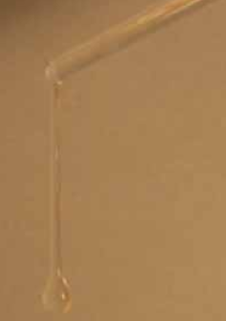
Macroscopic Examination
WHO criteria 2010 |  | Description
Appearance | Normal: | Whitish to grey opalescent
Yellow (urine, jaundice); Pink/Reddish/Brown (RBCs)
Liquefaction | Normal: | 15–30 minutes after collection
Lumpy >60 min – sperms may be trapped in unliquefied jelly; may be sign of prostatic infection, lack of prostatic protease
Viscosity | Normal | Smooth and watery
Abnormal – thick with long threads. High viscosity impede sperm movements
Normal semen viscosity test
MIX SEMEN THOROUGHLY BEFORE ANALYSIS –USE A PIPETTE
Notes:
Liquefaction: Immediately after ejaculation into the collection vessel, semen is typically a semi-solid coagulated mass. Within a few minutes at room temperature, the semen usually begins to liquefy (become thinner), at which time a heterogeneous mixture of lumps will be seen in the ﬂuid.

Slide 14
Macroscopic Examination
Volume | Normal: | 1.5 ml per ejaculation
Low volume (<1ml) reflect a problem with the seminal vesicles and prostate – a block, retrograde ejaculation, infection or lack of androgen. Low semen volume cannot neutralize vaginal acidity High semen volume dilute sperms/ active infection
pH | Normal: | =/>7.2 (alkaline)
Acidic pH (<7.0) in a low volume & density sample indicates –congenital bilateral absence of vas deferens (in which seminal vesicles are also poorly developed) and ejaculatory duct obstruction. pH increases with time as natural buffering capacity of semen decreases – therefore high pH is not clinically useful

Slide 15
Microscopic Examination

Slide 16
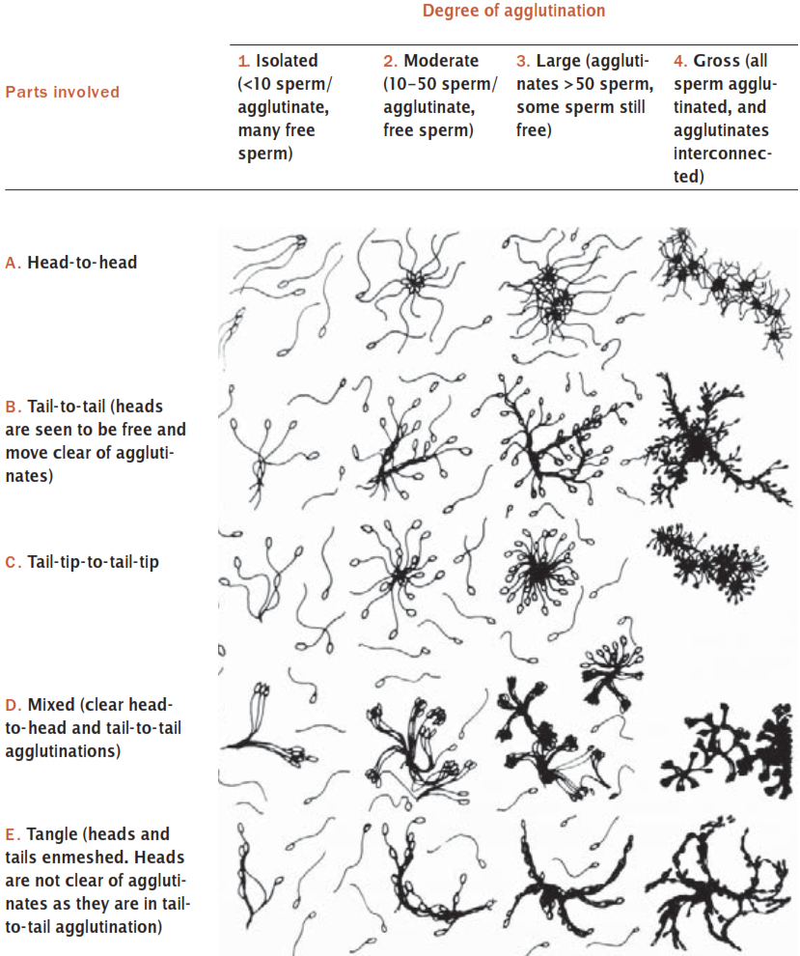
Sperm Agglutination

Slide 17
Sperm Motility

Slide 18
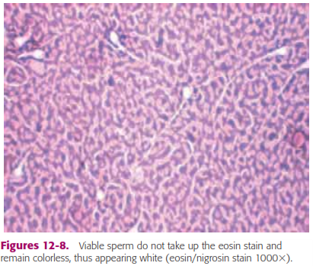
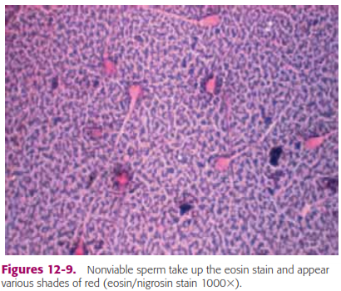
Sperm Vitality
Eosin-nigrosin (dead sperm stain pink/red)
Eosin (1%) (dead sperm stain pink/red)
Trypan (0.4%) blue (dead sperm stain blue)
Hypo-osmotic swelling test (HOS) (live sperm shows tail curling)
Test 1, 2 and 3 for diagnostic uses. Usually 1:1 ratio of semen to dye mixture, mix well and smear onto a slide. Read immediately at x40 objective, count 200 sperms
Test 4 is use to choose live (immotile) sperm for ICSI. Dead sperms will not react in HOS while live sperm will take up fluids causing their tails to curl within 5 min and stabilize at 30 min. Therefore viable sperms may be selected for ICSI.

Slide 19
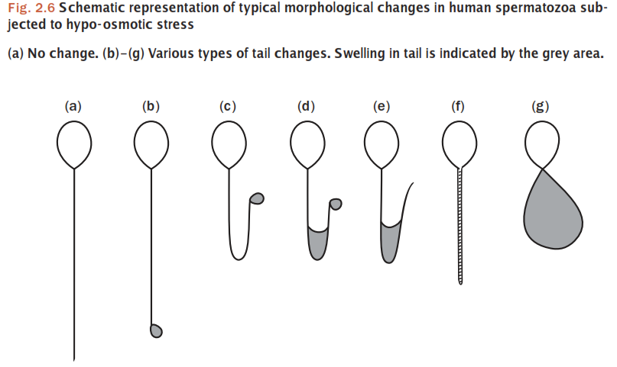

Slide 20
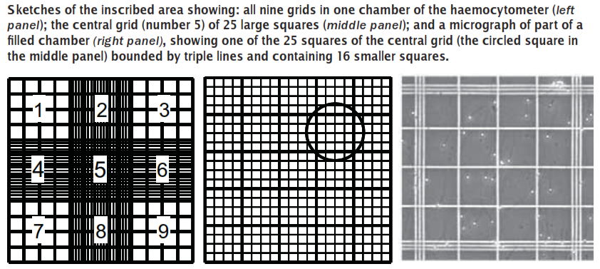
Sperm Counts
Neubauer Haemocytometer

Slide 21
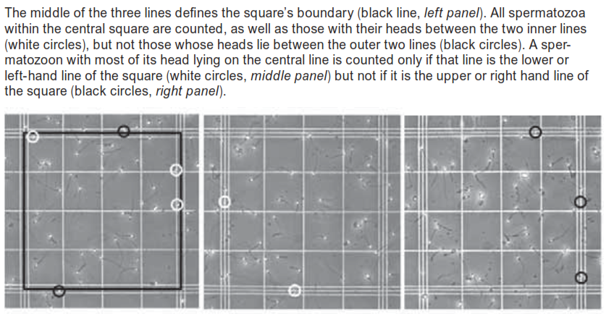

Slide 22
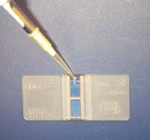
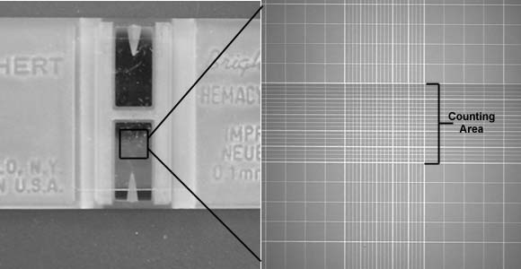
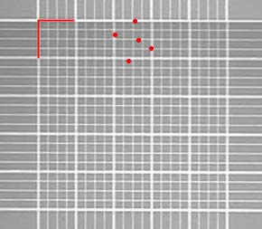
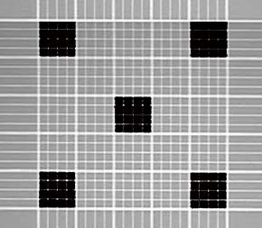
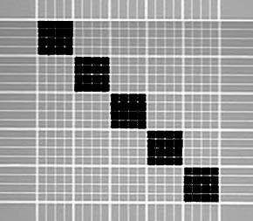
Counting Cells with a Hemacytometer
The example at right shows red lines where cells on the line would be counted. If red dots represent cells, one would count 3 cells in the top middle large square.
All 25 large squares can be counted, or a counting pattern using fewer squares can be used like the ones below. It is important to distribute the counting areas in a non-biased manner since cells can be more concentrated on one side of the chamber. If you count over only 5 of the 25 large squares, then multiply that value by 5 to obtain the number of cells per central counting area. At least two chambers should be counted, including at least 100 cells within each central counting area of each chamber. For higher precision, additional sperm can be counted and the average used to calculate cell concentration.
Each of the nine squares on the grid, including the central counting area of 25 large squares, has an area of 1 mm², and the coverglass rests 0.1 mm above the floor of the chamber. Thus, the volume over the central counting area is 0.1 mm³ (1/10cm x 1/10cm x 1/100cm=10⁻⁴cc) [1cc=1ml]. You can thus multiply the average number of sperm over each central counting area by 10,000 to obtain the number of sperm per ml of diluted sample.
Sperm/ml= ave. no. of sperms for each chamber x 10⁴ x dil. factor
Example: Assume that you dilute the original semen sample by adding 0.1 ml of semen to 9.9 ml of diluent (1:100 dilution factor). You then count the number of sperm in 5 of the 25 large squares within the central counting area of two chambers, obtaining counts of 132 and 128 cells.
1. The mean number of sperm per chamber is thus 130 (132+128/2) x 5 or 650 cells per counting area (650 cells per 0.1 microliter).
2. Multiply the 650 cells per counting area by 10,000 to obtain the number of cells per ml of diluted sample (answer = 6,500,000)
3. Multiply 6,500,000 cells per ml of diluted sample by 100 (the dilution factor) to obtain 650,000,000 per ml of original semen sample.

Slide 23
Several terms are used to describe both sperm concentration and sperm count:
Azoospermia describe a total absence of spermatozoa in semen. (After centrifuge sperm count is zero/HPF).
Oligozoospermia refers to a reduced number of spermatozoa in semen and is usually used to describe a sperm concentration of less than 20 million/ml. Sperm count 5-10 sperm/HPF.
Severe oligospermia, sperm count 1-2 sperm/HPF.
Polyzoospermia denotes an increased number of spermatozoa in semen and is usually refers to a sperm concentration in excess of 350 million/ml.

Slide 24
Sperm Morphology
This describes the shape of the sperm.
70% of the sperm should be normal by these criteria.
Generally accepted that a high incidence of morphologically abnormal spermatozoa in a semen sample is associated with reduced fertility.
Human sperm can be visualized using bright field microscopy on fixed stained specimens.
Examples of fixed stained preparations (Papanicolaou stain, Vital staining with eosin/nigrosin, giemsa stain).
Normal spermatozoa should have an oval shaped head (4-5.5µm long and 2.5-3.5µm wide).
The midpiece should be cylindrical (3-5µm long and 1.0µm wide).
The tail should also be cylindrical (45-50µm long and 0.5µm wide) with a narrower terminal segment (4-6µm long).
There should be no head, midpiece or tail defects, and no cytoplasmic droplet more than one-third the size of a normal sperm head.

Slide 25
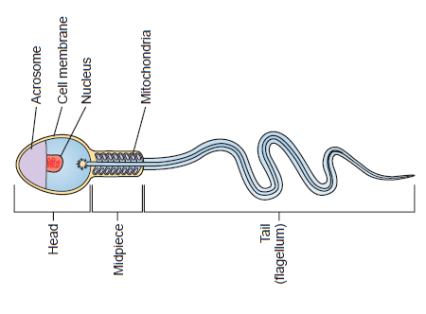
Normal spermatozoa structure

Slide 26
Defects to be scored
Head shape/size defects - such as large, small, tapering, pinhead form, amorphous, vacuolated, multiple heads or any combination of these.
Neck and midpiece defects - such as non-inserted or bent tail, distended, irregular / bent midpiece, thin midpiece (no mitochondrial sheath), absent tail (free or loose heads) or any combination of these.
Tail defects - such as short, multiple, hairpin, broken, irregular width, coiled tails, tails with terminal droplets or any combination of these.
Cytoplasmic droplets - greater than one-third the size of a normal sperm head.

Slide 27
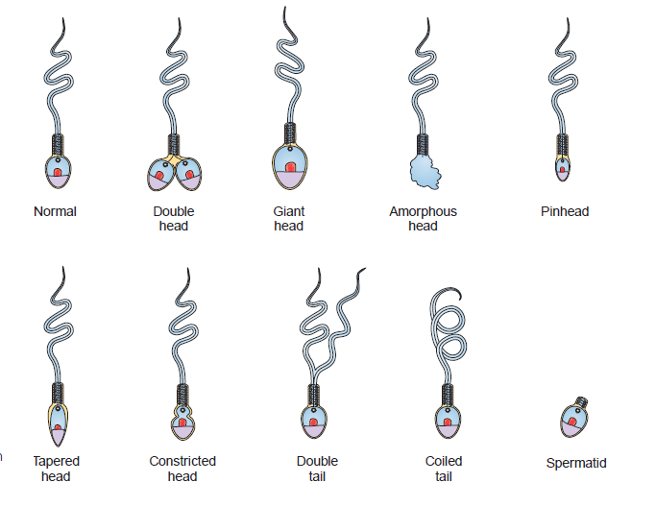
Each spermatozoa is scored as either normal or abnormal with each of the defects being tallied separately. If a majority of the cells have a particular morphological defect this should also be noted.
In stained preparations 100-200 sperm should be scored using a x100 oil-immersion bright field objective

Slide 28
Hematoxylin-Eosin Staining
Fairly good differentiation
The acrosomal area and cytoplasmic fragments is stained pink and the post-acrosomal area is stained dark purple.
Abnormally stained sperms (nuclear/ chromatin material) may be differentiated.
Takes longer and need experience to produce good staining
Hematoxylin-Eosin
Fix slide in EtOH/MeOH 95% | 20 min
Wash in running tap water | 5 min
Dry on absorbent paper
Hematoxylin (Sigma, HHS-128) | 20 min
Wash in running tap water | 5 min
Acid alcohol (99 ml 70% EtOH + 1 ml H₂SO₄) | Dip (2)
Eosin (Sigma, HT1102128) | 5 min
EtOH 70% | 2 min
EtOH 90% | 2 min (2)
Absolute EtOH (99.9%) | 2 min (2)
Xylene | 2 min (2)

Slide 29
Diff-Quik Staining
Diff-Quik Staining (Baxter, Australia)
Simple, quick staining method.
Moderate differentiation of structures --the acrosome is stained red and the post acrosomal area dark red. Very thin smears are necessary as the background is influenced by the presence of protein in the seminal fluid and tends to be dark.
The slides are fixed with fixative (Cytospray, Kinetik, Australia).
Diff Quik 1 for 5-6 seconds.
Clean water x 2. Removed excess moisture.
Diff Quik 2 for 10 seconds
2-3 dips in clean water.
It is left to dry by standing the slide on one end on absorbent paper towel.
Sperms stained by Diff-Quik are larger by comparison to H&E staining as the cells did not undergo dehydration by alcohol.

Slide 30
Abnormal Sperms

Slide 31
Abnormal Sperms
Triple head sperm
Acrosome reacted sperm
Sperm with no acrosome
Sperm with a tapering head and swollen mid-piece

Slide 32
Morphology Assessment
Assessment is subjective due to the wide variation in sperm sizes and shapes.
% NF correlated well with the fertilization rate in-vitro and pregnancy rate [Kruger et al, 1996; Morgenthaler et al, 1995]
Sperms with defective heads are more likely to be immotile than sperms without defects, and defective motile sperms tend to show sluggish motility as compared to normal sperms [Aitken et al, 1995].

Slide 33
Chemical Analysis

Slide 34
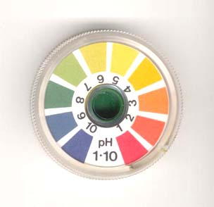
pH
Should be measured within an hour of collection (acidic: lactic acid production with high sperm count; alkaline: loss of CO₂ over time).
Nitrozine paper is used to measure pH.
pH of fresh semen: 7.2-7.8.
Congenital aplasia of vas deferentia & seminal vesicles >>> Acidic pH
Male reproductive infection (Ureaplasma urealyticum, Mycoplasma hominis, Chlamydia trachomatis, Herpes simplex) >>> Alkaline pH

Slide 35
Acid Phosphatase
It is used to evaluate the secondary function of the prostate.
Normal level: ≥200 units/ejaculate
It is used to establish the validity of alleged sexual assault in vaginal fluid, skin washings, or clothing.

Slide 36
Fructose
Fructose provides energy for spermatozoa.
Semen fructose is produced by the seminal vesicles, with normal levels ≥13 µmol/ejaculate & comprises 99% of reducing sugar found in semen.
Low level >>> indicates presence of ejaculatory duct obstruction or abnormalities in the vas deferens & is accompanied by azoospermia (absence of sperm).
Low level >>> correlate with androgen deficiency & decreased testosterone levels.

Slide 37
Common Causes of Low Sperm Count (Oligospermia)
Lifestyle: Factors like stress, heat, obesity & toxins (SHOT) can reduce sperm counts drastically.
Varicocele: Varicose veins (enlarged veins) in the scrotum, known as varicoceles, have been known to impact testosterone and sperm production as well as sperm health (motility, morphology). Varicoceles are relatively common, occurring in about 15% of all men, and impact men differently. Some men can have large varicoceles with little to no impact on fertility, while other men are more sensitive and even small varicoceles can dramatically impact semen parameters. Varicoceles are repairable through surgery; it often takes 6-12 months post-surgery to fully improve fertility.

Slide 38
Common Causes of Low Sperm Count (Oligospermia)
Genetics: There are a number of genetic disorders that contribute to male infertility. Because the molecular science is still relatively young, new genetic markers for male fertility are still being discovered. The good news is that most genetic causes of infertility are relatively rare. The most common disorders are:
Klinefelter’s Syndrome: Genetic condition in which a man has an extra X chromosome causing him to be XXY rather than the normal XY.
Y chromosome microdeletions: The deletions of genes from the Y chromosome that are responsible for sperm production.

Slide 39
Common Causes of Low Sperm Count (Oligospermia)
Infection: Viral and bacterial infections – both in childhood and as an adult – can cause scarring on tiny microtubes of the male reproductive tract leading to a partial or complete blockage. Leading offenders include: mumps, tuberculosis, chlamydia, gonorrhea, mycoplasma, urinary tract infections and prostate infections.
Hormone imbalances: Hormones play a critical role in the production and maturation of sperm cells. For reproductive health, the most critical hormones include – Testosterone, Follicle Stimulating Hormone (FSH), and Luteinizing Hormone (LH). Hormonal imbalances can occur for a number of reasons including: impaired testicular function, thyroid disorders, diabetes, pituitary disorders or growths and abuse of androgens for athletic performance.

