Slide 1
Course – Biomedical Laboratory Science & Management
4th Semester
Paper-BLM-401
Advance techniques in Laboratory Science
Topic- Centrifuge (ordinary, ultra, cold)
Material No. 1

Slide 2
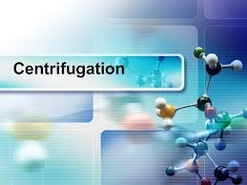
TOPIC -
CENTRIFUGATION
Dr. Chhanda Mallick
Assistant Professor
Dept. of Biomedical laboratory Science & Management
Vidyasagar University

Slide 3
DEFINITION
Centrifugation is a sedimentation of particles under the influence of centrifugal force and it is used for superfine suspension.
In 1923 Svedberg and Nicolas employed a centrifuge for the first time to increase the gravitational force so as to speed up the rate of sedimentation.

Slide 4
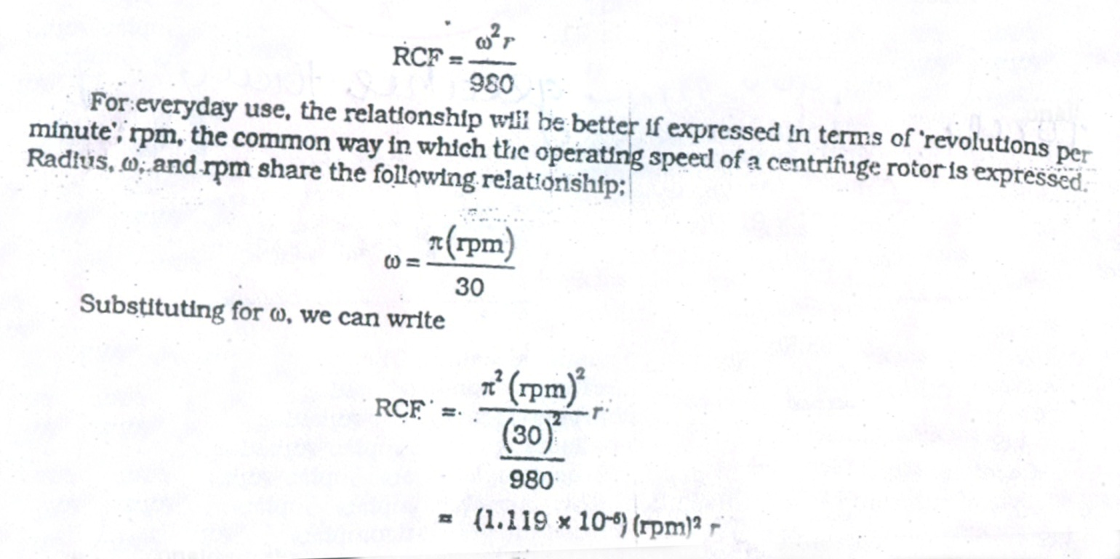
PRINCIPLE OF CENTRIFUGATION
An object in a circle at a steady angular velocity will experience a force directed outward .This is the basis of centrifugation. Angular velocity in an w and the radius of rotation r.Magnitude of the force F
F = w2r F might be expressed in terms of earth gravitational force if it is divided by 980.The resultant is referred as the relative centrifugal force RCF. RCF = W2r

Slide 5
BASIC COMPONENTS OF A CENTRIFUGE-
A metal rotor with holes in it to accommodate a vessel of liquid as shown in fig.
A motor means of spinning the rotor at a selected speed.

Slide 6
TYPES OF CENTRIFUGES
1. DESKTOP CENTRIFUGE
2.HIGH SPEED CENTRIFUGE
3.ULTRA CENTRIFUGE

Slide 7
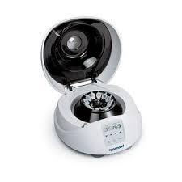
1.DESK TOP CENTRIFUGES
Simple ,small and least expensive
Their max. speed is 3000 rpm
Do not have any temperature regulatory system
Rotors are mounted on a rigid shaft
Used to collect rapidly sedimenting substances like red blood cell ,yeast cells or bulky precipitate of chemical reaction

Slide 8
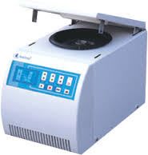
2.HIGH SPEED CENTRIFUGE
Their max. speed is 25,000 rpm
Usually equipped with refrigeration equipment to remove heat generated due to friction between air and spinning rotor
Temperature can be maintained in the range 0-40 c
Used to collect microorganism, large cellular organelles and immunoprecipitates.

Slide 9
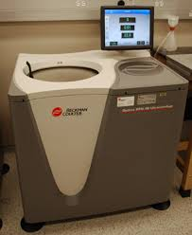
3 ULTRACENTRIFUGE
Can operate at speed up to 75000 rpm .
It has a refrigeration system which can maintain temperature of the rotor between 0 to 4 0 C.
In this centrifuge rotors are mounted on a rigid shaft . Shaft is made up of aluminum or titanium alloy of high tensile strength to withstand the great force generated during centrifugation.
Ultracentrifuges are of two types –
1] Preparatory ultracentrifuge
2] Analytical centrifuge

Slide 10
l .
PREPARATIVE CENTRIFUGE preparative centrifuge are of two types- 1] DIFFERENTIAL ULTRACENTRIFUGE 2]DENSITY GRADIENT CENTRIFUGE 1] Differential ultracentrifuge- In this type of centrifuge separation is carried out in a suspending medium which is homogenous are known as differential centrifugation.
2]Density gradient centrifuge-In this type of centrifuge separation is carried out in a suspending medium having density gradient. Separation under centrifugal field is therefore depend upon buoyant density of particles. It has two variations - 1]RATE ZONAL CENTRIFUGATION l2]ISOPYCNIC CENTRIFUGATION .

Slide 11
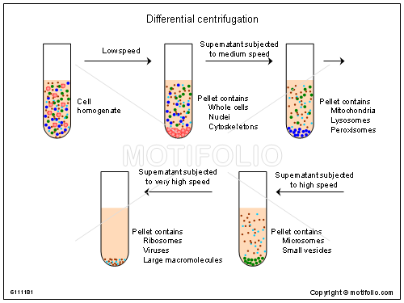

Slide 12
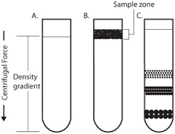
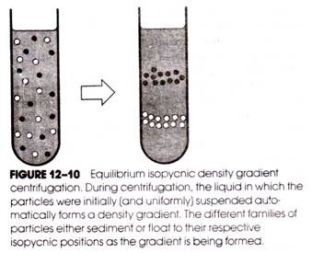
Difference between rate zonal and isopycnic centrifugation
RATE – ZONAL
ISOPYCNIC
Gradient is shallow, gradient density is maximum less than that of the least dense sedimenting specie.
Centrifugation is carried out at low speed for a short time.
This method is used for separating particles which differ in size not on density. e.g. DNA – RNA hybrid ,Ribosomal subunit etc.
Gradient is steep, gradient density is maximum greater than that of the most dense sedimenting specie.
Centrifugation is carried out at high speed for a long time.
This method is used for separating particles which differ in density. E.g. –DNA,plasma,lysosomes,mitochondria,peroxisomes,plama.

Slide 13
APPLICATIONS OF PREPARATIVE CENTRIFUGATION Preparative centrifugation is concerned with the actual isolation of biological material for subsequent biochemical investigations. It is used to separate organelles like mitochondria,ribosomes, microsomes and viruses. Preparative centrifugation is done in a variety of rotors suitable for a great range of experiment. .It is used for gradient separations in which tubes are filled from top to bottom with an increasing concentration of a dense substances in solution.

Slide 14
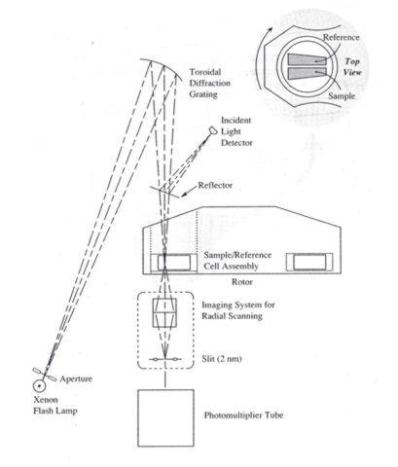
ANALYTICAL ULTRACENTRIFUGE It has refrigerated and evacuated chamber .The alloy used in the rotor and the shaft are same. It possess a specialized optical system to monitor the progress of centrifugation. The rotor of this type of centrifuge is elliptical and has two holes for holding two centrifuge cells. The analytical cell is sector shaped and can hold a liquid column about 14 mm.The upper and lower planes of the analytical centrifuge are quartz or synthetic sapphire windows. The windows are provided for the passage of light to monitor the process of transparent having centrifugation.

Slide 15
APPLICATIONS OF ANALYTICAL CENTRIFUGATION Analytical centrifugation is a key technique for isolating and analyzing cells ,sub cellular organelles isolated macromolecules such as proteins and nucleic acids. Sedimentation coefficient can be determine by this type of technique. Analytical centrifugation is used to separate certain organelles from whole cells for further analysis of specific parts of cells.

Slide 16
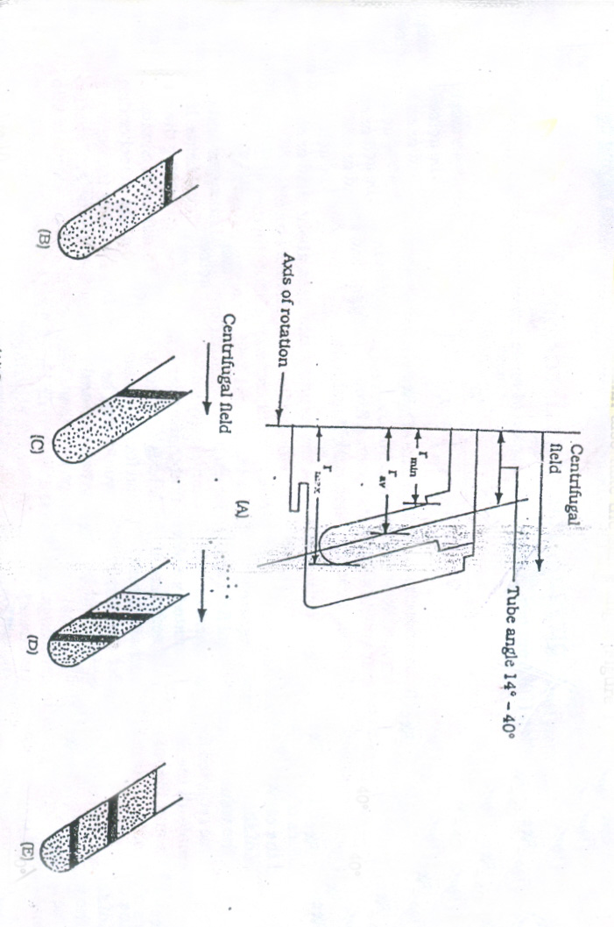
1.Fixed angle rotors-
. 1]These rotors have holes within their body. Since the holes are at an angle [between 14 to 40
degree Celsius ] . The tubes and solution within also take the same angle .Under centrifugal field the particles move radically outward and show wall –effect

Slide 17
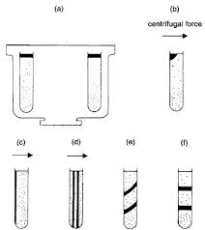
2] VERTICAL TUBE ROTORS
These rotors too have holes within their body and lie parallel to the rotor shaft. As the rotor accelerates and centrifugal field is applied the solution within the tube reorient through 90 degree. this reorientation makes it perpendicular to the axis of rotation. as the rotor decelerates sol orient back to its original position .

Slide 18
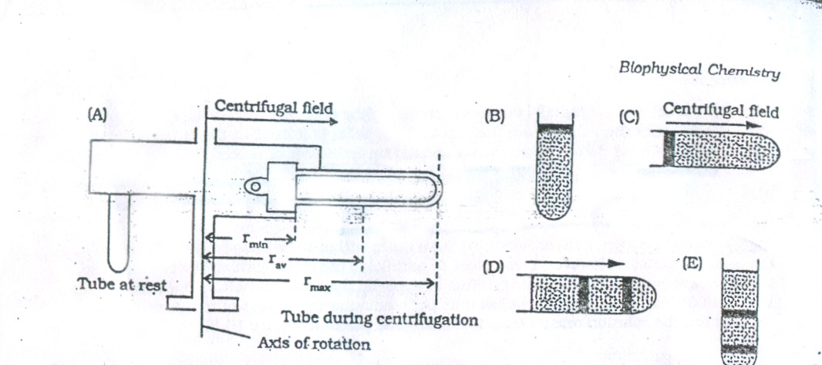
3] SWINGING BUCKET ROTORS
THESE rotors have bucket that swing out a horizontal position when the rotor accelerates. The sol in the tube reorients to lie perpendicular to the axis of rotation and parallel to the applied centrifugal field .When the rotor decelerates the tubes fall back to their original position .These rotor too suffer wall effect.

Slide 19
4]ZONAL ROTOR
In this rotor centrifugation is carried out in sector shaped cell the particles will not make a contact with the wall even they move radically. The zonal rotor is more or less a flattened or sphere which has its interior subdivided into four equal quadrants.

Slide 20
APPLICATIONs OF CENTRIFUGATION
Centrifugation technique is used in separation of milk .The whole milk consists of water and and soluble or non-soluble fats and other solid.The heavier cream tends to flow down the centrifuge container according to the centrifugal force applied by the spinning.
Medical laboratories benefit greatly from this device. Blood plasma and serum are procured for a set amount of time.
Urinalysis in the medical laboratory also finds a great use of human urine can indicate possible disease .The solids within are pulled towards the bottom of the tube by centrifugal force.
Pharmaceutical companies also use vast centrifuges to separate chemicals for analysis and production.
In Biotechnology it is used for the separation of cells.

