Slide 1
Transfusion-Transmitted Infections (TTI)
Dr Surojit Das, PhD
Assistant Professor
Vidyasagar University

Slide 2
Blood Safety
The CDC is one of the federal agencies responsible for assuring the safety of the U.S. blood supply by protecting health through investigations and surveillance. The U.S. Food and Drug Administration (FDA) is responsible for regulating how blood donations are collected and blood is transfused

Slide 3
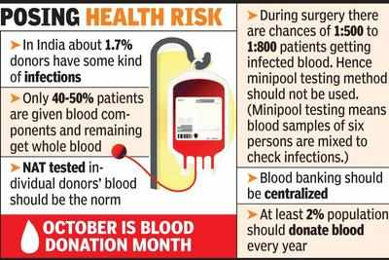

Slide 4
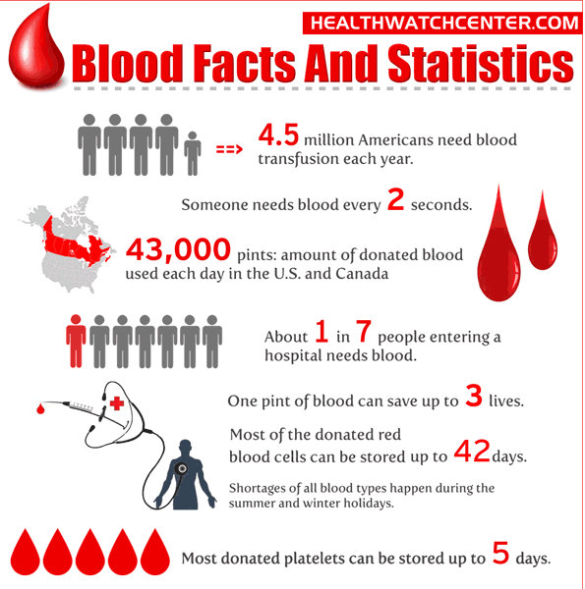
Notes:
Pints: a unit of liquid or dry capacity equal to one eighth of a gallon, in Britain equal to 0.568 litre and in the US equal to 0.473 litre (for liquid measure) or 0.551 litre (for dry measure)

Slide 6
Key Facts
Each day life-saving blood transfusions are needed in hospitals and emergency treatment facilities across the U.S.
There are more than 9.5 million blood donors in the United States and an estimated 5 million patients who receive blood annually, resulting in a total of 14.6 million transfusions per year.
Most patients do not experience any side effects from blood transfusions. On rare occasions, blood transfusions can cause adverse reactions in the patients receiving blood.
Although the U.S. blood supply is safer than ever before, some bacteria, viruses, prions, and parasites can be transmitted by blood transfusions.
Each donor is screened for risk of transmissible disease by questionnaire, and each unit of blood donated in the U.S. is routinely screened for various infectious disease pathogens, including five transfusion–transmitted viruses, using nine laboratory tests.

Slide 8
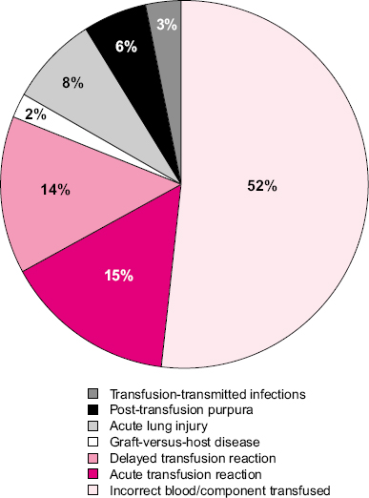
Adverse Reactions Associated with Blood Transfusions
The chance of having a reaction to a blood transfusion is very small. The most common adverse reactions from blood transfusions are allergic and febrile (fever–associated) reactions, which make up over half of all adverse reactions reported. Rare but serious adverse reactions include infection caused by bacterial contamination of blood products and immune reactions due to problems in blood type matching between donor and recipient.
The following is a list of blood transfusion-associated adverse reactions that are tracked through the National Healthcare Safety Network (NHSN) Hemovigilance Module. These adverse reactions are not common following blood transfusions but are tracked so that CDC can better understand them and develop interventions to prevent them.

Slide 9
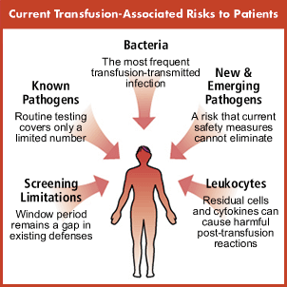

Slide 10
Adverse Reactions Associated with Blood Transfusions
Allergic reaction An allergic reaction results from an interaction of an allergen in the transfused blood with preformed antibodies in the person receiving the blood transfusion. In some instances, infusion of antibodies from the donor may be involved. The reaction may present only with irritation of the skin and/or mucous membranes but can also involve serious symptoms such as difficulty breathing.
Acute hemolytic transfusion reaction (AHTR) An acute hemolytic transfusion reaction is the rapid destruction of red blood cells that occurs during, immediately after, or within 24 hours of a transfusion when a patient is given an incompatible blood type. The recipient’s body immediately begins to destroy the donated red blood cells resulting in fever, pain, and sometimes severe complications such as kidney failure.
Delayed hemolytic transfusion reaction (DHTR) A delayed hemolytic transfusion reaction occurs when the recipient develops antibodies to red blood cell antigen(s) between 24 hours and 28 days after a transfusion. Symptoms are usually milder than in acute hemolytic transfusion reactions and may even be absent. DHTR is diagnosed with laboratory testing.
Delayed serologic transfusion reaction (DSTR) A delayed serologic transfusion reaction occurs when a recipient develops new antibodies against red blood cells between 24 hours and 28 days after a transfusion without clinical symptoms or laboratory evidence of hemolysis. Clinical symptoms are rarely associated with DSTR.
Febrile non-hemolytic transfusion reaction (FNHTR) Febrile non-hemolytic transfusion reactions are the most common reaction reported after a transfusion. FNHTR is characterized by fever and/or chills in the absence of hemolysis (breakdown of red blood cells) occurring in the patient during or up to 4 hours after a transfusion. These reactions are generally mild and respond quickly to treatment. Fever can be a symptom of a more severe reaction with more serious causes, and should be fully investigated.
Hypotensive transfusion reaction A hypotensive transfusion reaction is a drop in systolic blood pressure occurring soon after a transfusion begins that responds quickly to cessation of the transfusion and supportive treatment. Hypotension also can be a symptom of a more severe reaction and should be fully investigated.

Slide 11
Adverse Reactions Associated with Blood Transfusions
Post-transfusion purpura (PTP) Post-transfusion purpura is a rare but potentially fatal condition that occurs when a transfusion recipient develops antibodies against platelets, resulting in rapid destruction of both transfused and the patient’s own platelets and a severe decline in the platelet count. PTP usually occurs 5-12 days after a transfusion and is more common in women than in men.
Transfusion-associated circulatory overload (TACO) Transfusion-associated circulatory overload occurs when the volume of blood or blood components are transfused cannot be effectively processed by the recipient. TACO can occur due to an excessively high infusion rate and/or volume or due to an underlying heart or kidney condition. Symptoms may include difficulty breathing, cough, and fluid in the lungs.
Transfusion-related acute lung injury (TRALI) Transfusion-related acute lung injury is a serious but rare reaction that occurs when fluid builds up in the lungs, but is not related to excessive volume of blood or blood products transfused. Symptoms include acute respiratory distress with no other explanation for lung injury such as pneumonia or trauma occurring within 6 hours of transfusion. TRALI is a leading cause of transfusion-related death reported to the FDA. The mechanism of TRALI is not well understood, but is thought to be associated with the presence of antibodies in donor blood.
Transfusion-associated dyspnea (TAD) Transfusion associated dyspnea is the onset of respiratory distress within 24 hours of transfusion that cannot be defined as TACO, TRALI, or an allergic reaction.
Transfusion-associated graft vs. host disease (TAGVHD) Transfusion-associated graft vs. host disease is a rare complication of transfusion that occurs when donor T-lymphocytes (the “graft”) introduced by the blood transfusion rapidly increase in number in the recipient (the “host”) and then attack the recipient’s own cells. Symptoms include fever, a characteristic rash, enlargement of the liver, and diarrhea that occur between 2 days and 6 weeks post transfusion. Though very rare, this inflammatory response is difficult to treat and often results in death.
Transfusion-transmitted infection (TTI) A transfusion-transmitted infection occurs when a bacterium, parasite, virus, or other potential pathogen is transmitted in donated blood to the transfusion recipient.

Slide 13
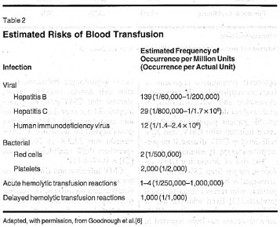

Slide 14
Screening Donated Blood
Blood donors are asked a set of standard questions just before they donate blood to assist in determining if they are in good health and free of any diseases that could be transmitted by blood transfusion. If the donor’s answers indicate they are not well or are at risk for having a disease transmissible by blood transfusion, they are not allowed to donate blood.
If the donor is eligible to donate, the donated blood is tested for blood type (ABO group) and Rh type (positive or negative). This is to make sure that patients receive blood that matches their blood type. Before transfusion, the blood is also tested for certain proteins (antibodies) that may cause problems in a person receiving a blood transfusion.
All blood is tested for evidence of certain infectious disease pathogens, such as hepatitis B and C viruses and human immunodeficiency virus (HIV). The tests used to screen donated blood are listed below.

Slide 15
Screening Donated Blood
Infectious Disease Pathogen | Laboratory Tests Used
Bacterial Contamination | Bacterial culture
Hepatitis B virus (HBV) | Hepatitis B surface antigen (HBsAg) detection Hepatitis B core antibody (anti-HBc) detection
Hepatitis C virus (HCV) | Hepatitis C virus antibody (anti-HCV) detection Nucleic acid amplification testing (NAT) for HCV
Human Immunodeficiency virus Types 1 and 2 (HIV) | HIV-1 and HIV-2 antibody (anti-HIV-1 and anti-HIV-2) detection Nucleic acid amplification testing (NAT) for HIV-1
Human T-Lymphotropic Virus Types I and II (HTLV) | HTLV-I and HTLV-II antibody (anti-HTLV-I and anti-HTLV-II) detection
Treponema pallidum (syphilis) | Anti-treponemal antibody detection
West Nile virus (WNV) | Nucleic acid amplification testing (NAT) for WNV
The following tests are not required for all transfusions but are often performed by blood centers or for special needs patients
Infectious Disease Pathogen | Laboratory Tests Used
Trypanosoma cruzi (Chagas disease) | T. cruzi antibody detection
Cytomegalovirus (CMV) | CMV antibody detection

Slide 16
Diseases and Organisms
Any blood-borne pathogen has the potential to be transmitted by blood transfusion.
Transfusion-transmitted infections (TTIs) are infections resulting from the introduction of a pathogen into a person through blood transfusion.
A wide variety of organisms, including bacteria, viruses, prions, and parasites can be transmitted through blood transfusions.
The use of a standard donor screening questionnaire as well as laboratory tests help to reduce the risk of an infectious organism being transmitted by blood transfusion.

Slide 18
Bacterial Contamination of Blood Products
Bacterial contamination of blood products, especially in platelets that are stored at room temperature, is the most common infectious risk of blood transfusion, occurring in approximately 1 of 2000-3000 platelet transfusions. Transfusion–transmitted sepsis, while less common, can cause severe illness and death. Improved donor screening as well as improved methods of collection, handling, and storing of blood products has decreased bacterial contamination in recent years.
Gram–positive bacteria normally found on the skin, such as Staphylococcus epidermidis or Staphylococcus aureus, are the most common bacterial contaminants of blood products. This type of contamination is thought to occur when the bacteria on the skin is passed into the collected blood through the collection needle.
Gram-negative bacteria can cause infections including pneumonia, bloodstream infections, wound or surgical site infections, and meningitis. Examples include Acineobacter, Klebsiella, and Escherichia coli (E. coli). Gram-negative bacteria are resistant to multiple drugs and are increasingly resistant to most available antibiotics. Bacteria, such as Escherichia coli (E. coli), may contaminate the donation when blood is collected from donors who have bacterial infection without symptoms.
Anaplasmosis
Anaplasmosis is a tickborne disease caused by the bacterium Anaplasma phagocytophilum. It is transmitted to humans by tick bites primarily from the black-legged tick and the western black-legged tick. Symptoms of anaplasmosis include fever, headache, chills, and muscle aches.

Slide 19
Parasitic Diseases
Transmission of parasitic infections through blood donation is very rare. To help minimize the risk of transfusion-transmitted illnesses, including parasitic infections, donors are asked questions to assist in determining if they are in good health. To reduce the risk of transmitting specific infections (e.g., malaria), donors are asked about recent travel to areas where some infections are more common. Examples of parasitic diseases that can be transmitted by blood transfusion are listed below.
Babesiosis
Babesiosis is caused by microscopic parasites that infect red blood cells and are spread by certain ticks. In the United States, tick-borne transmission is most common in particular regions and seasons: it mainly occurs in parts of the Northeast and upper Midwest and usually peaks during the warm months.
Chagas Disease
Chagas disease is caused by the parasite Trypanosoma cruzi, which is transmitted to animals and people by insects. Trypanosoma cruzi is found only in the Americas, and transmission of the parasite occurs mainly in rural areas of Latin America where poverty is widespread. Since 2007, the blood supply has been screened for Chagas disease in the U.S., making the risk of transfusion-transmitted Trypanosoma cruzi extremely rare.
Leishmaniasis
Leishmaniasis includes two major diseases, cutaneous leishmaniasis and visceral leishmaniasis, caused by more than 20 different leishmanial species. Leishmaniasis is transmitted by the bite of small insects called sand flies. The distribution of leishmaniasis is world-wide.
Malaria
Malaria is a serious and sometimes fatal disease caused by a parasite that commonly infects a certain type of mosquito which feeds on humans. People who get malaria are typically very sick with high fevers, shaking chills, and flu-like illness. About 1,700 cases of malaria are diagnosed in the United States each year. The vast majority of cases in the United States are in travelers and immigrants returning from countries where malaria transmission occurs, many from sub-Saharan Africa and South Asia.

Slide 21
Viral Diseases
Like bacteria and parasites, viruses that are blood-borne and can be transmitted by blood transfusion. Donors are asked questions about their social behavior and health history to help minimize the risk of transfusion-transmitted viral diseases. In addition, blood donations are screened by routine testing for five viral diseases that are potentially transfusion-transmitted: HBV, HCV, HIV, HTLV, and WNV. Examples of viral diseases that can be transmitted through transfusion are listed below.
Dengue Fever
Dengue fever (DF) is caused by any one of four related viruses transmitted by the mosquitoes. With more than one-third of the world’s population living in areas at risk for transmission, dengue infection is a leading cause of illness and death in the tropics and subtropics. As many as 100 million people are infected yearly.
Hepatitis A Virus
Hepatitis A is a contagious liver disease that results from infection with the Hepatitis A virus (HAV). Hepatitis A is spread primarily by the fecal-oral route, but transfusion-transmitted HAV infection has been reported. Hepatitis A can range in severity from a mild illness lasting a few weeks to a severe illness lasting several months, and in rare occasions can cause death.
Hepatitis B Virus
Hepatitis B is a contagious liver disease caused by the Hepatitis B virus (HBV). 1.2 million Americans are living with chronic Hepatitis B, most are unaware of their infection. Over time, approximately 15%–25% of people with chronic Hepatitis B develop serious liver problems, including liver damage, cirrhosis, liver failure, and liver cancer. Every year, approximately 3,000 people in the United States and more than 600,000 people worldwide die from Hepatitis B-related liver disease. Since 1972, the blood supply has been screened for Hepatitis B in the U.S., making the risk of transfusion-transmitted HBV extremely rare.

Slide 22
Viral Diseases
Hepatitis C Virus
Hepatitis C is a contagious liver disease caused by the Hepatitis C virus (HBV). Hepatitis C is the most common chronic blood-borne infection in the United States. 3.2 million Americans are living with chronic Hepatitis C, most are unaware of their infection. Chronic Hepatitis C is a serious disease that can result in long-term health problems, including liver damage, cirrhosis, liver failure, and liver cancer. Approximately 12,000 people die every year from Hepatitis C-related liver disease. Since 1992, the blood supply has been screened for Hepatitis C in the U.S., making the risk of transfusion-transmitted HCV extremely rare.
Human Immunodeficiency Virus (HIV)
HIV is the human immunodeficiency virus. It is the virus that can lead to acquired immune deficiency syndrome, or AIDS. CDC estimates that about 56,000 people in the United States contracted HIV in 2006. This risk of transfusion-transmitted HIV is extremely remote due to the rigorous testing of the U.S. blood supply.
West Nile Virus
West Nile virus (WNV) is a potentially serious illness. Experts believe WNV is established as a seasonal epidemic in North America that flares up in the summer and continues into the fall. Symptoms of the illness is include fever, headache, tiredness, aches, and sometimes rash. Although WNV is most often transmitted by the bite of infected mosquitoes, the virus can also be transmitted through contact with infected animals, their blood, or other tissues.

Slide 23
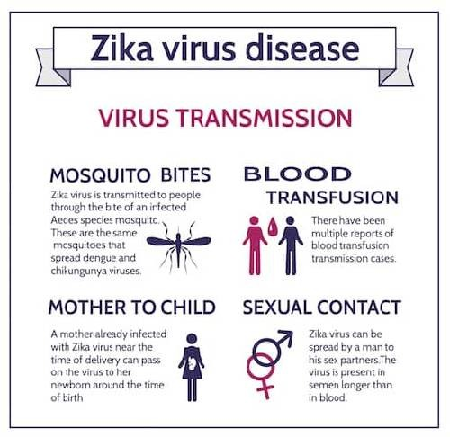

Slide 24
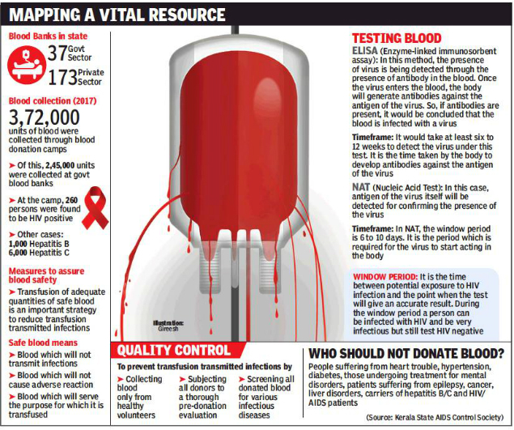

Slide 25
Prion Diseases
Prion Diseases, or transmissible spongiform encephalopathies (TSEs), are a family of rare, progressive neurodegenerative disorders that affect both humans and animals. The causative agent of TSEs is believed to be a prion. A prion is an abnormal, transmissible agent that is able to induce abnormal folding of normal cellular prion proteins in the brain, leading to brain damage and the characteristics signs and symptoms of the disease. Prion diseases are usually rapidly progressive and always fatal. Like viruses, bacteria, and parasites, prions are blood-borne and may be transmitted by blood transfusion.
Variant Creutzfeldt-Jakob Disease (vCJD)
Variant Creutzfeldt-Jakob Disease (vCJD) is a rare, rapidly progressing neurological disease that causes dementia and death. In 1996, cases of this variant form of Creutzfeldt-Jakob Disease (vCJD) were first reported in the United Kingdom.
Transmission of vCJD in the United Kingdom has been thought to be related to transfusions received years earlier with non-leukoreduced red blood cells from healthy donors who became ill with vCJD months to less than 4 years after the donations. Recipients of blood components from other donors later diagnosed with vCJD remain under surveillance in the United Kingdom and France. The magnitude of the risk of acquiring vCJD from transfusion is uncertain.

Slide 26
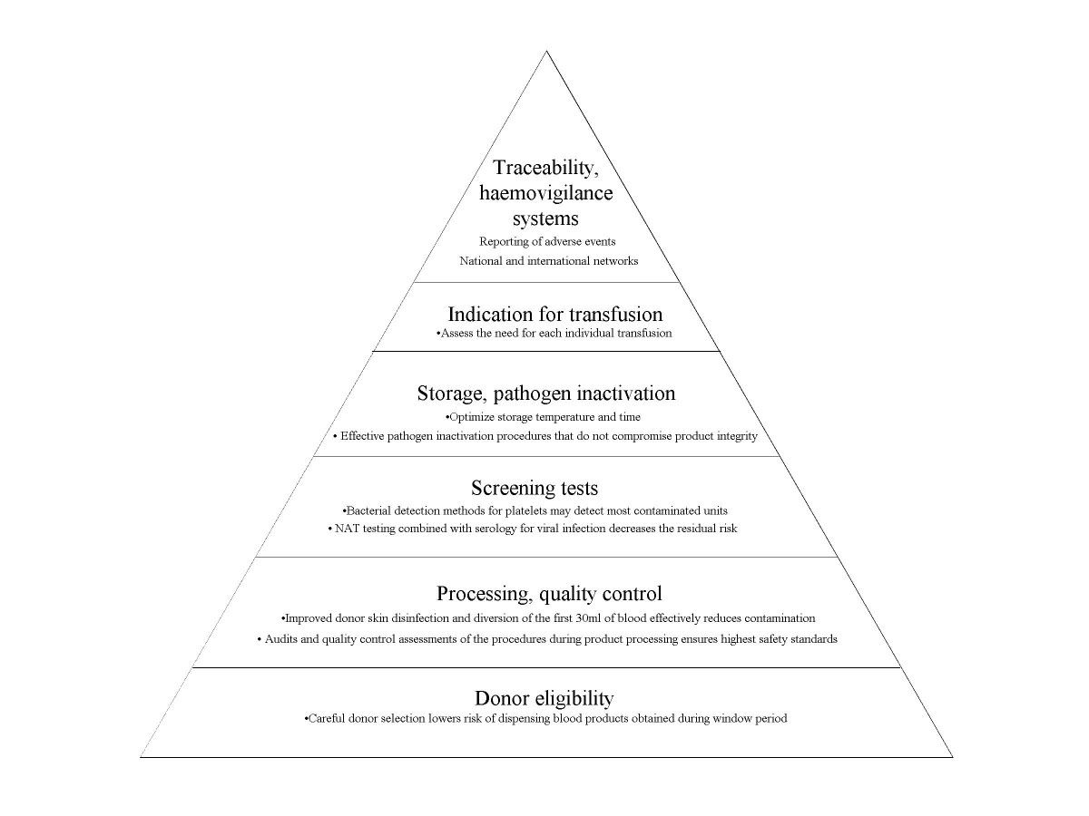
Strategies to Reduce TTIs

