Slide 1
Microbiology 2nd Sem MCB 203B 4. Ligand‐protein interaction
Dr. Nandini Ghosh

Slide 5
Protein- Protein docking software: ClusPro, ZDOCK

Slide 14
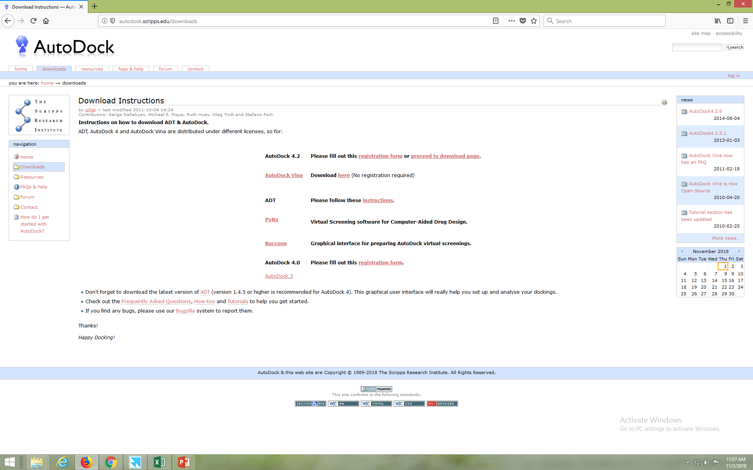
AutoDock Download page: It’s a free suite.
AutoDock4.exe and AutoGrid4.exe
Batch Docking
AutoDockTools, the GUI

Slide 15
AutoDockTools Graphical User Interface
(single target vs single ligand)

Slide 16
Upload the Macromolecule
(single target vs single ligand)
File -----> Read Molecule ----> open ‘.pdb’ file

Slide 17
Process the macromolecule
Edit-----> Delete water -----> Add hydrogen (polar)
Hydrogens (white color)

Slide 18
Upload the Ligand
(single target vs single ligand)
Ligand ----> Input ----> open ‘.pdb’ file

Slide 19
Process the ligand
(single target vs single ligand)
Ligand ----> Torsion tree ----> detect root ----> choose torsions ----> set number of torsions
Ligand ----> Output ----> save as ‘.pdbqt’

Slide 20
Pdbqt format
Charge
REMARK 4 XXXX COMPLIES WITH FORMAT V. 2.0
ATOM 1 N SER A 117 57.695 -55.127 18.685 1.00138.45 -0.055 N
ATOM 2 HN1 SER A 117 58.516 -55.351 19.247 1.00 0.00 0.276 HD
ATOM 3 HN2 SER A 117 56.953 -54.752 19.276 1.00 0.00 0.276 HD
ATOM 4 HN3 SER A 117 57.880 -54.314 18.098 1.00 0.00 0.276 HD
ATOM 5 CA SER A 117 57.189 -56.229 17.877 1.00138.62 0.284 C
ATOM 6 C SER A 117 55.944 -55.889 17.024 1.00135.29 0.265 C
ATOM 7 O SER A 117 54.961 -56.647 17.029 1.00135.29 -0.270 OA
ATOM 8 CB SER A 117 56.870 -57.407 18.797 1.00122.91 0.177 C
ATOM 9 OG SER A 117 55.980 -57.012 19.838 1.00122.01 -0.380 OA
ATOM 10 HG SER A 117 55.782 -57.744 20.410 1.00 0.00 0.211 HD
ATOM 11 N PRO A 118 55.963 -54.754 16.289 1.00158.38 -0.312 N
ATOM 12 CA PRO A 118 54.790 -54.544 15.438 1.00155.81 0.163 C
ATOM 13 C PRO A 118 54.784 -55.432 14.216 1.00156.65 0.251 C
ATOM 14 O PRO A 118 55.826 -55.821 13.696 1.00158.53 -0.271 OA
ATOM 15 CB PRO A 118 54.934 -53.094 14.994 1.00114.59 0.034 C
ATOM 16 CG PRO A 118 56.370 -52.822 15.045 1.00116.31 0.027 C
ATOM 17 CD PRO A 118 56.872 -53.593 16.239 1.00119.03 0.105 C
ATOM 18 N ILE A 119 53.580 -55.726 13.757 1.00111.64 -0.338 N
ATOM 19 HN ILE A 119 52.772 -55.336 14.242 1.00 0.00 0.164 HD

Slide 21
Preparing grid parameter file
(single target vs single ligand)
1
2
Grid ----> macromolecule ----> choose ----> 2XA0 ----> save as ‘.pdbqt’
Grid ----> set map types ----> choose ligand
3
4
Grid ----> grid box ----> set spacing as 1 Å ----> number of points in each dimension as 30 ----> close saving current
Grid ----> Output ----> save as ‘.gpf’

Slide 23
Run AutoGrid

Slide 24
Preparing docking parameter file
Docking ----> Macromolecule ----> Set rigid Filename ----> open 2XA0.pdbqt
Docking ----> Ligand ----> choose
Docking ----> Docking parameters ----> Set all defaults
Docking ----> search parameters ----> Genetic Algorithm
Docking ----> Output ----> Lamarkian GA ----> save as ‘.dpf’

Slide 25
Run AutoDock

Slide 26
Part of .dlg file

Slide 27
Analysis of dockings
Analyze----> Dockings----> open ‘.dlg’
Analyze----> Macromolecule----> open
Analyze----> conformations----> play, ranked by energy

