Slide 1
Communicable Diseases: Health Risk & Prevention
Dr. Surojit Das
PhD
Assistant Professor
Vidyasagar University

Slide 2
Critical World Health Problems
Communicable diseases such as TB, measles, mumps, rubella & polio
Maternal & child health
Diarrheal diseases
Nutritional deficits
Malaria
AIDS

Slide 3
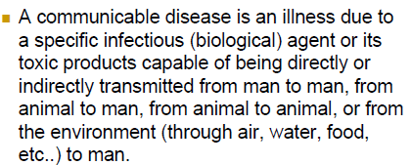
Communicable Diseases
Definition

Slide 4
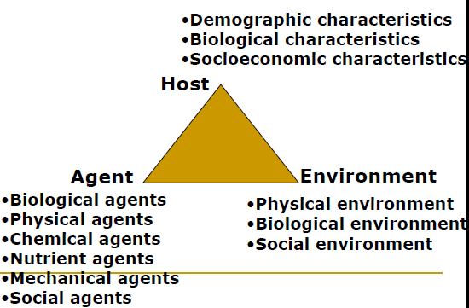
Epidemiologic Triad

Slide 5
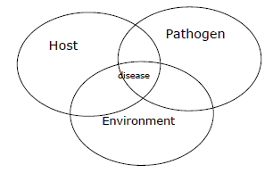
Infectious Disease Model

Slide 6
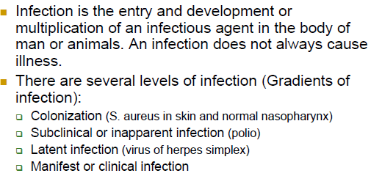
Terminology & Definitions
Health
Complete state of physical, mental & social well-being & not the mere absence of disease
Infection
Contamination

Slide 7
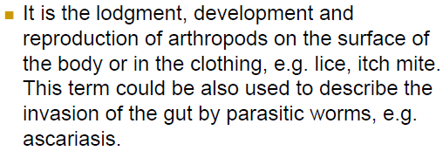
Infestation
Contagious disease

Slide 8
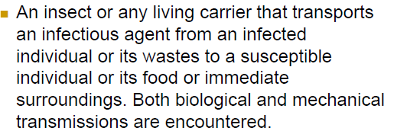
Host
Vector of infection

Slide 9
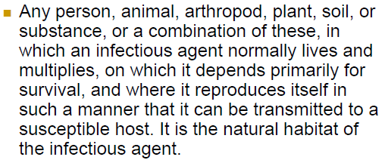
Reservoir

Slide 10
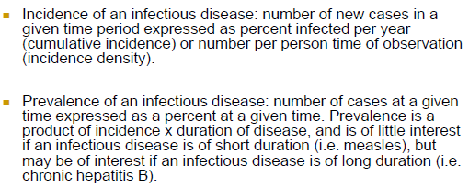
Incidence & prevention of infectious diseases

Slide 11
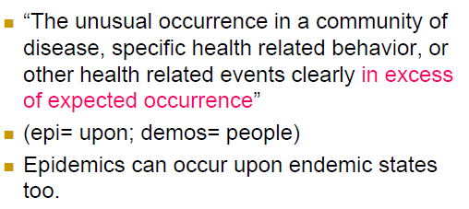
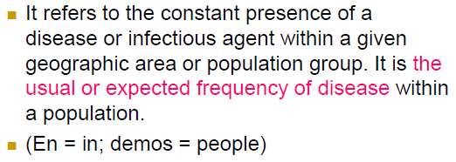
Epidemic
Endemic

Slide 12
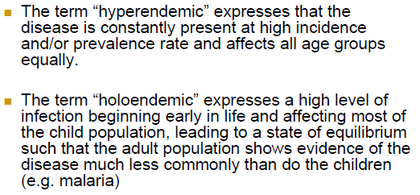
Hyperendemic & Holoendemic

Slide 13
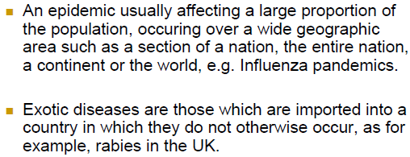
Pandemic & Exotic

Slide 14
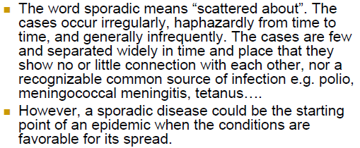
Sporadic

Slide 15
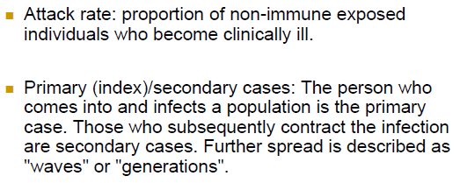
Attack rates & primary/secondary cases

Slide 16
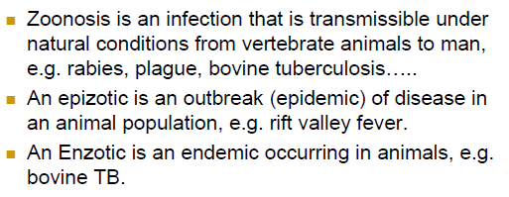
Zoonosis, Epizotic & Enzotic

Slide 17
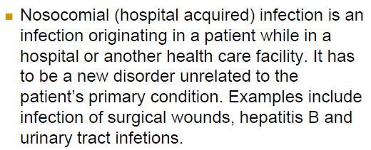
Nosocomial infections

Slide 18
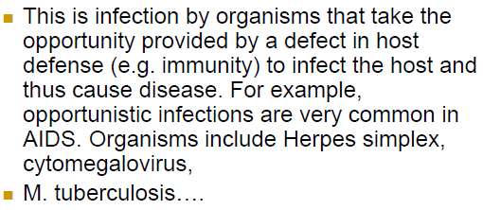
Opportunistic infection

Slide 19
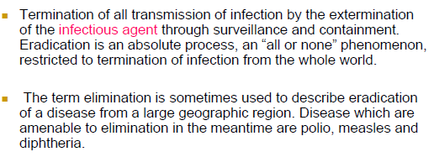
Eradication & Elimination

Slide 20
Reproductive rate of infection

Slide 21
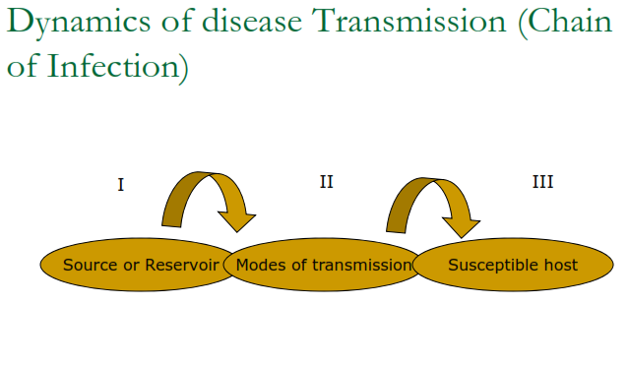

Slide 22
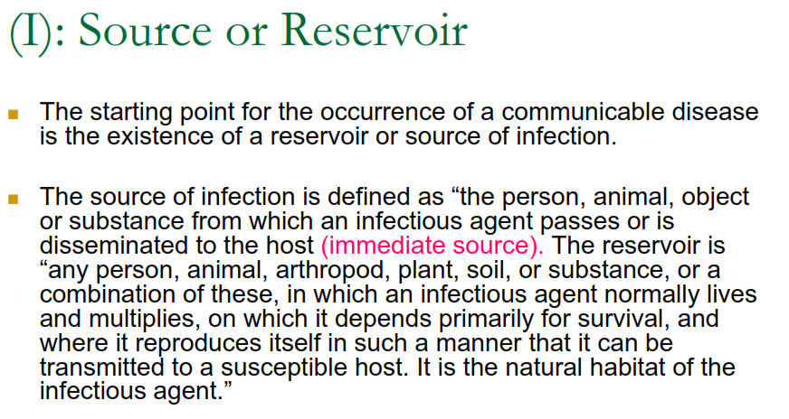

Slide 25
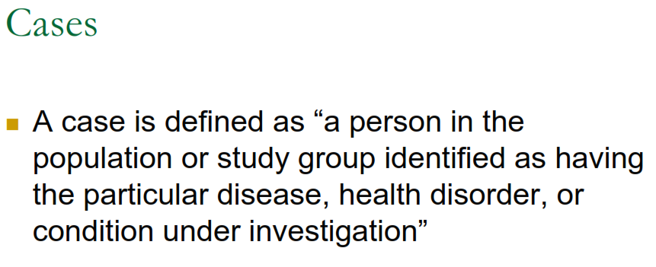

Slide 30
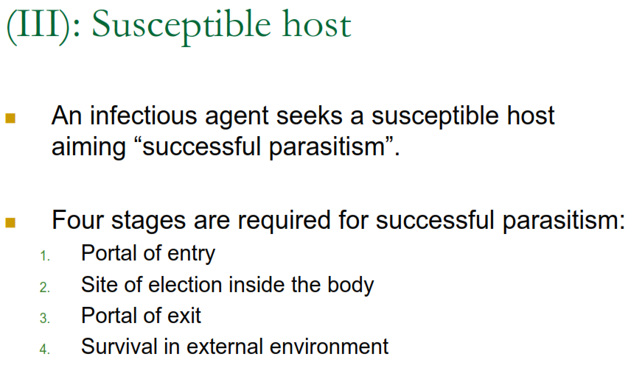

Slide 31
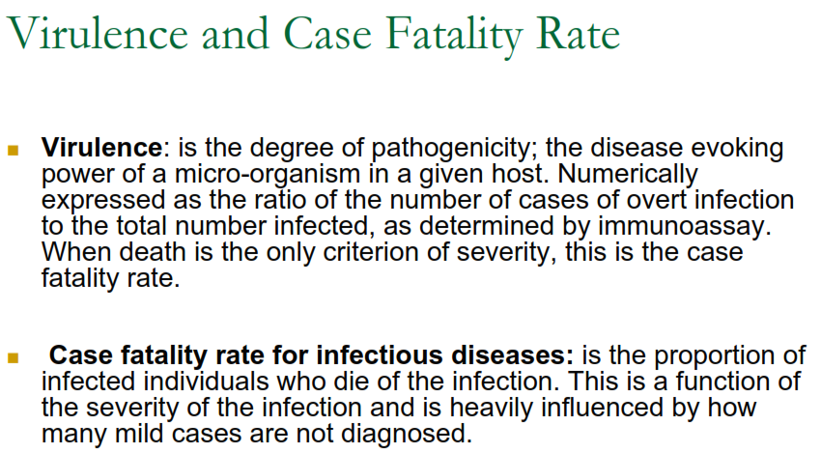

Slide 36
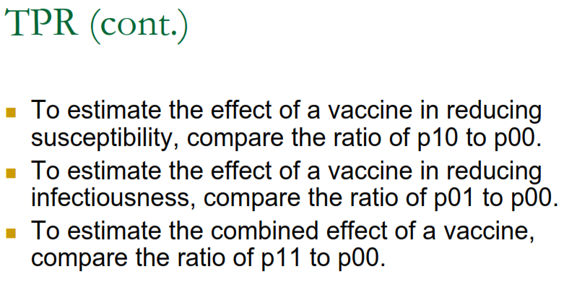

Slide 38
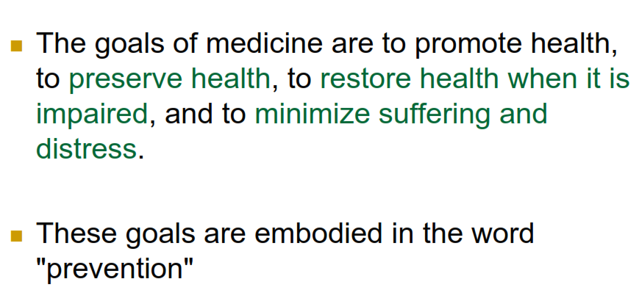

Slide 41
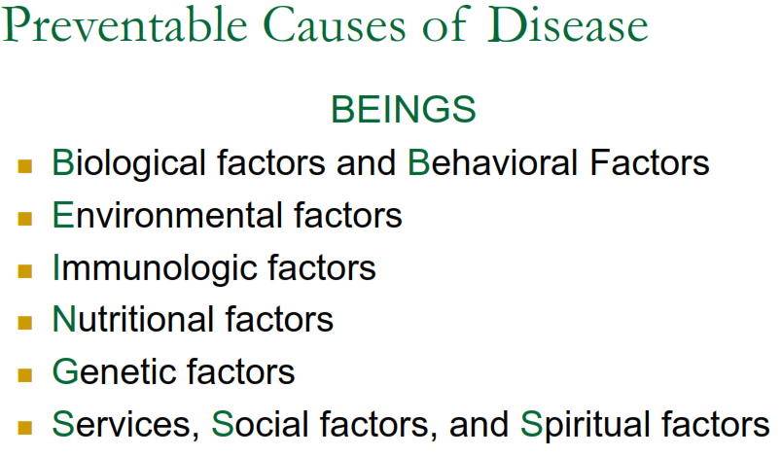

Slide 42
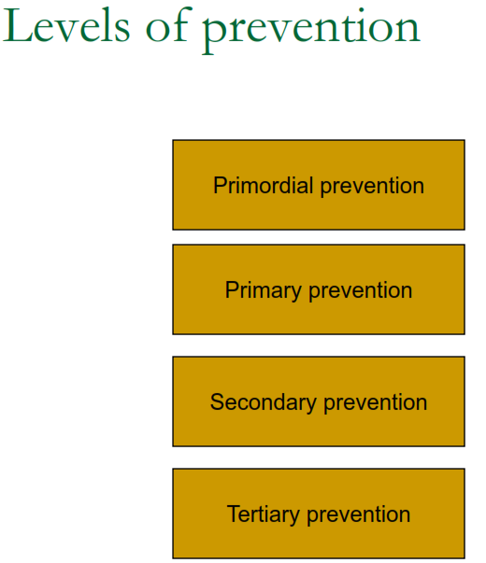

Slide 43
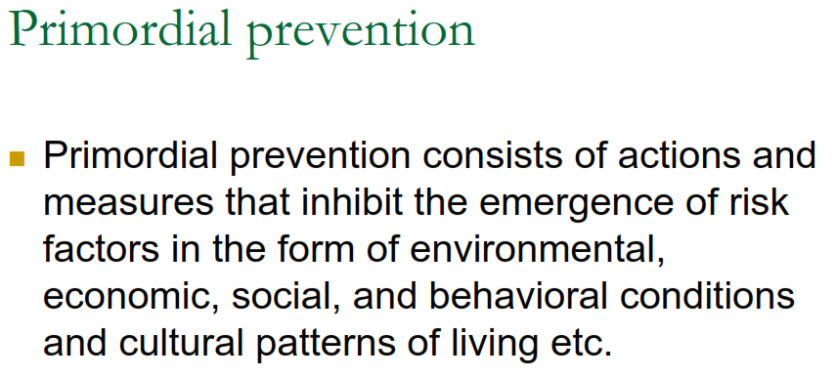

Slide 44
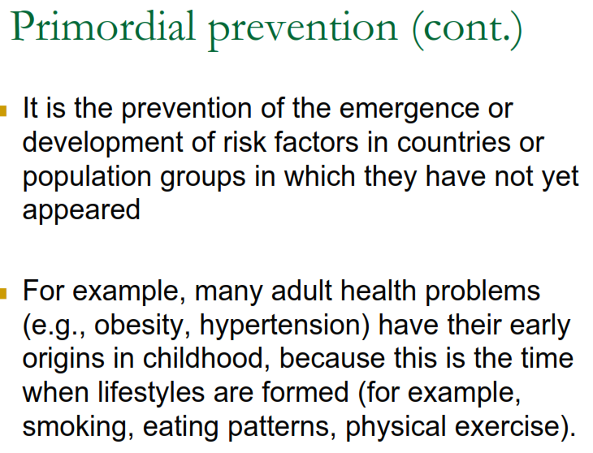

Slide 47
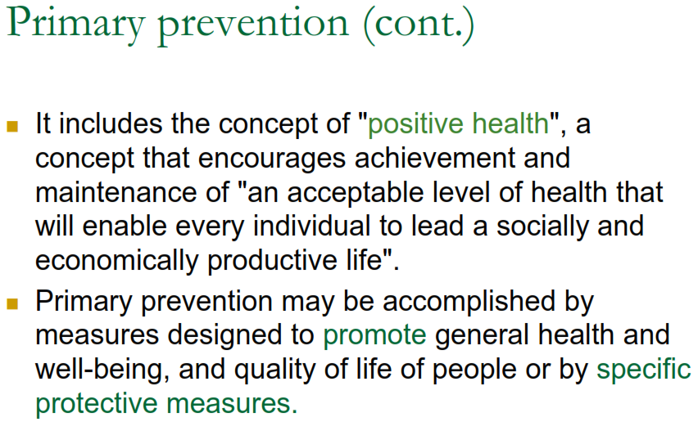

Slide 48
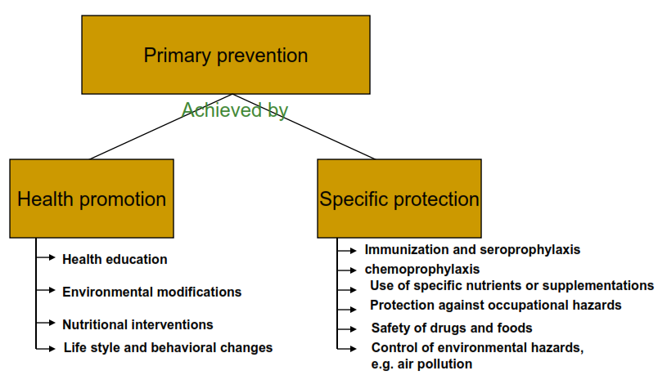

Slide 49
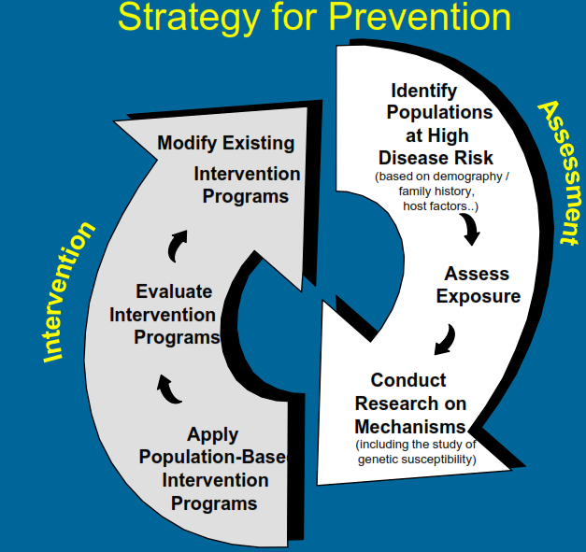

Slide 54
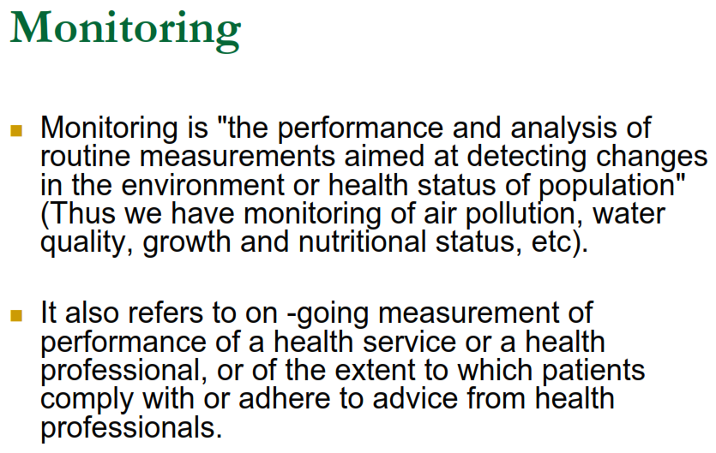

Slide 55
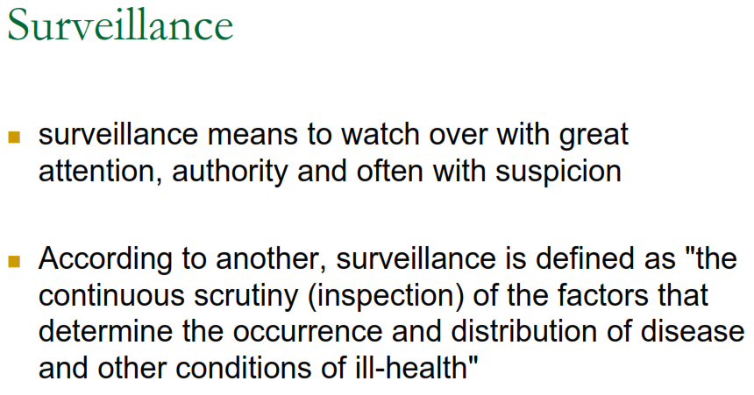

Slide 57
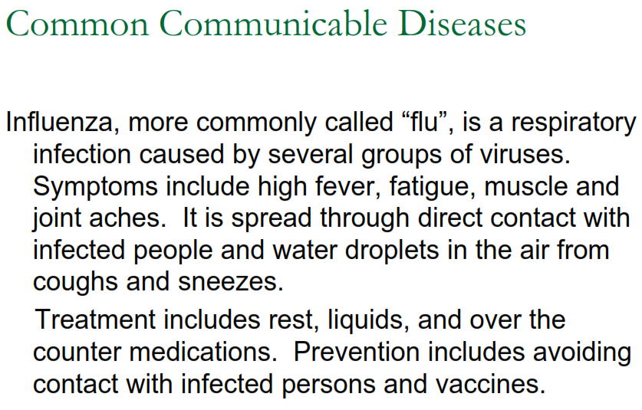

Slide 58
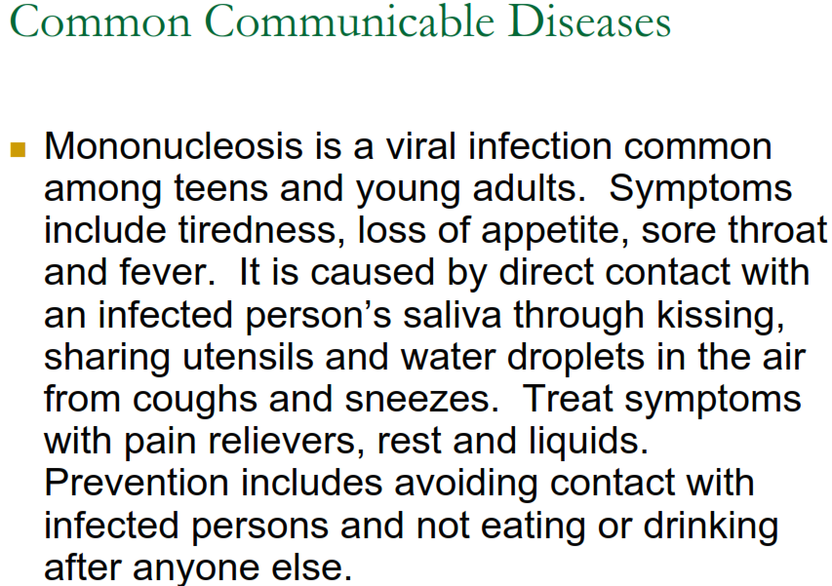

Slide 67
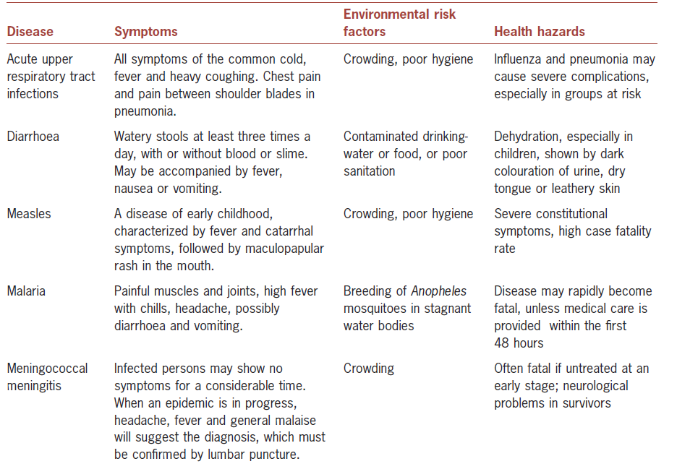

Slide 68
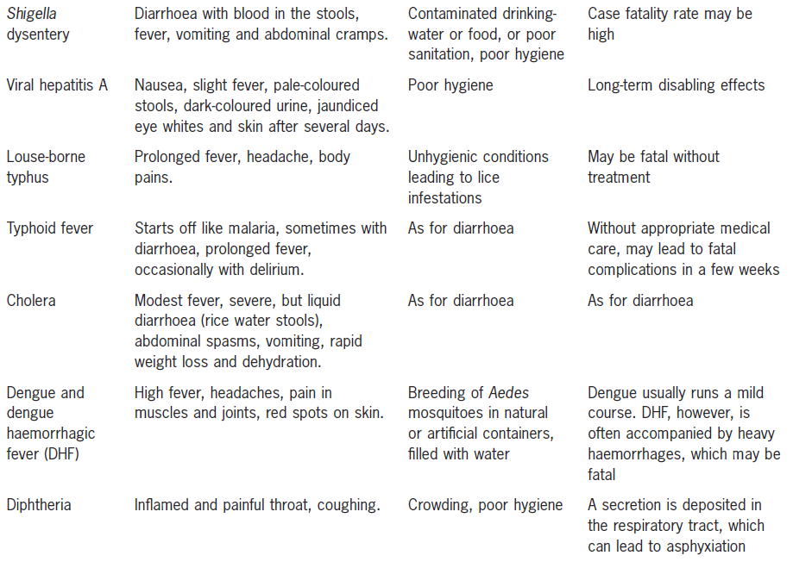

Slide 69
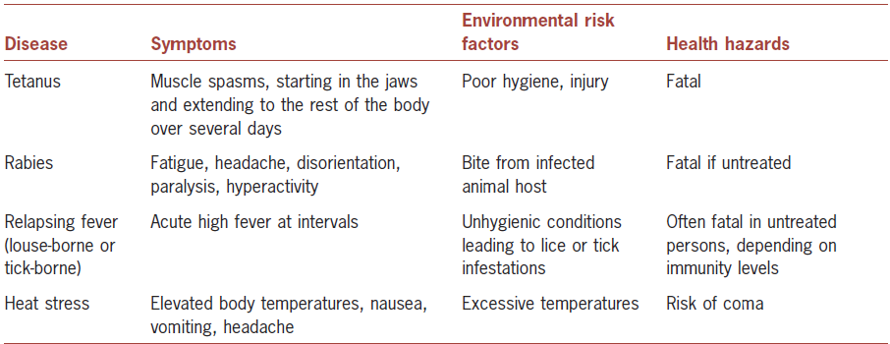

Slide 71
