Slide 1
VIDYASAGAR UNIVERSITY
MIDNAPORE . WEST BENGAL . PIN - 721102
M.Phil
SEMESTER – II
DEPARTMENT OF HISTORY
DR. SHAMITA SARKAR
COURSE : HIS-122 : UNIT-II [Environment and Protest in Independent India ]

Slide 2
PPT PRESENTATION
ON
TEHARI DAM MOVEMENT
COURSE – HIS-122 . UNIT - II
DR. SHAMITA SARKAR

Slide 3
THIS PPT FOR FIVE CLASS LECTURES

Slide 32
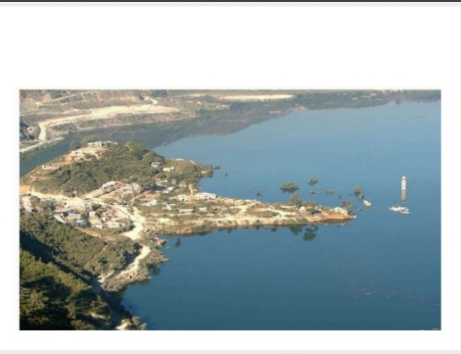

Slide 38
