Slide 1
Introduction to Prolog

Slide 2
Introduction
Prolog is a logical programming language and stands for PROgramming in LOGic
Created around 1972
Preferred for AI programming and mainly used in such areas as:
Theorem proving, expert systems, NLP, …
Logical programming is the use of mathematical logic for computer programming.

Slide 3
Introduction (Cont’d)
For symbolic, non-numeric computation
e.g. : parent (tom, bob).
Parent is a relation between its parameters: tom and bob
The whole thing is called a clause
Each clause declares one fact about a relation

Slide 4
How to Run
We will use SWI-Prolog, one of the many implementation used currently.
Developed at “Swedish Institute of Computer Science”
Start using SWI Prolog and you will get the Prolog
prompt

Slide 5
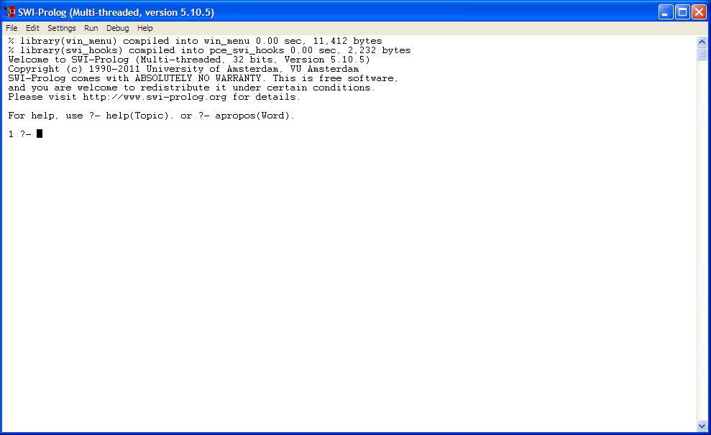
How to Run (Cont’d)

Slide 6
Prolog
Prolog has an interactive interpreter
After starting SWI-Prolog, the interpreter can start reading your Prolog files and accept your queries.
To exit Prolog simply type the command ‘halt.’ (Notice the full-stop)
Prolog program files usually have the extension .pl or .pro

Slide 7
Statements
There are three categories of statements in Prolog:
Facts: Those are true statements that form the basis for the knowledge base.
Rules: Similar to functions in procedural programming (C++, Java…) and has the form of if/then.
Queries: Questions that are passed to the interpreter to access the knowledge base and start the program.

Slide 8
Facts
A fact is a one-line statement that ends with a full-stop.
parent (pam, bob).
parent (tom, bob).
parent (tom, liz).
male (bob).
male (tom).
female (pam).
female (liz).

Slide 9
Rules
A Rule consists of
a condition part (right-hand side) → body of clause
a conclusion part (left-hand side) → head of clause
They are separated by ‘:-’ which means ‘if’
offspring relation
offspring (X, Y) : X is an offspring of Y
∀ X,Y (offspring (X, Y) ← parent (Y, X))
offspring (X, Y) :- parent (Y, X).
head
body

Slide 10
Rules (Cont’d)
Variables in head of rules are universally quantified
Variables appearing only in the body are existentially quantified
Rules vs. Facts
A Fact is something unconditionally true
Rules specify things that are true if some condition is satisfied

Slide 11
Queries
Queries are questions
The engine tries to entail the query (goal) using the Facts and Rules in KB
There are two kinds of answer
Yes/No: parent (tom, bob).
Unified Answer/No: parent (X, bob).
Other possible answer(s) can be found using semicolon (return for stopping)
For example : parent (X, Y).
X=pam
Y=bob;
X=tom
Y=bob;
X=tom
Y=liz;
no

Slide 12
Queries (Cont’d)
Q: Who is a grandparent of Jim? (using parent relationship)
Who is a parent of Jim? Assuming “Y”
Who is a parent of “Y”? Assuming “X”
?- parent (Y, jim) , parent (X, Y).
If we change the order of them the logical meaning remains the same
Q: Who are Tom’s grandchildren?
Q: Are Ann and Pat siblings?

Slide 13
Where the program is written?
Facts and Rules are stored in one or more files forming our Knowledge Base
Files containing KB are loaded into the interpreter
After changing these files, the files should be loaded again to be effective
Queries are asked in the interactive mode in front of the question prompt: ?-

Slide 14
Reading Files
consult (filename).
Reads and compiles a Prolog source file
consult ('/home/user/prolog/sample.pl').
reconsult (filename).
Reconsult a changed source files.
reconsult('/home/user/prolog/sample.pl').
[‘filename’].
['/home/user/prolog/sample.pl'].
make.
Reconsult all changed source files.

Slide 15
Examples
mother (X, Y) :- parent (X, Y) , female (X).
sister (X, Y) :-
parent (Z, X) ,
parent (Z, Y) ,
female (X).
What is wrong with this rule?
Any female is her own sister
Solution?

Slide 16
Comments
Multi-line :
/* This is a comment
This is another comment */
Short :
% This is also a comment

Slide 17
Prolog Syntax
Terms in Prolog:
Simple
Constants:
Atoms
Numbers
Integer
Real
Variables
Complex Structures

Slide 18
Atoms
They should consist of the following set of characters:
The upper-case letters
The lower-case letters
The digits
The special characters: +, -, *, /, <, >, =, :, ., &, ~, _
Atoms should not start with upper-case letters or underscore and can be followed by any set of characters.
The scope of an atom is the whole program

Slide 19
Examples of Atoms
anna, x30, x_, x___y, miss_Jones
<---> , ==>, … , .:. , ::= (except reserved ones like :- )
‘Tom’ , ‘Sarah Jones’ (Useful for having an atom starting with a capital letter)

Slide 20
Numbers
Integer
limited to an interval between some smallest and some largest number permitted by a particular Prolog implementation
e.g. : 1, 1001 , 0 , -98
Real
Not frequently used
e.g. : 3.14 , -0.0035 , 100.2

Slide 21
Variables
Consists of letters, digits and ‘_’
Starting with an upper-case or an ‘_’
The variable ‘_’ (a single underscore character) is a special one. It's called the anonymous variable.
The scope of a variable is its clause
If the name X15 occurs in two clauses, it represents two different variables.
Each occurrence of X15 within the same clause means the same variable

Slide 22
Structures
Compound Objects
Each constituent is a simple object or structure.
e.g. : date (1, jan, 2007)
Components can be variables.
Any day in Jan 2007 → date (Day, jan, 2007)

Slide 23
Conjunction and Disjunction
Conjunction → ,
Disjunction → ;
P :- Q ; R.
P :- Q
P :- R
‘,’ has more priority
P :- Q , R ; S , T , U .
P :- (Q , R) ; (S , T , U) .

Slide 24
Recursion
Define ancestor relation based on parent relation.
ancestor (X, Z) :-
parent (X, Z).
ancestor (X, Z) :-
parent (X,Y) , parent (Y, Z).
ancestor (X, Z) :-
parent (X, I) , parent (I, Y) , parent (Y, Z).
Solution is Recursion

Slide 25
Recursion
Remember from functional programming languages
void func (int a , int b)
{
//base case if (condition)
return;
…
// recursion func (x, y);
…
}

Slide 26
Recursion
Rules in Prolog are like functions in procedural programming languages
For recursion we should define the ancestor relation in terms of itself
Base Case :
ancestor(X, Z) :- parent (X, Z).
Recursion Step :
ancestor (X, Z) :- parent (X, Y) , ancestor (Y, Z).

Slide 27
How Prolog Answers Questions
Instead of starting with simple facts given in the program, prolog starts with the goals. In fact, Prolog does goal driven search.
Using rules, Prolog substitutes the current goals (which matches a rule head) with new sub-goals (the rule body), until the new sub-goals happen to be simple facts.
Prolog returns the first answer matching the query. When prolog discovers that a branch fails or if you type ‘;’ to get other answers, it backtracks to the previous node and tries to apply an alternative rule at that node.

Slide 28
Example
Facts:
parent (pam, bob). parent (tom, bob). parent (tom, liz).
parent (bob, ann). parent (bob, pat). parent (pat, jim).
Rules:
ancestor (X, Z) :- parent (X, Z).
ancestor (X, Z) :- parent (X, Y) , ancestor (Y, Z)
?- ancestor (tom, pat). (goal)
The rule that appears first, is applied first
Unifying: {tom/X} , {pat/Z}
The goal is replaced by : parent (tom, pat). (sub-goal)
Fails ⇒ backtracking

Slide 29
Example (Cont’d)
Applying the next rule
2. ancestor (X, Z) :- parent (X, Y) , ancestor (Y, Z)
Unifying: {tom/X} , {pat/Z}
New Goal: parent (tom, Y) , ancestor (Y, pat)
Prolog tries to satisfy them in order in which they are written
The first one matches one of the facts {bob/Y}
Second sub-goal: ancestor (bob, pat)
The same steps should be done for this sub-goal

Slide 30
Orders of Clauses and Goals
ancestor (X, Z) :- parent (X, Z).
ancestor (X, Z) :- parent (X, Y) , ancestor (Y, Z).
2. ancestor (X, Z) :- parent (X, Y) , ancestor (Y, Z).
ancestor (X, Z) :- parent (X, Z).
3. ancestor (X, Z) :- parent (X, Z).
ancestor (X, Z) :- ancestor (Y, Z) , parent (X, Y).
4. ancestor (X, Z) :- ancestor (Y, Z) , parent (X, Y).
ancestor (X, Z) :- parent (X, Z).

Slide 31
Orders of Clauses and Goals
It turns out that :
The first and second variations are able to reach and answer for ancestor.
The third sometimes can and sometimes can’t
And the forth can never reach and answer (infinite recursion)
“Try simple things first”.

Slide 32
More about Prolog
A collection of facts and rules is called a knowledge base (KB).
Prolog works based on “first-order predicate logic”
Matching corresponds to what is called “Unification”.
Prolog has no data types

