Slide 1
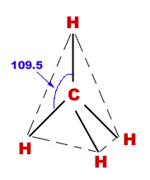
Application of Nanotechnology as NANO FERTILIZERS

Slide 2
CONTENTS
INTRODUTION
WHAT IS NANO-TECHNOLOGY
APPLICATIONS OF NANO-TECHNOLOGY
NANO FERTILIZERS IN INDIA
WHY WE WANT TO USE NANO-FERTILIZERS
MANUFACTURING METHODS OF NANO-FERTILIZERS
COMPARISION OF NANO FERTILIZERS AND ORDINARY FERTILIZERS
TYPES OF NANO FERTILIZERS
ADVANTAGE AND DISADVANTAGE OF NANO FERTILIZERS
CONCLUSION

Slide 3
INTRODUCTION
Agriculture is always the backbone of many developing countries.
In agriculture the main reason to use fertilizer is to give full-fledged macro and micro nutrients which usually soil lacks.
35-40% of the crop productivity depends upon fertilizer, but some of the fertilizer affects the plant growth directly.
To overcome all these drawbacks a smarter way i.e., nanotechnology can be one of the source.

Slide 4
Since fertilizers are the main concern, developing nano based fertilizer would be a new technology in this field.
Fertilizers are sprayed in many ways either to soil or through leaves, even to aquatic environments; these inorganic fertilizers are supplied in order to provide three main components, nitrogen, phosphorous and potassium in equal ratios

Slide 5
NANO FERTILIZER IN INDIA
An Indian agro-scientist has innovated nano-fertilisers using biosynthesis, for the first time in the world.
The newly developed nano-fertiliser will bring down the use of chemical fertilizers by 80-100 times, thus saving considerable foreign exchange in import of fertilizers.

Slide 6
WHY WE WANT TO USE NANO-FERTILIZERS
Nano-fertilisers are more beneficial as compared to chemical fertilizers
(i) Three-times increase in Nutrient Use Efficiency (NUE)
(ii) 80-100 times less requirement to chemical fertilizers
(iii) 10 times more stress tolerant by the crops
(iv) Complete bio-source, so eco-friendly

Slide 7
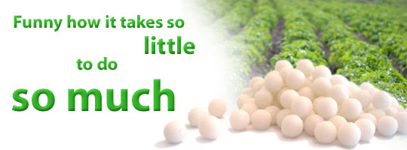
(v) 30% more nutrient mobilization by the plants.
(vi) 17-54 % improvement in the crop yield.

Slide 8
MANUFACTURING METHODS OF NANO-FERTILIZERS
The fertilizer was prepared by developing a methodology to use microbial enzymes for breakdown of the respective salts into nano-form.
Nano-fertilisers in India and for the first time in the world developed biosynthesis process to make nano-fertilisers.

Slide 9
Freshly prepared apatite nano particle suspensions in the absence of CMC (left) and in the presence of CMC (right)

Slide 10
COMPARISION OF NANO FERTILIZERS AND ORDINARY FERTILIZERS
When comparing to chemical fertilizers requirement and cost, nano fertilizers are economically cheap and are required in lesser amount.

Slide 11
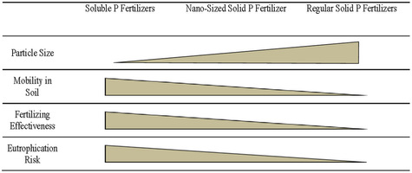

Slide 14
Growth of soybean plants under different treatments

Slide 16
TYPES OF NANO FERTILIZERS
Nano porous Zeolite
Zinc Nano Fertilizer
Nano Herbicide
Nano Pesticide
Carbon Nano tube
Nano Aptamers
Boron Nano fertilizers

Slide 17
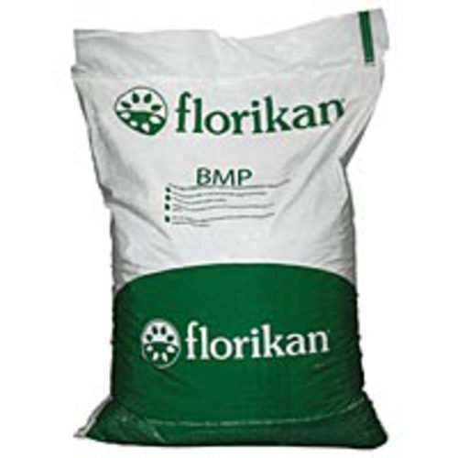
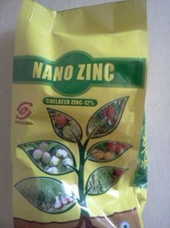
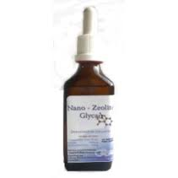
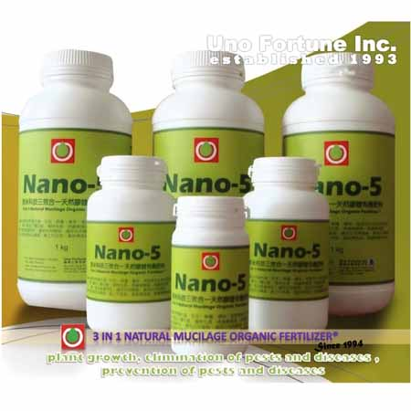

Slide 19
TYPES OF NANO FERTILIZERS
Nano porous Zeolite
Zinc Nano Fertilizer
Nano Herbicide
Nano Pesticide
Carbon Nano tube
Nano Aptamers

Slide 20
ADVANTAGES OF NANO FERTILIZERS
Nano coatings and technology can help in numerous ways to reduce costs and increase productivity around the farm.
Improvement in soil aggregation, moisture retention and carbon build up.
The yield per hectare is also much higher than conventional fertilizers, thus giving higher returns to the farmers.

Slide 21
DISADVANTAGES OF NANO FERTILIZERS
The Catchy term 'Nanotechnology' also pose some risks and problem towards the health and also towards environment.
When considering risk and safety interm of the same will be relevant to only certain area.
The initial studies performed for nano materials have caused serious health hazards and also showed toxic effects, also when entered into human body caused tissue damage reaching all the vital organs.

Slide 23
CONCLUSION
Nanotechnology in many fields is in its primary stage, seeing al such new innovations it clearly tells that it has a great scope and for any new technology to that matter there will be objection and rejections, overcoming all the myths and ethics this will reach heights in its own manner.
This technology will help in feeding generations and not a single one.
There is awareness created on the risks of consuming and performing few operations rather than the benefits and effectiveness of the technology.

