Slide 1
Disorders of the Testes & Male Reproductive System
Dr Surojit Das, PhD
Assistant Professor
Vidyasagar University

Slide 2
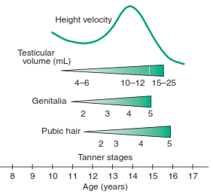
Normal Male Pubertal Development

Slide 3
Tanner stages/scale
The Tanner scale (also known as the Tanner stages) is a scale of physical development in children, adolescents and adults. The scale defines physical measurements of development based on external primary and secondary sex characteristics, such as the size of the breasts, genitals, testicular volume and development of pubic hair. This scale was first identified by James Tanner, a British pediatrician, and thus bears his name.
Due to natural variation, individuals pass through the Tanner stages at different rates, depending in particular on the timing of puberty. In HIV treatment, the Tanner scale is used to determine which treatment regimen to follow (adult, adolescent or paediatric).

Slide 4
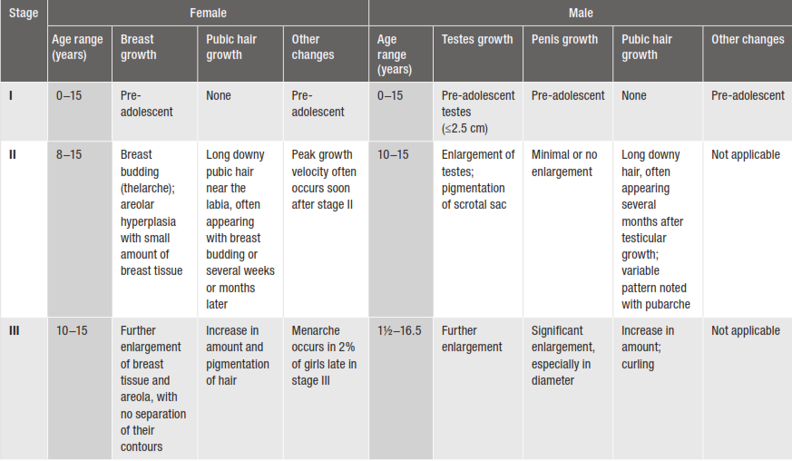
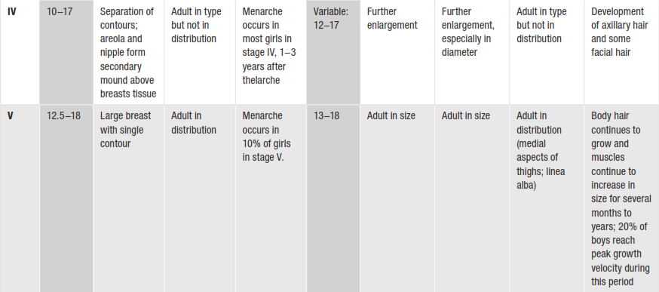
Sexual maturity Rating (Tanner staging) in Adolescents
Notes:
Menarche: The 1st menstrual cycle, or 1st menstrual bleeding in female humans.

Slide 5
Regulation of Testicular Function

Slide 6
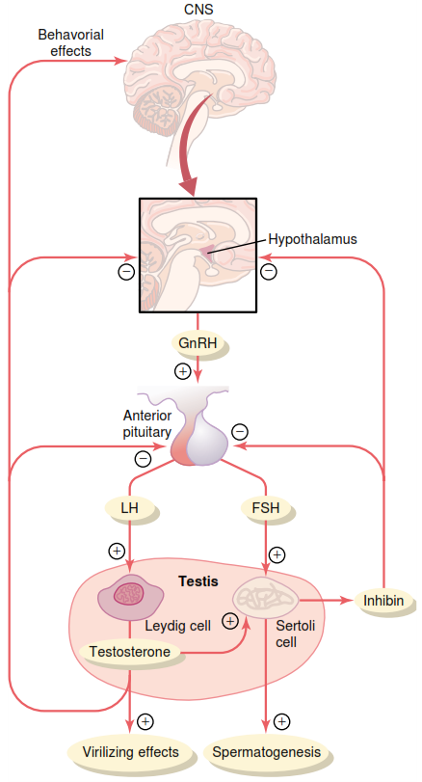
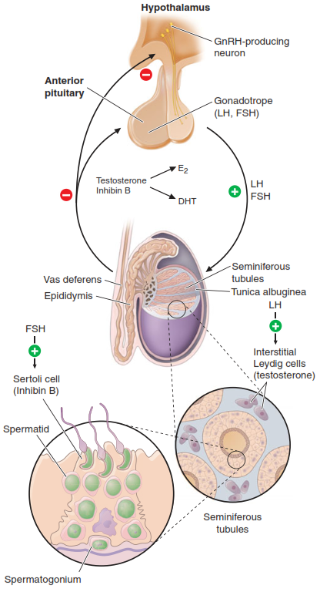
Feedback Regulation of the Hypothalamic-Pituitary-Testicular Axis in Adult Man

Slide 7
GnRH, LH, FSH
Gonadotropin releasing hormone (GnRH)
Secreted by hypothalamus into hypothalamo-hypophyseal portal system
Increases at puberty, less sensitivity to testosterone feedback
Pulsatile release ~90 min → pulsatile LH & FSH release
Luteinizing hormone (LH)
From anterior pituitary, stimulated by GnRH, inhibited by testosterone
Acts on Leydig cells of testis →↑ testosterone release
Follicle stimulating hormone (FSH)
From anterior pituitary, stimulated by GnRH, inhibited by inhibin
Acts with testosterone on Sertoli cells to promote spermatogenesis
Note: LH & FSH are produced by the same anterior pituitary cell.
Notes:
Pulsatile: Beating rhythmically.

Slide 8
Testosterone
Source
synthesized & released by Leydig (interstitial) cells of testis
release stimulated by LH
Actions
inhibits release of GnRH & LH (not FSH)
stimulates spermatogenesis (in conjunction with FSH)
stimulates differentiation of male genitalia (in utero)
stimulates development of male 2° sexual characteristics at puberty
growth & development of internal/external genitalia
bone growth and epiphyseal plate closure, muscle development
axillary, pubic, body hair, male pattern baldness
fat distribution, laryngeal growth, sebaceous glands
behavioral effects, libido, aggression
Mechanism: steroid, androgen binding protein, ↑ transcription, ↑ translation
Notes:
In ureto: in the womb/in the uretus

Slide 9
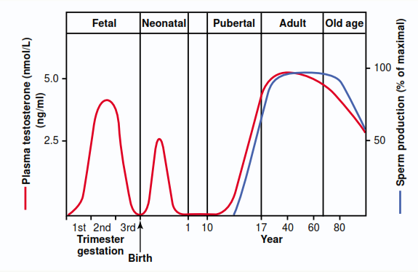
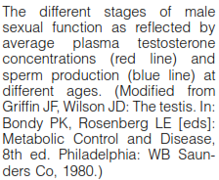

Slide 10
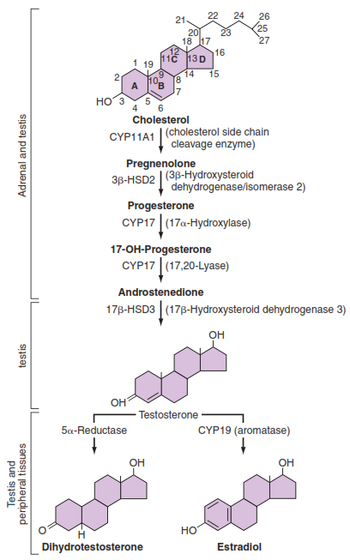
The Leydig Cell: Androgen Synthesis
Notes:
Androgen: Any steroid hormone that has masculinizing effects, including testosterone & dihydrotestosterone.

Slide 11
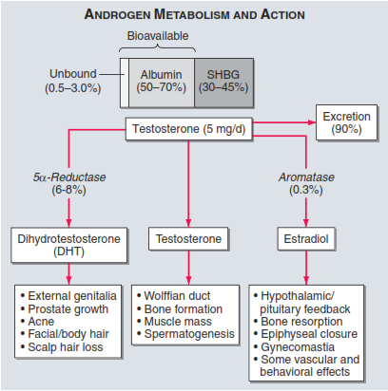
Circulating testosterone is bound to two plasma proteins: albumin & sex hormone-binding globulin (SHBG).
Acc. to the “free hormone” hypothesis, only the unbound fraction is biologically active.
Albumin-bound hormone dissociates readily in the capillaries & may be bio-available.
Testosterone is metabolized predominantly in the liver, although some degradation occurs in the peripheral tissues, particularly the prostate & skin.

Slide 12
Clinical & Laboratory Evaluation of Male Reproductive Function

Slide 13
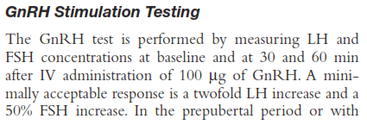
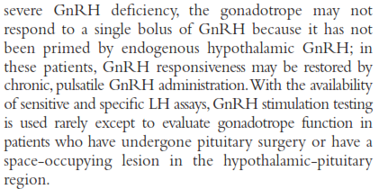
Gonadotropin (LH, FSH) & Inhibin Measurements

Slide 14
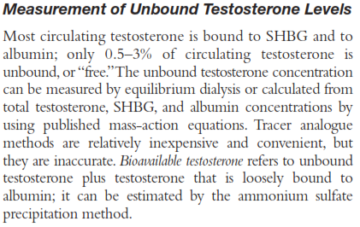
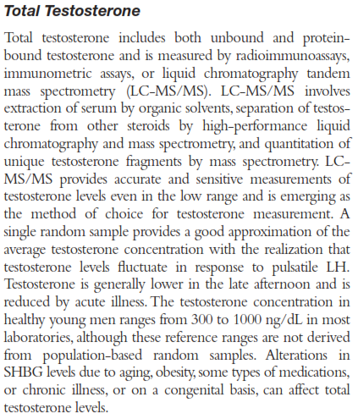
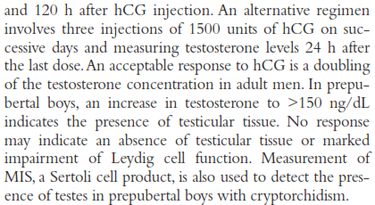
Testosterone Assays

Slide 15
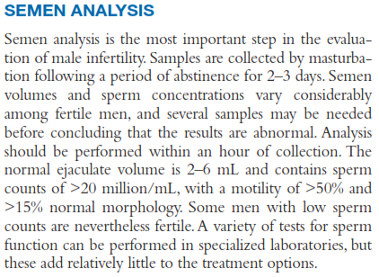

Slide 16
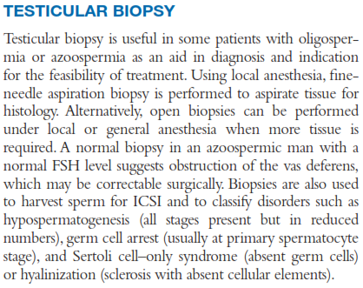
Notes:
ICSI- Intracytoplasmic sperm injection

Slide 17
Abnormal Spermatogenesis & Male Fertility

Slide 18
Effect of temperature on spermatogenesis
Increasing the temp. of the testes can prevent spermatogenesis by causing degeneration of most of the cells of seminiferous tubules.
Cryptorchidism
Failure of testes to descend from the abdomen into the scrotum at or near the time of birth of a fetus
Effect of sperm count on fertility
Semen ejaculate: 3.5 ml
Sperm count: 120 million/ml (35-200 million/ml)
Ave. total sperm per ejaculate: 400 million
Infertility: <35 million/ml sperm

Slide 19
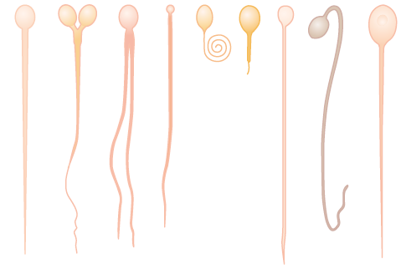
Effect of sperm morphology & motility on fertility
<<<<<<<<<<<Abnormal>>>>>>>>>>
Normal

Slide 20
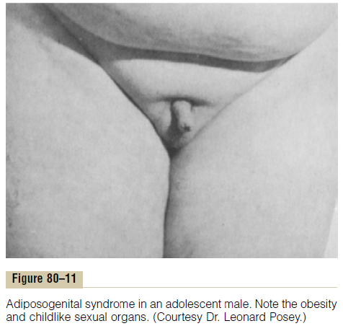
Abnormalities of Male Sexual Function
Prostate gland & its abnormalities
Benign prostatic fibroadenoma: This hypertrophy is caused by abnormal overgrowth of prostate tissue but not by testosterone in many older men & cause urinary obstruction.
Prostatic cancer: Stimulates by testosterone & are inhibited by removal of both testes or by administration of estrogens.
Hypogonadism: Primary testicular failure originates form a problem in the testicles or in the hypothalamus or the pituitary gland (parts of the brain that signal the testicles to produce testosterone) [Fig. 80.11].
Hypergonadism: Interstitial Leydig cell tumors develop in the testes producing higher amounts of testosterone.

