Slide 1
Nutritional Analysis Software
Dr Surojit Das
Assistant Professor
Vidyasagar University

Slide 2
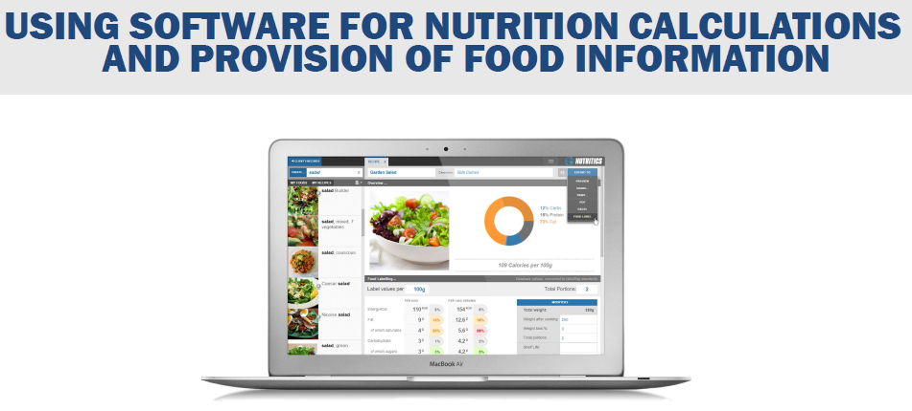

Slide 4
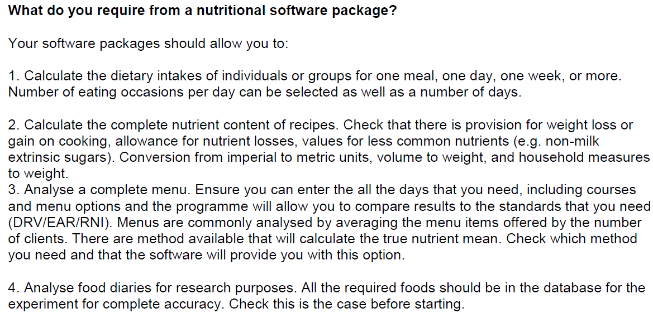
Notes:
DRV: Dietary Ref. Value
EAR:
RNI:Ref. Nutrient Intake

Slide 7
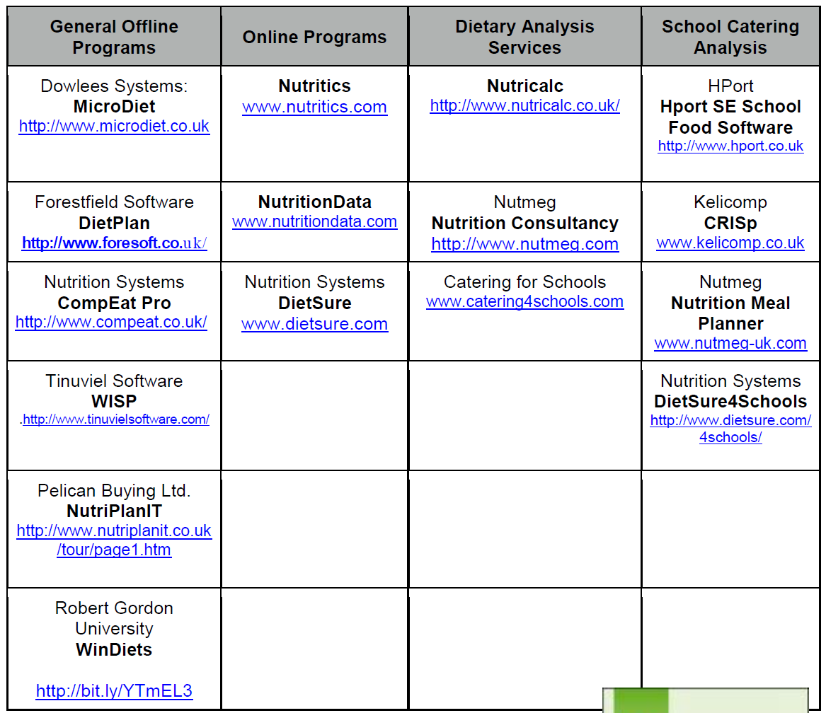

Slide 9
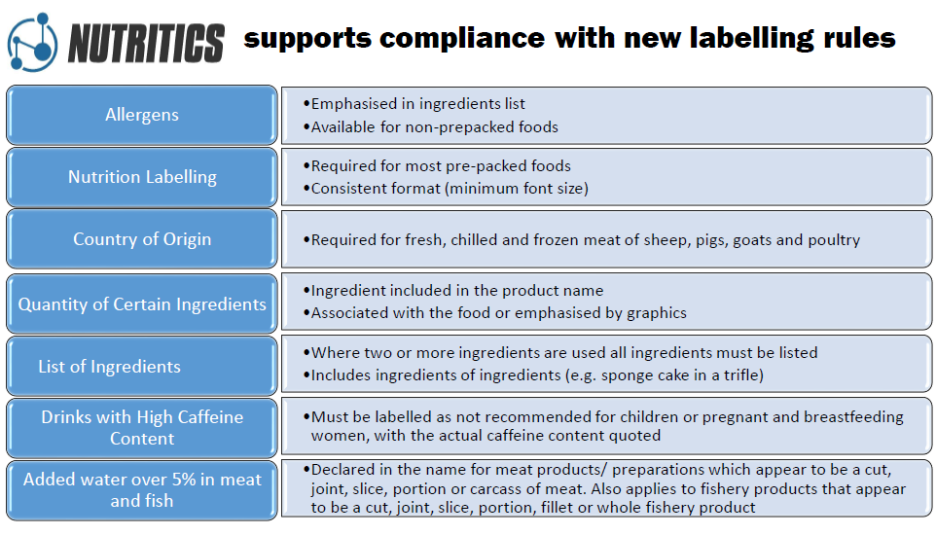

Slide 10
