Slide 1
Department of Political Science, Vidyasagar University M.Phil
Lecture Delivered by
Professor Sibaji Pratim Basu
Date: 17/09/2019

Slide 2
Mikhail Bakhtin (1895-1975)
Dialogic Imagination & Heteroglossia

Slide 3
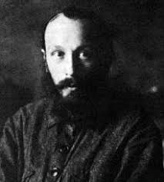
Bakhtin
The Russian Literary Theorist

Slide 4
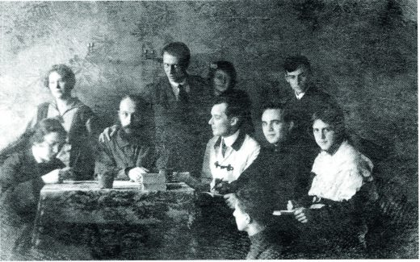
The Bakhtin Circle
Bakhtin introduced a ‘dialogical’ method for reading prose, especially novels.
Problems of Dostyevsky’s Poetics is a very important work of Bakhtin.

Slide 5
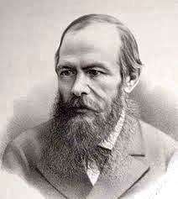
Fyodor Dostoyevsky (1821-1881)
One of the great Russian novelists and story writers. Important works include: Crime and Punishment; The Brothers Karmazov; The Idiot etc.

Slide 6
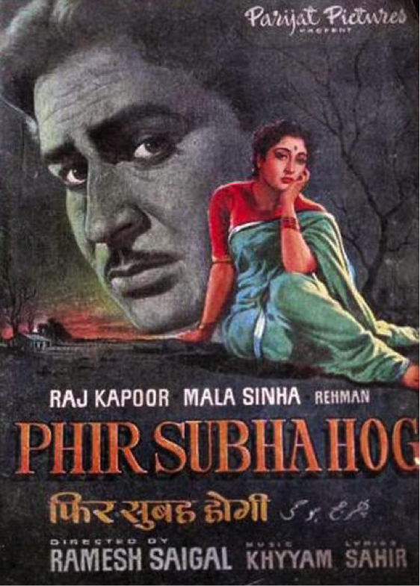
Dostyevsky’s Stories in Indian Films Crime and Punishment
As Raj Kapoor starrer
Phir Subha Hogi (1958)
https://www.youtube.com/watch?v=6PcQcFZ7GOw

Slide 7
Saawariya (2007)
Adopted from Dostoyevsky’s White Night
https://www.youtube.com/watch?v=_Xw5S3cT1PE

Slide 8
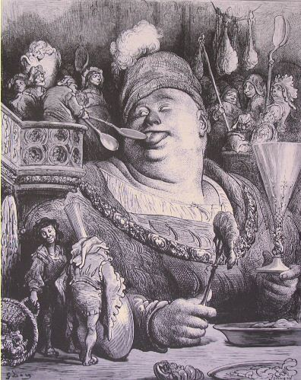
Bakhtin
Rabelais and His World : Carnival and Grotesque
First published in English in 1965

Slide 9
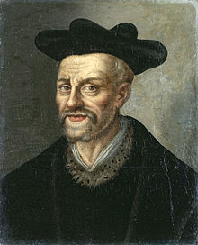
François Rabelais (Between 1483 and 1494-1553)
The French Renaissance Humourist

Slide 10
Dialogic Imagination (1)
Bakhtin contrasts the dialogic and the "monologic" work of literature. Dialogic means relates to or is characterized by dialogue and its use. A dialogic is communication presented in the form of dialogue. Dialogic processes refer to implied meaning in words uttered by a speaker and interpreted by a listener. Dialogic works carry on a continual dialogue that includes interaction with previous information presented. The term is used to describe concepts in literary theory and analysis as well as in philosophy.

Slide 11
Dialogic Imagination (2)
The term 'dialogic' does not only apply to literature. For Bakhtin, all language—indeed, all thought—appears as dialogical. This means that everything anybody ever says always exists in response to things that have been said before and in anticipation of things that will be said in response. In other words, we do not speak in a vacuum. All language (and the ideas which language contains and communicates) is dynamic, relational and engaged in a process of endless re-descriptions of the world.

Slide 12
Heteroglossia (1)
The term heteroglossia describes the coexistence of distinct varieties within a single "language”. In this way the term was introduced by Bakhtin in his 1934 paper published in English as "Discourse in the Novel."
Bakhtin argues that the power of the novel originates in the coexistence of, and conflict between, different types of speech: the speech of characters, the speech of narrators, and even the speech of the author. He defines heteroglossia as "another's speech in another's language, serving to express authorial intentions but in a refracted way"(1934).

Slide 13
Heteroglossia (2)
Heteroglossia is all the different ways people speak to one another: and how each appropriates each other's speech/ideas and attempts to make it their own. These different ways are different because of class, gender, culture, dialect, accent, demographics, and so on. A peasant will speak a certain way to another peasant, and he/she will speak a very different way to a city official. The complexity of these different ways of speaking reflect all the baggage of culture, economics and so on.

Slide 14
Heteroglossia (3)
Heteroglossic method is very much in the postmodern theory: democratization and pluralization of meaning, inter-relatedness, hybridity, and intertextuality of culture in languages. The method is decentralizing what is a formal unity: the novel - by recognizing the complex of multiple ideologies as manifested through different ways of speaking.
Bakhtin referred to the authoritative (and sometimes oppressive - The State) unification as centripetal; and to heterology as centrifugal: A 'spinning out' or decentralizing of a monoglossic text.

