Slide 1
Vector
Prof. S.Roy
Former Professor
Department of Physiology
Vidyasagar University

Slide 2
What is Vector
Vector" is an agent that can carry a DNA fragment into a host cell. If used for reproducing the DNA fragment, it is called a cloning vector. If used for expressing certain gene in the DNA fragment, it is called an expression vector.
Commonly used vectors include plasmid, Lambda phage, cosmid and yeast artificial chromosome (YAC).
A plasmid is a small DNA molecule within a cell that is physically separated from a chromosomal DNA and can replicate independently. They are most commonly found as small circular, double-stranded DNA molecules in bacteria; however, plasmids are sometimes present in archaea and eukaryotic organisms.
In nature, plasmids often carry genes that may benefit the survival of the organism, for example antibiotic resistance. While the chromosomes are big and contain all the essential genetic information for living under normal conditions, plasmids usually are very small and contain only additional genes that may be useful to the organism under certain situations or particular conditions.
Artificial plasmids are widely used as vectors in molecular cloning, serving to drive the replication of recombinant DNA sequences within host organisms. In the laboratory, plasmids may be introduced into a cell via transformation

Slide 3
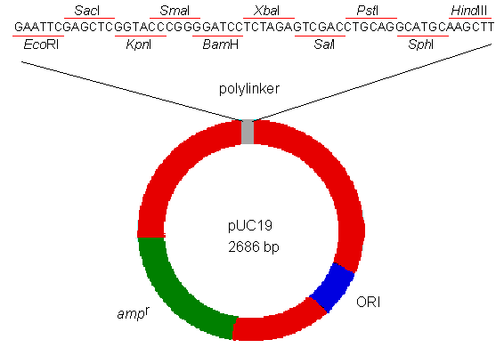
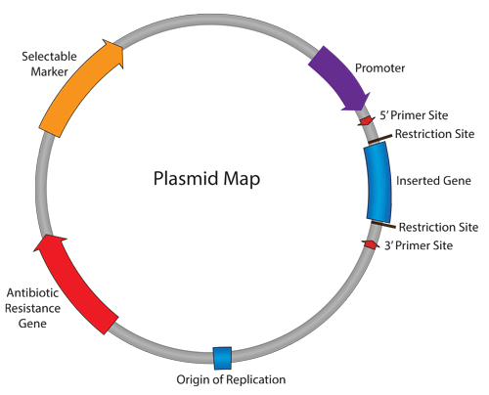
Structure of Plasmid Vector
A typical plasmid vector. It contains a polylinker which can recognize several different restriction enzymes, an ampicillin-resistance gene (amp^{r}) for selective amplification, and a replication origin (ORI) for proliferation in the host cell.
Plasmids are extrachromosomal double-stranded circular DNA molecules that can be found in various bacteria and some eukaryotes. In their original form, the size of plasmids ranges between 1 and 200 kbp (kilo-base pairs).

Slide 5
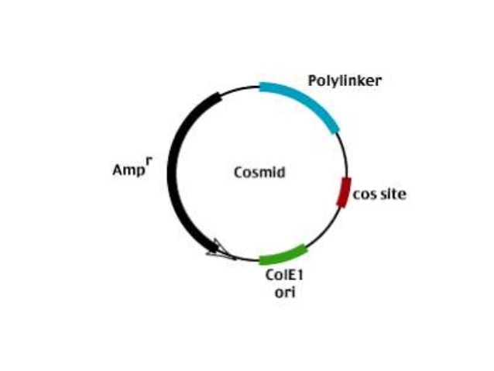
WHAT IS COSMIDS?

Slide 7
Features of Cosmid Vector
Cosmids are predominantly plasmids with a bacterial oriV, an antibiotic selection marker and a cloning site, but they carry one, or more recently two, cos sites derived from bacteriophage lambda.
Depending on the particular aim of the experiment broad host range cosmids, shuttle cosmids or 'mammalian' cosmids (linked to SV40 oriV and mammalian selection markers) are available.
The loading capacity of cosmids varies depending on the size of the vector itself but usually lies around 40–45 kb. The cloning procedure involves the generation of two vector arms which are then joined to the foreign DNA.
Selection against wild type cosmid DNA is simply done via size exclusion. Cosmids, therefore, always form colonies and not plaques.
The clone density is much lower with around 10⁵ – 10⁶ CFU per µg of ligated DNA.

Slide 8
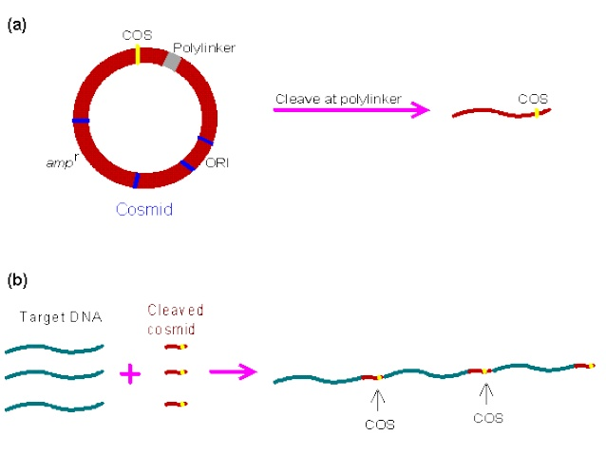

Slide 9
Advantages and Disadvantages of Cosmid Vector

Slide 10
WHAT IS ARTIFICIAL CHROMOSOME VECTORS?

Slide 11
Yeast Artificial Chromosomes
Yeast artificial chromosomes (YACs) are genetically engineered chromosomes derived from the DNA of the yeast, Saccharomyces cerevisiae, which is then ligated into a bacterial plasmid. By inserting large fragments of DNA, from 100–1000 kb, the inserted sequences can be cloned and physically mapped using a process called chromosome walking.
This is the process that was initially used for the Human Genome Project, however due to stability issues, YACs were abandoned for the use of Bacterial artificial chromosomes (BAC).
The primary components of a YAC is centromere, and telomeres from S. cerevisiae. Additionally, selectable marker genes, such as antibiotic resistance and a visible marker, are utilized to select transformed yeast cells. Without these sequences, the chromosome will not be stable during extracellular replication, and would not be distinguishable from colonies without the vector

Slide 12
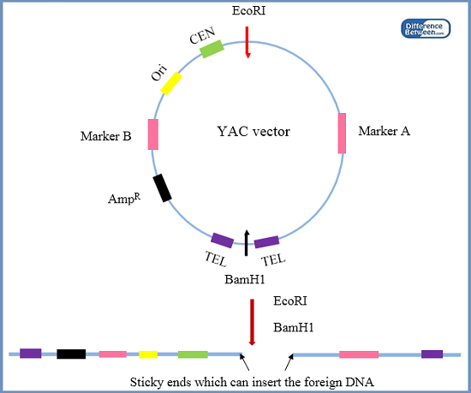
Structure of YAC
A YAC is built using an initial circular DNA plasmid, which is typically cut into a linear DNA molecule using restriction enzymes;
DNA ligase is then used to ligate a DNA sequence or gene of interest into the linearized DNA, forming a single large, circular piece of DNA.^{[2]}
The basic generation of linear yeast artificial chromosomes can be broken down into 6 main steps

Slide 13
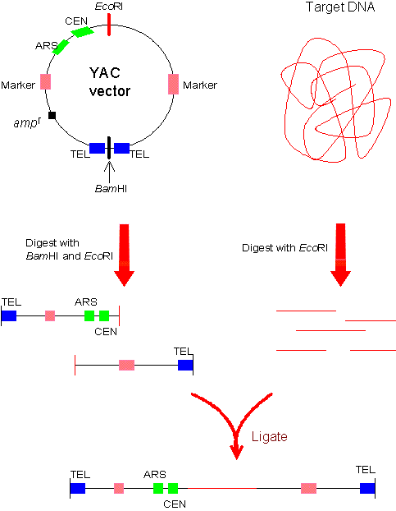
Construction steps of YAC

Slide 14
Construction steps of YAC
1.Ligation of selectable marker into plasmid vector: this allows for the differential selection of colonies with, or without the marker gene An antibiotic resistance gene allows the YAC vector to be amplified and selected for in E. coli by rescuing the ability of mutant E. coli to synthesize leucine in the presence of the necessary components within the growth medium. TRP1 and URA3 genes are other selectable arkers. The YAC vector cloning site for foreign DNA is located within the SUP4 gene. This gene compensates for a mutation in the yeast host cell that causes the accumulation of red pigment. The host cells are normally red, and those transformed with YAC only, will form colorless colonies. Cloning of a foreign DNA fragment into the YAC causes insertional inactivation of the gene, restoring the red color. Therefore, the colonies that contain the foreign DNA fragment are red.
2. Ligation of necessary centromeric sequences for mitotic stability
3. Ligation of Autonomously Replicating Sequences (ARS) providing an origin of replication to undergo mitotic replication. This allows the plasmid to replicate extrachromosomally, but renders the plasmid highly mitotically unstable, and easily lost without the centromeric sequences.
4. Ligation of artificial telomeric sequences to convert circular plasmid into a linear piece of DNA
5. Insertion of DNA sequence to be amplified (up to 1000kb)
6. Transformation yeast colony

Slide 17
Shuttle Vector
A shuttle vector is a vector (usually a plasmid) constructed so that it can propagate in two different host species . Therefore, DNA inserted into a shuttle vector can be tested or manipulated in two different cell types.
Shuttle vectors include plasmids that can propagate in eukaryotes and prokaryotes (e.g. both Saccharomyces cerevisiae and Escherichia coli) or in different species of bacteria (e.g. both E. coli and Rhodococcus erythropolis). There are also adenovirus shuttle vectors, which can propagate in E. coli and mammals.
Shuttle vectors are frequently used to quickly make multiple copies of the gene in E. coli (amplification). They can also be used for in vitro experiments and modifications, e.g. mutagenesis, PCR)
One of the most common types of shuttle vectors is the yeast shuttle vector

Slide 19
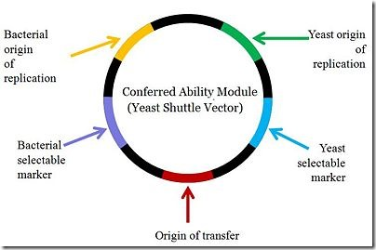
Construction of Shuttle Vectors

Slide 20
Advantages of Shuttle Vectors
Disadvantages of Shuttle Vectors
Cannot accept large Fragment

Slide 22
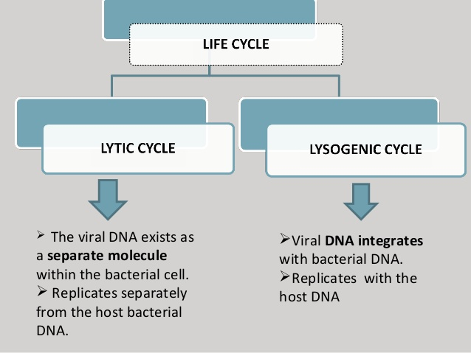

Slide 23
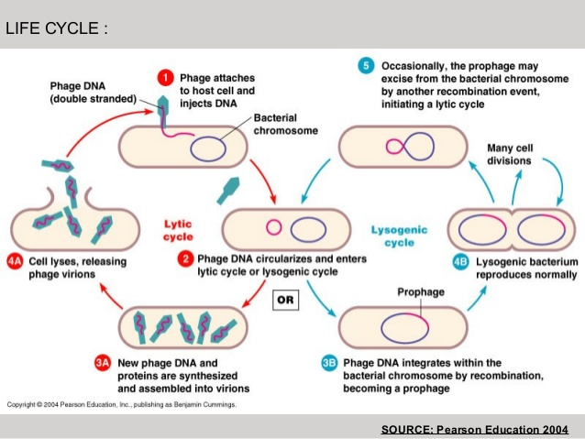

Slide 26
M13 Phage Vector

Slide 28
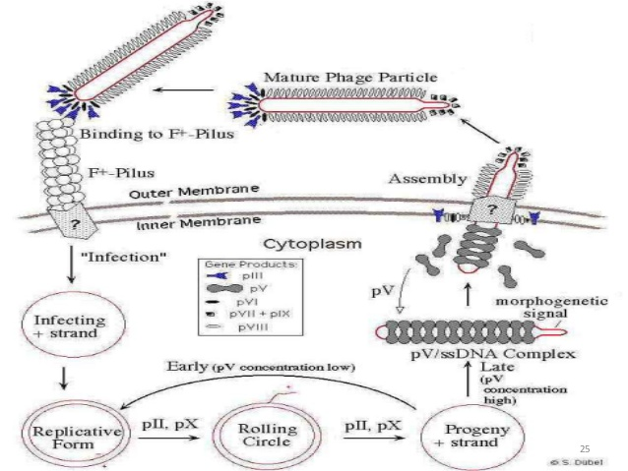
Life Cycle of M13 Phage

Slide 33
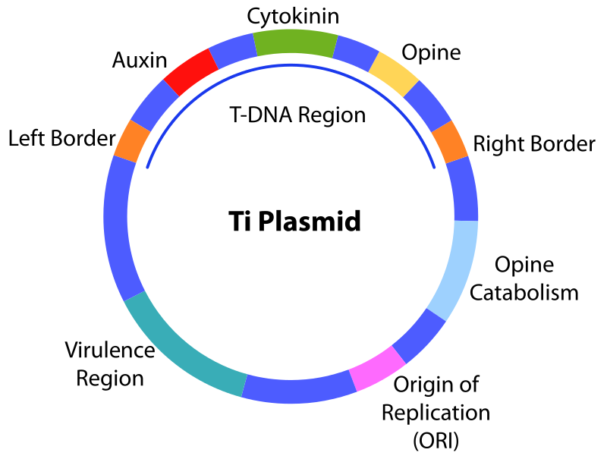
Ti Plasmid
A Ti or tumour inducing plasmid is a plasmid that often, but not always, is a part of the genetic equipment that Agrobacterium tumefaciens and Agrobacterium rhizogenes use to transduce their genetic material to plants.
The Ti plasmid is lost when Agrobacterium is grown above 28 °C. Such cured bacteria do not induce crown galls, i.e. they become avirulent. pTi and pRi share little sequence homology but are functionally rather similar.
The Ti plasmids are classified into different types based on the type of opine produced by their genes.
The different opines specified by pTi are octopine, nopaline, succinamopine and leucinopine

Slide 34
Characteristic Features
Agrobacterium is called the natural genetic engineer.
Size of the plasmid: ~250 kbp.
Contains one or more T-DNA region.
Contains a region enabling conjugative transfer.
Contains regions for opine synthesis and catabolism.
Responsible for crown gall disease in plants.

Slide 36
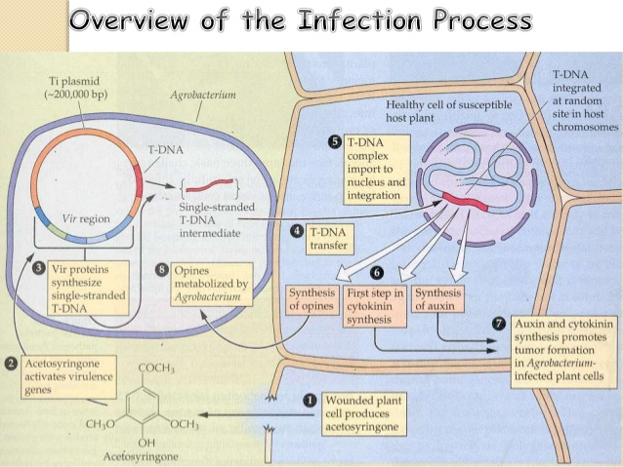

Slide 38
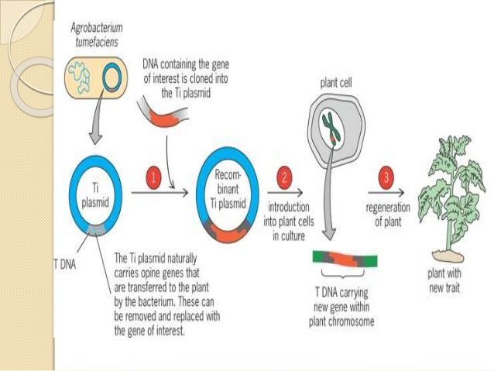
Integration of Ti Plasmid

