Slide 1
“Pitfalls of National Consciousness” :From Rabindranath Tagore to Frantz Fanon: A Psychoanalytic Perspective
Debashis Bandyopadhyay

Slide 2
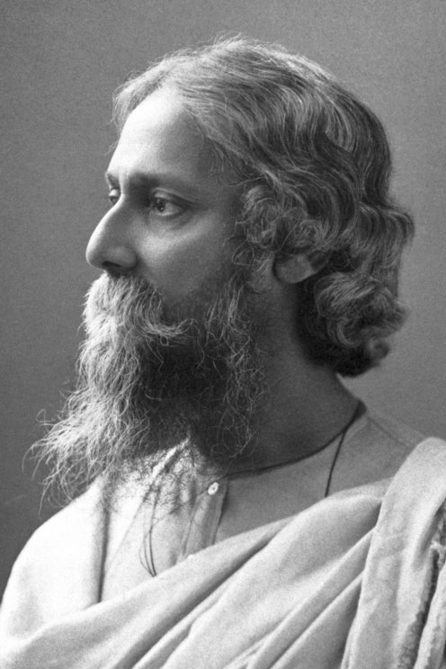
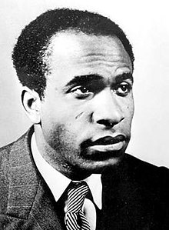

Slide 3
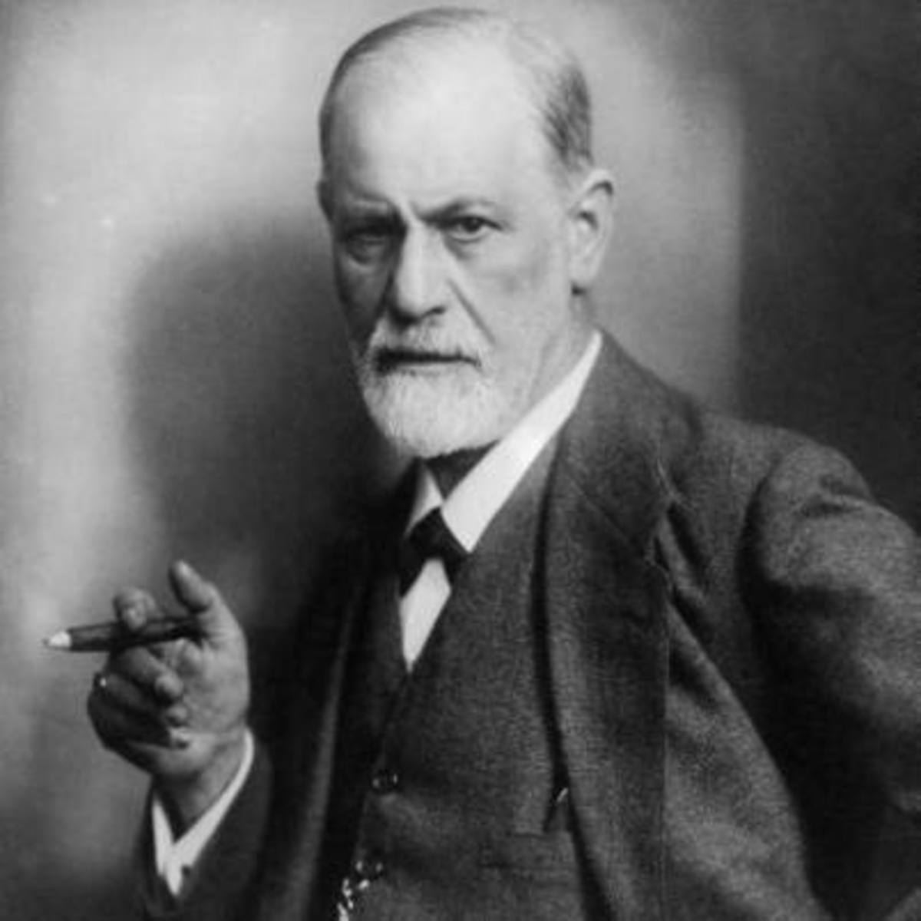
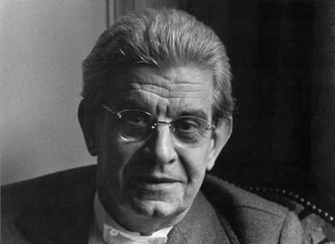

Slide 4
Benedict Anderson 1936 - 2015

Slide 5
Anderson’s Linguistic Origin of Nationalism
Esoterization of Latin; the Reformation; and the haphazard development of administrative vernaculars
Print capitalism and the fatality of human linguistic diversity- creation of monoglot mass reading public
The print languages laid the bases for national consciousnesses:
They created unified fields of exchange and communications below Latin and above the spoken vernaculars
Print capitalism gave a new fixity to language: it helped to build the image of antiquity central to the notion of a nation
Print capitalism created languages of power: certain dialects are inevitably closer to the print forms; their disadvantaged cousins, assimilable to the emerging print form, lost caste

Slide 6
Tagore’s Nationalism, 1917
Tagore subscribes to an idea of nationalism that seeks not just political freedom for the Nation but equal rights for all its citizens. Where other nationalisms insisted on a homogeneity of attitudes and world views, the idea of India respected and even celebrated the linguistic, cultural and religious diversity of its peoples. This idea of India was inclusive outside its borders, prepared to overlook the horrors of colonialism once colonialism had formally ended, to forge new and equitable relations with all the countries and peoples of the world.

Slide 7
Tagore’s Nationalism contd.
There is one safety for us upon which we may count, and that is that we can claim Europe herself as our ally in our resistance to her temptations and to her violent encroachments; for she has ever carried her own standards of perfection, by which we can measure her falls and gauge her degrees of failure, by which we can call her by her own tribunal and put her to shame.

Slide 8
Tagore’s Creative Unity, 1922
Hatred of the foreigner could later turn into hatred of Indians different from oneself.
He was critical of the cold-blooded utilitarianism of the West
He was critical of Gandhi’s non-cooperation movement and maintained that such a movement will not dissolve Hindu Muslim differences.
Man is man, machine is machine And never the twain shall wed

Slide 9
Tagore’s two paths of the West in the East
Hammargen, the obscure individual from Sweden
The ubiquity of red tape and sealing wax

Slide 10
Tagore’s Visit to China, 1924
In India, when I spoke to my own people of what the whole world was suffering from, they replied that I was trying to make them weak…They had no time to waste on higher ideals. It was the law of nature
Asia is again waiting for such dreamers to come and carry on the work not of fighting, not of profit making, but of establishing bonds of spiritual relationship

Slide 11
Fanon’s Impression of National Consciousness
After Independence, nationalism might morph into ultra-nationalism to chauvinism and to racism: like anti-Dahoman and anti-Voltaic movements in Ivory Coast; anti-Sudanese movement in Senegal; anti-Nigerian movement in Ghana
Micro-national chauvinism can turn to tribalism as in the case of the Wolofs in Senegal
Nationals in places rich in resources wish to segregate from other nationals
Pre-colonial enmities between tribes might resurface:
“In the country districts and the bush, minor confraternities, local religions and maraboutic cults will show a new vitality and will once more take up their round of excommunication”

Slide 12
Fanon on National Consciousness
Colonialism which was shaken by the desire for African liberation and unity is re-invoked again after the Independence:
In Senegal the newspaper New Africa distils hatred of Islam and Arabs
Enmity against Islam was fanned by the missionaries by using the historical past as an alibi: the Arab occupation had paved the way for European colonization.
Religious hatred changes into racial hatred between the blacks and the whites – the south of Sahara people vs the north of Sahara people.
The Western bourgeoisie’s hatred of the niggers and Arabs is covered up by showcasing gestures of equality to the sub-men

Slide 13
THE END

