Slide 1
8085 Microprocessor Architecture & Pin configuration
MCA 1ST YEAR 2ND SEMESTER 2020
Paper: MCA 203
Dr. Utpal Nandi
Dept. of Computer Science
VIDYASAGAR UNIVERSITY

Slide 2
8085 Microprocessor Architecture & Pin configuration
Pin configuration of 8085
Limitations of 8085
Internal Architecture of 8085
8085 Single board Microcomputer System

Slide 3
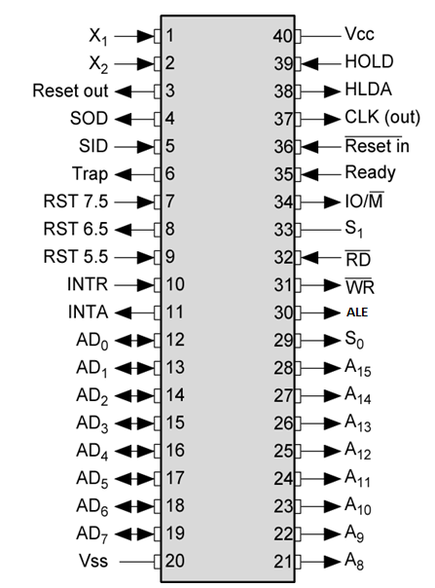
Pin configuration of 8085
8-bit general purpose μp
Capable of addressing 64 k of memory
Has 40 pins
Requires +5 v power supply
Can operate with 3 MHz clock

Slide 4
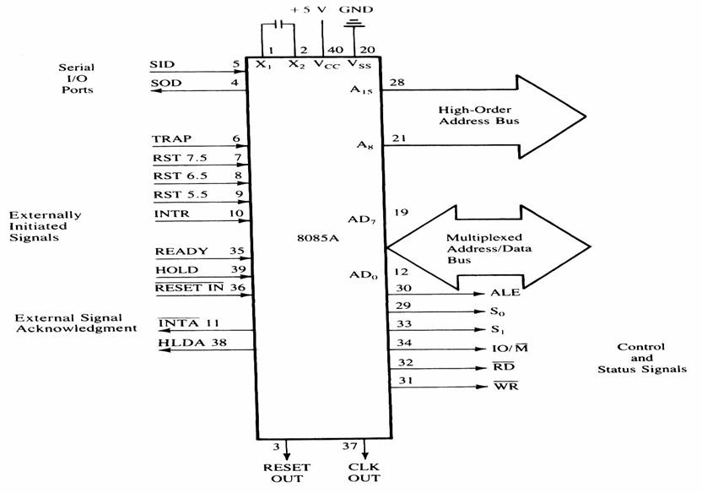
Pin configuration of 8085
All the signals can be classified into
Six groups –
Address Bus
Data Bus
Control & Status signals
Power signal & frequency signals
Externally initiated signals
Serial I/O ports

Slide 5
Address & data bus
8085 μp consists of 16 signal pins use as address bus.
Divide into 2 part: A15 – A8 (upper)
AD7 – AD0 (lower).
A15 – A8 : Unidirectional, known as ‘high order address’.
AD7 – AD0 : bidirectional and dual purpose (address and data placed
once at a time).
AD7 – AD0 also known as ‘low order address’.
To execute an instruction, at early stage AD7 – AD0 uses as address bus and alternately as data bus for the next cycle.
The method to change from address bus to data bus known as ‘bus multiplexing’.

Slide 6
Control & Status signals
This group of signal includes-
Two control signals (RD’ & WR’)
Three status signals (IO/M’ , S1 & S0)
One special signal (ALE)
RD’ – Read (active low). To indicate that the I/O or memory selected is to be read and data are available on the bus.
WR’ – Write (Active low). This is to indicate that the data available on the bus are to be written to memory or I/O ports.
IO/M’ – To differentiate I/O operation or memory operations.
‘0’ - indicates a memory operation.
‘1’-indicates an I/O operation.
IO/M’ combined with RD and WR to generate I/O and memory control signals.

Slide 7
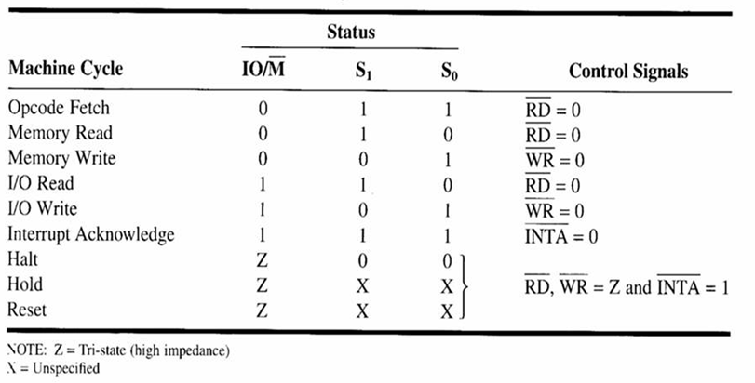
Control and Status Signals.
S1 and S0: Status signals, similar to IO/M, can identify various
operations as shown on the following table :

Slide 8
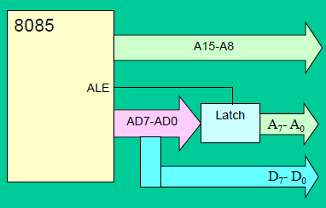
Control & Status signals
ALE (Address Latch Enable) signal :
ALE used to de-multiplex address/data bus
Active high signal - generated to show the start of 8085 operation.
When transition 1-to-0: indicate that lines AD7-AD0
(AD7-AD0 = A7-A0) act as address lines.

Slide 9
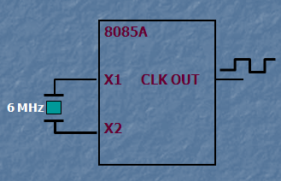
Power signal & frequency signals
Vcc : +5 V power supply
Vss : Ground reference
X1 & X2 : A crystal is connected at these two pins. The frequency is divided by two.
Therefore, to operate a system at 3 MHz, the crystal should have a frequency of 6 MHz.
CLK OUT : This signal is used as the system clock for other devices.

Slide 10
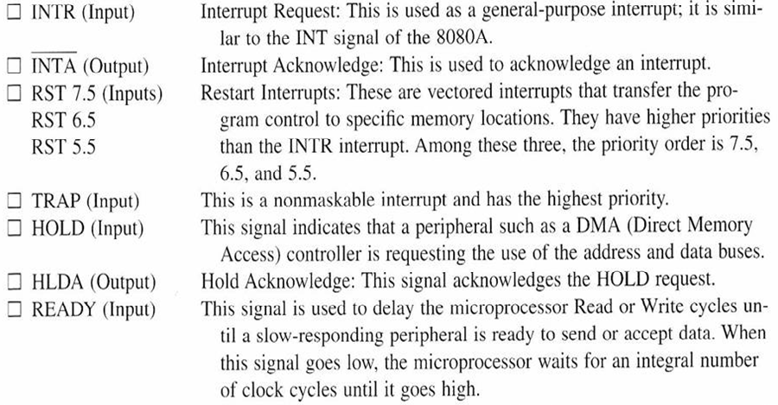
Externally initiated Signals including Interrupt

Slide 11
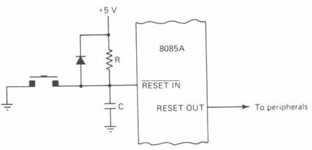
Externally initiated Signals including Interrupt
RESET IN’ : When the signal on this pin goes low,
the program counter is set to zero.
the buses are tri-sated.
MPU is reset.
RESET OUT : This signal is used to reset other
devices.

Slide 12
Serial I/O ports
The 8085 has two signals to implement the
serial transmission:
SID: Serial Input Data
SOD: Serial Output Data

Slide 13
Limitations of 8085
The low order address bus is multiplexed with the data bus. The buses need to be de-multiplexed.
Appropriate control signals need to be generated to interface memory and I/O with the 8085.

Slide 14
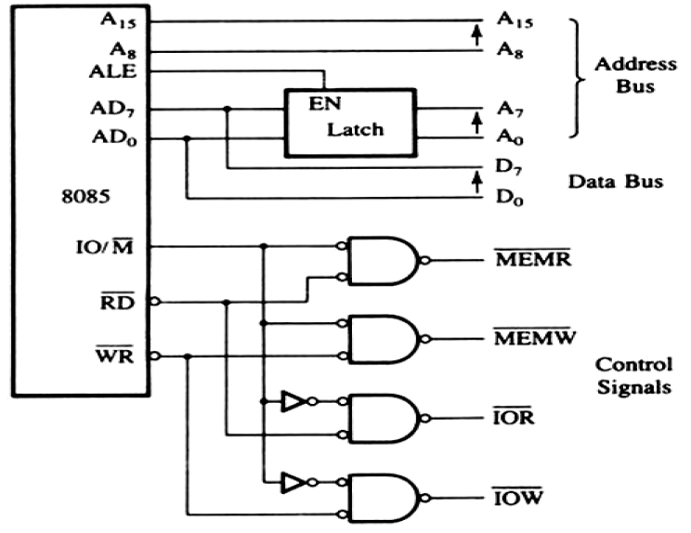
De-multiplexed Address & Data bus with Control Signals

Slide 15
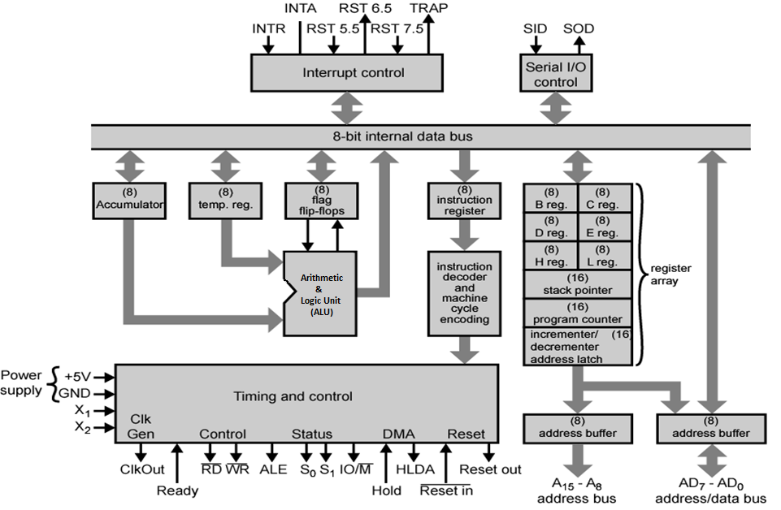
Internal Architecture of 8085
It includes-
ALU
Timing & Control Unit
Instruction Register and Decoder
Register Array
Interrupt Control
Serial I/O Control

Slide 16
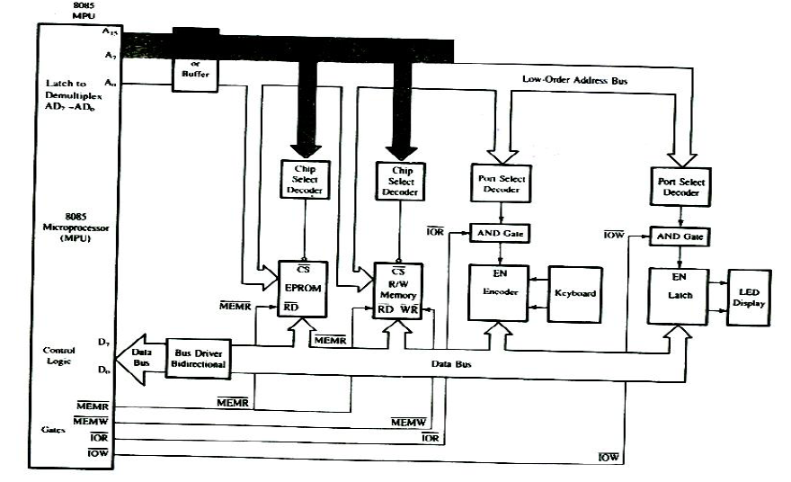
8085Single board Microcomputer System

Slide 17
Reference Book “Microprocessor Architecture, Programming and Applications with 8085”, 5thEdition, Prentice Hall by Ramesh S. Goankar

Slide 18
END

