Slide 1
Healthcare Data Analytics
Dr. Surojit Das, PhD
Assistant Professor
BMLSM, VU

Slide 2
Introduction to Healthcare Data Analytics Learning Objectives
Give a basic overview of data analytics in healthcare
Give a basic overview of data elements and their attributes
Describe the nine steps of the data analytics process
Notes:
This unit, Introduction to Health Care Data Analytics, Lecture A, has the following objectives:
Give a basic overview of data analytics in health care
Describe the nine steps of the data analytics process

Slide 3
Introduction
“Information is the oil of the 21st century, and analytics is the combustion engine.”
Peter Sondegaard, Senior Vice President and Global Head of Research for Gartner
Notes:
In 2011, Peter Sondegaard, senior vice president and global head of research for the worldwide information technology research and advisory company Gartner, stated that “Information is the oil of the 21st century, and analytics is the combustion engine.” So what exactly is analytics and why is it so important to 21st century healthcare?

Slide 4
The Big Picture of Patient Data
Multiple systems in a health information system
These systems are designed for clinical use and reporting purposes
None has a complete set of data for
Individual patients
Groups of patients
All aspects of a health information system
5
Notes:
Consider the information systems you’ve learned about so far. A hospital will likely have an electronic health record system as well as specialized departmental systems for laboratory, diagnostic imaging, pharmacy, nutrition services, billing, anatomic pathology, and so on. Each of these systems is designed and intended for clinical use – in other words, patient care, and so they capture specific data about the patient. However, none of these systems has a complete set of data for any individual patient or for a group of patients – such as all patients who were admitted in January with a certain diagnosis – that can be used for analysis and reporting. Obtaining deep insight into what is happening with individual patients as well as across groups of patients requires aggregating data together from many systems and performing statistical analyses of this aggregated data.

Slide 5
A Data Element Is …
The atomic unit of data that is finely grained and has a precise meaning
Level at which data are created and collected
Level that is necessary to define clinical models and input for clinical decision making
Level at which data elements can be precisely, uniquely, and unambiguously defined, that is independent of use, location, and circumstance
What simplifies achieving semantic interoperability
Essential for computer understandability
Notes:
Interoperability—the ability to share and use data—begins with the basic building blocks of what is shared. We call that basic component a data element. A data element has a name attribute—which we call terminology—and we have talked about terminology in the previous lecture. The focus of that lecture was terminology, not the data element. In this lecture, we will discuss data elements and what attributes—or characteristics—a data element should have to enable interoperability.
A data element is the atomic unit of data that is finely grained and has a precise meaning. It is the
level at which data is created and collected. This is the level that is necessary to define clinical models and input for clinical decision making.
This atomic unit is the level at which data elements can be precisely, uniquely and unambiguously defined, that is independent of use, location, and circumstance. That information is important, but it is a qualifier or additional information that is collected in addition to the data element. The data element simplifies achieving semantic interoperability. It is essential for computer understandability.
A meta-dictionary is a collection or repository of data elements and their attributes.

Slide 6
Data Elements and Terminology
What is a data element and what is a terminology?
Is diagnosis a data element or a terminology?
Any and every concept is a data element
Notes:
In some of the controlled vocabularies, the distinction between data elements and terminology is difficult to identify. The confusion between terminology and data elements may be a matter of focus. However, to be clear, this unit relates terminology to the actual name of the data element.
So, when we are defining data elements, these are questions we must understand.
Is hypertension a data element?
Is a symptom a data element?
Is a lab test a data element?
Is atenonol a data element?
Is marital status a data element and what are the possible answers?
The answer is that all of these are data elements at different levels of specificity. Some data elements are at the class level; others are at an item level. Some are generic and others are specific. It’s like comparing man as a data element to Charles as a data element. We need to define every word we will ultimately use to document health care and to support secondary uses of the data.

Slide 7
What is analytics?
“The discovery of meaningful patterns in data, and is one of the steps in the data life cycle of collection of raw data, preparation of information, analysis of patterns to synthesize knowledge, and action to produce value.”
(National Institute of Standards and Technology [NIST], 2015)
21
Notes:
What is analytics? Isn’t it the same thing as statistics?
The term analytics has been used in a variety of ways and with different meanings. In fact, Gartner stated that “Analytics has emerged as a catch-all term for a variety of different business intelligence (BI) and application-related initiatives.
In 2015, the National Institute of Standards issued a formal definition of analytics, as follows:
“The term analytics refers to the discovery of meaningful patterns in data, and is one of the steps in the data life cycle of collection of raw data, preparation of information, analysis of patterns to synthesize knowledge, and action to produce value.”

Slide 8
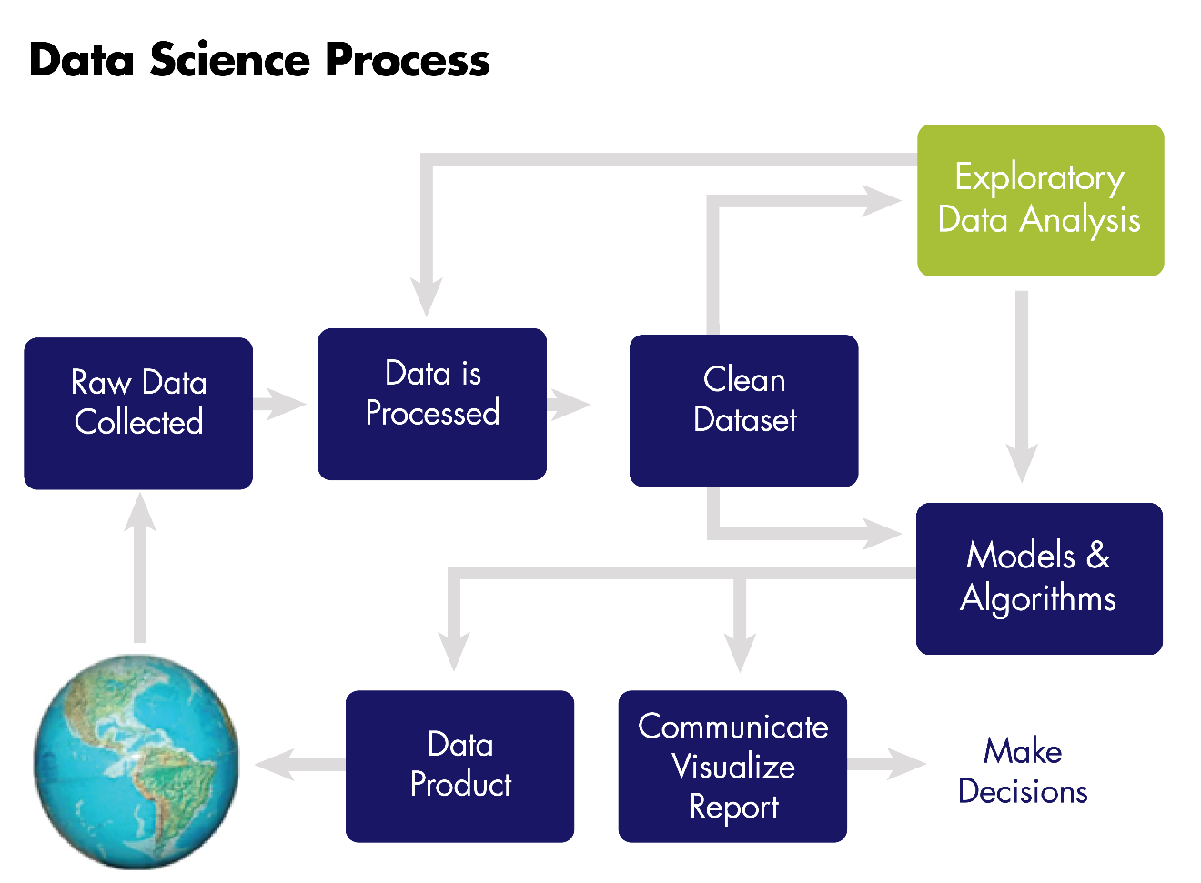
What is analytics?
Entire process of data collection, extraction, transformation, analysis, interpretation, and reporting
22
Notes:
As shown in this diagram, analytics is the entire process of data collection, extraction, transformation, analysis, interpretation, and reporting. It includes statistical analysis as one of the steps.

Slide 9
What is analytics?
“Analytics is used to refer to the methods, their implementations in tools, and the results of the use of the tools as interpreted by the practitioner.”
(NIST, 2015)
The analytics process is the synthesis of knowledge from information.
23
Notes:
Further, the NIST stated that
“Analytics is used to refer to the methods, their implementations in tools, and the results of the use of the tools as interpreted by the practitioner.”
The analytics process is the synthesis of knowledge from information.

Slide 10
Types of Analytics: Overview
Descriptive: Uses business intelligence and data mining to ask: “What has happened?”
Predictive: Uses statistical models and forecasts to ask: “What could happen?”
Prescriptive: Uses optimization and simulation to ask: “What should we do?” (IBM Software, 2013)
Diagnostic: Examines data to answer “Why did it happen?”
(Gartner IT Glossary, 2015)
24
Notes:
IBM (2013) categorizes analytics into three types:
Descriptive: uses business intelligence and data mining to ask: “What has happened?”
Predictive: uses statistical models and forecasts to ask: “What could happen?”
Prescriptive: uses optimization and simulation to ask: “What should we do?”
To these three types, Gartner adds a fourth type, of diagnostic analytics, which they define as “a form of advance analytics which examines data or content to answer the question “Why did it happen?”.

Slide 11
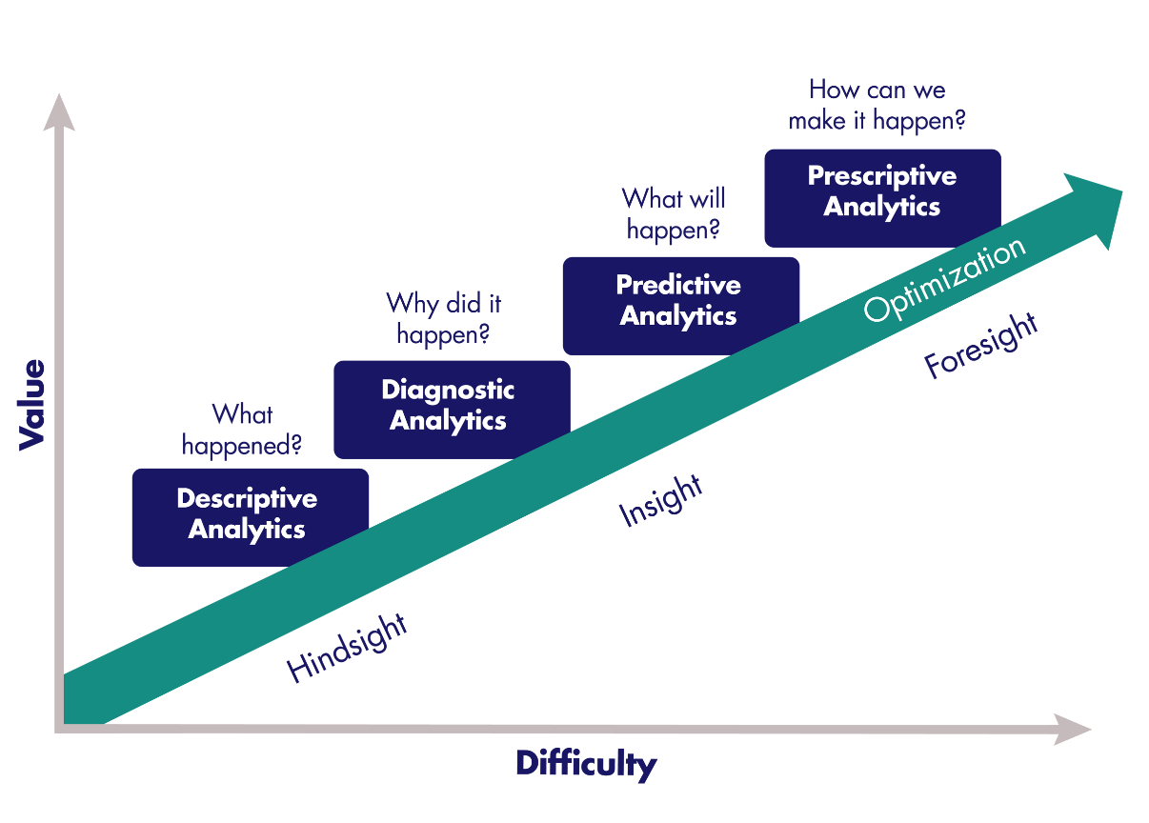
Descriptive Analytics
Describe the data
Common statistics:
Counts
Averages
Typical reporting methods:
Tables
Pie charts
Column/bar charts
Written narratives
(Gartner, 2012)
26
Notes:
Descriptive analytics are the simplest type of analytics and simply describe the data. Common statistics are used, such as the number of laboratory tests, the average age of patients, or the average length of stay in the hospital for patients with a particular diagnosis. Descriptive analytics are often presented as pie charts, bar or column charts, tables, or written narratives.

Slide 12
Diagnostic Analytics
Attempts to answer “why did it happen?”
Drill-down techniques
Data discovery
Correlations
(Gartner, 2012)
27
Notes:
Gartner defines Diagnostic Analytics as “a form of advance analytics which examines data or content to answer the question “Why did it happen?”.
Tools used for diagnostic analytics include drill-down techniques, data discovery, and correlations.

Slide 13
Predictive Analytics
Predicts instead of describing or classifying
Rapid analysis
Relevant insights
Ease of use
(Gartner, 2012)
28
Notes:
Let’s start with an example before going into the formal definitions.
Kaiser Permanente analyzed data on infants to develop an algorithm for classifying which babies were at risk for developing sepsis, and conversely, which babies did not need to be treated. Sepsis is described by the Mayo Clinic as “a potentially life-threatening complication of an infection. Sepsis occurs when chemicals released into the bloodstream to fight the infection trigger inflammatory responses throughout the body. This inflammation can trigger a cascade of changes that can damage multiple organ systems, causing them to fail. If sepsis progresses to septic shock, blood pressure drops dramatically, which may lead to death.”
Kaiser Permanente stated that “Judicious application of our scheme could result in decreased antibiotic treatment in 80,000 to 240,000 US newborns each year”.
With that example in mind, let’s now look at a definition of predictive analytics and how the Kaiser Permanente case is an example of predictive analytics.
Gartner states that predictive analytics has the following four attributes:
First: An emphasis on prediction (rather than description, classification or clustering). In the Kaiser Permanente example, they were trying to predict which newborns were at risk of developing a life-threatening condition, so that they could treat the babies to prevent it.
The second attribute defined by Gartner is rapid analysis – often in hours or days. Consider again the sepsis example. Sepsis is a rapidly progressing condition that, if it progresses to the most severe stage of septic shock, can have a 50% mortality rate. Therefore, analysis of the data to predict which infants are at risk of developing this condition must be done rapidly – not over a period of weeks or months.
The third attribute defined by Gartner is “an emphasis on the business relevance of the resulting insights.” Consider the word “relevance” and how that would apply to the example of infants with a life-threatening infection. Information that would directly affect the care and prevent infants from dying is relevant.
And finally, the fourth attribute defined by Gartner is “An emphasis on ease of use, thus making the tools accessible to business users.” In other words, these tools should be available to the clinical staff to use.

Slide 14
What Predictive Analytics Cannot Do
“The purpose of predictive analytics is NOT to tell you what will happen in the future. It cannot do that. In fact, no analytics can do that. Predictive analytics can only forecast what might happen in the future, because all predictive analytics are probabilistic in nature.”
(Bertolucci, 2013)
29
Notes:
However, it is important to note that, as Michael Wu of Lithium states, “the purpose of predictive analytics is NOT to tell you what will happen in the future. It cannot do that. In fact, no analytics can do that. Predictive analytics can only forecast what might happen in the future, because all predictive analytics are probabilistic in nature.”
This brings us then to the highest level of analytics, which is prescriptive analytics.

Slide 15
Prescriptive Analytics
Examines data or content to answer the question “What should be done?” or “What can we do to make _______ happen?
Is characterized by techniques such as:
Graph analysis
Simulation
Complex event processing
Neural networks
Recommendation engines
Heuristics
Machine learning
(Gartner, 2012)
30
Notes:
Gartner defines prescriptive analytics as “a form of advanced analytics which examines data or content to answer the question “What should be done?” or “What can we do to make _______ happen?”, and is characterized by techniques such as graph analysis, simulation, complex event processing, neural networks, recommendation engines, heuristics, and machine learning.”

Slide 16
Steps in Data Analytics
Identify the problem and the stakeholders
Identify what data are needed and where those data are located
Develop a plan for analysis and a plan for retrieval
Extract, transform, load the data
Check, clean, and prepare the data for analysis
Analyze and interpret the data
Visualize the data
Disseminate the new knowledge
Implement the knowledge in the organization
31
Notes:
Now let’s look at the steps in data analysis in more detail.
Data analytics involves a sequence of steps.
Identify the problem
Identify what data are needed and where those data are located
Develop a plan for analysis and a plan for retrieval
Extract the data
Check, clean, and prepare the data for analysis
Analyze and interpret the data
Visualize the data
Dissiminating the new knowledge
Implement the knowledge into the organization
We will go into each of these in more detail on the next slides.

Slide 17
1. Identify the Problem or Question and the Stakeholders
Why is this an important problem?
How will the results impact patient care or the institution?
What is the business case?
Who are the stakeholders?
32
Notes:
The first step is to define the problem to be studied, or in business terms, identify the business case. Why is this important to study? How will the results impact patient care or the institution? You must have a clearly stated problem or question to guide the rest of the process. You also need to identify any stakeholders- people who have a direct interest in this problem and who need to receive the results of the analysis at the end of the process.

Slide 18
2. Identify What Data Are Needed
What data elements, such as date of birth, gender, medications, laboratory results, and so on, are needed?
Where are these data elements located—in which system or systems and which database tables?
Is there a clinical data warehouse?
Who is the contact person for each system who will be responsible for retrieving the data?
33
Notes:
Next, the data needed for the analysis need to be identified. Where are the data elements located in what system or systems and what database tables? Who is the contact person for each system who will be responsible for retrieving the data? Is there a clinical data warehouse? If not, the required data elements may be stored in different systems, requiring multiple extraction steps.

Slide 19
3. Develop Plans for Retrieval and Analysis
Retrieval
Enlist database administrator for each system
Develop specific plan for retrieving the required data elements
Method for cross-checking number of records as well as completeness—how many should you expect and did you get everything?
Analysis
Enlist statistician
Identify population, sample size, statistical tests to be performed
34
Notes:
A plan for retrieving the data from the various systems along with a plan for checking that all the data required were actually retrieved should be developed. There needs to be some way to determine how many records are expected and then actually retrieved. This may involve cross-checking against other systems. This step will require the participation of the individuals who normally perform data retrieval from the system(s) involved.
An analysis plan needs to be developed. A statistician should be consulted, and questions to be addressed here include: What is the population? What size does the sample need to be? What statistical tests should be performed?

Slide 20
4. Extract, Transform, Load Process
Extraction
May be an iterative process
The data are retrieved
Checked for completeness
Descriptive statistics
Errors corrected, empty fields addressed
Transformation
Data synchronized (“transformed”) (e.g., M, F, U vs. 1, 2, 9)
Loading
Data then imported into destination system
35
Notes:
The next step is the actual extraction of the data from the system or systems involved.
After the data are retrieved, the data need to be checked for completeness – is the set of data complete? Were all the records that should be retrieved actually retrieved? At a minimum, descriptive statistics, such as counts, must be performed at this step.
At this point, changes to the extraction plan may be needed and another extraction from the source system(s) may need to take place.
Once a complete set of records is extracted from the source systems, errors in the records need to be identified and corrected (and all data have errors, such as transposed letters in names and incorrect values). Decisions must be made about how to handle empty fields.
Next, data must also be synchronized or “transformed”. For example, patient gender in one system in the hospital may be stored as M, F, U while another system might use 1, 2, 9. One set of values must be changed so that all the records are using the same values.
After all necessary transformation steps have been completed, the data are then imported into the destination system where the actual data analysis and reporting will take place. This may be a system as complex as a clinical data warehouse or as simple as a desktop computer.

Slide 21
5. Check, Clean, and Prepare the Data
Data are now in the system where analysis will be run
Should be a complete set of data
Need to check that everything is ready for analysis
Descriptive statistics
Double-check problem or question being investigated
Double-check against analysis plan
36
Notes:
The data are now in the system where the analysis will be run and it should be a complete set of data. You need to check that everything is ready for analysis – did you get what you needed? Check and verify this against the analysis plan that was developed in Step 3 and that you have everything to address the problem that was identified in Step 1.

Slide 22
6. Analyze and Interpret the Data
Use the data analysis plan
Perform the actual statistical analyses as described in the plan
Consult with statistician to confirm interpretations and conclusions
37
Notes:
Now you are ready to do the actual analysis – to execute the analysis plan that was developed earlier. Perform the statistical analyses and enlist the assistance of the statistician to confirm the interpretations and conclusions of your analysis.

Slide 23
8 and 9: Disseminating and Implementing
Disseminating the new knowledge
Write up the findings
Disseminate to the stakeholders
Implementing the new knowledge
Requires participation of stakeholders
39
Notes:
Once the analysis, interpretation, and any visualizations are complete, a report must be developed – it might be a formal written document, an email, or a presentation. Regardless of the delivery method, the report needs to clearly state the original problem, the process that was used to address the problem, and then the results of the analysis along with the supporting visualizations. This represents new knowledge and needs to be distributed to the stakeholders that were identiifed in Step 1.
Finally, the new knowledge needs to be implemented to address the original problem. This will require the participation of the stakeholders.

Slide 24
For Additional Information
For more information on these topics, read these articles:
Six Steps of an Analytics Project by Jaideep Khanduja
The Seven Key Steps of Data Analysis by Gwen Shapira
40
Notes:
For more information on these topics read articles:
Six Steps of an Analytics Project by Jaideep Khanduja
The Seven Key Steps of Data Analysis by Gwen Shapira
Article URLs are mentioned in the reference slide at the end of the slidedeck.

Slide 25
Introduction to Healthcare Data Analytics Summary
Analytics is the entire process of data collection, extraction, transformation, analysis, interpretation, and reporting.
It can be categorized into three types: descriptive, predictive, and prescriptive.
Notes:
This concludes Lecture A of Introduction to Health Care Data Analytics (Unit 3, Data and Interoperability).
To summarize:
Analytics is the entire process of data collection, extraction, transformation, analysis, interpretation, and reporting
It can be categorized into three types: Descriptive, Predictive, and Prescriptive.

Slide 26
Introduction to Healthcare Data Analytics References
References
American Health Information Management Association. (2012). Managing a data dictionary. Journal of AHIMA, 83(1), 48-52. Retrieved from http://library.ahima.org/PB/DataDictionary#.WI9uCVMrJhE
Bertolucci, J. (2013). Big data analytics: Descriptive vs. predictive vs. prescriptive. InformationWeek. Retrieved from http://www.informationweek.com/big-data/big-data-analytics/big-data-analytics-descriptive-vs-predictive-vs-prescriptive/d/d-id/1113279
Dictionary.com. (n.d.). Nominal scale. Retrieved from http://www.dictionary.com/browse/nominal-scale
Escobar, G. J., Puopolo, K. M., Wi, S., Turk, B. J., Kuzniewicz, M. W., Walsh, E. M., ... & Draper, D. (2014). Stratification of risk of early-onset sepsis in newborns≥ 34 weeks’ gestation. Pediatrics, 133(1), 30-36. Retrieved from http://pediatrics.aappublications.org/content/pediatrics/133/1/30.full.pdf
Gartner. (2011, October 17). Gartner says worldwide enterprise IT spending to reach $2.7 trillion in 2012. Retrieved from http://www.gartner.com/newsroom/id/1824919
Gartner IT Glossary. (2015). Descriptive analytics. Retrieved from http://www.gartner.com/it-glossary/descriptive-analytics
Notes:
No Audio.

Slide 27
Introduction to Healthcare Data Analytics References
References
Gartner IT Glossary. (2015). Diagnostic analytics. Retrieved from http://www.gartner.com/it-glossary/diagnostic-analytics
IBM. (2013). Descriptive, predictive, prescriptive: Transforming asset and facilities management with analytics. Retrieved from http://www-01.ibm.com/common/ssi/cgi-bin/ssialias?infotype=SA&subtype=WH&htmlfid=TIW14162USEN
Institute of Medicine of the National Academies. (2012). Best care at lower cost: The Path to continuously learning health care in America. Washington, DC: Institute of Medicine of the National Academies. Retrieved from http://www.nationalacademies.org/hmd/Reports/2012/Best-Care-at-Lower-Cost-The-Path-to-Continuously-Learning-Health-Care-in-America.aspx
Institute of Medicine of the National Academies. (n.d.). The learning health care system in America. Retrieved from http://www.nationalacademies.org/hmd/Activities/Quality/LearningHealthCare.aspx
Khanduja, J. (2015). Six steps of an analytics project - Quality assurance and project management. (2015). Quality Assurance and Project Management. Retrieved from http://itknowledgeexchange.techtarget.com/quality-assurance/six-steps-of-an-analytics-project/
Notes:
No Audio.

Slide 28
Introduction to Healthcare Data Analytics References
References
Mayo Clinic. (2016). Overview - Sepsis. Retrieved from http://www.mayoclinic.org/diseases-conditions/sepsis/home/ovc-20169784
Murdoch, T., & Detsky, A. (2013). The inevitable application of big data to health care. JAMA, 309(13), 1351. http://dx.doi.org/10.1001/jama.2013.393
National Institute of Standards and Technology (NIST). (2015). NIST big data interoperability framework: Volume 1, definitions. Gaithersburg, MD: NIST. Retrieved from http://nvlpubs.nist.gov/nistpubs/SpecialPublications/NIST.SP.1500-1.pdf
National Institutes of Health. (2015). What is big data? Retrieved from http://datascience.nih.gov/bd2k/about/what
NIST/SEMATECH e-Handbook of statistical methods. (n.d.). Retrieved May 02, 2016, from http://www.itl.nist.gov/div898/handbook/
Sas.com. (2016). What is Hadoop? Retrieved from http://www.sas.com/en_my/insights/big-data/hadoop.html
Schneeweiss, S. (2014). Learning from big health care data. New England Journal of Medicine, 370(23), 2161-2163. Retrieved from http://www.nejm.org/doi/full/10.1056/NEJMp1401111#t=article
Shapira, G. (2016). The seven key steps of data analysis. Oracle.com. Retrieved from http://www.oracle.com/us/corporate/profit/big-ideas/052313-gshapira-1951392.html
Notes:
No Audio.

Slide 29
Introduction to Healthcare Data Analytics References
Figures
Smith, K. (2016). Clinical data warehouse. Used with permission from Kimberly Smith.
Gartner IT Glossary. (2012). Predictive analytics. Retrieved from http://www.gartner.com/it-glossary/predictive-analytics
Images
Farcaster. (2014). Data visualization process v1 [online Image]. Retrieved April 28, 2016, from https://commons.wikimedia.org/wiki/File:Data_visualization_process_v1.png#/media/File:Data_visualization_process_v1.png
Innesw. (2014). Simple pie chart [online Image]. Retrieved May 2, 2016, from
https://commons.wikimedia.org/wiki/File%3ACharts_SVG_Example_5_-_Simple_Pie_Chart.svg
Notes:
No Audio.

