Slide 1
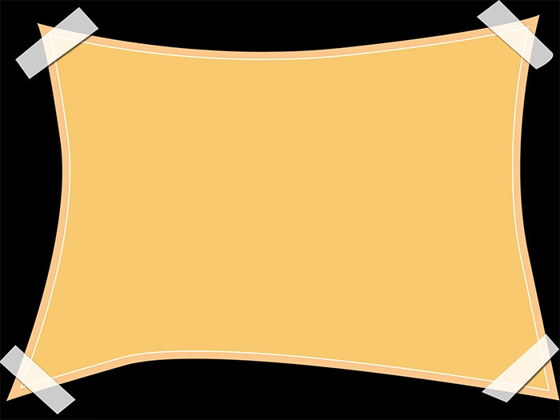
THE CRITERION OF THE PERCEPTUALITY OF OBJECT
PAPER: PHI – 403 ADV (ADVAITA VEDĀNTA)
Semestar --- IV
DR. BHUPENDRA CHANDRA DAS
PROFESSOR
DEPT. OF PHILOSOPHY
VIDYASAGAR UNIVERSITY

Slide 2
When there is identity between pramatr caitanya and visaya caitanya then there is perceptuality of object. That is to say, the perception of an object is passible if the consciousness limited by pramata becomes identical with the consciousness limited by object.

Slide 3
It may be objected that the identity between the consciousness limited by mind and consciousness limited by object is not possible as it will go against the experience in the form – ‘I am perceiving this’.

Slide 4
If the identity between the two types of consciousness mentioned above is possible there will arise the defect called contradiction in respect of subject and object (karmakartrvirodha). That is to say, there will be no difference between the subject and the object, which is absurd in character.

Slide 5
In response to this, the Vedantins say that it has been mentioned that there will be identity of the consciousness limited by pramata with the object. That is to say, at the time of perception of an object there will be the existence of pramata alone and non-existence of those that are apart from pramata.

Slide 6
The objects like jar etc. are superimposed on the consciousness limited by objects like jar etc. So the existence of a jar has been proved by the existence of the consciousness limited by jar, because the existence of the object which is superimposed has not been accepted other than the existence of the substratum of the superimposition.

Slide 7
The consciousness limited by object turns into the consciousness limited by pramata through the mental state in the form of an object. So the consciousness limited by pramata is the substratum of the object like jar etc.

Slide 8
According to the principle mentioned above, the existence of a jar which is superimposed has been proved by the existence of the consciousness limited by pramata which is the substratum of superimposition. Here, there is the existence of the consciousness limited by pramata alone as the existence of an object which is superimposed has not been accepted. So the perception of a jar (i. e. object) is possible.

Slide 9
Utility of Contact:
Though sense-organ, according to Vedantinsts is not the instrument of perceptual knowledge, it has got some utility in producing mental state that reveals consciousness.

Slide 10
The mental state in the form of object does not arise in mind if it is not connected with the external object. The relation between object and mind is possible if there is the contact of sense-organ.

Slide 11
That mental state which is produced out of the contact of the sense-organ is of four types-doubt (samsaya), certitude (niscaya), egoism (garva) and recollection (smaran). Due to the diversity of states, the mind, though one, is described as the manas , the intellect (buddhi), the ego (ahamkara) and the citta. The doubt (samsaya), certitude (niscaya), egoism (garva) and recollection (smarana) are the object of manas, the intellect (buddhi), the ego (ahamkara) and the citta respectively.

Slide 12
THANK YOU

