Slide 1
Satellite Remote Sensing & Applications
BY
Dr. ABHISEK CHAKRABARTY
Department of Remote Sensing & GIS
Vidyasagar University, Midnapore-721102
WB, India.

Slide 2
Outline
Remote Sensing
Electromagnetic Radiations (Energy) (EMR)
Resolution
Types
Applications conducted by SUPARCO

Slide 3
Remote Sensing
Remote Sensing:
The art and science of obtaining information about an object without physical contact between the object and sensor
The processes of collecting information about Earth surfaces and phenomena using sensors not in physical contact with the surfaces and phenomena of interest.
There is a medium of transmission involved i.e. Earth’s Atmosphere.

Slide 4
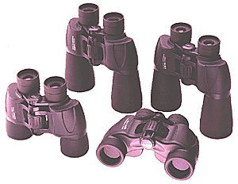
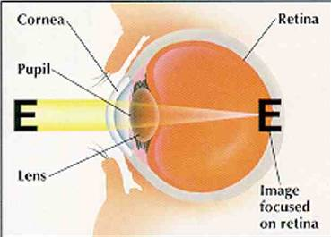
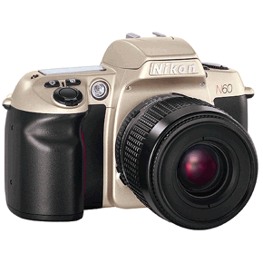
Some Remote Sensors

Slide 5
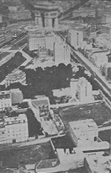
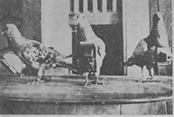
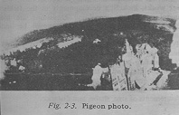
History of Remote Sensing
Balloon photography (1858)
Pigeon cameras (1903)
Kite photography (1890)
Aircraft (WWI and WWII)
Space (1947)
Images: Jensen (2000)

Slide 6
Remote sensing cycle
Remote Sensing Includes:
A) The mission plan and choice of sensors
B) The reception, recording, and processing of the signal data
C) The analysis of the resultant data.

Slide 7
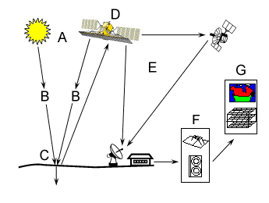
Remote Sensing Process Components
Energy Source or Illumination (A)
Radiation and the Atmosphere (B)
Interaction with the Target (C)
Recording of Energy by the Sensor (D)
Transmission, Reception, and Processing (E)
Interpretation and Analysis (F)
Application (G)
Source: Canadian Centre for Remote Sensing

Slide 8
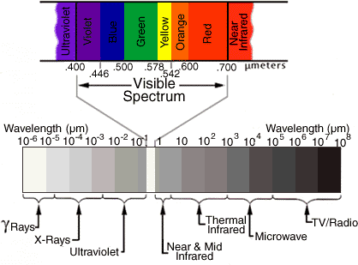
Electromagnetic Spectrum

Slide 10
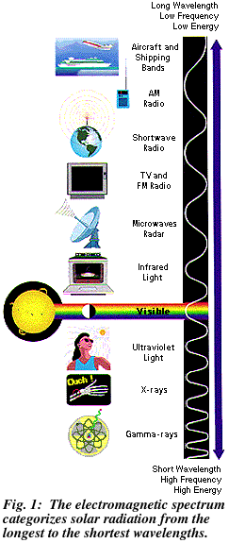

Slide 11
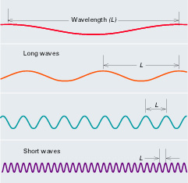
Electromagnetic Radiation

Slide 12
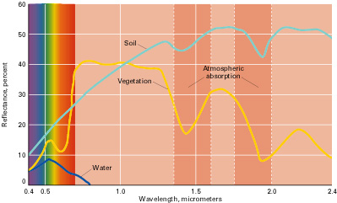
Signature Spectra

Slide 13
Fundamental term
Resolution
All remote sensing systems have four types of resolution:
Spatial
Spectral
Temporal
Radiometric

Slide 14
Spatial Resolution
The earth surface area covered by a pixel of an image is known as spatial resolution
Large area covered by a pixel means low spatial resolution and vice versa

Slide 15
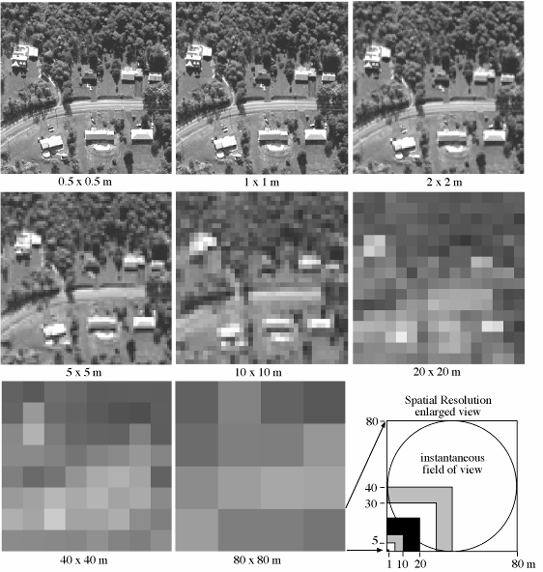
Spatial Resolution
High vs. Low?
Source: Jensen (2000)

Slide 16
Spectral Resolution
Is the ability to resolve spectral features and bands into their separate components
More number of bands in a specified bandwidth means higher spectral resolution and vice versa

Slide 17
Spectral Resolution

Slide 18
Three spectra recorded at low, medium and high spectral resolution, illustrating how the high resolution mode yields sharper peaks, and separates close lying peaks, which are merged together at low resolution
Spectral Resolution

Slide 19
Temporal Resolution
Frequency at which images are recorded/ captured in a specific place on the earth.
The more frequently it is captured, the better or finer the temporal resolution is said to be
For example, a sensor that captures an image of an agriculture land twice a day has better temporal resolution than a sensor that only captures that same image once a week.

Slide 20
Temporal Resolution
July 2
July 18
August 3
16 days
Time
11 days
July 1
July 12
July 23
August 3

Slide 21
Radiometric Resolution
Sensitivity of the sensor to the magnitude of the received electromagnetic energy determines the radiometric resolution
Finer the radiometric resolution of a sensor, if it is more sensitive in detecting small differences in reflected or emitted energy

Slide 22
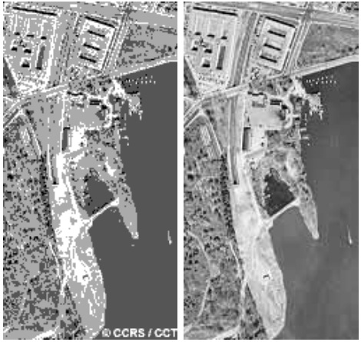
Radiometric Resolution
2-bit range
0
4
6-bit range
0
63
8-bit range
0
255
10-bit range
0
1023

Slide 23
Types of Remote Sensing
Aerial Photography
Multispectral
Active and Passive Microwave and LIDAR

Slide 24
Some known satellites
NOAA-AVHRR (1100 m)
GOES (700 m)
MODIS (250, 500, 1000 m)
Landsat TM and ETM (30 – 60 m)
SPOT (10 – 20 m)
IKONOS (4, 1 m)
Quickbird (0.6 m)

Slide 25
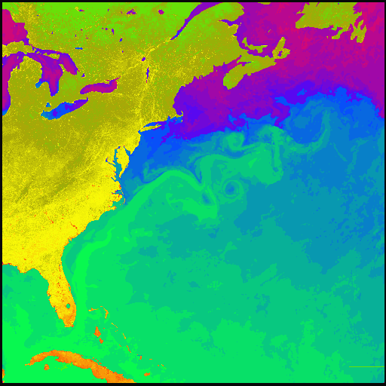
AVHRR (Advanced Very High Resolution Radiometer) NASA

Slide 26
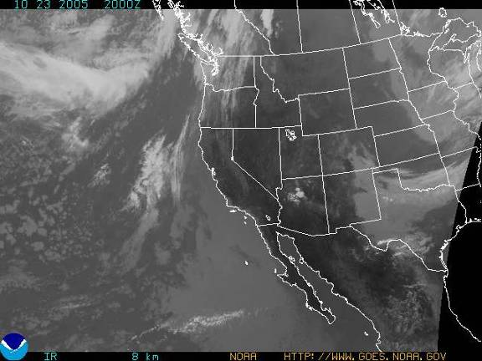
GOES (Geostationary Operational Environmental Satellites) IR 4

Slide 27
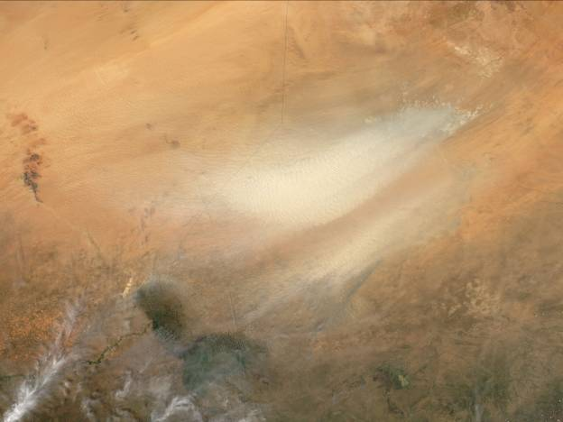
MODIS (250 m)
Notes:
October 23, 2005 Dust storm in Chad at 250 m resolution, MODIS (Moderate Resolution Imaging Spectroradiometer) NASA Moderate Resolution Imaging Spectrometer, 705 km, sun-synchronous orbit, 1-2 day for all of earth, 250 m, 500 m, 1000 m resolution. NASA

Slide 28
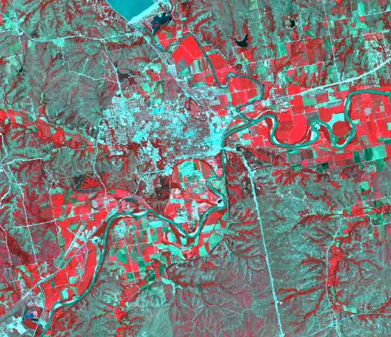
Landsat TM (False Color Composite)
Notes:
30 m resolution and 60 m resolution (thermal), 705 km orbit, 7 bands including thermal infrared, Manhattan, KS. Image, 2000 (USGS-EROS)

Slide 29
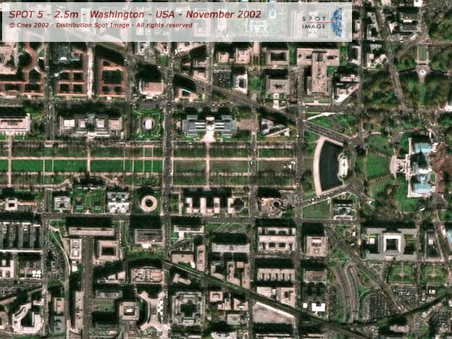
SPOT (2.5 m)

Slide 30
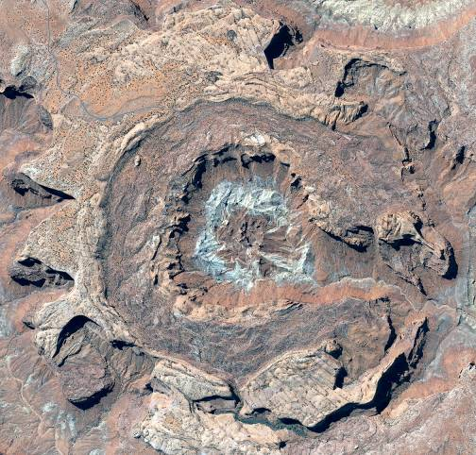
QUICKBIRD (0.6 m)

Slide 31
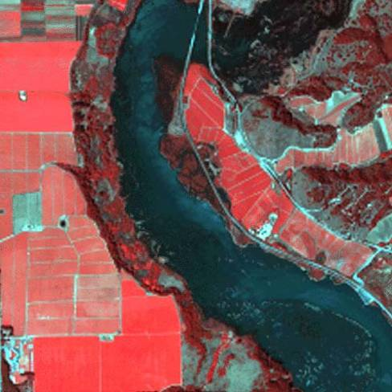
IKONOS (4 m Multispectral)

Slide 32
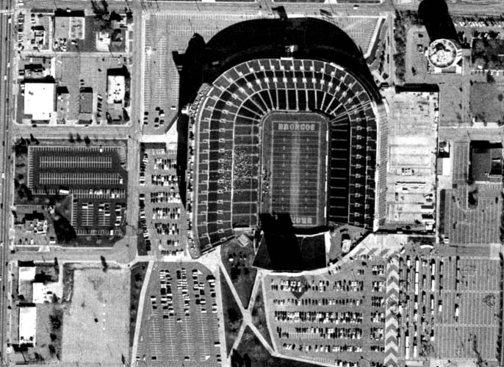
IKONOS (1 m Panchromatic)

Slide 33
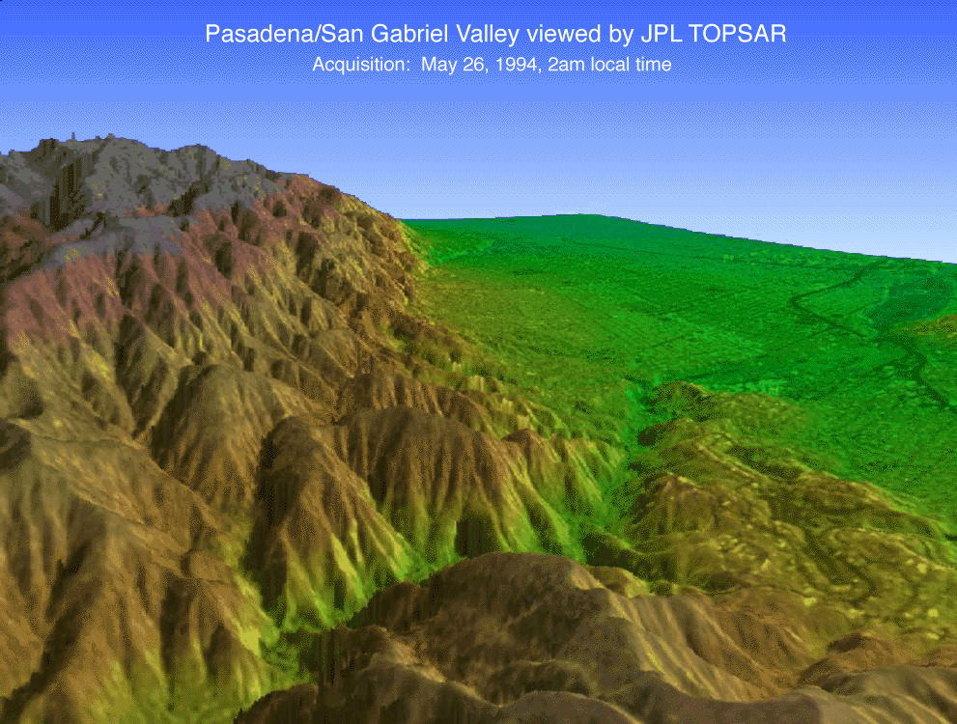
RADAR (Radio Detection and Ranging)
Image: NASA 2005

Slide 34
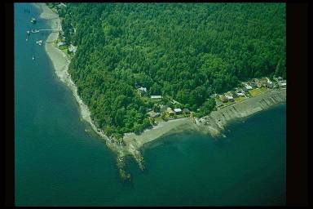
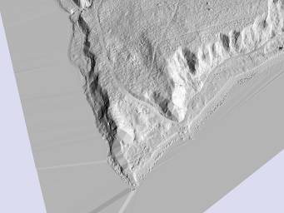
LIDAR (Light Detection and Ranging)
Image: Bainbridge Island, WA courtesy Pudget Sound LIDAR Consortium, 2005

Slide 35
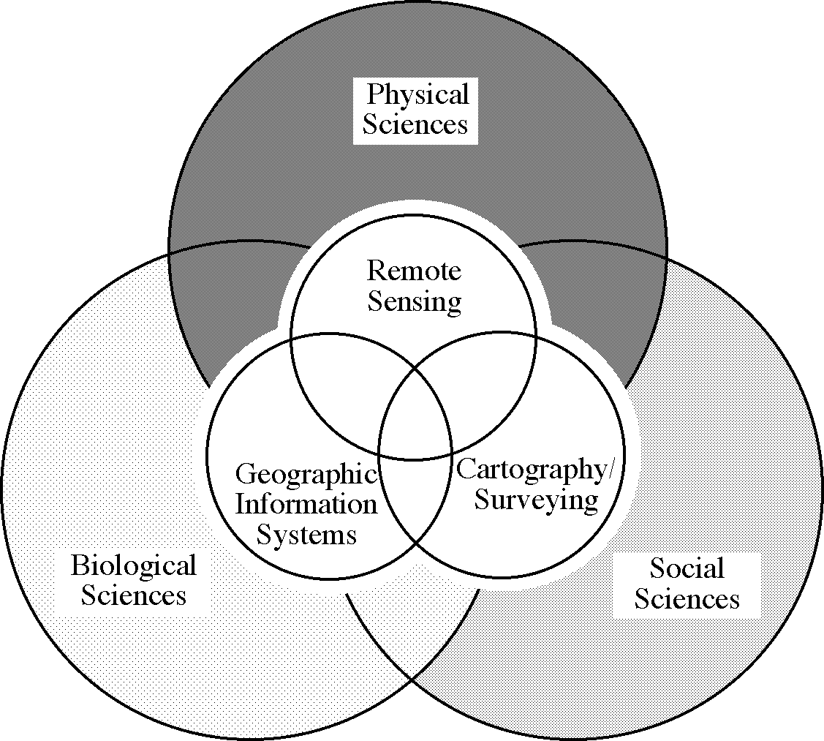
Application Domain
Source: Jensen (2000)

Slide 36
Representative Applications of Remote Sensing Conducted by SUPARCO

Slide 37
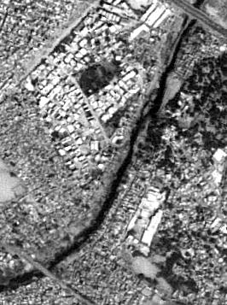
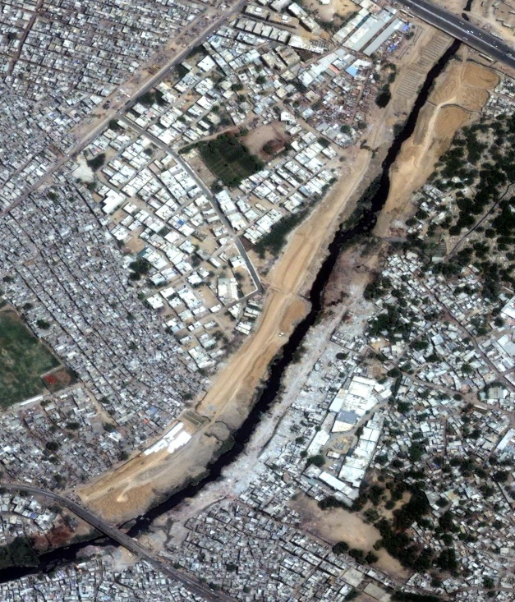
Urban & Regional Planning
Scope
Mapping & updation of city/town maps
Urban sprawl monitoring
Town planning
Facility management
GIS database development
Lyari Express Way – Section (Essa Nagri)
Benefits
Better decision support, planning & management
Rapid information updation
Infrastructure development monitoring
Spatial information analysis

Slide 38
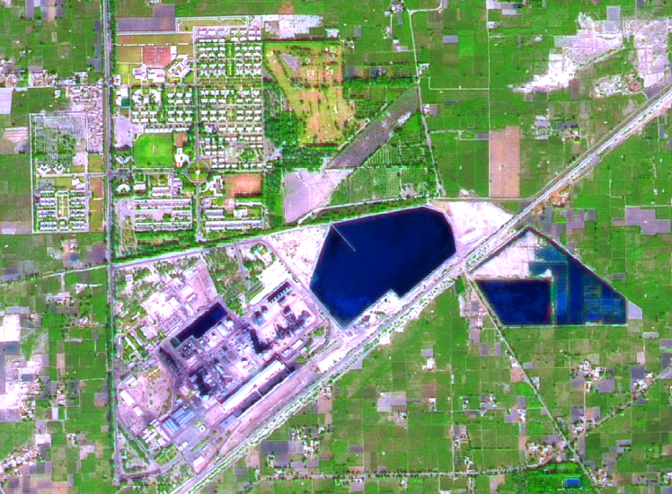
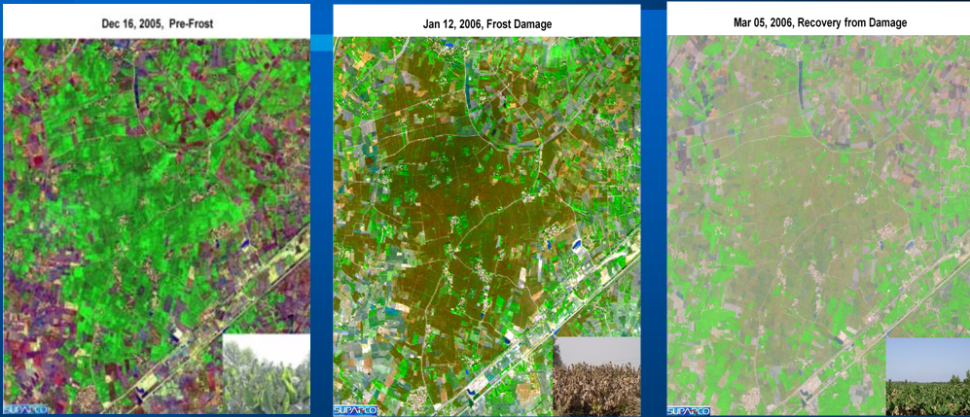
Agriculture
Scope
Crop acreage estimation
Crop modeling for yield & production forecast / estimation
Crop & Orchard monitoring
Benefits
Timely availability of crop statistics for decision making & planning
Crop growth monitoring
Soil status monitoring
Regular reports regarding total area under cultivation
FFC Goth Macchi
Dec 16, 2005, Pre-Frost
Jan 12, 2006, Damage
Mar 05, 2006, Recovery
Banana Plantation – Muhammad Pur (Ghotki)

Slide 39
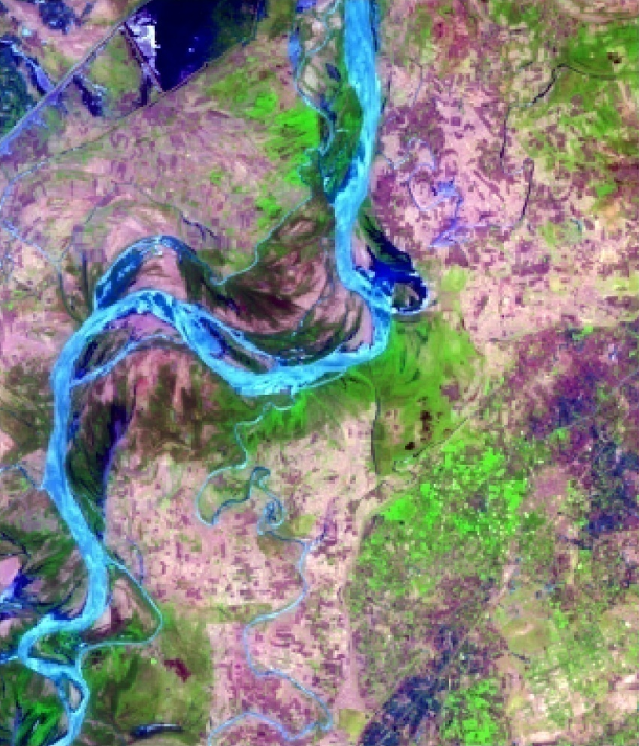
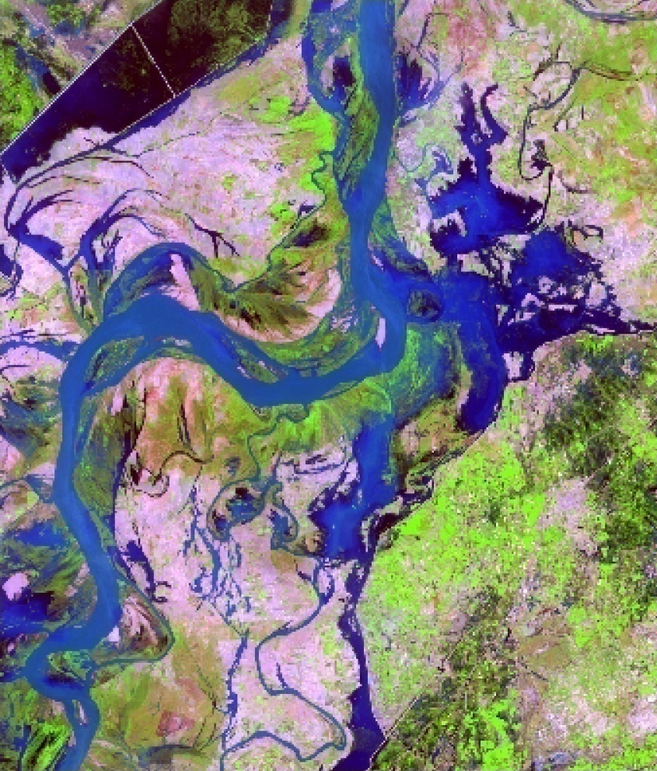
Flood Damage to Standing Crops
Pre Flood – 17 July 2006
Post Flood – 09 Aug 2006
● Muhro Mari
● Muhro Mari
● Darapur
● Darapur
● Kot Shahgarch
● Kot Shahgarch
10098 acr
● Godhpur
● Godhpur
● Phulani
● Phulani
● Than Lake
● Than Lake
● Goth Lataran
● Goth Lataran
● Shahpur
● Ural
● Shahpur
● Ural
● Junno Dhand
● Junno Dhand
● Goth Raza Mahar
● Goth Raza Mahar
● Goth Azizpur
● Goth Azizpur
3516 acr
Sukkur

Slide 40
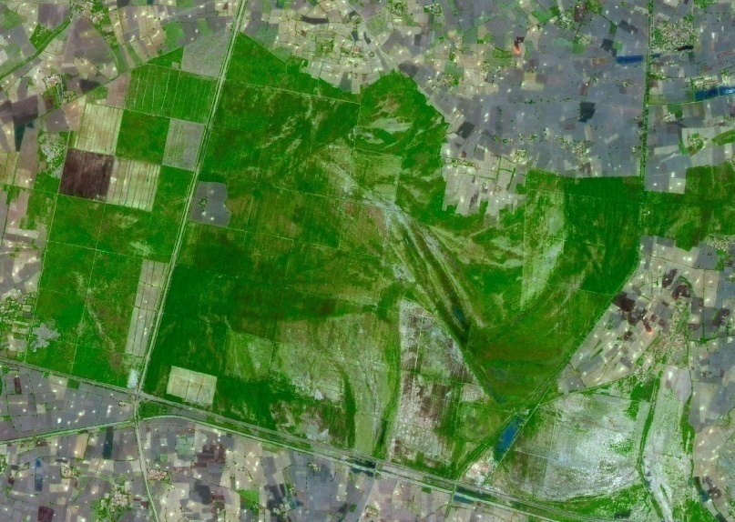
Forestry
Scope
Satellite image based forest resource mapping and updation
Forest change detection
Forest resource inventory
GIS database development
Benefits
Availability of baseline information
Planning for aforestation strategies
Futuristic resource planning
Sustainability of environment
Wild life conservation & development for recreation purpose
Sarhad Reserve Forest (Ghotki)
Nausharo
Firoz

Slide 41
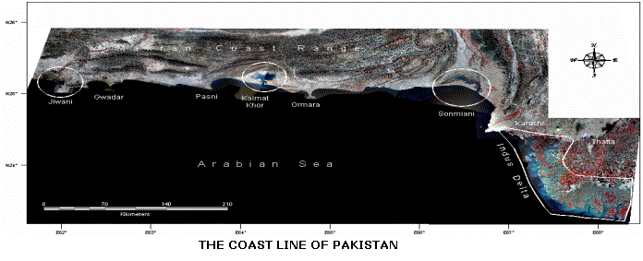
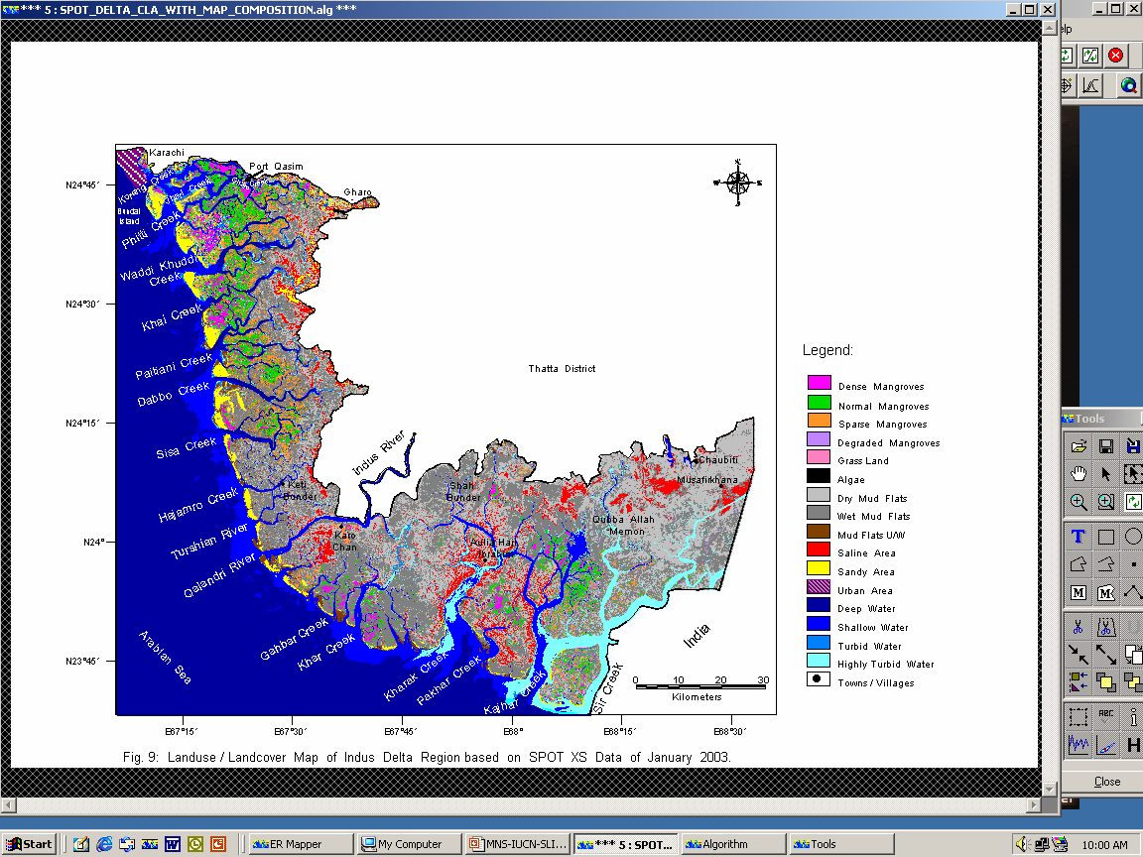
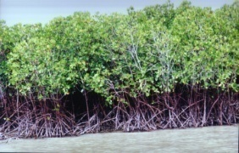
Sindh Coast Resource Mapping
Scope
Mangrove forest monitoring
Change detection
Hazard impacts
Aqua-culture zones
Benefits
Availability of updated information on mangroves forest
Planning strategies for aforestation and deforestation trend
Timely Intervention in specific areas as and when needed
Satellite image
Mangroves forest map

Slide 42
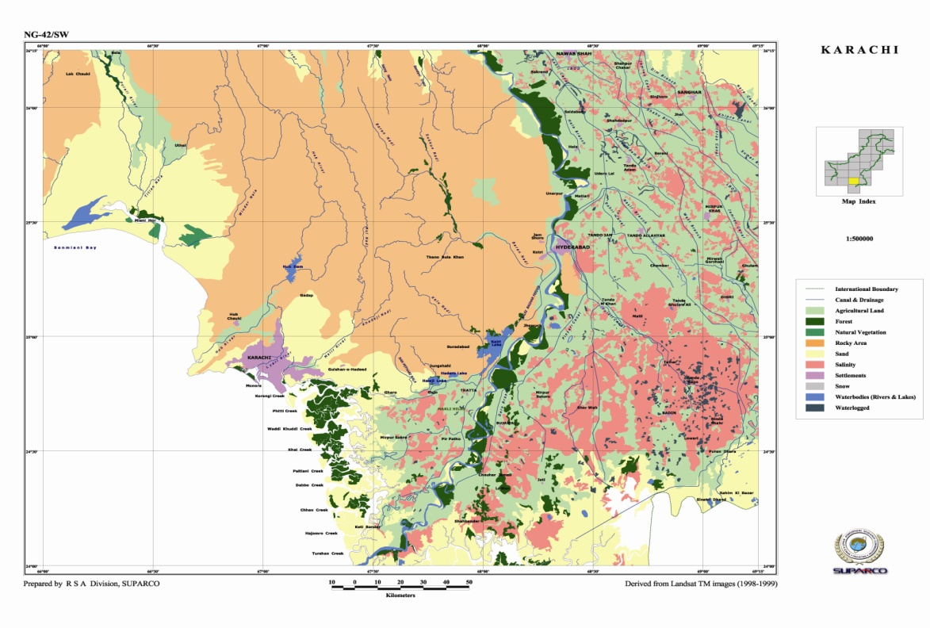
Landuse / Landcover Mapping
Scope
Monitoring dynamic changes
Urban/Rural infrastructure
Waterlogging & salinity
Benefits
Assessment of spatial distribution of land resources
Infrastructure monitoring
Availability of usable land
Future planning for better land management for socio-economic development

Slide 43
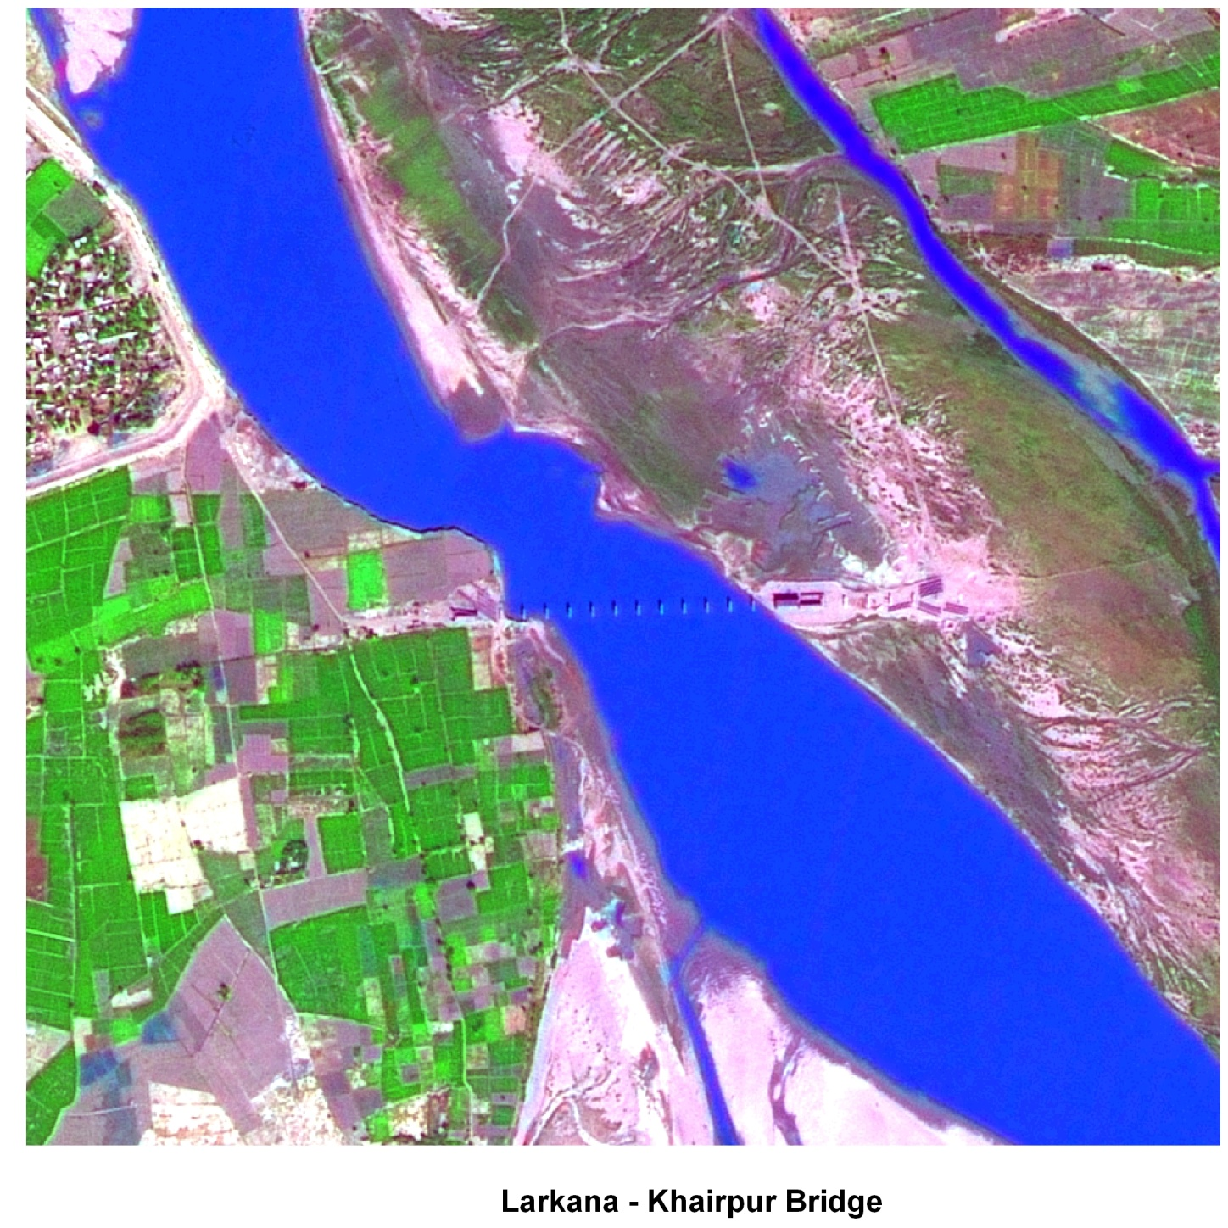
Infrastructure Development
Larkana-Khairpur Bridge

Slide 44
Thanks for patience

