Slide 1
VIDYASAGAR UNIVERSITY
MIDNAPORE . WEST BENGAL . PIN - 721102
M.Phil
SEMESTER – II
DEPARTMENT OF HISTORY
DR. SHAMITA SARKAR
COURSE : HIS-122 : UNIT- [Environment and Protest in Independent India]

Slide 2
PPT PRESENTATION
ON
RADIOACTIVE MINERAL DEPOSITS IN INDIA
COURSE – HIS-122 . UNIT - II
DR. SHAMITA SARKAR

Slide 3
This ppt is equal to four class lectures

Slide 18
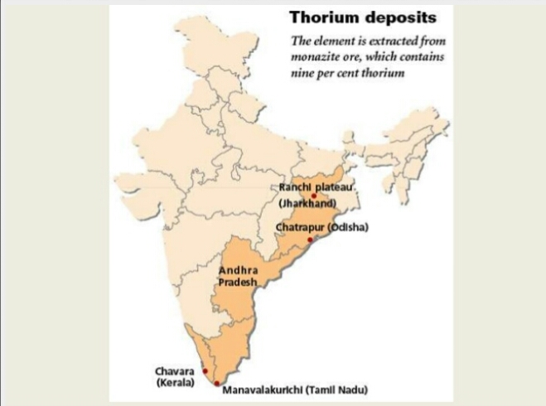

Slide 20
